Slide 1
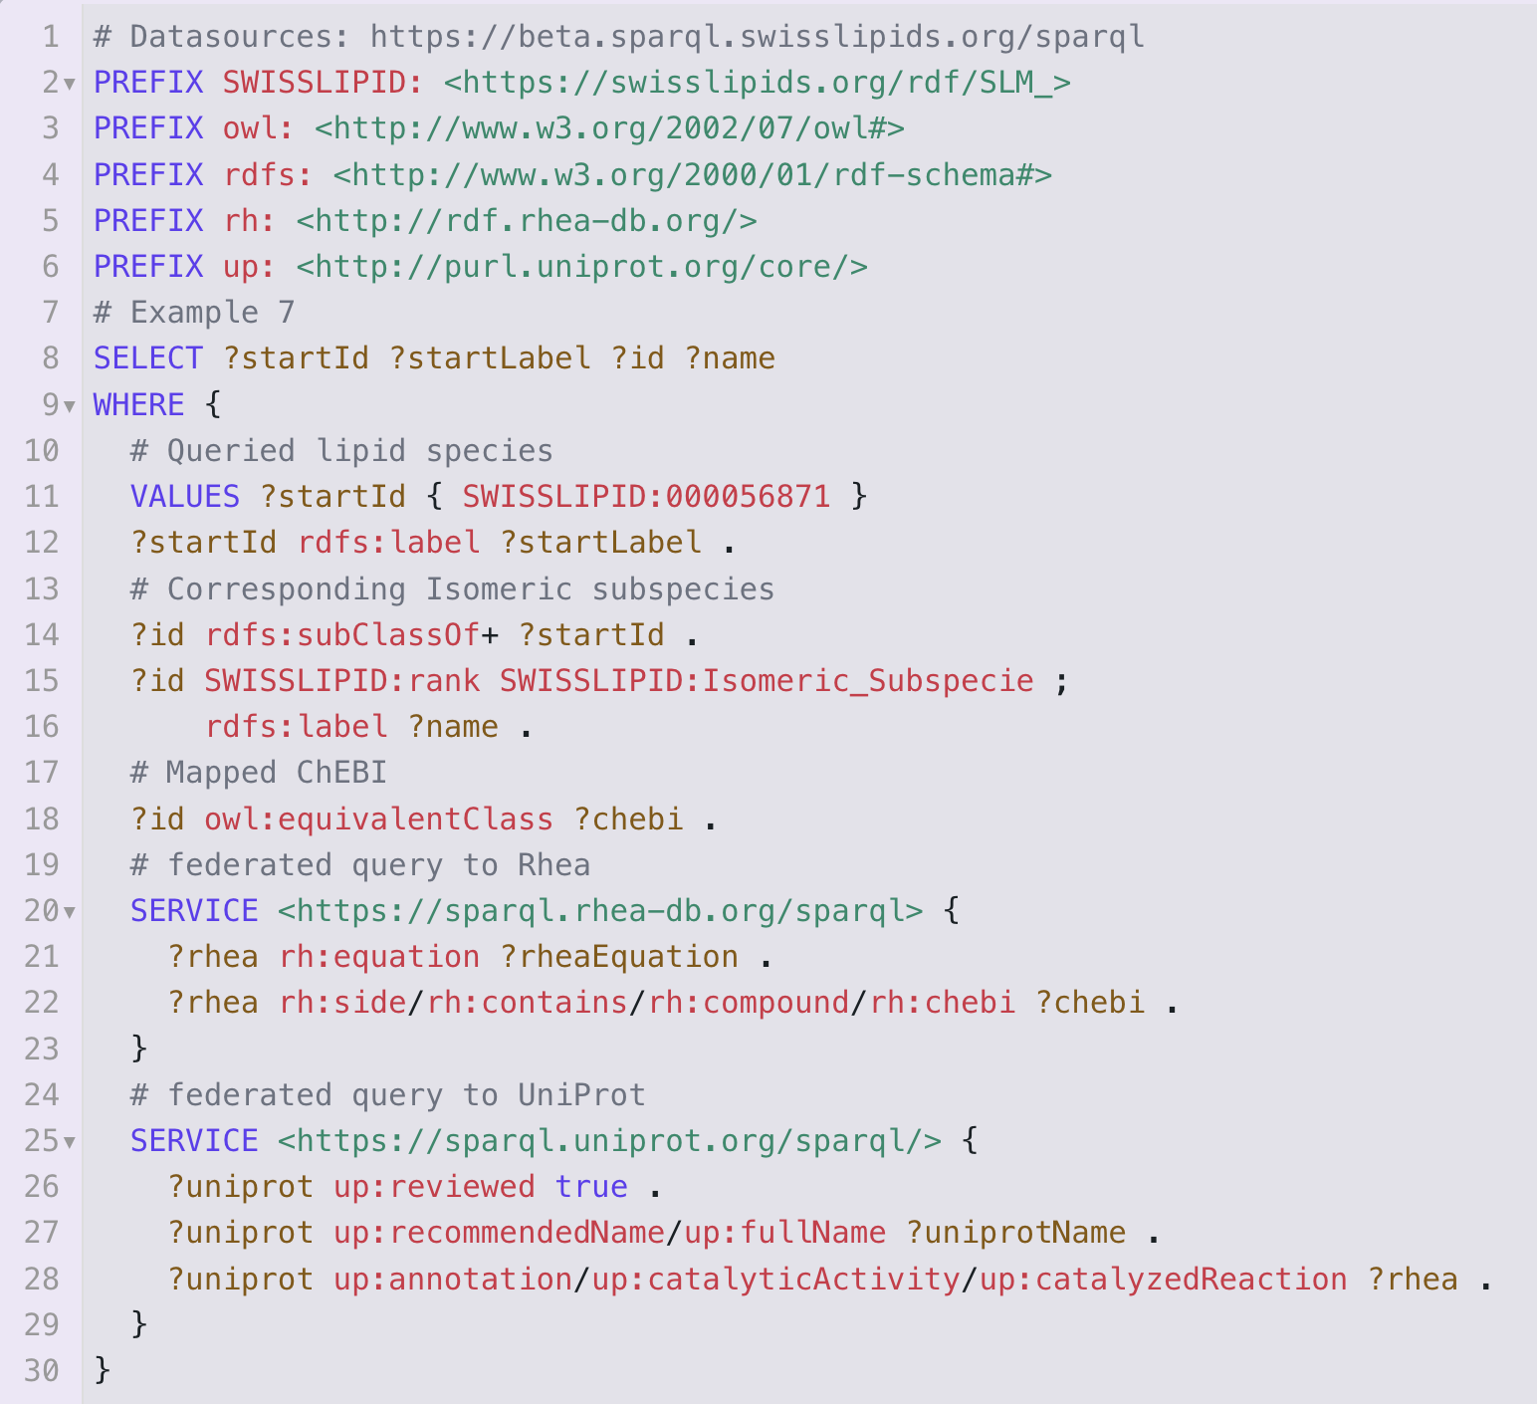

Slide 2
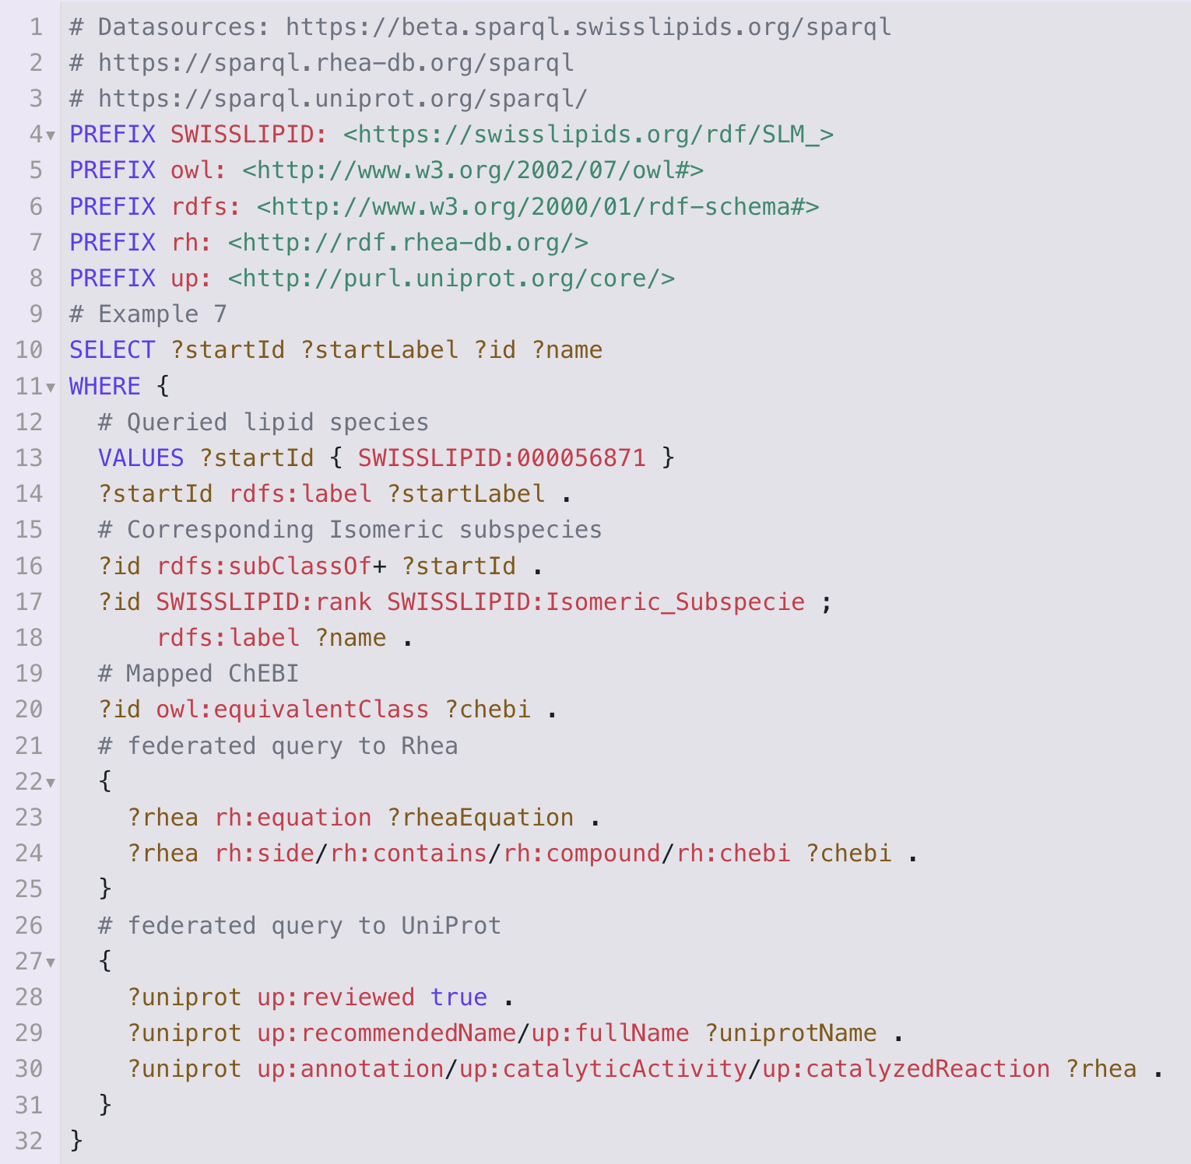
Federated SPARQL Query with and without SERVICE clauses

Slide 3
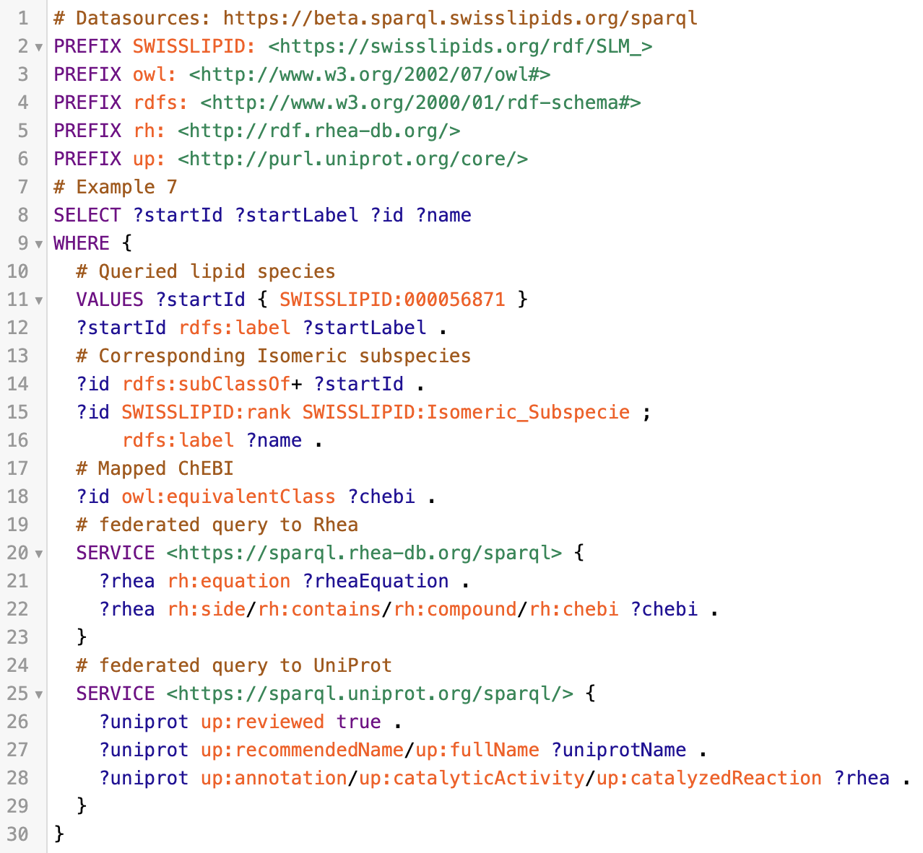
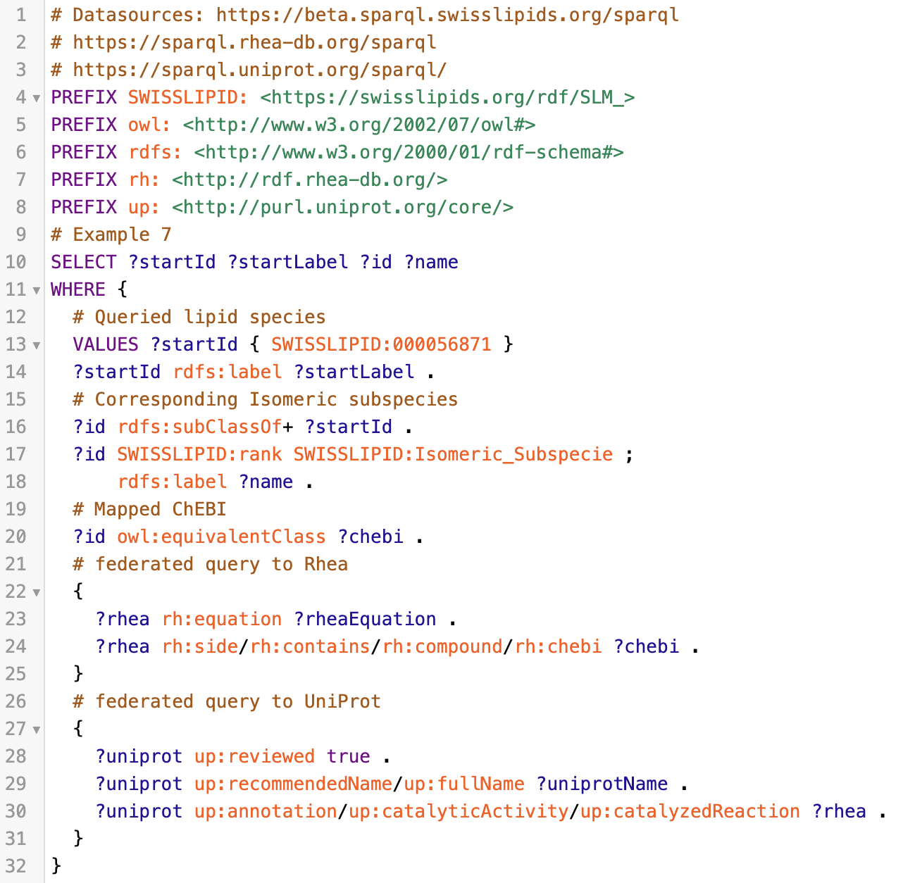
Federated SPARQL Query with and without SERVICE clauses

