Slide 1

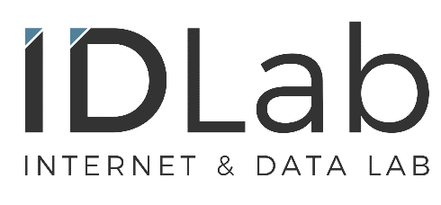
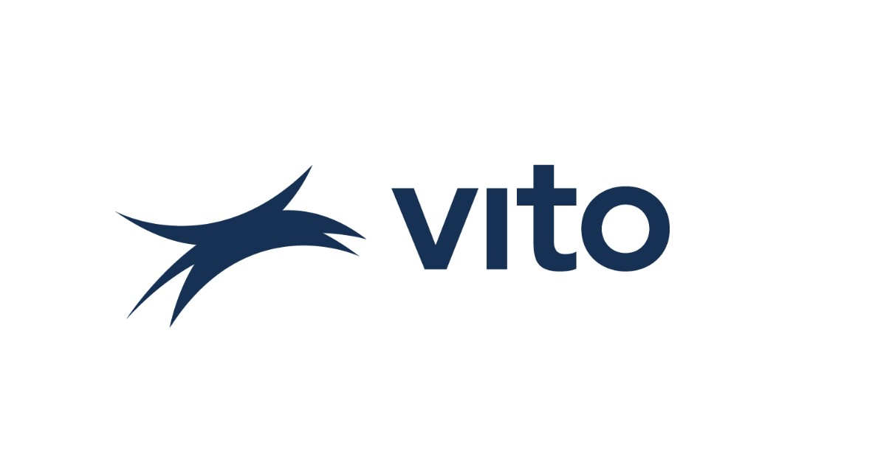
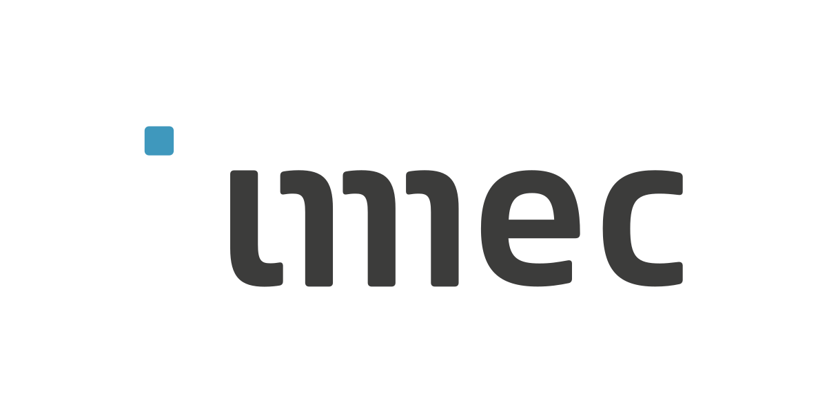














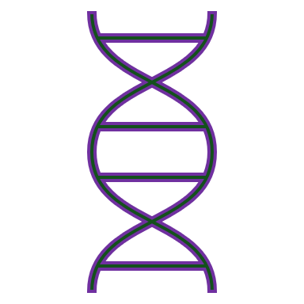

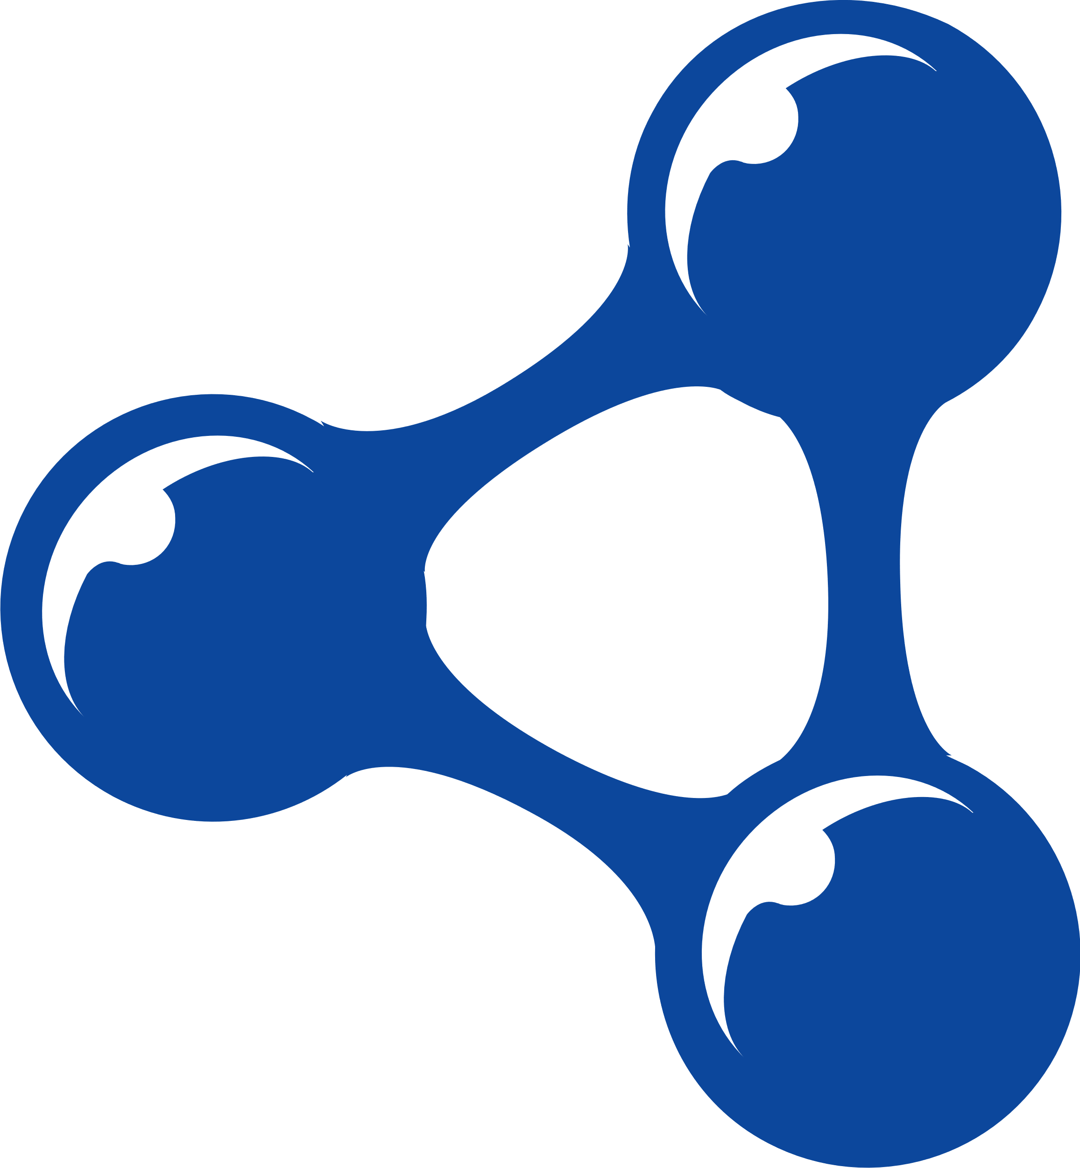
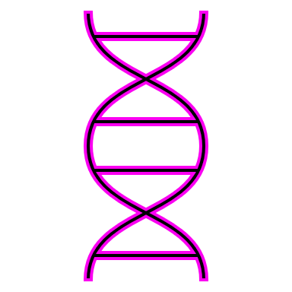


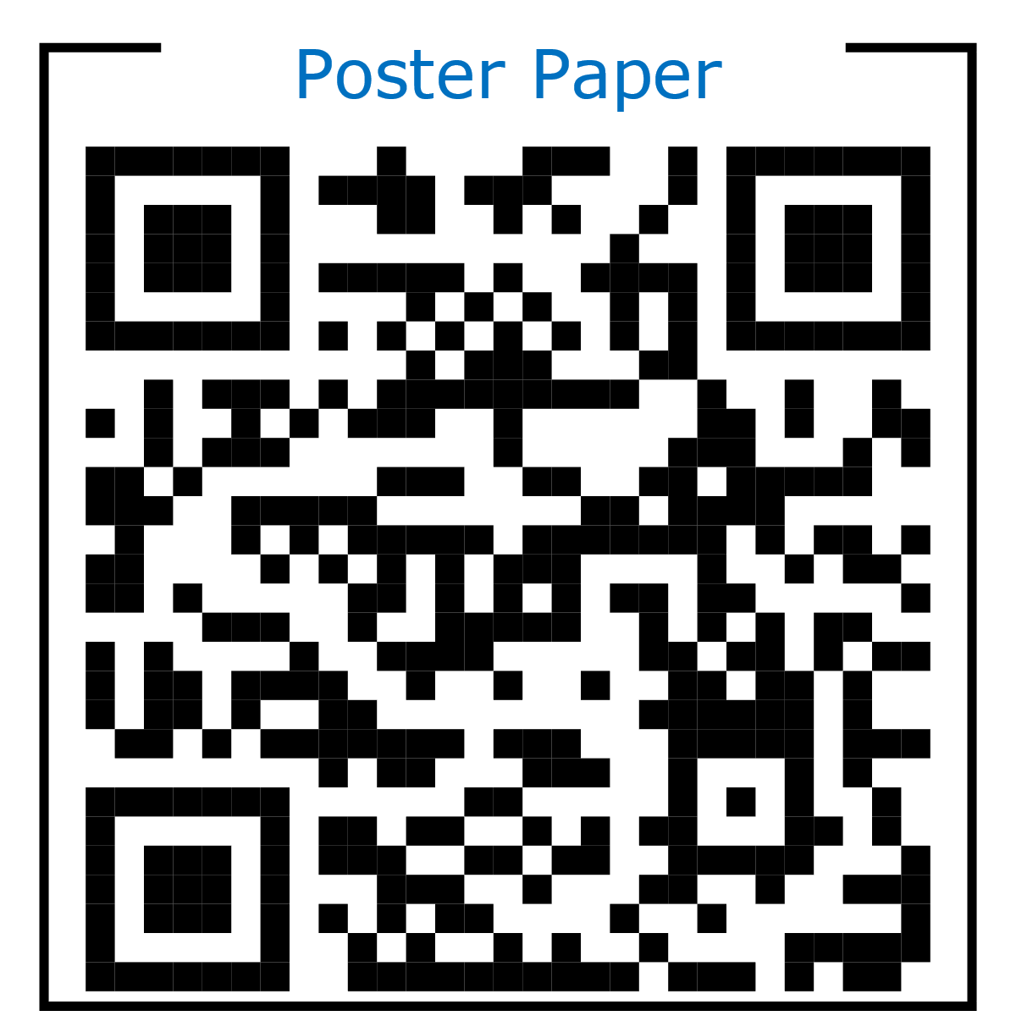
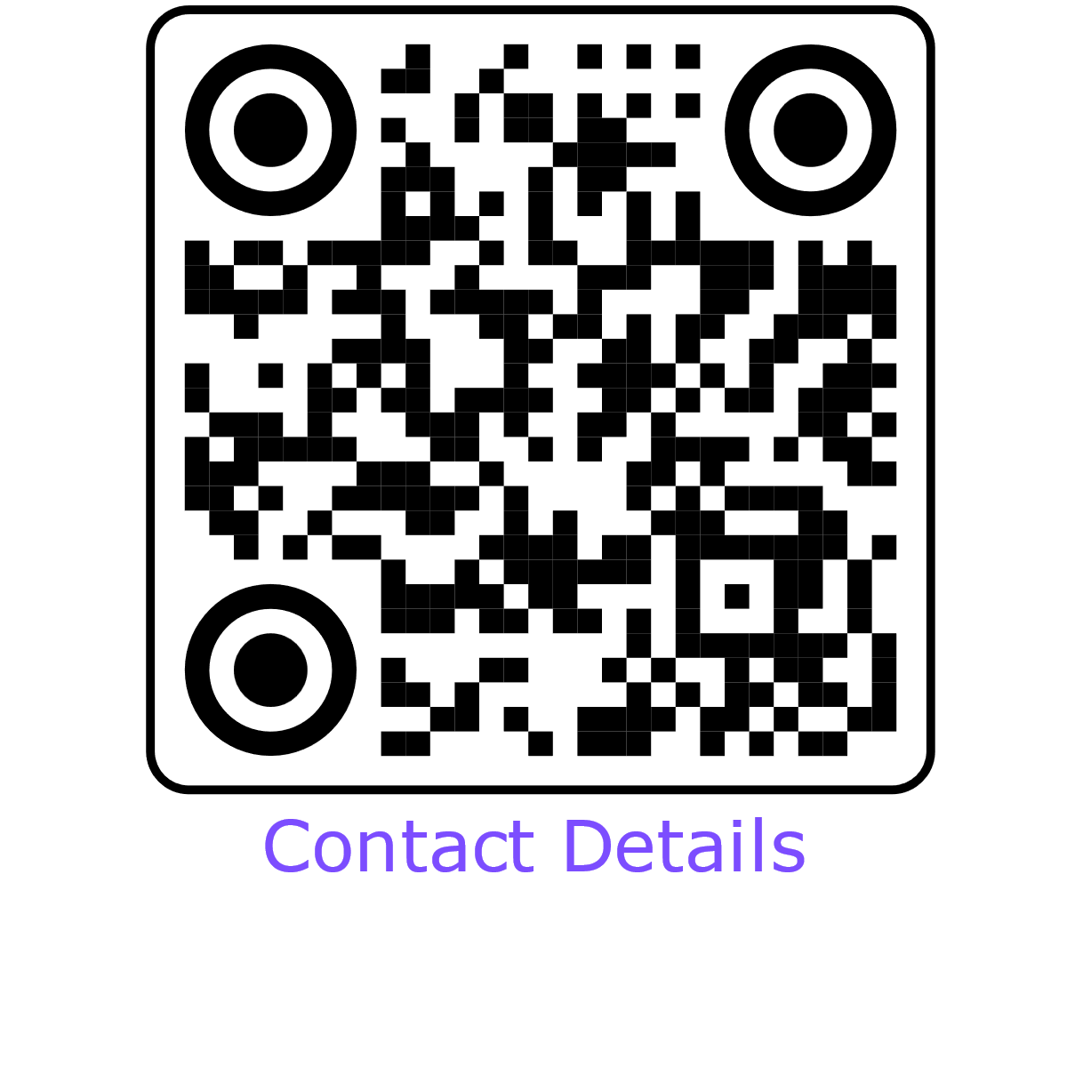
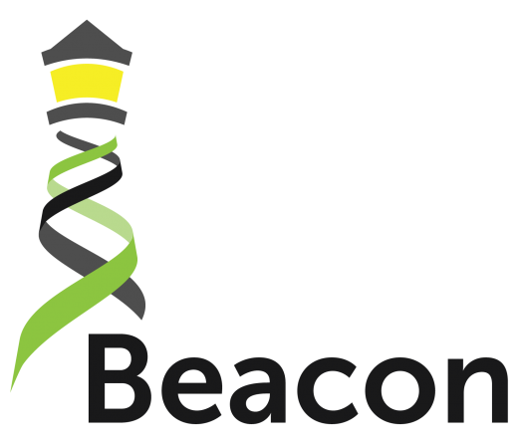

Personalized Medicine Through Personal Data Pods
Elias Crum^{1,2}, Ruben Taelman¹, Bart Buelens², Gökhan Ertaylan² and Ruben Verborgh¹
¹IDLab, Department of Electronics and Information Systems, Ghent University – imec, Belgium ²Flemish institute for Technological Research (VITO) Mol, Belgium
Scalable Personalized Medicine?
The current institution-centric system
Unfortunately, still quite expensive
But why? Sequencing is getting pretty cheap.
Answer:
Data privacy is crucial
X
Genomic data storage is expensive
Question:
Any way to fix that?
X
Personal Genome Sequence Data
X
Public Database
Very large (~GBs in size)
Downstream impacts?
Researcher
Reduced data sharing
Require strict privacy protections
Reduced patient transparency
Increased pertinent data dispersion
Data duplication
A Patient-centric Approach
Primary Physician
Key Challenges
Patient Pod
Privacy granularity
Auxiliary Physician
Governance?
How much patient control?
Test Results
Other Patient
Data Linkages
What data should be linked?
Data formatting Standards?
Public Database
Querying performance
Genomic data is BIG
Patient
Researcher
Requires novel approach?
Future Directions
Researcher Access
Unified Framework
Consent infrastructure
Funding provided from VITO NV (UG_PhD_2303_contract)

