Slide 1


Genomic Data Processing and Analysis Solution
Elias Crum
For source code see GitHub Repo

Slide 2
Python CommandLine Solution workflow
Download / Decompress vcf.gz file
Parse VCF file into RDF (using RDFLib package)
SPARQL search for SNP ID variant allele
Serialize RDF data into local .ttl files

Slide 3
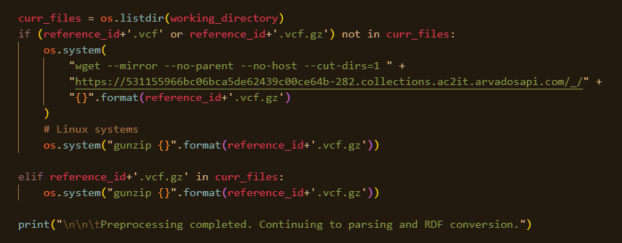
VCF file processing
Utilize built-in Linux Command-Line utilities:
Download file → wget()
Decompress file → gunzip()
Python script will recognize if file is already downloaded and/or decompressed

Slide 4
RDF Triple Production
Ontology Definitions
Read + Parse decompressed VCF file by line (“\n”)
Define Triples using RDFLib package
Serialize VCF graphs by Chromosome (essentially making RDF Quads)

Slide 5
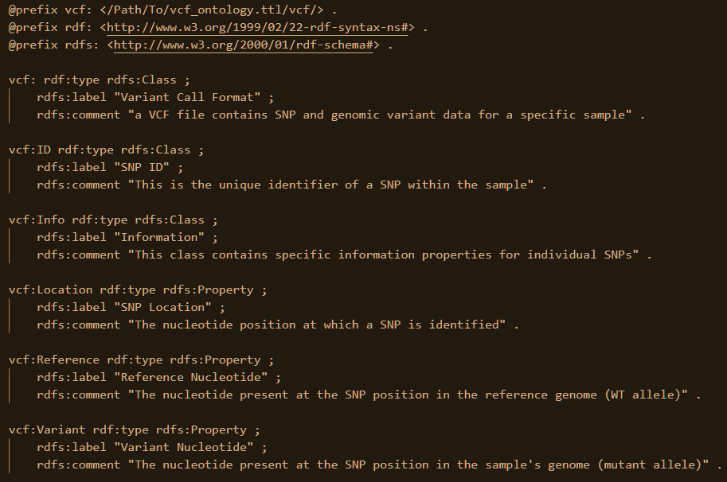

Ontology Definition
For the triples to be searchable via SPARQL
Could not find an existing ontology for VCF data types
Web ontologies use an address, local files function similarly
1st @prefix line is crucial and must provide the correct address

Slide 6
Parsing VCF file
VCF file is a fancy .txt file (“\t” and “\n” delimiters)
Python’s readlines() method splits this document into a list of lines (individual SNPs)
List can then be iterated over, using the for() operator
Individual pieces of information are represented in columns separated by “\t”
Important information – ID (SNP ID) and ALT (Variant allele) columns
**** With more time, statistics within QUAL, FILTER, and INFO should be considered

Slide 7
Defining RDF Triples
RDFLib Python package
Subject and Predicate are URIs → URIRef()+ defined by local ontology
Objects are literals → Literal()
RDF knowledge graph → g = Graph()
Triples added to graph → g.add(subject, predicate, object)
Serialize graph (store graph as file) → g.serialize()

Slide 8
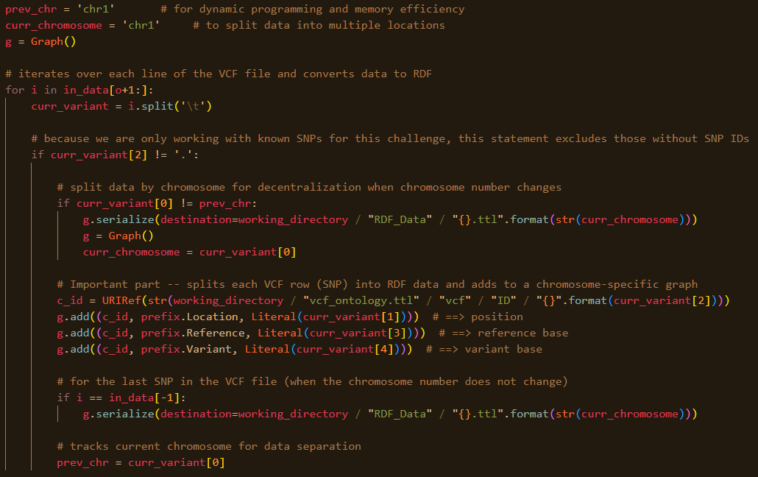
RDF Graph Data Stores
Chromosome loci as data store separator (.ttl files)
Chromosome loci data are “localized” in VCF file
Ignore SNPs with “.” SNP ID
* could be an area for improvement with more time

Slide 9
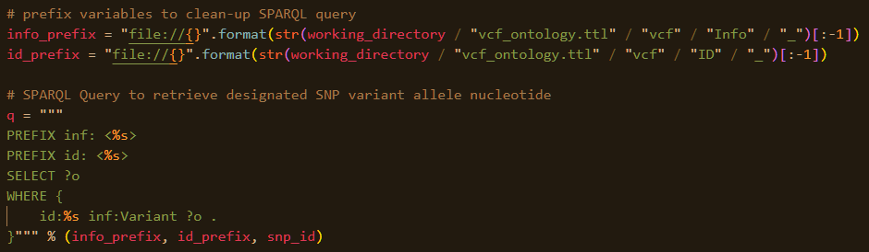
SNP SPARQL Querying
Query Anatomy:
(Subject) (Predicate) (Object)
Known: SNP ID + Known: Variant → Unknown: Wildcard
File prefix (ontology address)
Search: SNP ID
Return: ALT literal

Slide 10
Results
** Participant hu7A4DE, is NOT a slow metabolizer of caffeine **
With more time,
Medical implications for other known SNPs could be displayed
Using dbSNP, dbGaP, and other publicly available databases
Relevant Publications could be displayed
Using PubMed, Entrez, or OMIM

Slide 11
Challenges / Things to Improve
Windows Command Line functionality (make ontology web-based)
Run Time reduction →
Mojo (if staying in Python), C++ for parsing VCF, Flask/Django to make tool into an API
Could have disregarded the gunzip() step and done file unzipping in Python with gzip
File and variable size issues could be averted by utilizing data streaming (using pandas or something similar)

Slide 12


Solution #2
For source code see GitHub Repo

Slide 13
General Approach
Upload compressed VCF file
Parse VCF file into RDF (using rdf-js package)
SPARQL search for SNP ID variant allele
Create Quads and write to .ttl files + upload to a local server

Slide 14
Ideal Approach
Fetch VCF file from online database
Parse VCF file into RDF (using rdf-js package)
SPARQL query by SNP ID for variant allele using communia multiple endpoints
Transfer Quads to Solid Pods via SolidAPI (with data store decentralization) + method to store Solid endpoint addresses

Slide 15

VCF file upload
node_server.js file
Utilizes express framework to get() and post() file to a server
Vcf.gz file is best to upload because it is much smaller in size
* With more time this could be improved to not require a file upload and rather fetch the vcf file data from the host web database

Slide 16
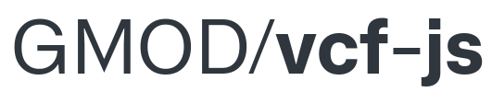

VCF file parsing
zlib module used to decompress vcf.gz file (using data streaming)
vcf-js module used to parse VCF file
As file is decompressed, the VCF() method organizes data to a callable format
The VCF ID and ALT literal were then added to an N3 store()
* With more time this could also include more information from the VCF file

Slide 17
RDF data storage
RDF data is written to a .ttl file using a writeStream and the write() method
* With more time this step could be avoided, and the RDF data could be directly streamed to Solid Pods via the SolidAPI
With the local file approach, the goal is to:
Assign the .ttl file (or files if separated into separate data stores) to a SPARQL endpoint(s) using the communica-sparql-file-http method
Craft a SPARQL query to search for a SNP ID’s ALT literal using the QueryEngine() js method (similar to how this was done in the Python solution)
Display the results on the index.html webpage
* With the Solid approach, this would be simplified because Solid pods intrinsically act as SPARQL endpoints

