Slide 1
Predicting students' dropout and academic success rates
By: Chukwudi Nkamnebe
DS535 Capstone
Nov 2023

Slide 2
INTRODUCTION
For the fourth part of the report, we will be using the neural network estimation method to explore the selected variables and determine the most significant variables classifying the Y variable (Target).
A neural network is an application of artificial intelligence that instructs computers on how to interpret data in a way that resembles the way the human brain does.

Slide 3
BACKGROUND OF THE STUDY
This dataset provides a comprehensive view of students enrolled in various undergraduate degrees offered at a higher education institution. It includes demographic data, social-economic factors and academic performance information that can be used to analyze the possible predictors of student dropout and academic success.
This dataset was sourced from kaggle.com via the link below:
https://www.kaggle.com/datasets/thedevastator/higher-education-predictors-of-student-retention/data.
This dataset consists of 4424 observations and 35 variables.

Slide 4
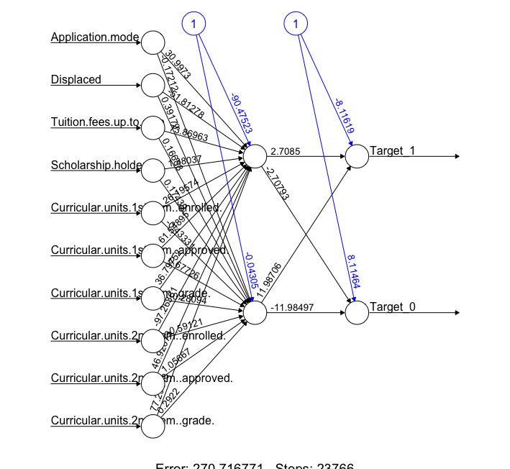
NEURAL NETWORK FULL MODEL
For the full model, all the variables were used to show the neural network graph of the model

Slide 5
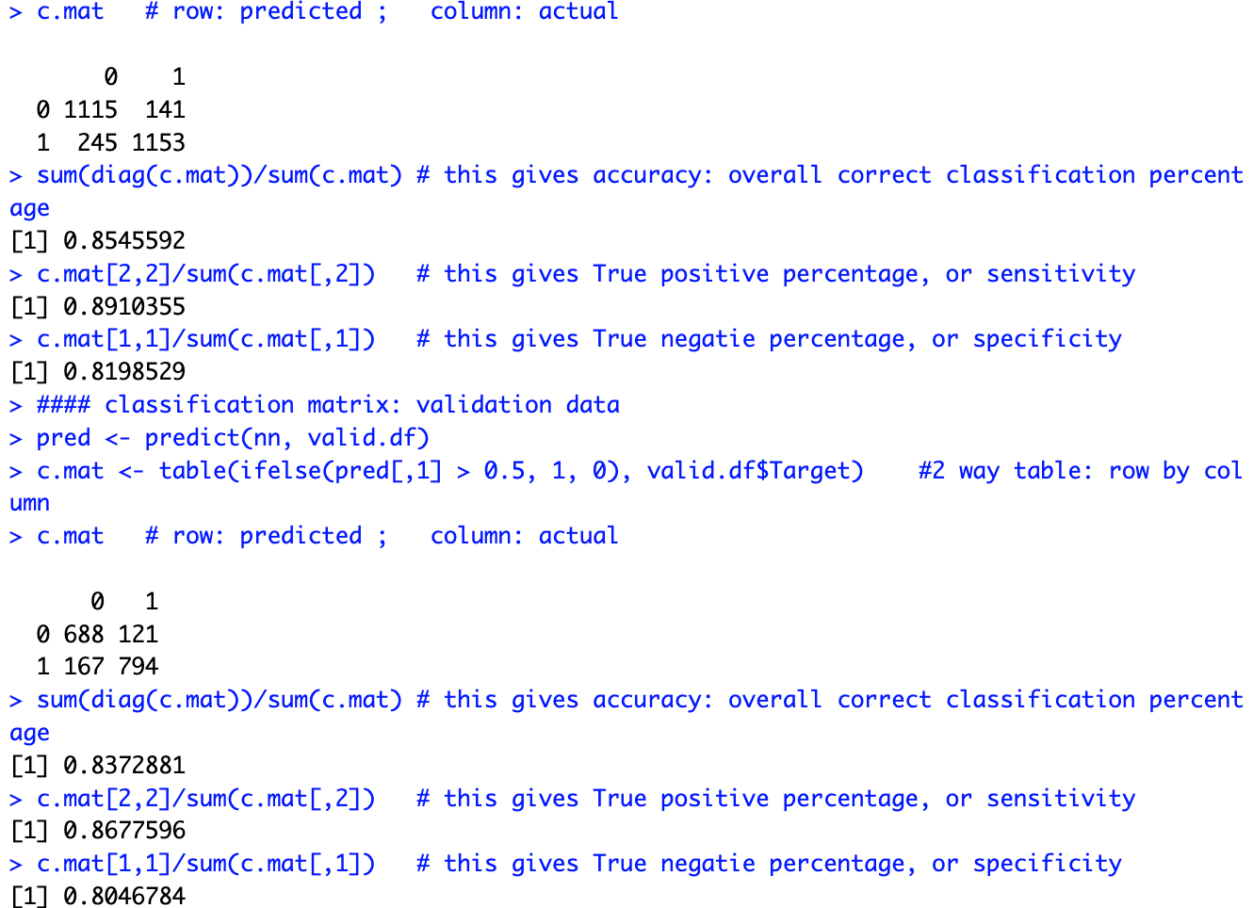
FULL MODEL – CLASSIFICATION MATRIX
The overall correct classification percentage for the validation data is approximately 83.73%.
Sensitivity: The model correctly identifies about 89.10 in the training data and 86.78% of the positive cases in the validation data.
Specificity: The model correctly identifies about 81.98% in training data and 80.47% of the negative cases in the validation data.

Slide 6
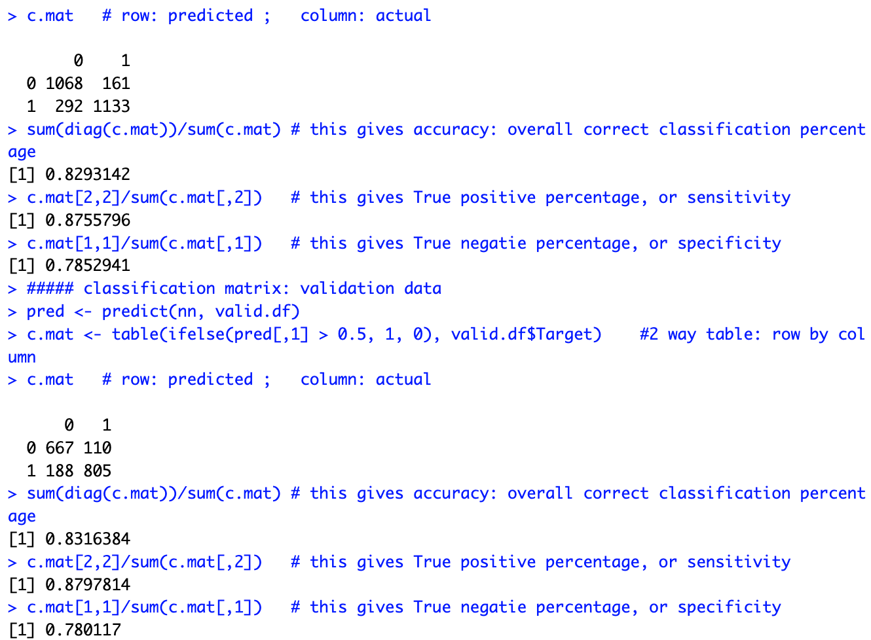
MODEL 2 – CLASSIFICATION MATRIX
The overall correct classification percentage for the validation data is approximately 83.16%.
Sensitivity: The model correctly identifies about 87.56% in the training data and 87.% of the positive cases in the validation data.
Specificity: The model correctly identifies about 81.52% in training data and 8% of the negative cases in the validation data.

Slide 7
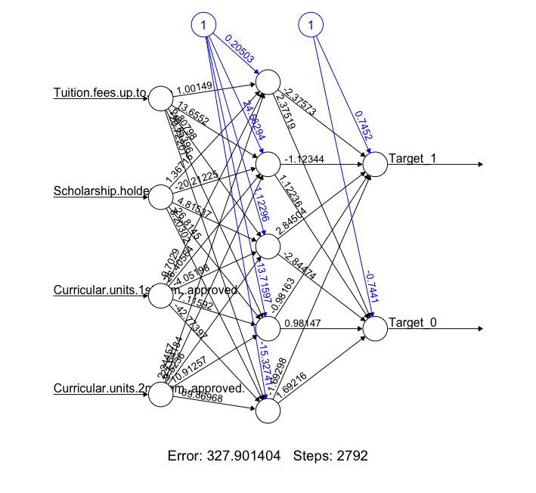
NEURAL NETWORK – MODEL 2
For the second model, four variables named Tuition fees up to date, scholarship holder, curricular units 1st semester approved and curricular units 2nd semester approved were used to show the neural network graph of the model
This neural network consists of one layer 5 neurons.

Slide 8
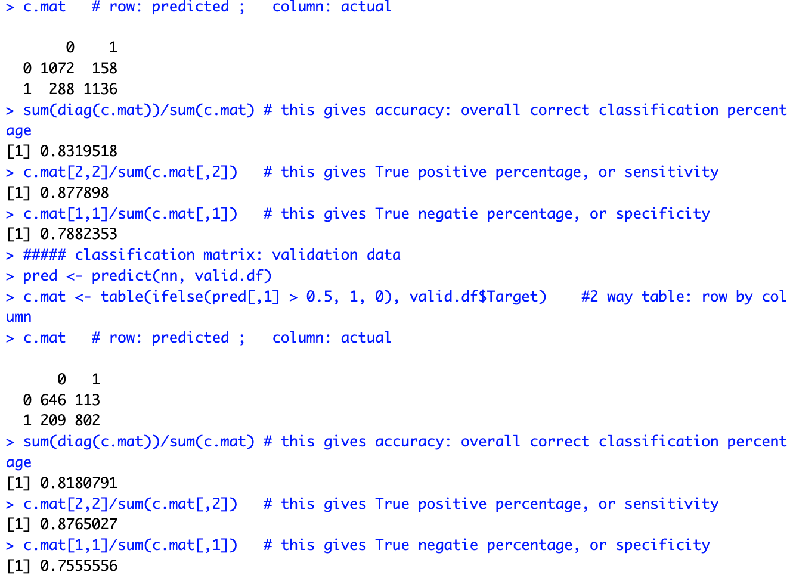
MODEL 3 – CLASSIFICATION MATRIX
The overall correct classification percentage for the validation data is approximately 81.81%.
Sensitivity: The model correctly identifies about 87.78% in the training data and 87.65% of the positive cases in the validation data.
Specificity: The model correctly identifies about 78.82% in training data and 75.56% of the negative cases in the validation data.

Slide 9
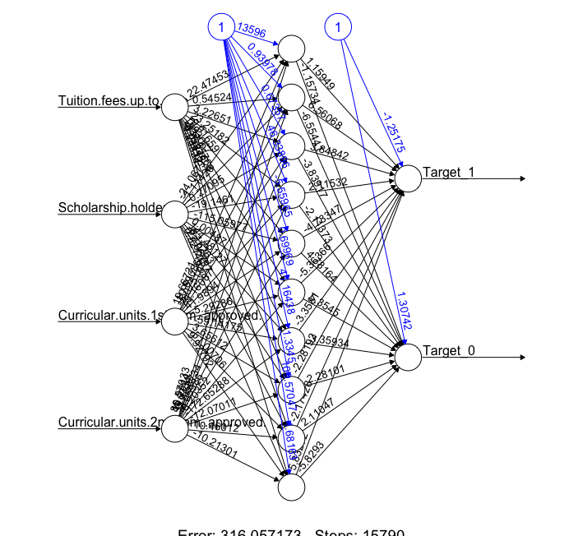
NEURAL NETWORK – MODEL 3
For model 3, four variables named Tuition fees up to date, scholarship holder, curricular units 1st semester approved and curricular units 2nd semester approved were used to show the neural network graph of the model
This neural network consists of one layer 10 neurons.

Slide 10
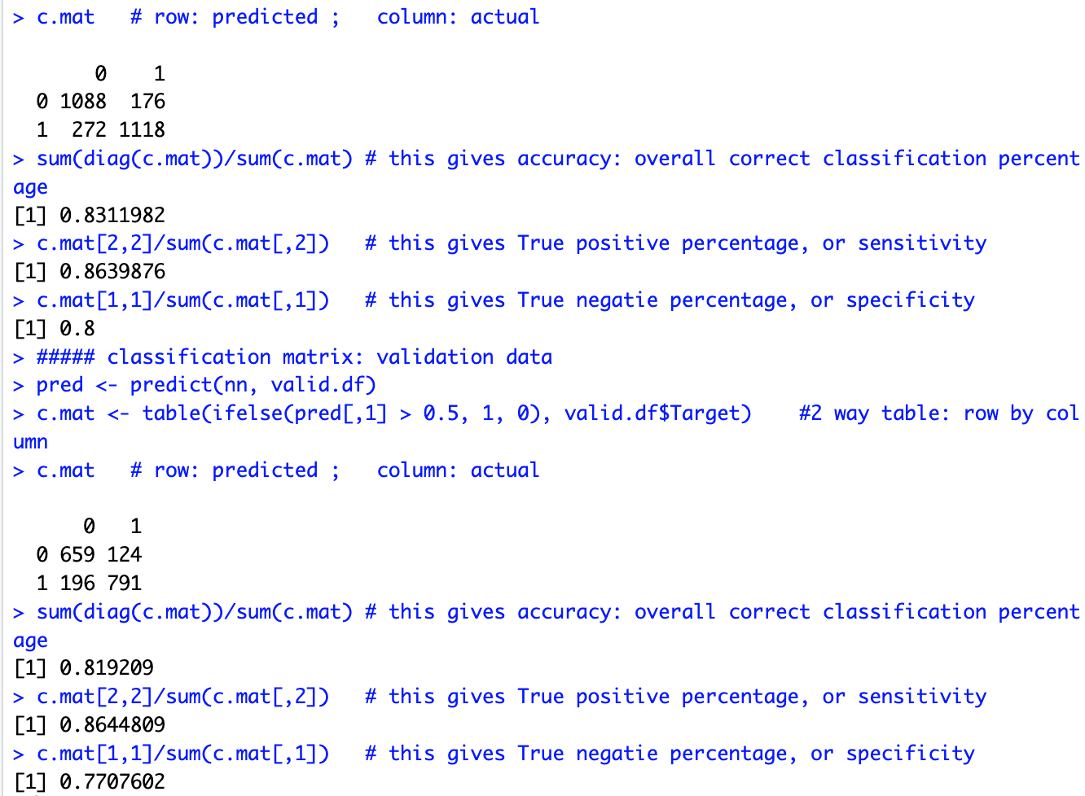
MODEL 4 – CLASSIFICATION MATRIX
The overall correct classification percentage for the validation data is approximately 81.92%.
Sensitivity: The model correctly identifies about 86.39% in the training data and 86.45% of the positive cases in the validation data.
Specificity: The model correctly identifies about 80% in training data and 77.07% of the negative cases in the validation data.

Slide 11
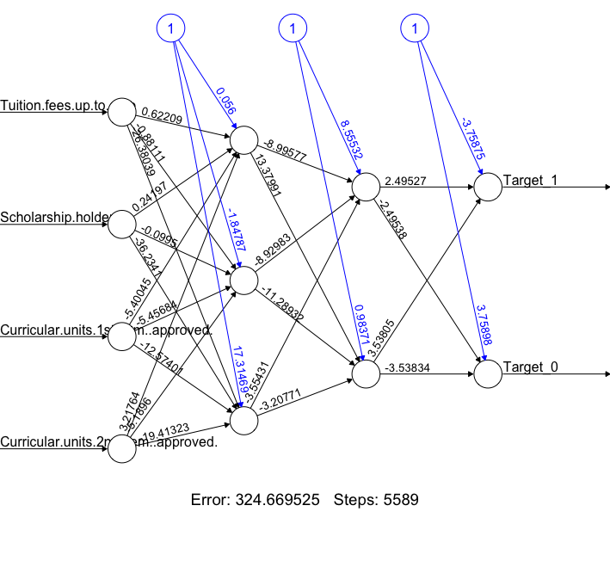
NEURAL NETWORK – MODEL 4
For model 4, four variables named Tuition fees up to date, scholarship holder, curricular units 1st semester approved and curricular units 2nd semester approved were used to show the neural network graph of the model
This neural network consists of two layers of 3 and 2 neurons.

Slide 12
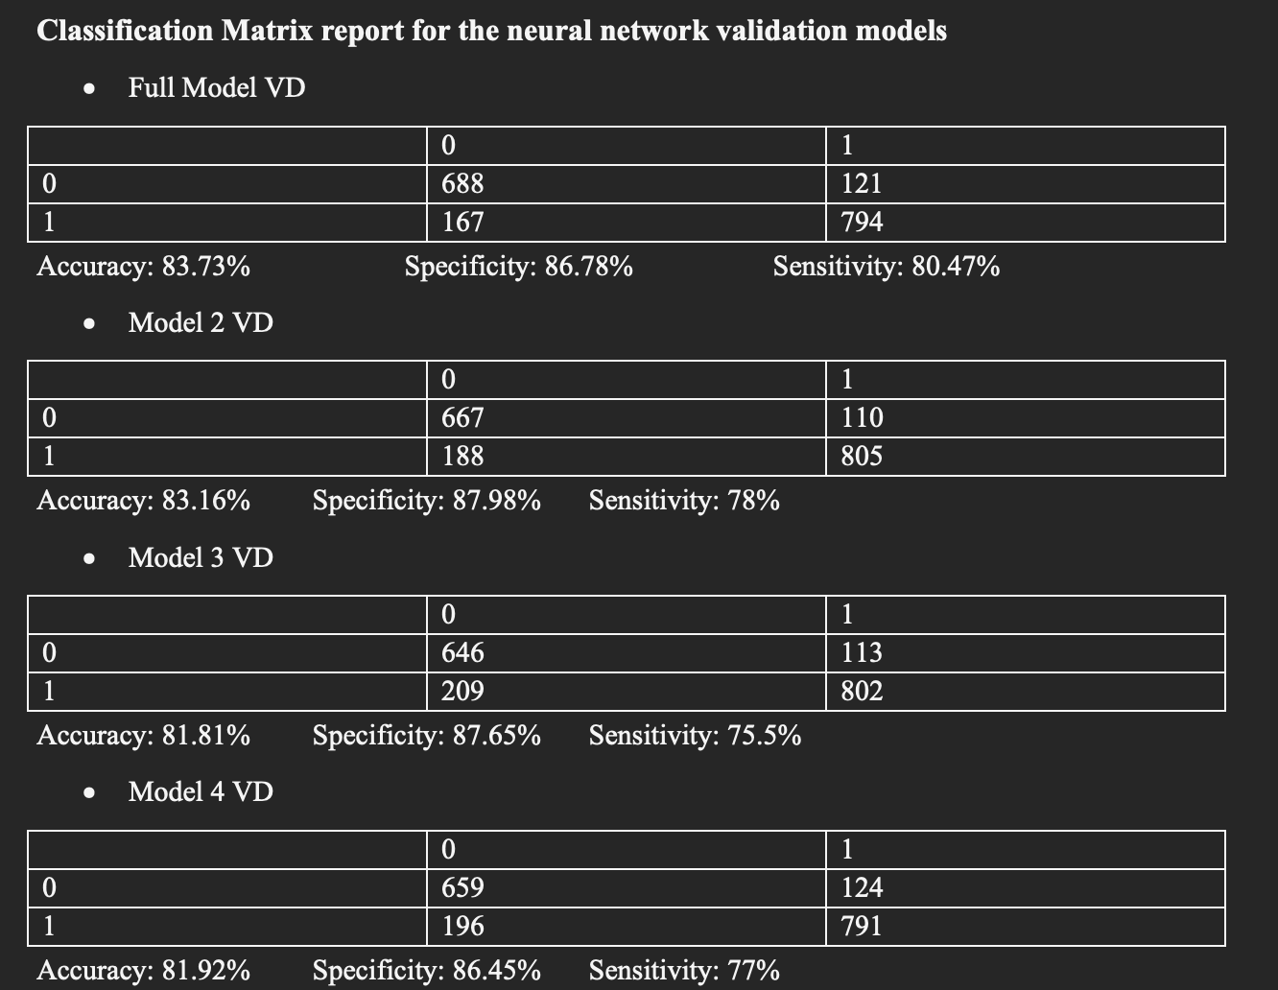
MODEL COMPARISON

Slide 13
SUMMARY AND CONCLUSION
A neural network is an application of artificial intelligence that instructs computers on how to interpret data in a way that resembles the way the human brain does.
Overall, the neural network's output surpassed the logistic regression in most cases. The best model demonstrates its usefulness in accurately classifying true positives, true negatives, and producing more accurate forecasts, respectively, with its excellent performance in terms of specificity, sensitivity, and accuracy.
We may conclude that, in comparison to the logistic regression, the neural network performs better with our data.

