Slide 1
Interact system in Distributed social network
Mujo

Slide 2

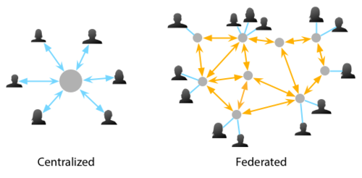
Existing problem
Benefit: More private, create your own rules, etc.
Problem: Less interact between admin and users.

Slide 3


Existing problem
When there are more than 10,000 users in your server
What if users can help manage their server?

Slide 4


Our approach
upload
mute: apple
mute: apple
mute: orange

Slide 5


Our approach
edit
upload
update
mute: apple
mute: apple
mute: orange
mute: apple

Slide 6
Preview
client side
server side
Word filter
Upload to server
Receive feed back
Database for filtered word
Implement for server

Slide 7
Design

Slide 8
Implementation

Slide 9
Result

Slide 10
Conclusion

Slide 11
Question?

