Slide 1

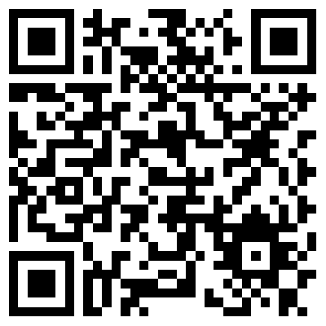

Article Level Metrics and Many Labs Replication Outcomes
Erika Salomon (ecsalomon@gmail.com)
Department of Psychology, University of Illinois at Urbana-Champaign
Introduction
Psychologists have started using metrics based on test statistics or p-values to infer the evidential value of published research findings.
At the same time, large-scale replication projects (e.g., Many Labs^{1,2}, Reproducibility Project: Psychology³) have tested the large-scale replicability of psychological research.
Using data from Many Labs 1 and 3, this study examines whether paper-level metrics predict replication results.
Research Question: Is it possible to predict from a paper’s statistics whether or how well its effects will replicate?
Results
Difference in Effect Size
Table 1 presents correlations between the predictor variables and the difference in effect size between original and replication results. None of the relationships reached significance at p < .05. However, Figure 1 shows restricted range among many predictors.
Replication Success
Table 2 presents logistic regression coefficients from models predicting success from each of the predictors. Figure 2 shows the predicted probability of successful replication from each model.
Method
Sample: Original papers reporting effects included in Many Labs 1 and 3 were used because of the availability of meta-analytic estimates of replication success.
Only papers that reported sufficient information to calculate the appropriate metrics were included in each analysis.
Predictors: Using the p-checker app, six predictors were estimated for each original paper, based on tests of critical hypotheses, as recommended by Simonsohn, Nelson, & Simmons⁴.
P-Curve: Evidential Value: Test statistic (z) for evidential value of a set of studies based on p-values⁵
P-Curve: Lacks Evidential Value: Test statistic (z) for evidential value of a set of studies based on p-values⁵
R-Index: Based on the difference between the expected and actual number of significant results⁶
Test of Insufficient Variance (TIVA): The variance in the converted z-scores of test statistics⁷
Correlation Between Effect Size and N: Pearson correlation between the observed effect sizes and sample sizes in a paper
N-Pact Factor: Median sample size for included tests⁸
Outcomes: Replication outcomes were operationalized in two ways:
Difference in Effect Size (continuous): The difference between the original and replication effects, scaled to Cohen’s d
Replication Success (dichotomous): Whether the meta-analytic estimate of the effect size was significant a p < .05.
Table 1. Correlations Among Predictors and Continuous Outcome
 | 1 | 2 | 3 | 4 | 5 | 6
1. Difference in Effect Size
2. P-Curve: Evidential Value | .44
3. P-Curve: Lacks Evidential Value | -.45 | -.99
4. R-Index | -.44 | -.89 | .89
5. TIVA: Variance in Z | -.05 | -.37 | .39 | .35
6. Correlation Between Effect Size and N | -.49 | -.37 | .37 | .42 | .40
7. N-Pact Factor | .16 | .06 | -.03 | .15 | .27 | -.06
Table 2. Six Different Logistic Regression Models Predicting Replication Success
 | b | SE | z | p | OR
1. P-Curve: Evidential Value | -0.23 | 0.18 | -1.31 | .19 | 0.79
2. P-Curve: Lacks Evidential Value | 0.23 | 0.18 | 1.33 | .18 | 1.26
3. R-Index | 0.93 | 1.64 | 0.56 | .57 | 2.53
4. TIVA: Variance in Z | 0.14 | 0.58 | 0.25 | .80 | 1.16
5. Correlation Between Effect Size and N | 0.12 | 0.66 | 0.19 | .85 | 1.13
6. N-Pact Factor | -0.00 | 0.01 | -0.48 | .63 | 1.00
Conclusions
Reporting practices should be improved so that papers consistently report information needed for meta-analytic and meta-scientific research (e.g., cell sizes, effect sizes, full model details).
Researchers should exercise caution in making inferences from metrics based on single papers or small sets of studies.
P-curve may show promise in predicting replication outcomes but is far from definitive when used on single papers.
PDF, Data, & Code
https://github.com/ecsalomon/TSR---Test-Stats-Replication
References
¹Ebersole et al., 2015 ²Klein et al., 2014 ³Open Science Collaboration, 2015 ⁴Simonsohn, Simmons, & Nleson, 2015 ⁵Simonsohn, Nelson, & Simmons, 2015, Quantifying Statistical Research Integrity: The Replicabilty-Index ⁶Schimmack, 2014, The Test of Insufficient Variance (TIVA): A New Tool for the Detection of Questionable Research Practices ⁷Fraley & Vazire, 2014

