Slide 1
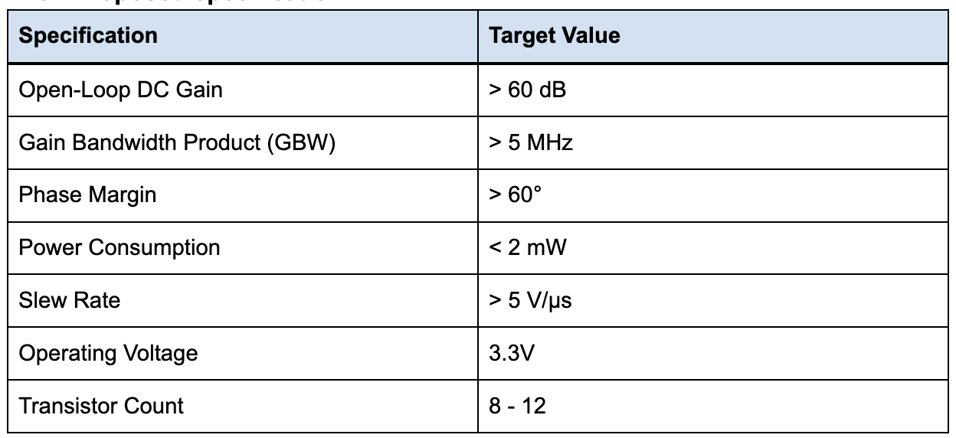
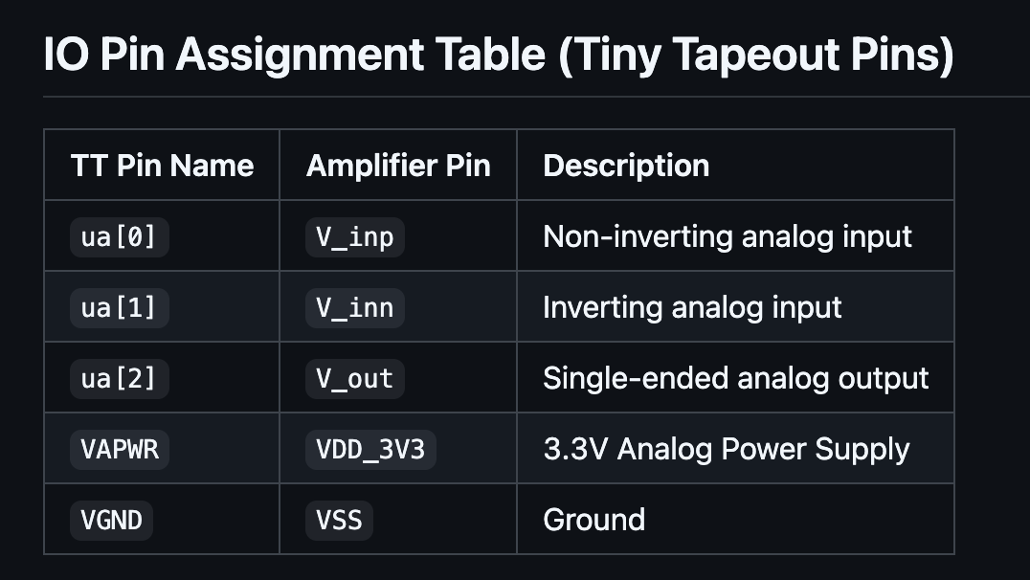
Target Values
Why Two-Staged
Two-stage Miller-compensated op amp
Vout
High Gain A(V/V), Input Impedance
Wide Output Swing
Vin+
Vin-
1st Stage
Differential Pairing
2nd Stage
1.8V
A two-stage CMOS op amp amplifies the difference between its two inputs with high gain, using Miller compensation to stay stable in feedback with single-ended output.
Purpose: The purpose of this 2-stage amplifier is to explore the world of signal amplification at the transistor level. Our goal is to maximize gain and bandwidth while maintaining stability with common-mode feedback (for differential input). Op-amp will drive a external Load.

Slide 2
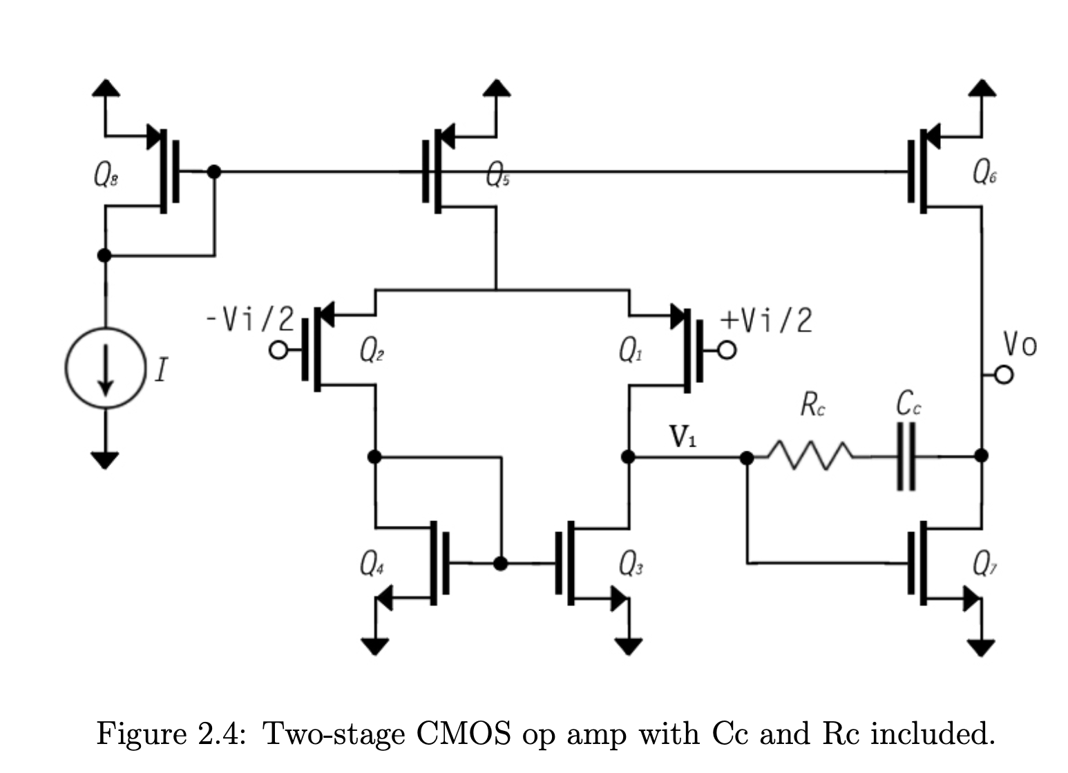
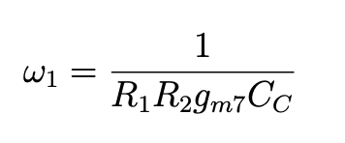
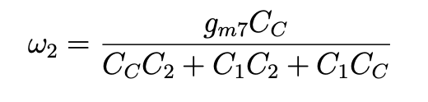
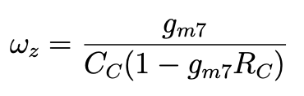
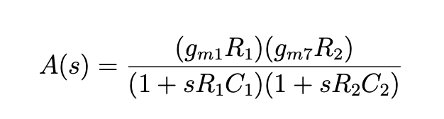
Circuit Topology selection
Dominant Pole
Second Pole
Zero by Miller RC
Fixes RHP
Overall Gain Vout/Vin

Slide 3
Timeline for completion & Task assignment
Early October: Schematic design and component sizing in Xschem. DC, AC, and transient simulation in Ngspice against gain, bandwidth, and phase margin targets. Initial floorplan and layout in Magic.
Mid-October/November: Complete the layout and close DRC and LVS. Extract parasitics and run post-layout simulation. Resize devices or adjust compensation if results drift from the schematic.
Late November: Final verification, GDS submission to Tiny Tapeout, and documentation.
Task Breakdown
Group: Topology selection,diff pair magic layout and specification targets post-layout simulation.
Qasim: Xschem schematic, device sizing, Ngspice simulation and optimization,
Ella: Magic layout for second stage & active load, overall integration, DRC/LVS, parasitic extraction.

