Slide 1
GloVe: Global Vectors for Word Representation
CSE Machine Learning Paper Review
By: Jeffrey Pennington, Richard Socher, Christopher Manning
https://nlp.stanford.edu/pubs/glove.pdf

Slide 2
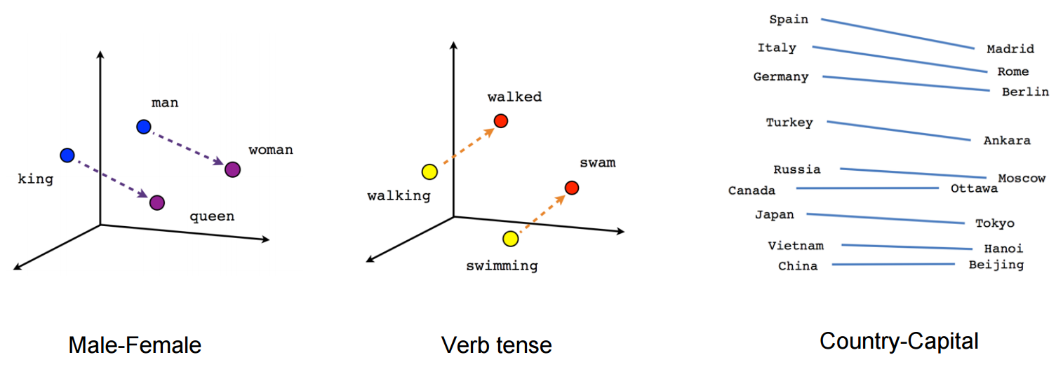
A bit about word embeddings
An important requirement for many NLP tasks is a measure of semantic similarity between words within a corpus (or across corpora)
This requires a representation for words where such semantic attributes can be encoded
Text representations or numeric tokenized forms (based on a dictionary) are not useful for such a representation
If a corpus is viewed as a high dimensional vector space, words can be viewed as points in that space i.e. vectors
Distance/Angle measures between such vectors can then represent semantic correlation
These word vectors are also otherwise known as “embeddings”
The words get “embedded” into the vector space
GloVe is a model that allows deriving embeddings for words in a corpus
You use vector dimensions of your choice and leverage a global (corpus wide) cooccurrence matrix
GloVe is not your usual model training task (i.e. a predictor or a classifier etc.) – it is more a pre-training task to transform inputs for a downstream model that performs NLP tasks like NER etc.
Notes:
NLP tasks need semantic correleation/similarity established
Example notepad to laptop vs notepad to diary
Dictionary meaning or tokenization is not rich enough
Vector Space Model - Corpus -> vector space
Each word is a vector in that space
High dimensionality provides enough richness to encode more info
Need algorithms to derive these vectors (Embeddings – same thing) from corpus
GloVe is one such algorithm (amongst many)

Slide 3
Cooccurrence Matrix & Probability Ratios
A cooccurrence matrix records the cooccurrence counts of context words with respect to a center word within a specific window
The Cat Sat On The Mat
 | The | Cat | Sat | On | Mat
The | 0 | 0 | 0 | 0 | 0
Cat | 0 | 0 | 0 | 0 | 0
Sat | 0 | 0 | 0 | 0 | 0
On | 0 | 0 | 0 | 0 | 0
Mat | 0 | 0 | 0 | 0 | 0
Window Width = 2 (on each side of the center word)
Notes:
GloVe uses the concept of a global cooccurrence matrix and probability ratios derived from that matrix

Slide 4
Cooccurrence Matrix & Probability Ratios
A cooccurrence matrix records the cooccurrence counts of context words with respect to a center word within a specific window
The Cat Sat On The Mat
 | The | Cat | Sat | On | Mat
The | 1 | 1 | 1 | 0 | 0
Cat | 0 | 0 | 0 | 0 | 0
Sat | 0 | 0 | 0 | 0 | 0
On | 0 | 0 | 0 | 0 | 0
Mat | 0 | 0 | 0 | 0 | 0
Window Width = 2 (on each side of the center word)

Slide 5
Cooccurrence Matrix & Probability Ratios
A cooccurrence matrix records the cooccurrence counts of context words with respect to a center word within a specific window
The Cat Sat On The Mat
 | The | Cat | Sat | On | Mat
The | 1 | 1 | 1 | 0 | 0
Cat | 1 | 0 | 1 | 1 | 0
Sat | 0 | 0 | 0 | 0 | 0
On | 0 | 0 | 0 | 0 | 0
Mat | 0 | 0 | 0 | 0 | 0
Window Width = 2 (on each side of the center word)

Slide 6
Cooccurrence Matrix & Probability Ratios
A cooccurrence matrix records the cooccurrence counts of context words with respect to a center word within a specific window
The Cat Sat On The Mat
 | The | Cat | Sat | On | Mat
The | 1 | 1 | 1 | 0 | 0
Cat | 1 | 0 | 1 | 1 | 0
Sat | 2 | 1 | 1 | 1 | 0
On | 0 | 0 | 0 | 0 | 0
Mat | 0 | 0 | 0 | 0 | 0
Window Width = 2 (on each side of the center word)

Slide 7
Cooccurrence Matrix & Probability Ratios
A cooccurrence matrix records the cooccurrence counts of context words with respect to a center word within a specific window
The Cat Sat On The Mat
 | The | Cat | Sat | On | Mat
The | 1 | 1 | 1 | 0 | 0
Cat | 1 | 0 | 1 | 1 | 0
Sat | 2 | 1 | 1 | 1 | 0
On | 1 | 1 | 1 | 1 | 1
Mat | 0 | 0 | 0 | 0 | 0
Window Width = 2 (on each side of the center word)

Slide 8
Cooccurrence Matrix & Probability Ratios
A cooccurrence matrix records the cooccurrence counts of context words with respect to a center word within a specific window
The Cat Sat On The Mat
 | The | Cat | Sat | On | Mat
The | 2 | 1 | 2 | 1 | 1
Cat | 1 | 0 | 1 | 1 | 0
Sat | 2 | 1 | 1 | 1 | 0
On | 1 | 1 | 1 | 1 | 1
Mat | 0 | 0 | 0 | 0 | 0
Window Width = 2 (on each side of the center word)

Slide 9
Cooccurrence Matrix & Probability Ratios
A cooccurrence matrix records the cooccurrence counts of context words with respect to a center word within a specific window
The Cat Sat On The Mat
 | The | Cat | Sat | On | Mat
The | 2 | 1 | 2 | 1 | 1
Cat | 1 | 0 | 1 | 1 | 0
Sat | 2 | 1 | 1 | 1 | 0
On | 1 | 1 | 1 | 1 | 1
Mat | 1 | 0 | 0 | 1 | 0
Window Width = 2 (on each side of the center word)

Slide 10

Cooccurrence Matrix & Probability Ratios
A cooccurrence matrix records the cooccurrence counts of context words with respect to a center word within a specific window
The Cat Sat On The Mat
Cooccurrence Matrix is calculated on entire corpus prior to training.
Helps produce cooccurrence probabilities
e.g.
P(Sat | Cat) = 1/3
P(Sat | The) = 2/7
Probability of the word k cooccurring with word i :
$P_{ik}$= P($W_{k}$|$W_{i}$) = $X_{ik}$ / $\sum_{j}{X_{ij}}$
 | The | Cat | Sat | On | Mat
The | 2 | 1 | 2 | 1 | 1
Cat | 1 | 0 | 1 | 1 | 0
Sat | 2 | 1 | 1 | 1 | 0
On | 1 | 1 | 1 | 1 | 1
Mat | 1 | 0 | 0 | 1 | 0
Window Width = 2 (on each side of the center word)

Slide 11
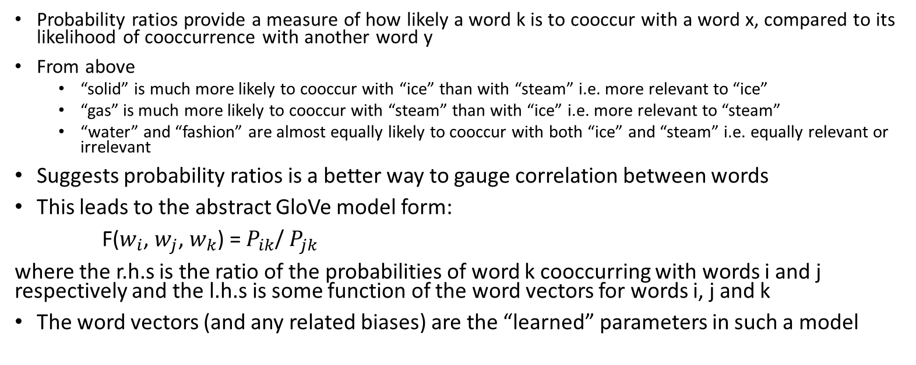
Cooccurrence Matrix & Probability Ratios
Source: https://nlp.stanford.edu/pubs/glove.pdf
Probability ratios provide a measure of how likely a word k is to cooccur with a word x, compared to its likelihood of cooccurrence with another word y
From above
“solid” is much more likely to cooccur with “ice” than with “steam” i.e. more relevant to “ice”
“gas” is much more likely to cooccur with “steam” than with “ice” i.e. more relevant to “steam”
“water” and “fashion” are almost equally likely to cooccur with both “ice” and “steam” i.e. equally relevant or irrelevant
Suggests probability ratios is a better way to gauge correlation between words
This leads to the abstract GloVe model form:
F($w_{i}$, $w_{j}$, $w_{k}$) = $P_{ik}$/ $P_{jk}$
where the r.h.s is the ratio of the probabilities of word k cooccurring with words i and j respectively and the l.h.s is some function of the word vectors for words i, j and k
The word vectors (and any related biases) are the “learned” parameters in such a model

Slide 12
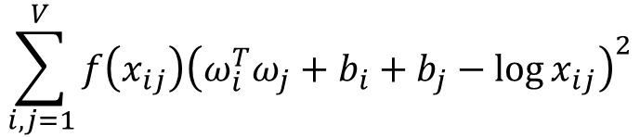

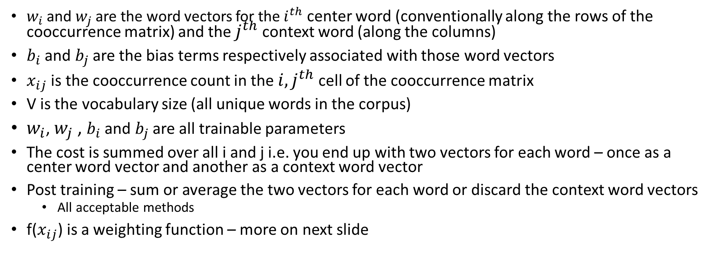
GloVe Model – Objective Function
$$\sum_{i,j=1}^{V}{f\left(x_{ij}\right){\left(ω_{i}^{T}ω_{j}+b_{i}+b_{j}−\log{x_{ij}}\right)}^{2}}$$
F($w_{i}$, $w_{j}$, $w_{k}$) = $P_{ik}$/ $P_{jk}$
Derivation skipped for brevity
GloVe cost function (weighted least squares)
$w_{i}$and $w_{j}$ are the word vectors for the $i^{th}$ center word (conventionally along the rows of the cooccurrence matrix) and the $j^{th}$ context word (along the columns)
$b_{i}$ and $b_{j}$ are the bias terms respectively associated with those word vectors
$x_{ij}$ is the cooccurrence count in the ${i,j}^{th}$ cell of the cooccurrence matrix
V is the vocabulary size (all unique words in the corpus)
$w_{i}$, $w_{j}$ , $b_{i}$ and $b_{j}$ are all trainable parameters
The cost is summed over all i and j i.e. you end up with two vectors for each word – once as a center word vector and another as a context word vector
Post training – sum or average the two vectors for each word or discard the context word vectors
All acceptable methods
f($x_{ij}$) is a weighting function – more on next slide

Slide 13

GloVe Model – Weighting Function
Words that cooccur infrequently can introduce noise
The weighting coefficient f($x_{ij}$) is a function that penalizes infrequently cooccurring pairs
f($x_{ij}$) = ${\text{(}x_{ij}\text{ / }x_{max}\text{)}}^{α}$ if $x_{ij}$ < $x_{max}$ otherwise 1
where $x_{max}$ is some prefixed cutoff (paper uses 100) and $α$ = 0.75 (per paper)
Multiplying the squared loss by above has the effect of reducing the contribution from cooccurrence counts that are less than the prefixed cutoff while those from over the cutoff remain as is.
Source: https://nlp.stanford.edu/pubs/glove.pdf

Slide 14
GloVe Objective Function (in code)
def loss_function(cooccur_mat:torch.tensor,
log_cooccur_mat:torch.tensor,
center_word_vectors:torch.tensor,
context_word_vectors:torch.tensor,
center_word_biases:torch.tensor,
context_word_biases:torch.tensor,
x_max = cooccurence_cutoff):
ones = torch.ones_like(cooccur_mat,device = torch_device)
weighting = torch.min(ones,(cooccur_mat/x_max)**(0.75))
loss = torch.sum(
weighting*( (torch.matmul(center_word_vectors,context_word_vectors.transpose(0,1))
+ center_word_biases
+ context_word_biases
- log_cooccur_mat)**2)
)
return loss

Slide 15
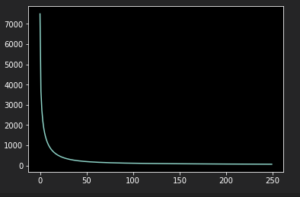
GloVe Training
Nothing special – use standard gradient descent ( or SGD or minibatch GD) to optimize loss
Run as many iterations as you need – consider a stopping criterion
optimizer = torch.optim.Adagrad([weight_center,weight_context,bias_center,bias_context])
for epoch in range(epochs): #need stopping criterion
optimizer.zero_grad()
loss_val = loss_function(cooccur_mat,
log_cooccur_mat,
weight_center,
weight_context,
bias_center,
bias_context)
loss_val.backward()
optimizer.step()
Loss
Epochs

Slide 16
GloVe – pre-trained vectors
Available at https://nlp.stanford.edu/projects/glove/
Also available via some popular NLP libraries such as SpaCy
All SpaCy English models are trained using GloVe on common crawl data
Using pre-trained vectors
model = k.models.Sequential()
model.add(k.layers.Embedding(max_words,embeddings_dim,
input_length=max_sent_len,name="embedding"))
embedding_layer = model.get_layer(name="embedding")
embedding_layer.set_weights([glove_embeddings_matrix]) # of size vocab x word vector dim
embedding_layer.trainable = False
You should almost never need to train your own word vectors
Plenty of pre-trained data available – not just for GloVe
The only situation where training your own word vectors might come into play is domain specific corpora

Slide 17
Questions ?

Slide 18
GloVe – points to ponder
A dot product as a measure of semantic correlation/similarity ?
Cooccurrence matrix sparsity – consider sparse matrix implementations
Large corpora can generate very large global cooccurrence matrices

Slide 19
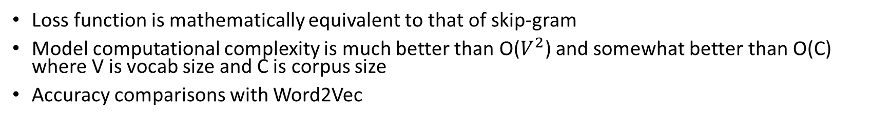
GloVe Comparisons
Loss function is mathematically equivalent to that of skip-gram
Model computational complexity is much better than O($V^{2}$) and somewhat better than O(C) where V is vocab size and C is corpus size
Accuracy comparisons with Word2Vec
Source: https://nlp.stanford.edu/pubs/glove.pdf

