Slide 1
CSBridge – Net 7

Slide 2
Internet Control Message Protocol (ICMP)
Layer 3 protocol with works in conjunction with IP
Used for passing informational messages
Used for informing a station that an error has occurred in transmission

Slide 3
ICMP Header
0 | 1 | 2 | 3 | 4 | 5 | 6 | 7 | 8 | 9 | 1 0 | 1 1 | 1 2 | 1 3 | 1 4 | 1 5 | 1 6 | 1 7 | 1 8 | 1 9 | 2 0 | 2 1 | 2 2 | 2 3 | 2 4 | 2 5 | 2 6 | 2 7 | 2 8 | 2 9 | 3 0 | 3 1
Type |  |  |  |  |  |  |  | Code |  |  |  |  |  |  |  | Checksum
content (variable length)

Slide 4
ICMP Rules
An ICMP error message is never sent in response to an ICMP error message
An ICMP error message will never be sent in response to a packet destined for a broadcast address
An ICMP error message will never be sent in response to a fragment other than the first.

Slide 5
ICMP Types/codes
0/0 – Echo Reply
8/0 – Echo Request
3/0 – Network Unreachable
3/1 – Host unreachable
3/3 – Port Unreachable
3/4 – Fragmentation needed but DF set
3/9 – Destination Network prohibited
3/10 – Destination host prohibited

Slide 6
ICMP types/codes
4/0 – Source quench
5/0 – Redirect for network
5/1 - Redirect for host
11/0 – TTL Exceeded during transit
17/0 – Address Mask Request
18/0 – Address Mask Reply

Slide 7
Address Mask Request/Reply
Used for workstations that implement RARP for address assignment.
The header is modified to include an 16-bit identifier, and 16-bit sequence number after the checksum.
A packet is sent to the broadcast address and will be replied to by the address mask authority. The 32-bit address mask will follow the sequence number.

Slide 8
Ping
Used (primarily) to determine if we have layer 3 connectivity to another device
And ICMP type 8 code 0 message is sent to the destination with a variable amount of data
The destination host replies with the same data in an ICMP type 0 code 0 packet.

Slide 9
Ping benefits
Can be used to determine network connectivity
Can be used to determine average speed of the network
Can be used to determine the “distance” to the destination.
Can be used to determine route path.
Useful for finding “black holes”

Slide 10
Ping disadvantages
A positive response doesn’t always mean the destination is working properly
A negative (NULL) response doesn’t always mean the destination isn’t working properly
ICMP gets the lowest possibly processing priority so time measurements cannot always be trusted
Has a very limited size for Recording route and timestamping

Slide 11
Record Route
0 | 1 | 2 | 3 | 4 | 5 | 6 | 7 | 8 | 9 | 1 0 | 1 1 | 1 2 | 1 3 | 1 4 | 1 5 | 1 6 | 1 7 | 1 8 | 1 9 | 2 0 | 2 1 | 2 2 | 2 3 | 2 4 | 2 5 | 2 6 | 2 7 | 2 8 | 2 9 | 3 0 | 3 1
IP Header (20 bytes)
Code |  |  |  |  |  |  |  | Length |  |  |  |  |  |  |  | Pointer |  |  |  |  |  |  |  | IP Addr 1(octet 1)
IP Addr 1 (octet 2-4) |  |  |  |  |  |  |  |  |  |  |  |  |  |  |  |  |  |  |  |  |  |  |  | IP Addr 2(octet 1)
IP Addr 2 (octet 2-4) |  |  |  |  |  |  |  |  |  |  |  |  |  |  |  |  |  |  |  |  |  |  |  | IP Addr 3(octet 1)
IP Addr 3 (octet 2-4) |  |  |  |  |  |  |  |  |  |  |  |  |  |  |  |  |  |  |  |  |  |  |  | IP Addr 4(octet 1)
IP Addr 4 (octet 2-4) |  |  |  |  |  |  |  |  |  |  |  |  |  |  |  |  |  |  |  |  |  |  |  | IP Addr 5(octet 1)
IP Addr 5 (octet 2-4) |  |  |  |  |  |  |  |  |  |  |  |  |  |  |  |  |  |  |  |  |  |  |  | IP Addr 6(octet 1)
IP Addr 6 (octet 2-4) |  |  |  |  |  |  |  |  |  |  |  |  |  |  |  |  |  |  |  |  |  |  |  | IP Addr 7(octet 1)
IP Addr 7 (octet 2-4) |  |  |  |  |  |  |  |  |  |  |  |  |  |  |  |  |  |  |  |  |  |  |  | IP Addr 8(octet 1)
IP Addr 8 (octet 2-4) |  |  |  |  |  |  |  |  |  |  |  |  |  |  |  |  |  |  |  |  |  |  |  | IP Addr 9(octet 1)
IP Addr 9 (octet 2-4) |  |  |  |  |  |  |  |  |  |  |  |  |  |  |  |  |  |  |  |  |  |  |  | (EOO Marker)

Slide 12
Record Route
Code is set to 7, length is set to 39 and ptr is set to 4
Each router places it’s IP address in the packet starting at offset ptr-1
If PTR reaches 40 no more data can be placed in the packet
The destination station sends the entire packet back
This does not effect the operation of ICMP!

Slide 13
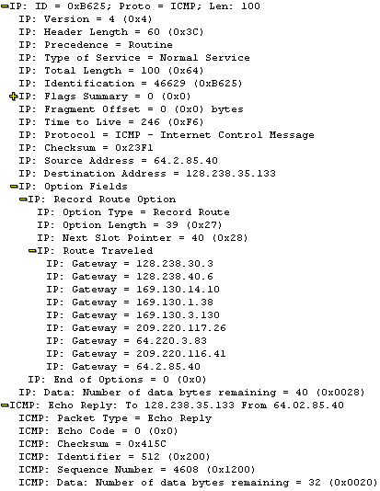
Ping In Action

Slide 14
Traceroute
Very useful program to see the route which a packet follows in traveling from A to B.
Uses either ICMP or UDP
The concept can be used for any protocol which operates on IP
Overcomes the 9 hop problem with IP RR

Slide 15
Traceroute operation
A packet is sent to the destination with a TTL of 1
When the first router receives the packet it decrements it to zero and an ICMP type 11 code 0 message is returned to the sender
The TTL is incremented and the process continues
We can stop when we receive the expected response from the destination

