Slide 1
30-Day Weather Probability Analysis
Cities: Karachi, New York, London, Islamabad, Dubai
Prepared by: Umed Ali & Group
BS Cyber Security – SMIU

Slide 2
Introduction
This project analyzes 30 days of weather data using probability and statistics.
Focus on temperature trends and rainfall probability across five cities.

Slide 3
Objectives
- Analyze 30-day weather data
- Calculate mean, median, standard deviation
- Compute probability of rainfall
- Compare different cities

Slide 4
Data Collection
- Simulated dataset (30 days)
- Parameters: temperature, humidity, precipitation
- Cities: Karachi, New York, London, Islamabad, Dubai

Slide 5
Methodology
- Data cleaning and validation
- Statistical calculations
- Probability analysis of rainfall
- Visualization using graphs

Slide 6
Summary Statistics
Karachi & Dubai show higher average temperatures.
New York shows lowest temperatures.
Rain probability varies significantly by city.

Slide 7
Rainfall Probability
Rain probability calculated as:
Rainy Days / Total Days
New York shows highest rain probability.

Slide 8
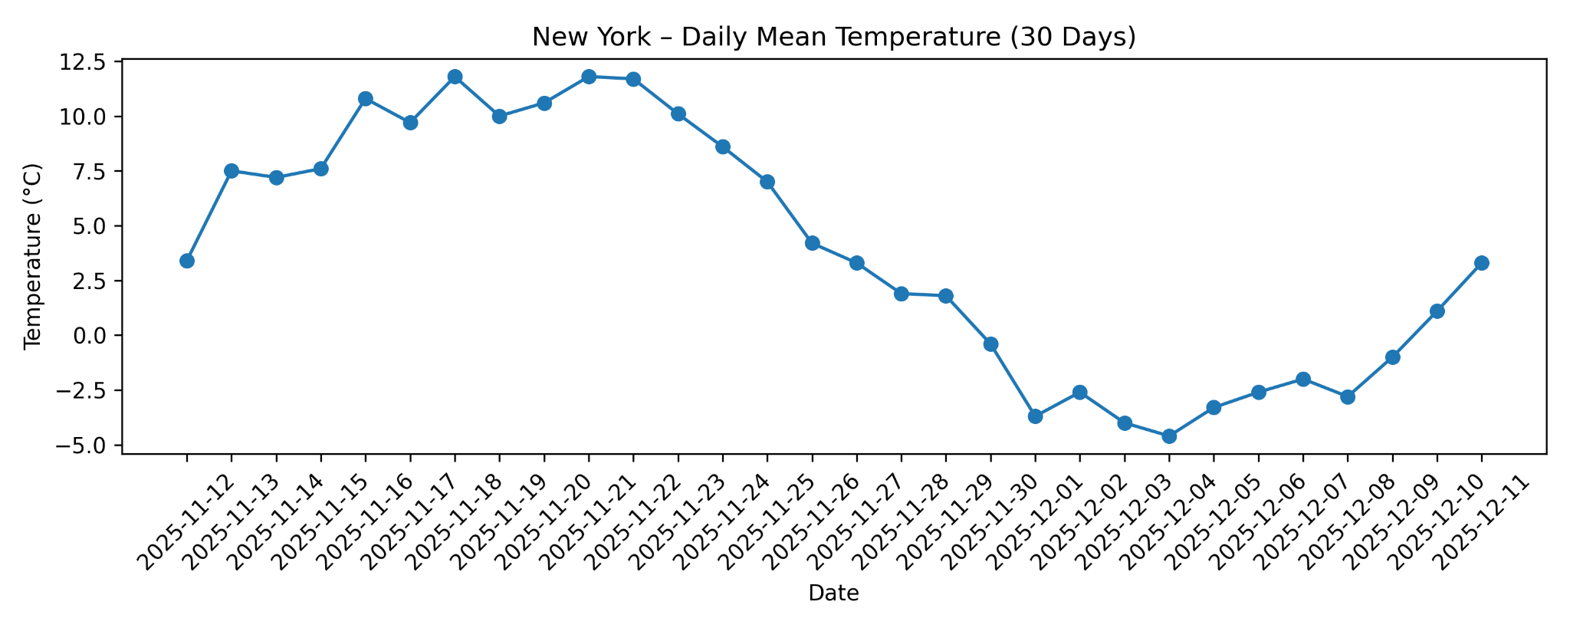
Visual Analysis
- Time series graphs

Slide 9
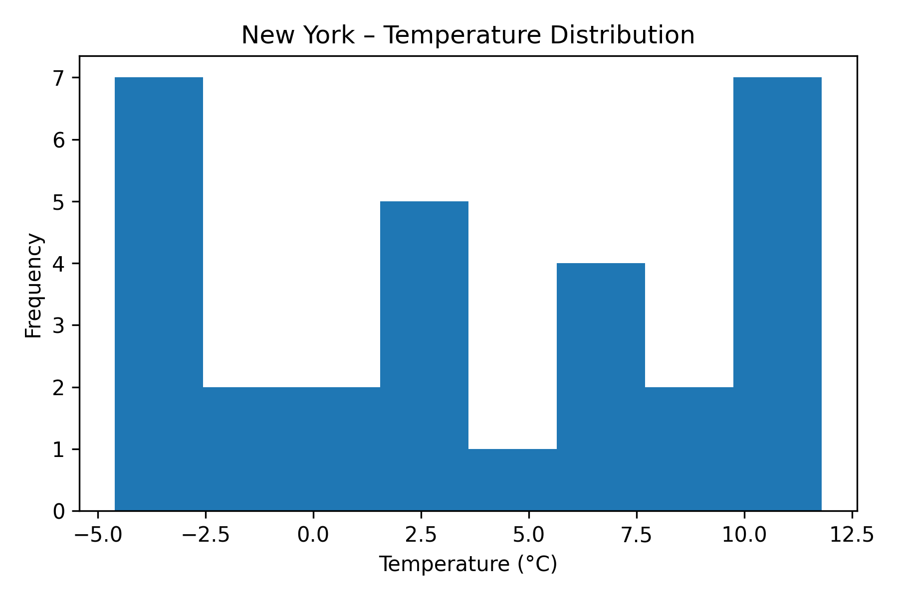
Visual Analysis
- Histograms

Slide 10
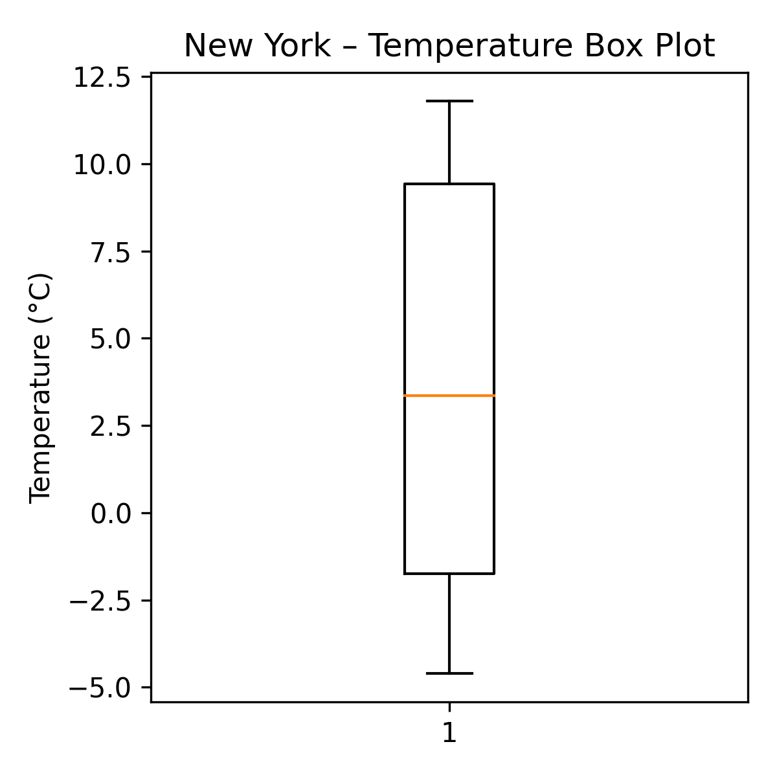
Visual Analysis
- Box plots

Slide 11
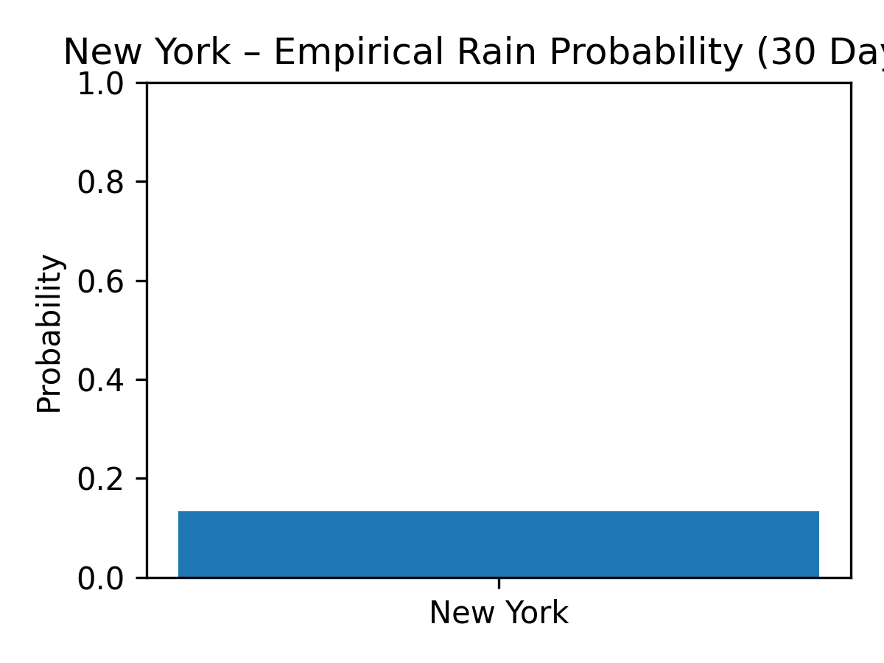
Visual Analysis
- Rain probability charts

Slide 12
Findings
- Climate patterns differ significantly
- Warmer cities have lower rain probability
- Cold regions show higher variability

Slide 13
Limitations
- Data is simulated
- Short time span (30 days)
- No seasonal analysis

Slide 14
Conclusion
Probability-based analysis helps understand weather uncertainty.
Useful for planning, forecasting, and climate studies.

Slide 15
Thank You
Thank you for your attention!
Any Questions?

