Slide 1

Erlang开发电信网管项目实践
Author: Ery Lee
Date: December 2008
Email: ery.lee@gmail.com

Slide 2

Agenda
About Opengoss Project
Road to Erlang
The Architecture
Erlang Highlights
What We Got
What We Lost
About Erlang Syntax
Thinking in Software

Slide 3
About Opengoss Project

Slide 4
What's Opengoss?
Next Generation Network and Business Management System
One uniform platform based on Linux,Erlang/OTP and ROR
Different applications for WIFI, EPON and Enterpise networks

Slide 5
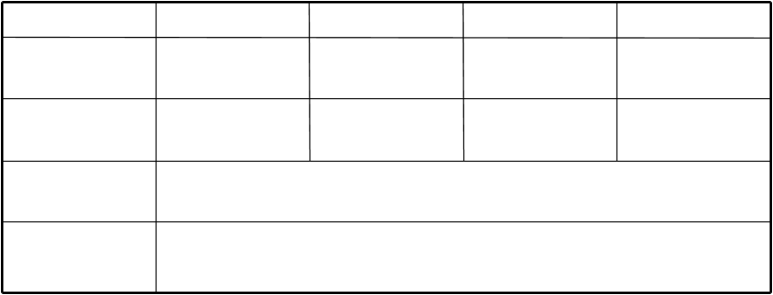
Opengoss Product Family
WIFI-OSS
EPON-OSS
Enterprise
Internet
OSS
WIMSS
N/A
N/A
N/A
NMS
Opengoss WLAN
Opengoss EPON
Opengoss Enterprise
N/A
Platform
DMIT, Monet, Evabus, Report, RRDB, WebTopo
Base
Linux/Unix, MySQL, Oracle, LDAP, Erlang/OTP, Ruby and Rails…

Slide 6
Future of Opengoss
The Network Management Cloud

Slide 7
Road to Erlang

Slide 8
Pure Java Originally…
First Version: Java and JEE…
Second Version: Java, OSGi, Eclipse, Model-Driven…

Slide 9
Java could do everything, but…
Java , JSP , JSF, Struts, Webwork, Velocity , Spring, Hibernate, iBatis, EJB, JDO, JMS, JNDI, JDBC, JAAS, JTA, RMI, IIOP, Web Services, SOAP, SOA, SDO...
But, could Java do anything best?

Slide 10
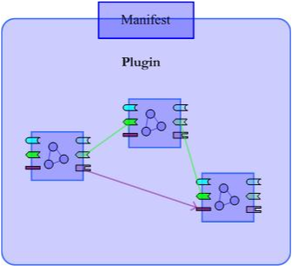
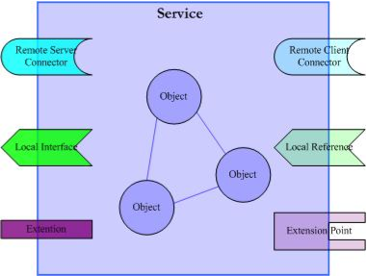
We Had a Big Idea Once☺
Planned Third Version: OSGI, Component, Plugin, SOA, SDO, SCA…

Slide 11
But we have no money and big team...

Slide 12
We are tired of NEW concepts and frameworks...
SDO, SCA, SOA, ESB, BPML,SOBA...
Endless WS-* Documents…

Slide 13

Into the Wild
We want to be far away...

Slide 14

“Hello Stranger”
Fall in love with REST, Rails and Erlang …

Slide 15
Why Erlang?
Simplicity
Performance
Concurrency
Distribution
Fault Tolerance

Slide 16
The Architecture

Slide 17
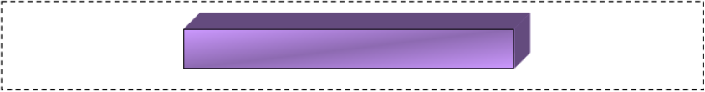
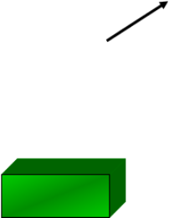

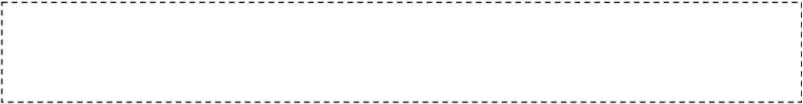





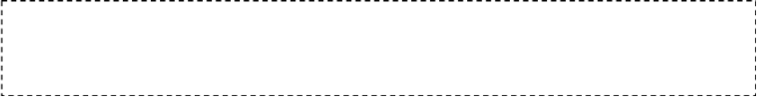


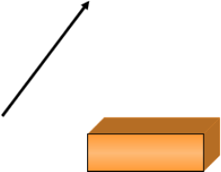




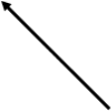
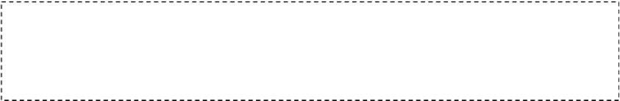



















Architecture
UI
WebPortal (WebTop)‏
Data
RRDB
LDAP/MIT
RDMS
Biz
Monet
DMIT‏
Evabus
Automations
Collect
M
M
M
M
P
P
P
P
SNMP
Monitor
Ping
Monitor
TCP
Monitor
Other
Monitor
SNMP
Probe
Syslog
Probe
API
Generic
Trouble Ticket
3rd party

Slide 18
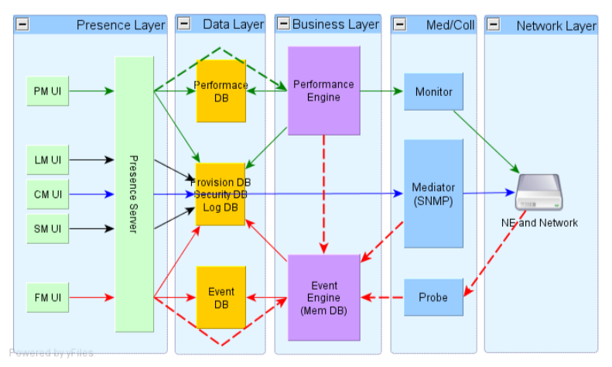
Design

Slide 19
Layers
  Present Layer:
    AJAX,
    Rails
  Data Center Layer:
    MySQL,
    Oracle,
    RRDB,
    LDAP
  Business Layer:
    DMIT(Distributed MIT),
    Evabus(Event and Alarm Bus),
    Monet(Distributed network monitor)‏
  Data Collection Layer:
    Probe,
    Monitor,
    Mediator

Slide 20
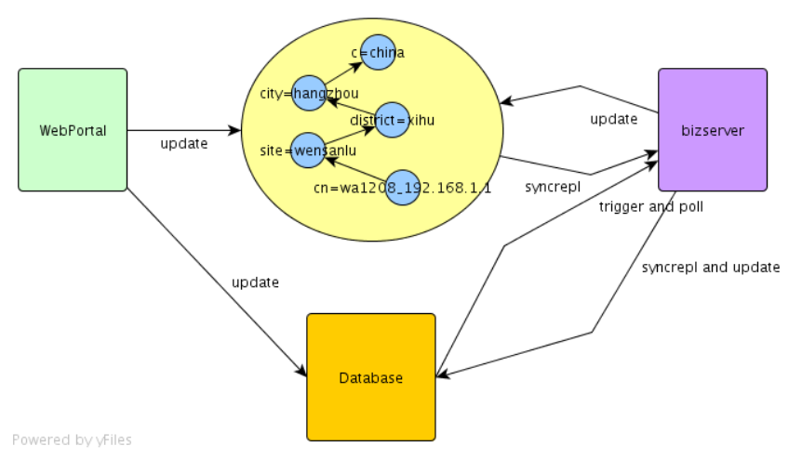
DMIT
LDAP and Syncrepl

Slide 21
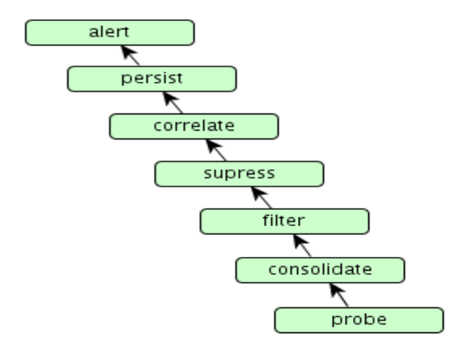
Evabus
Concurrent Event and Alarm Process Line

Slide 22
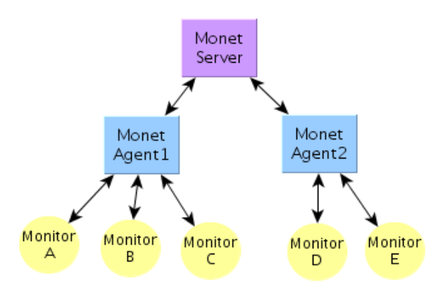
Monet
Massively distributed network monitor and data collection

Slide 23
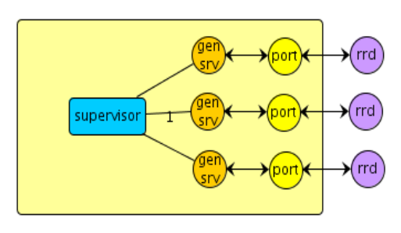
Errd
RRDTool Erlang port

Slide 24
Erlang Highlights

Slide 25
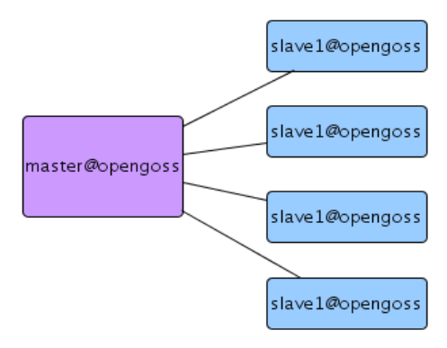
Master/Slave and Pool
Distribution and load balance.

Slide 26
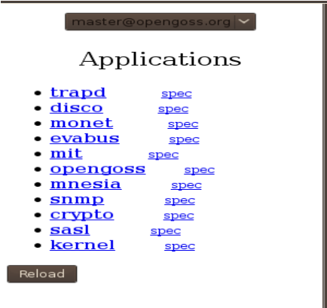
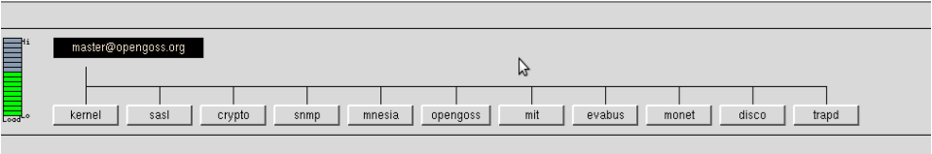
Master Applications

Slide 27
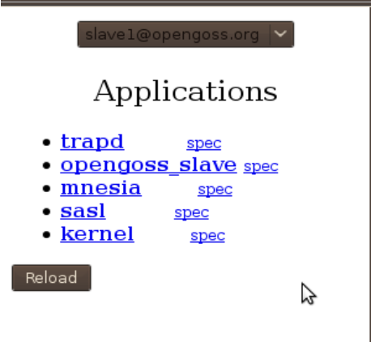
Slave Applications

Slide 28
Sample code: pool
handle_cast({add, Dn, Attrs}, State) ->
  Node = pool:get_node(),
  rpc:call(Node, monet_agent, monitor, [{Dn, Attrs}]),
  ets:insert(mon_entry_table, {Dn, Node}),
  {noreply, State};

Slide 29
OTP Behaviors
application
supervisor
gen_server
gen_event
gen_fsm
gen_monitor

Slide 30
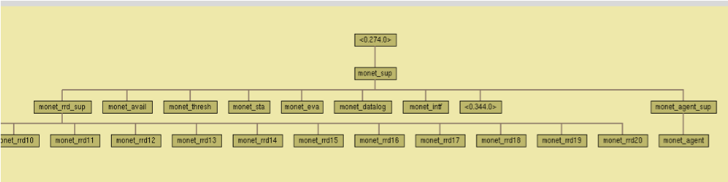
Supervisor tree

Slide 31
gen_server: opengoss_mysql
-module(opengoss_mysql).
-behaviour(gen_server).
-export([insert/2, select/1, select/2, select/3, update/2, update/3, delete/2]).
......
......
......

Slide 32
gen_server: opengoss_mysql(cont)‏
opengoss_mysql:select(wifi_mobile_units, [id, mac], {ap_dn, Dn})‏
opengoss_mysql:update(wifi_mobile_units, [{last_seen, {datetime, Now}}], {'and', {ap_Dn, Dn}, {'in', id, UpdatedIds}})‏
opengoss_mysql:delete(wifi_mobile_units, {'and', {ap_Dn, Dn}, {'in', id, DeletedIds}});

Slide 33
gen_event: mit_event_h
handle_event({present, Dn, Entry}, State) ->
  handle_add_entry(Dn, Entry),
  {ok, State};
handle_event({add, Dn, Entry}, State) ->
  handle_add_entry(Dn, Entry),
  {ok, State};
handle_event({modify, Dn, Entry}, State) ->
  handle_modify_entry(Dn, Entry),
  {ok, State};
handle_event({delete, Dn, _Entry}, State) ->
  handle_delete_entry(Dn),
  {ok, State};

Slide 34
gen_fsm: eldap_syncrepl
-module(eldap_syncrepl).
-behaviour(gen_fsm).
-include("eldap.hrl").
-include("ELDAPv3.hrl").
-export([init/1, connecting/2, wait_bind_response/2,
wait_syncrepl_response/2, handle_event/3, handle_sync_event/4,
handle_info/3, terminate/3, code_change/4, close/0]).

Slide 35
Other libraries
SNMP
Mochiweb
Errd
Eldap
MySQL driver
Cron

Slide 36
What We Got

Slide 37
Productivity
Small team to develop a NMS product
2 Ajax/Html, 2 Rails/DB, 1 Erlang
2 days to coding syncrepl protocol

Slide 38
Performance
1 HP380, 2 CPUs, 4G mem, 8 Cores
1 Oracle, 1 Mysql, 1 OpenLdap, 4 Mongrel,
1 Master, 4Slaves
5 minutes interval
10+ measure items average
Collect 200 Switches, 1200 Aps, 8000 Interfaces

Slide 39
Concurrency
  8000+ collect processes
  80 SNMP client
  80 PING
  30 RRDTools
  4 Erlang SNMP Client

Slide 40
Scalability
Massively Distributed Data Collection
Scale from 1000+ to 100,000+ Aps
Try to resolve IO bottleneck
Try to partition data

Slide 41
Stability
Never stop monitor engine
Failure Recover
Hot code loading

Slide 42
Distribution
Transparent distribution
No effort to get master/slave

Slide 43
Happiness
Less code, Less noises
More Happiness

Slide 44
Loneliness
No Girls?

Slide 45
What We Lost

Slide 46
Java
Comprehensive matured libraries and frameworks
The Java community

Slide 47
Buzzword
No SOA, SCA, SDO, ESB finally...

Slide 48
About Erlang Syntax

Slide 49
Love
Function Programming?
Pattern match
List comprehension

Slide 50
Hate
Ugly If
String Support
Records

Slide 51
Thinking in Software

Slide 52
Far away from SOA
SOAP Died...
WS-* is dying...
And then SOA???

Slide 53
OO is over evaluated
  The revolution is RDBMS and C Language
  http://pojo.javaeye.com/

Slide 54
It's just Data
  IT was named as "Data Processing" in enterprise.
  The data looks like table and records in DB
  The data looks like objects in business layer
  The data looks like Tables, Trees and Forms in UI layer

Slide 55
AJAX Sucks
  And Flex?

Slide 56
REST
  REST is very important.

Slide 57
Cloud is not a myth
  Build your own cloud.
  Erlang makes it easy?

Slide 58
Thanks :)‏

