Slide 1

Erlang & Comet Programming
许式伟
xushiweizh@gmail.com
2008年12月

Slide 2

Agenda
What is Comet Programming?
Comet Programming Model
Demo: Minimal Chat
Bayeux Protocol
Bayeux Client/Server
Demo: Cometd Chat

Slide 3

What is Comet Programming?
Low Latency Data for the Browser
Comet is a neologism to describe a web application model in which a long-held HTTP request allows a web server to push data to a browser, without the browser explicitly requesting it.

Slide 4
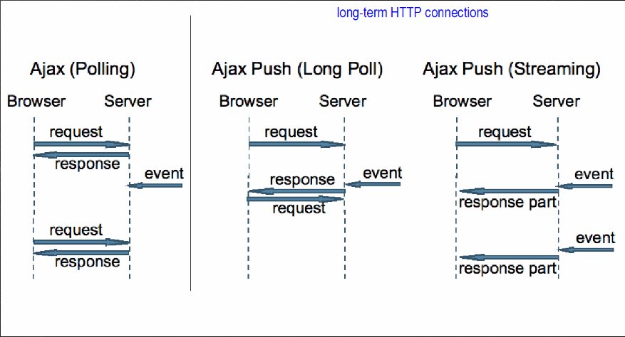
Comet Programming Model

Slide 5
Demo: Minimal Chat
http://ecug.googlecode.com/svn/comet/
  chat_web.erl

Slide 6
Minimal Chat: Room Server
room(Users) ->
receive
{From, subscribe} ->
From ! subscribed,
room([From | Users]);
{From, unsubscribe} ->
From ! unsubscribed,
room(Users -- [From]);
{From, post, Message} ->
From ! posted,
lists:foreach(fun(User) -> User ! Message end, Users),
room([]);
_Any ->
room(Users)
end.
Only 15 lines!

Slide 7
Minimal Chat: Room Sever
get_the_room() ->
% does the room exists?
Pid = whereis(theroom),
if
is_pid(Pid) ->
Pid;
true ->
% create it
NewPid = spawn(fun() -> room([]) end),
register(theroom, NewPid),
NewPid
end.
Forget this singleton model code. Not so good…

Slide 8
Minimal Chat: Sever Logic
loop(Req, DocRoot) ->
"/" ++ Path = Req:get(path),
case Req:get(method) of
Method when Method =:= 'GET'; Method =:= 'HEAD' ->
case Path of
"chat" ->
Room = get_the_room(),
Room ! {self(), subscribe},
receive
subscribed ->
receive
Message ->
{Type, Message} = {ok, Message}
after ?TIMEOUT ->
{Type, Message} = {error, <<"timeout">>}
end
after 1000 ->
{Type, Message} = {error, <<"timeout">>}
end,
case Type of
error ->
Room ! {self(), unsubscribe},
receive
unsubscribed ->
ok
after 1000 ->
ok
end;
ok ->
ok
end,
Req:ok(
{ "text/javascript", mochijson2:encode(
{ struct, [ {Type, Message} ] })
} );
_ ->
Req:serve_file(Path, DocRoot)
end;

Slide 9
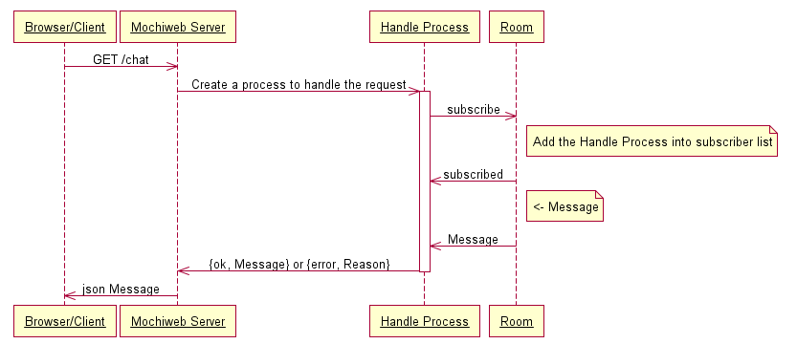
UML: Get Message
Server Logic

Slide 10
Minimal Chat: Sever Logic
'POST' ->
case Path of
"chat" ->
Data = Req:parse_post(),
Room = get_the_room(),
Room ! {self(), post, list_to_binary(proplists:get_value("message", Data))},
receive
posted ->
Body = {ok, <<"posted">>}
after 1000 ->
Body = {error, <<"timeout">>}
end,
Req:ok(
{ "text/javascript", mochijson2:encode(
{ struct, [Body] })
});
_ ->
Req:not_found()
end;
_ ->
Req:respond({501, [], []})
end.

Slide 11
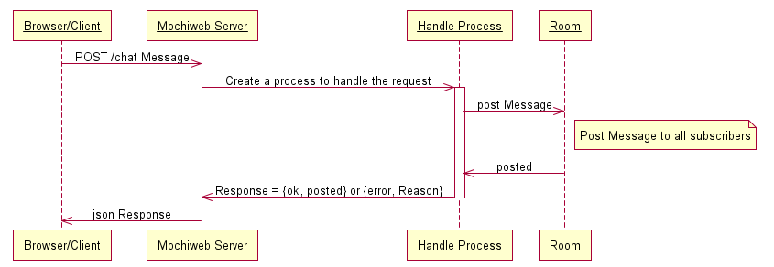
UML: Post Message
Server Logic

Slide 12
Minimal Chat: Brief Conclusion
Erlang is good at:
  Create a client/server model.
  Create a lot of connections (handle process).
Comet Programming Model is easy for Erlang.
  We consider all things in a natural way.

Slide 13
Why Erlang Can?
Erlang
  Thread Pool
  Scheduler
    Can be O(1)
Coroutine / Actor
CUDA

Slide 14
Bayeux Protocol
Bayeux is a protocol for transporting asynchronous messages (primarily over HTTP), with low latency between a web server and a web browser.
  http://cometdproject.dojotoolkit.org/documentation/bayeux
Specification
  http://svn.cometd.com/trunk/bayeux/bayeux.html

Slide 15
Bayeux Protocol Details
Channel
  What does it mean?
    Room (term in Minimal Chat)
    ConnectPoint (term in OLE/COM)
  Examples
    /foo
    /foo/bar
    /foo-bar/(foobar)

Slide 16
Bayeux Protocol Details
handshake
  response
    supportedConnectionTypes
    clientId
connect(channel, clientId, connectionType) -> ok
subscribe(clientId, subscription) -> ok
unsubscribe(clientId, subscription) -> ok
publish/deliver(channel, message) -> ok
disconnect(channel, clientId) -> ok

Slide 17
Bayeux Client
Javascript
  Dojo
    http://cometdproject.dojotoolkit.org/documentation/cometd-dojox
  jQuery
    http://plugins.jquery.com/project/Comet
    http://code.google.com/p/jquerycomet/

Slide 18
Bayeux Server
Java
  http://cometdproject.dojotoolkit.org/documentation/cometd-java
  http://cometdproject.dojotoolkit.org/documentation/cometd-jetty
Python
  http://cometdproject.dojotoolkit.org/documentation/cometd-twisted
Perl
  http://cometdproject.dojotoolkit.org/documentation/cometd-perl
Erlang
  http://code.google.com/p/erlycomet/

Slide 19
Demo: Cometd Chat
cometd-jetty + dojox
  http://ecug.googlecode.com/svn/comet/cometd/
erlycomet + dojox
  http://ecug.googlecode.com/svn/comet/erlycomet/

Slide 20
Thought Storm
Google Web Chat
  GChat = Comet + eJabberd?

Slide 21
Q & A
Thanks

