Slide 1

An Erlang Implementation of Restms

Slide 2

Why have messaging?
Separates applications cheaply
Feed information to the right applications cheaply
Interpret feed data in different ways

Slide 3

- separation of concerns
Allows one to separate one's components easily
Swap out easily
Communicate cheaply
Communicate quickly

Slide 4

- feed right thing at right time
Knows it's target
Subscribers don't poll
Server informs client when there is an update
Publisher says: “my package is in China” => all subscribers know immediately

Slide 5
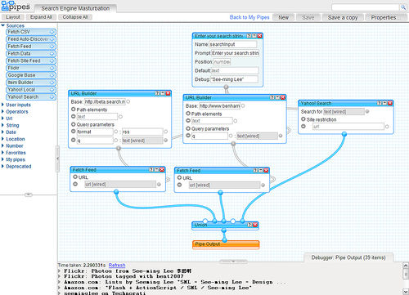
- mine feed data

Slide 6

What we expect from messaging.
Easy connection
Easy tools to mine feeds
Scalability – an order of magnitude
Loose coupling
Different languages

Slide 7

What can I do?
Monitor stocks
Perform server side computations on feeds
Create message based websites
etc

Slide 8

What is available for us?
Xmpp
RSS
AtomPub
Soap

Slide 9

What of the enterprise world?
JMS for the java universe....
Pub-sub
Queues
Closed source
Expensive
Vendor lock in

Slide 10

What are our challenges?
Routing model
  Static vs dynamic
Protocol vs Product
  Open standard
  Closed source impl
Complexity

Slide 11

Why is messaging unpopular?
Complex
Implementations do not follow standards
Few Free and Open Source Software solutions
  RabbitMq (via internet?)‏
  Ejabbard (named queues?)

Slide 12

AMQP
Free and Open
Generic extensible routing
Not easy to use in any language
  Need entire API stack of each language
Any OS
Fast
But?
  Inaccessible

Slide 13
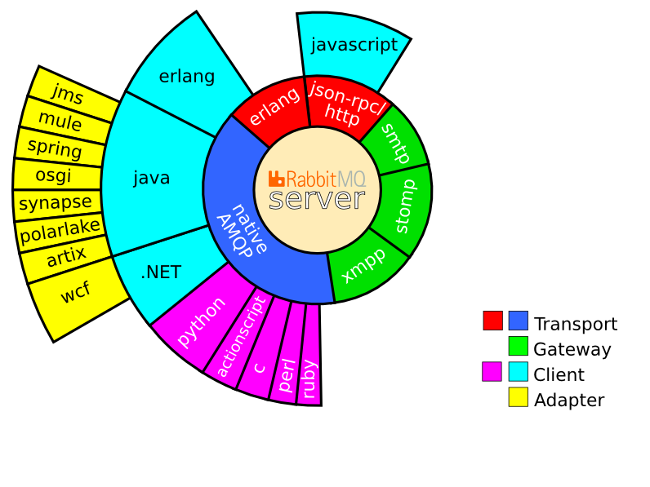
Advanced Messaging Queuing Protocol (AMQP)‏

Slide 14

AtomPub
Free and Open
Single limited routing model
  Publish to feed, read from feed, no routing
Easy to use in any language
Any OS
Fast
But?
  Limited

Slide 15

What we want....
Free and Open
Generic extensible routing
Easy to use in any language
Any OS
Fast

Slide 16

Enter RestMS
Twitter: Dion Almaer: “RestMS is like squashing AMQP and AtomPub together”
Improve on AMQP routing
RESTful access
Portable
Free standard

Slide 17
How does Restms work?
1) Publisher sends messages to Feed
2) Subscribers create pipes
  And join the pipes to feeds
3) Subscribers then read from their pipes
  Get message, process message, loop
4) Joins specify the routing algorithms
  By key, location, regular expression, etc

Slide 18

RESTful
RESTful access
  POST : creates feed, pipe, join
  GET: reads a pipe
  PUT: updates a feed, pipe, join
  DELETE: deletes a feed, pipe or join
Support for JSON, XML, YAML, Binary files, Image files, any format

Slide 19

Why HTTP?
Proxies
Load Balancers
Debugging tools
Web browsers
Prior knowledge
Guaranteed web access
Extensive hardware
Known scalability paths
Extensibility
Security

Slide 20

Problems with HTTP
Verbose
  Batch writes and reads
Polled vs Event driven
  BOSH / Long poll
NOT-XML!
  XML is a markup lang
  Use JSON

Slide 21

FireflyMq
Erlang Implementation of RestMs protocol
  Webmachine
  Riak
  Cappuccino

Slide 22

Basho
Webmachine
  Erlang RESTful toolkit
Riak
  Erlang implementation
  Amazon Dynamo clone
  2 yrs in production
  Distributed key/value database
  Not client server model

