Slide 1
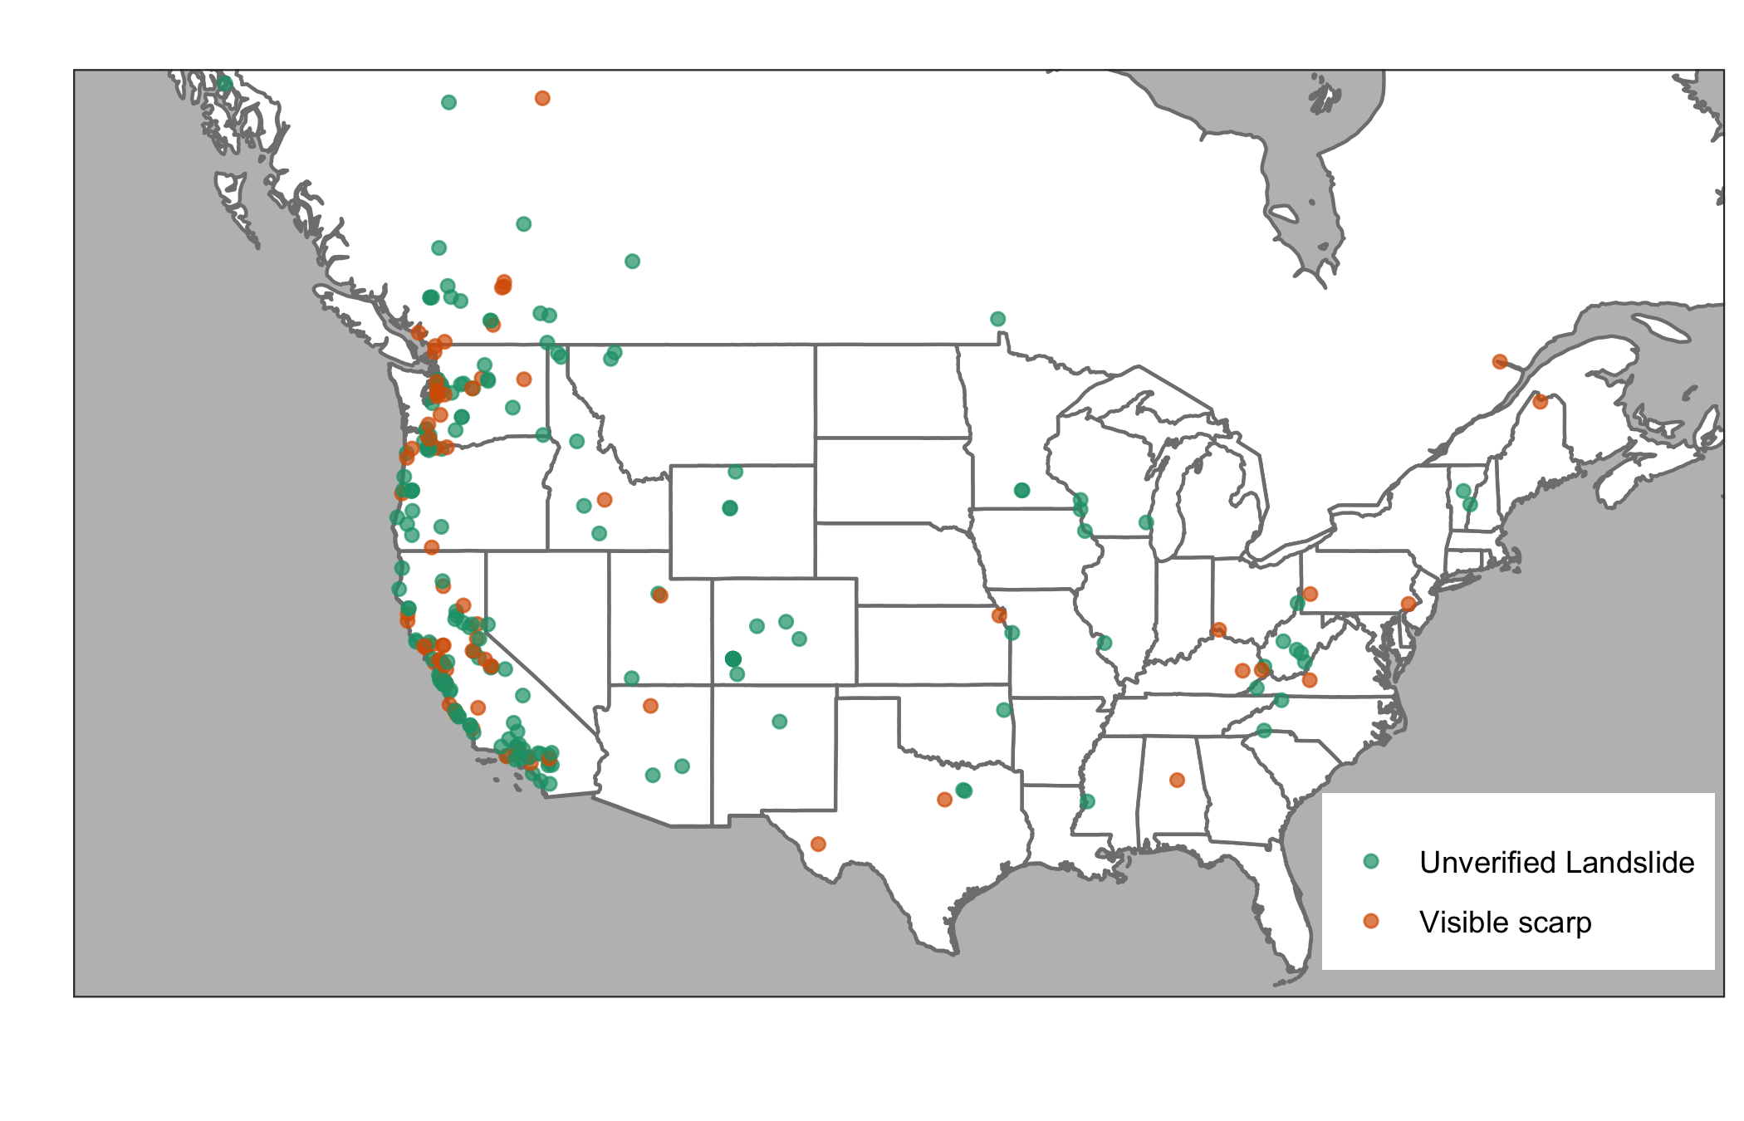
FIGURE 1: map of sites with overlaid graphs showing precipitation product comparison for select sites for ‘typical' storms

Slide 2
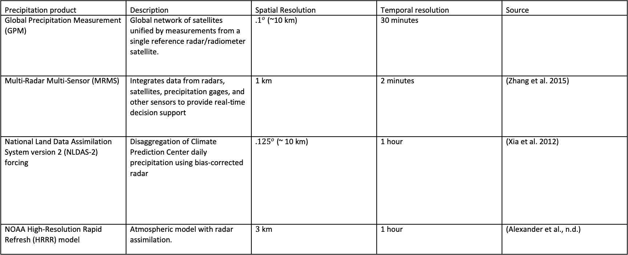
TABLE 1: precipitation products
Precipitation product | Description | Spatial Resolution | Temporal resolution | Source
Global Precipitation Measurement (GPM) | Global network of satellites unified by measurements from a single reference radar/radiometer satellite. | ${.1}^{o}$ (~10 km) | 30 minutes
Multi-Radar Multi-Sensor (MRMS) | Integrates data from radars, satellites, precipitation gages, and other sensors to provide real-time decision support | 1 km | 2 minutes | (Zhang et al. 2015)
National Land Data Assimilation System version 2 (NLDAS-2) forcing | Disaggregation of Climate Prediction Center daily precipitation using bias-corrected radar | ${.125}^{o}$ (~ 10 km) | 1 hour | (Xia et al. 2012)
NOAA High-Resolution Rapid Refresh (HRRR) model | Atmospheric model with radar assimilation. | $3$ km | 1 hour | (Alexander et al., n.d.)

Slide 3
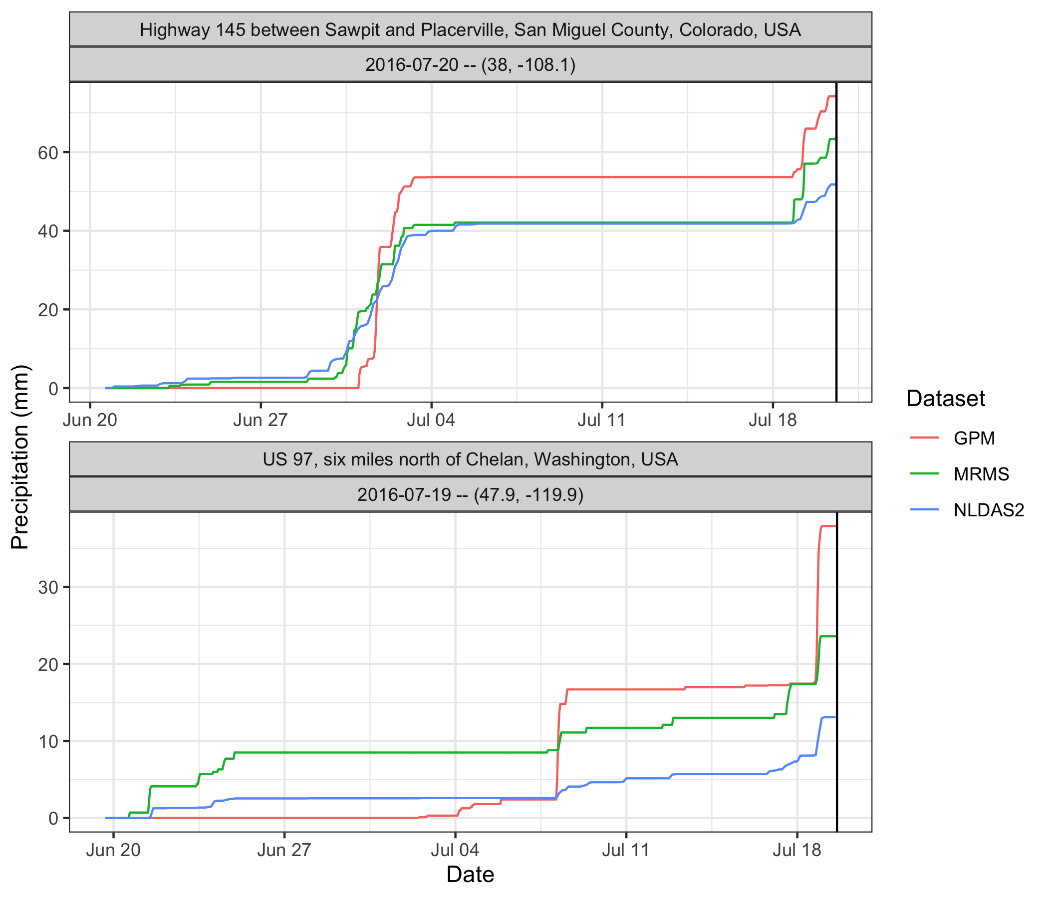
FIGURE 2: Cumulative precipitation comparison for select sites

Slide 4
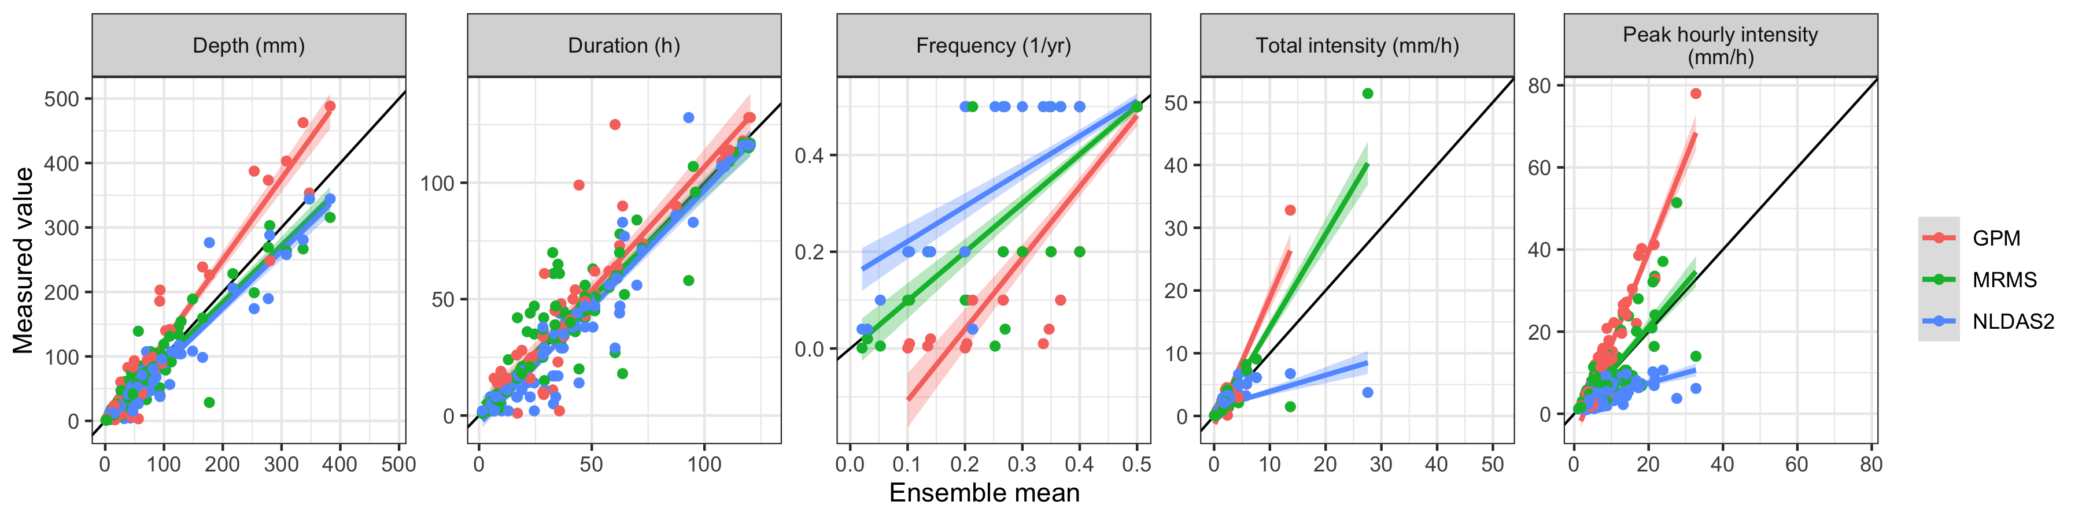
FIGURE 3: Scatter volume, intensity, frequency, and peak intensity for each product against the ensemble mean

Slide 5
TABLE 2: Bias and variability for volume and intensity for each product; for exact locations only; and for matched spatial/temporal/both resolutions
 | All data, original resolution |  | Exact locations only |  | Matching spatial resolution |  | Matching temporal resolution |  | Matching resolution
 | Volume | Intensity | Volume | Intensity | Volume | Intensity | Volume | Intensity | Volume | Intensity
GPM IMERG Early | Bias (Variability)
GPM IMERG Final
NLDAS-2
HRRR
MRMS

Slide 6
FIGURE 4: Precipitation frequency vs. peak intensity for landslide-triggering storm by site by product

Slide 7
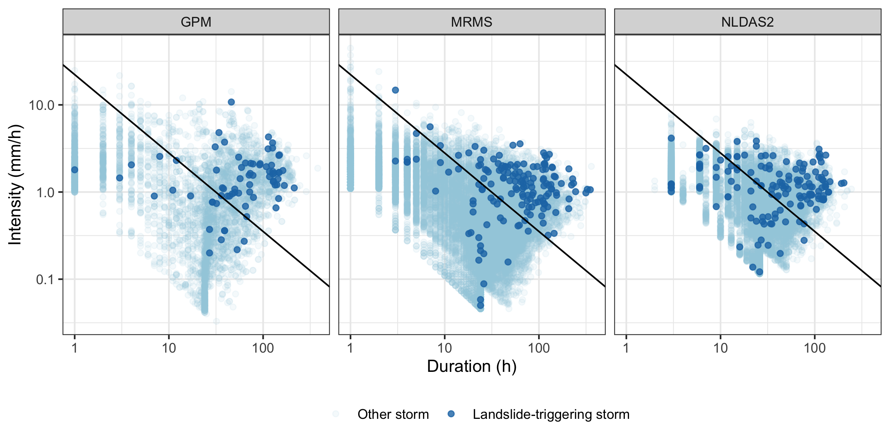
FIGURE 5: Example Intensity-Duration Threshold with multiple precipitation products plotted on top, landslide-triggering events in bold

Slide 8
TABLE 2: True positives, true negatives, false positives, false negatives, and threat score for each product and threshold (For exact locations only and matched resolutions in parentheses)
 | True positives | True negatives | False positives | False negatives | Threat score
GPM IMERG Early | Total (Exact, Matched resolution)
GPM IMERG Final
NLDAS-2
HRRR
MRMS

Slide 9
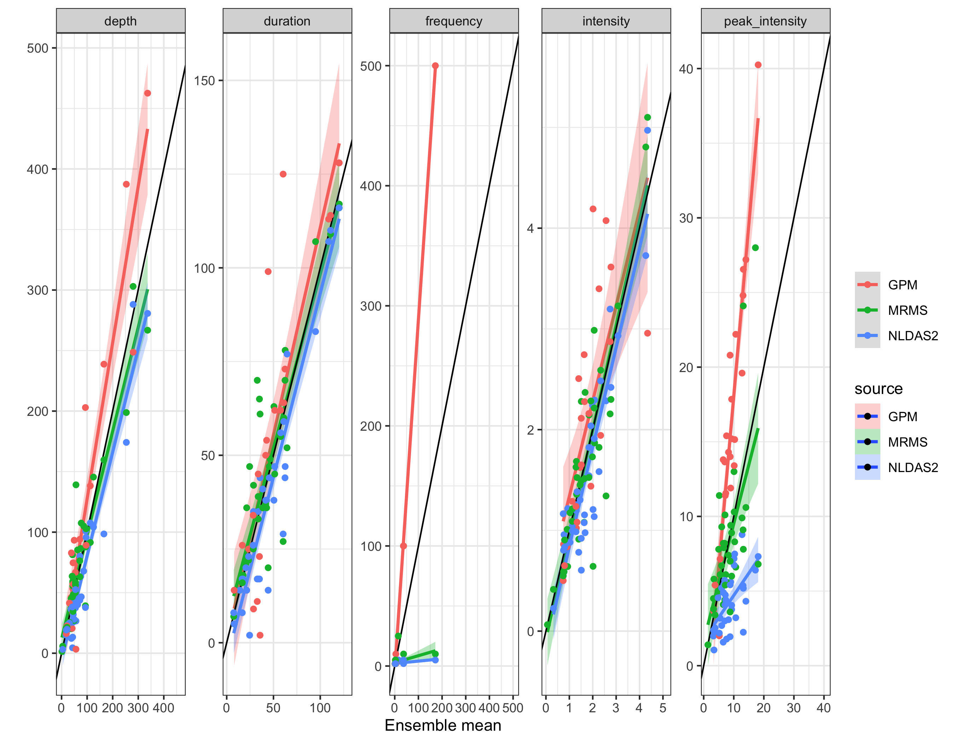
FIGURE 6: Scatter volume, intensity, frequency, and peak intensity for each product for exact locations only

Slide 10
FIGURE 7: Intensity-Duration Threshold example for exact locations only

Slide 11
FIGURE 8: Scatter volume, intensity, frequency, and peak intensity for each product with matched spatial resolution, temporal resolution, and both

Slide 12
FIGURE 9: Intensity-Duration Threshold example for each product with matched spatial resolution, temporal resolution, and both

