Slide 1
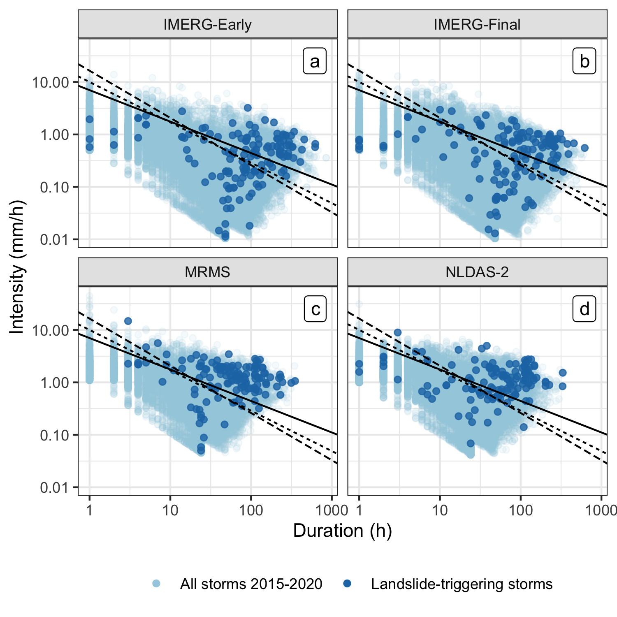
The degree of precipitation uncertainty across multiple precipitation products is evaluated for a large set of landslide-triggering storm events and the impact of these uncertainties on predicted landslide probability investigated using published intensity-duration thresholds.
A Multi-sensor Evaluation of Precipitation Uncertainty for Landslide-triggering Storm Events
Elsa Culler*
Andrew Badger, J.
Toby Minear
Kristy Tiampo
Spencer D. Zeigler
Ben Livneh

