Slide 1
Project proposal
Rui Oliveira and Lars Svensson

Slide 2
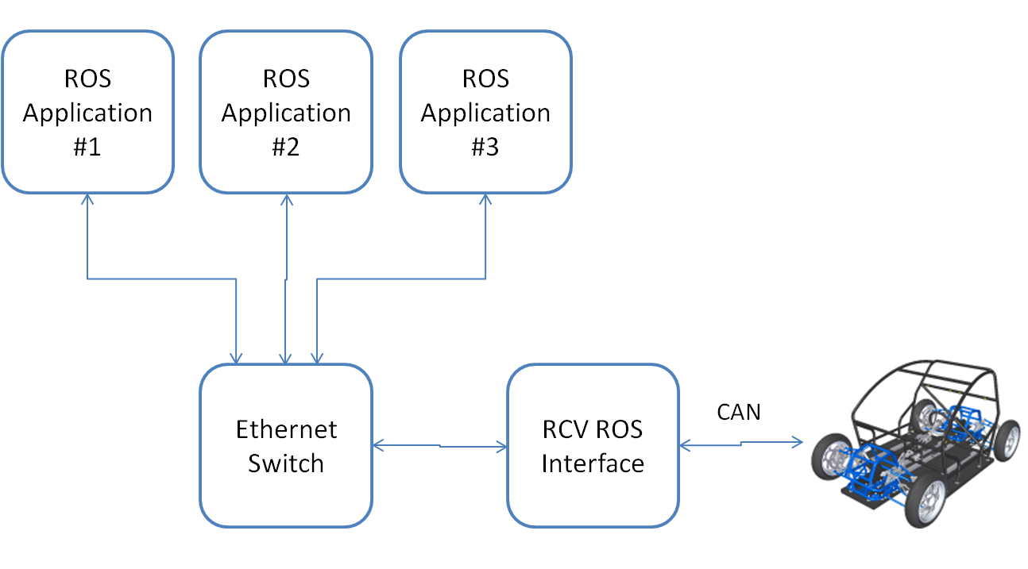
Project: ROS interface for RCV

Slide 3
Objectives
Mandatory:
Path following controller (UTM coordinate system)
Arc length position error
Low level sensor readings interface (all available raw data)
State estimates (Fan Gao’s work)
Optional:
GPS readings interface (longer term plan in global coordinate system)
Lane marking camera interface
Lane keeping controller
Radar interface
Radar safety checking
Odometry
Platform health
Notes:
Send IMU over ROS

