Slide 1
Project proposal
Rui Oliveira and Lars Svensson

Slide 2
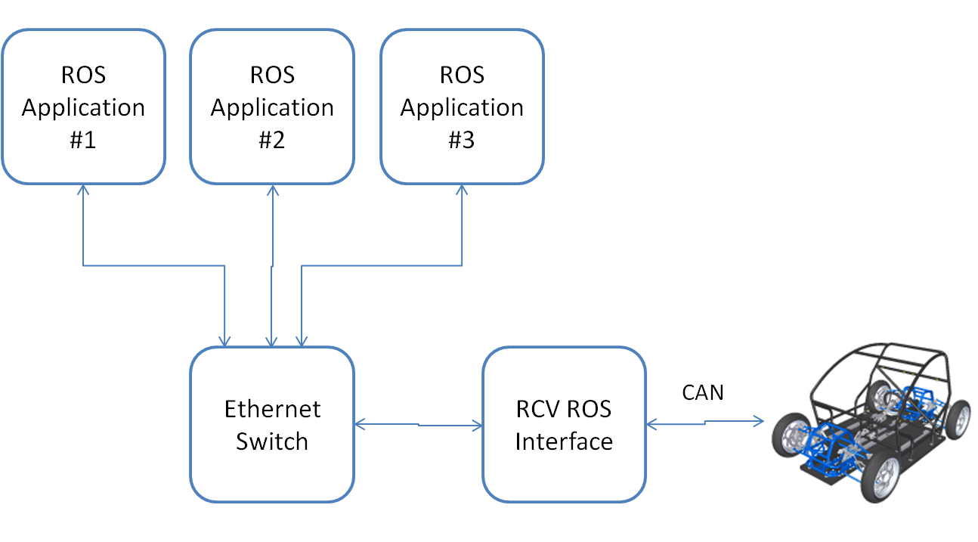
Project: ROS interface for RCV

Slide 3
Objectives
Mandatory:
Path following controller (short term plan in ego vehicle coordinate system)
Low level sensor readings interface (wheel encoders etc.)
Optional:
IMU interface
GPS readings interface (longer term plan in global coordinate system)
Lane marking camera interface
Lane keeping controller
Radar interface
Radar safety checking
Odometry
Platform health

