Slide 1
Hierarchical Risk Parity (HRP) Portfolio Construction
ED CHURCHILL

Slide 2
Contents
IBM Machine Learning Professional Certificate
Objective
Limitations of Minimum-Variance and Risk-Parity
HRP
Investment Strategy
Results
Stability
Cumulative Returns
Volatility
Sharpe Ratio
CVaR
Drawdowns
Conclusion
Next Steps and Questions

Slide 3





IBM Machine Learning Professional Certificate
NOTEBOOKS
• Data Collection
• EDA and Data Cleaning
• Hierarchical Risk Parity Portfolio Construction
• Risk Parity Portfolio Construction
• Minimum Variance Portfolio Construction
• Equal Weight Portfolio Construction
• Results
WRITEUP
Portfolio Construction with Hierarchical Risk Parity: a Comparison to the Minimum-Variance and Risk-Parity Methods

Slide 4
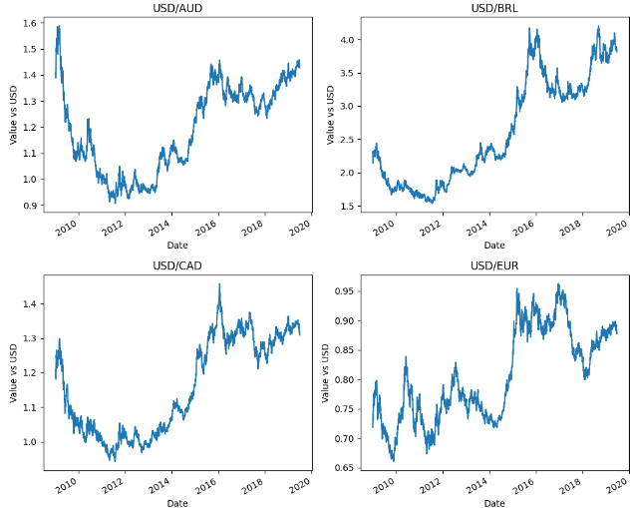
Objective
Use HRP to construct a portfolio and rebalance in a way that allocates risk more effectively (and is more practical to trade) than traditional techniques like Minimum-Variance and Risk-Parity.
Analysis based on 2016 paper by Marcos López de Prado: Building Diversified Portfolios that Outperform Out-of-Sample
HRP uses the unsupervised learning method hierarchical agglomerative clustering.

Slide 5
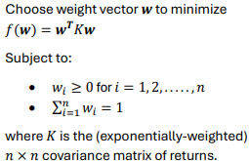
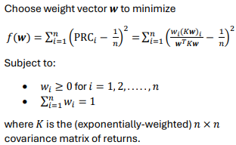
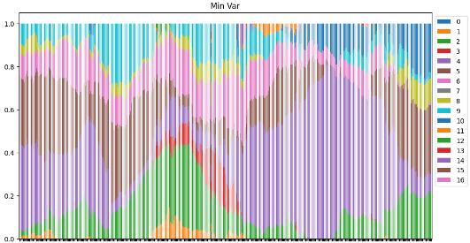
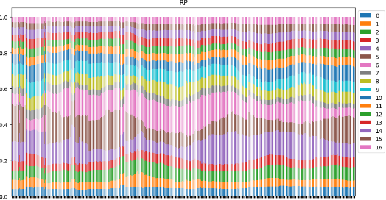
Limitations of Traditional Methods
Minimum-Variance
Risk-Parity
Minimizes portfolio-level variance, which is a measure of volatility and therefore risk.
Small change in covariance matrix (adding more time periods or new security) can lead to a completely different set of weights. Problematic when rebalancing.
Ensure each security contributes equally to portfolio risk.
More stable than Minimum-Variance but can overweight low-risk securities leading to poor diversification if these happen to fall into the same bucket (e.g. asset class, sector, geography)

Slide 6
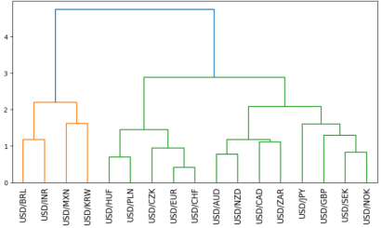
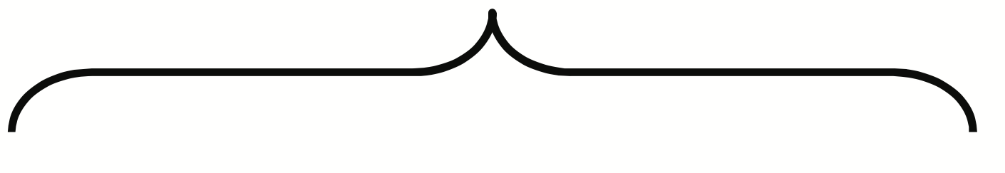

HRP
Uses unsupervised learning technique hierarchical agglomerative clustering to cluster together similar securities (from a correlation perspective).
Assign weights to each security so that there is risk-parity within each cluster.
Leads to better risk allocation across asset classes, sectors and geographies compared to traditional Risk-Parity.
Global EM
Brazil
Indonesia
Mexico
South Korea
European EM
Hungary
Poland
Czech Republic
European
Stable
Euro
Switzerland
Commodity
Exporters
Australia
New Zealand
Canada
South Africa
Global
Stable
Japan
UK
Scandinavia
Sweden
Norway

Slide 7
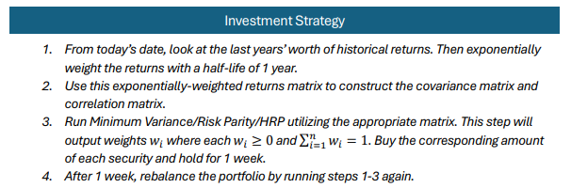
Investment Strategy
Rebalance weekly, using rolling 1-year exponentially-weighted returns

Slide 8

RESULTS
HRP vs risk-parity vs minimum-variance vs equally-weighted

Slide 9
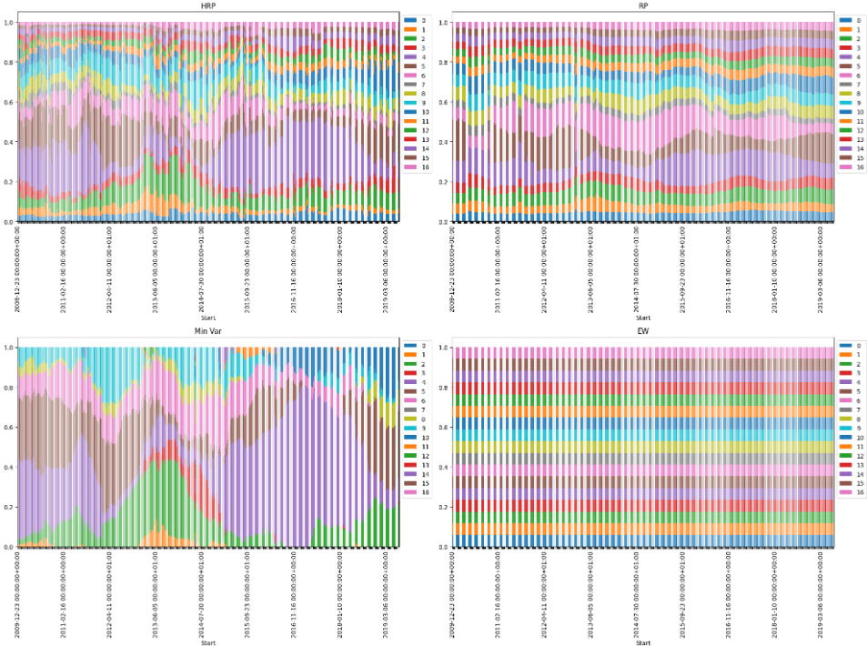
Stability
Minimum-Variance too unstable
Risk-Parity stable but not taking on enough risk to generate returns.
HRP stable and takes on sufficient risk

Slide 10
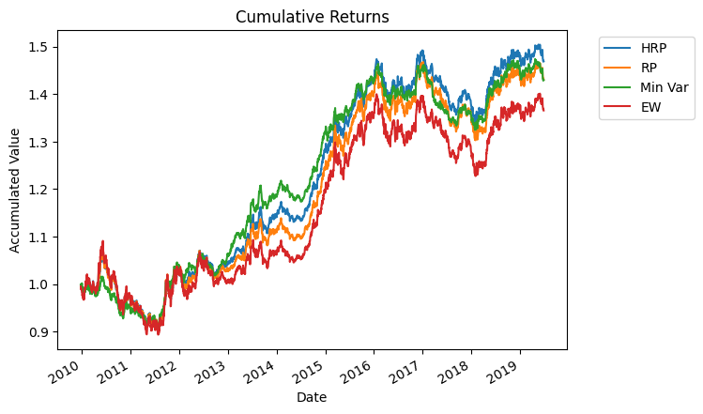
Cumulative Returns
HRP just about outperforms but not yet adjusted for risk
Hard to make the level of returns you’d see with equities with long-only FX.

Slide 11
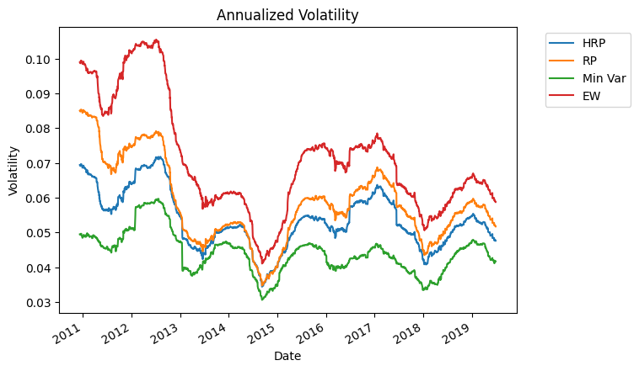
Volatility
Minimum-Variance has the lowest volatility by definition.
HRP has lower volatility than Risk-Parity

Slide 12
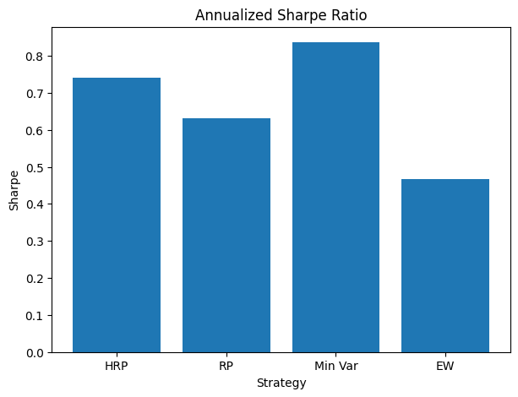
Sharpe Ratio
Minimum-Variance has the best Sharpe ratio due to its low volatility.
HRP has the best Sharpe ratio of the remaining methods.

Slide 13
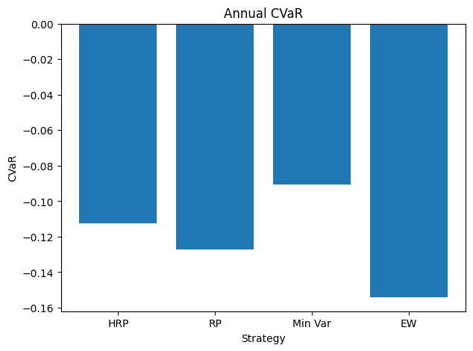
Conditional Value at Risk (CVaR)
With a confidence of 95%, how much can each strategy lose (in percentage terms) in 1 year?
Take the mean of all values in the 5th percentile of historical returns.
Minimum-Variance has best CVaR followed by HRP.

Slide 14
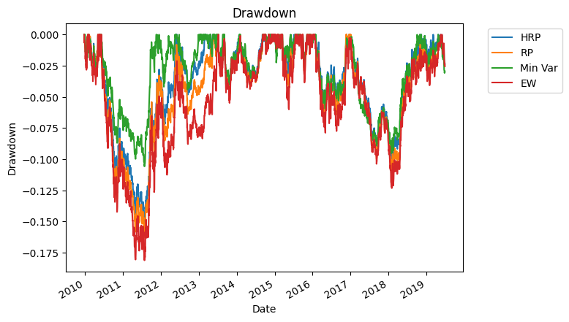
Drawdowns
Percentage that the current cumulative value of a strategy is below its running maximum.
Want drawdowns to be short and small.
Minimum-Variance has the shortest, smallest drawdowns followed by HRP.

Slide 15
Conclusion
Minimum-Variance and HRP performed the best with Minimum-Variance slightly outperforming HRP in most cases.
However, Minimum-Variance is not practical to trade, generating huge transaction costs and concentrated portfolios.
Once stability is considered, HRP outperforms both Minimum-Variance and Risk-Parity.

Slide 16
Next Steps and Questions
Complete ‘Deep Learning and Reinforcement Learning’ project to conclude the course.
Questions?

