Slide 1
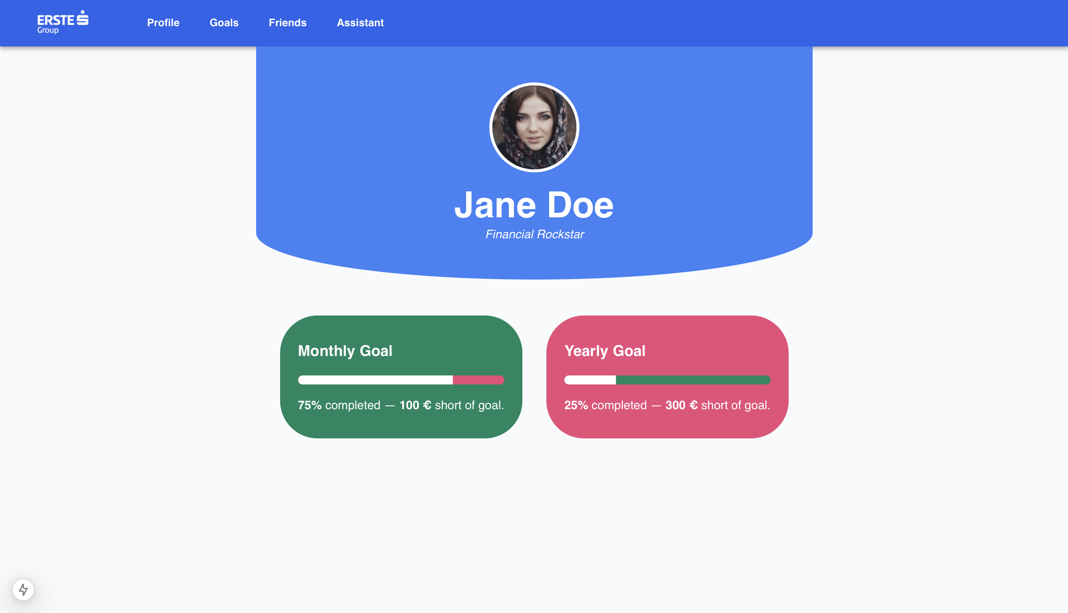
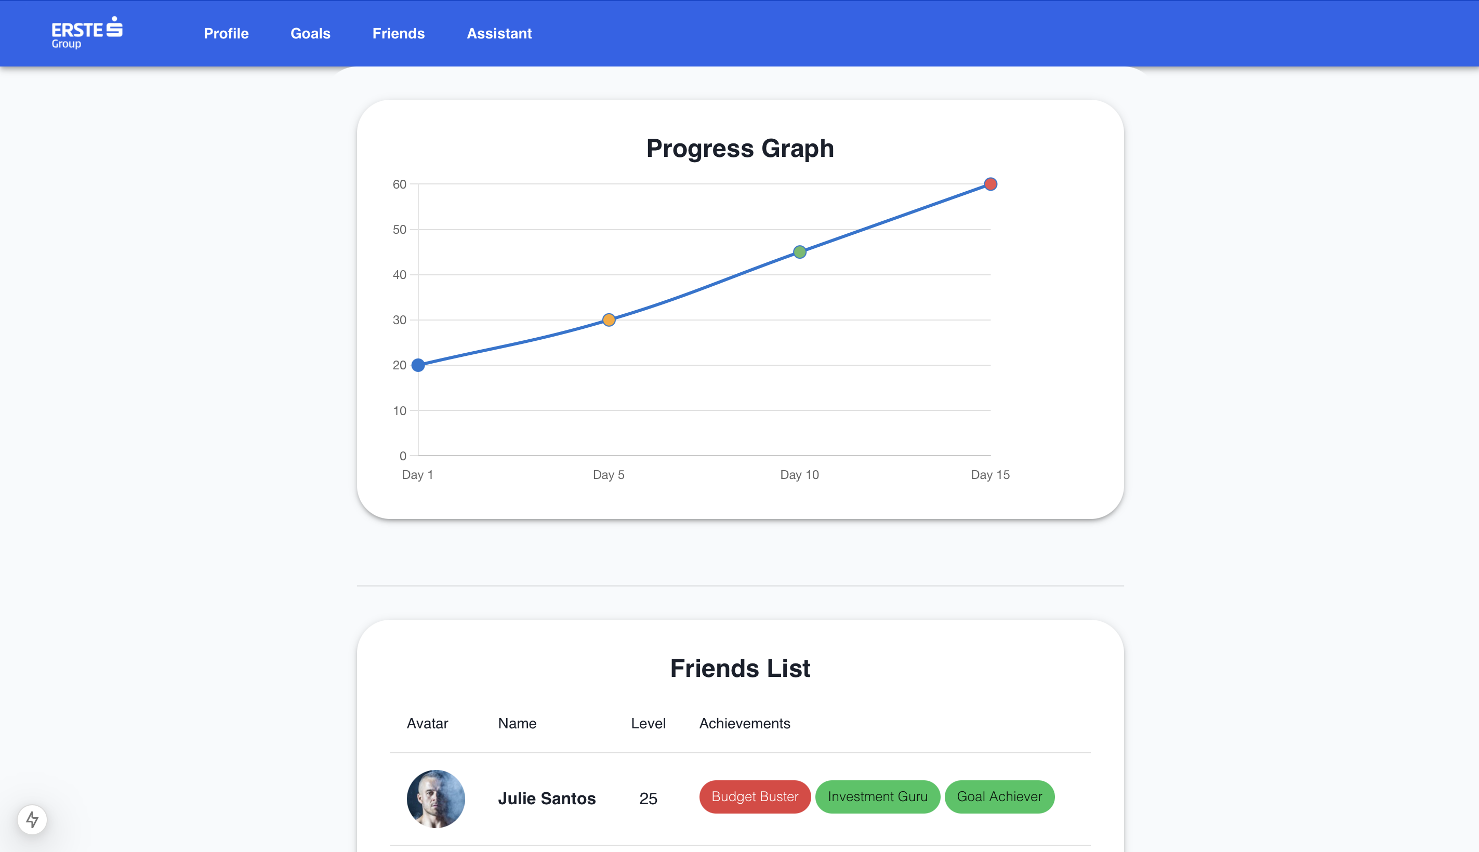
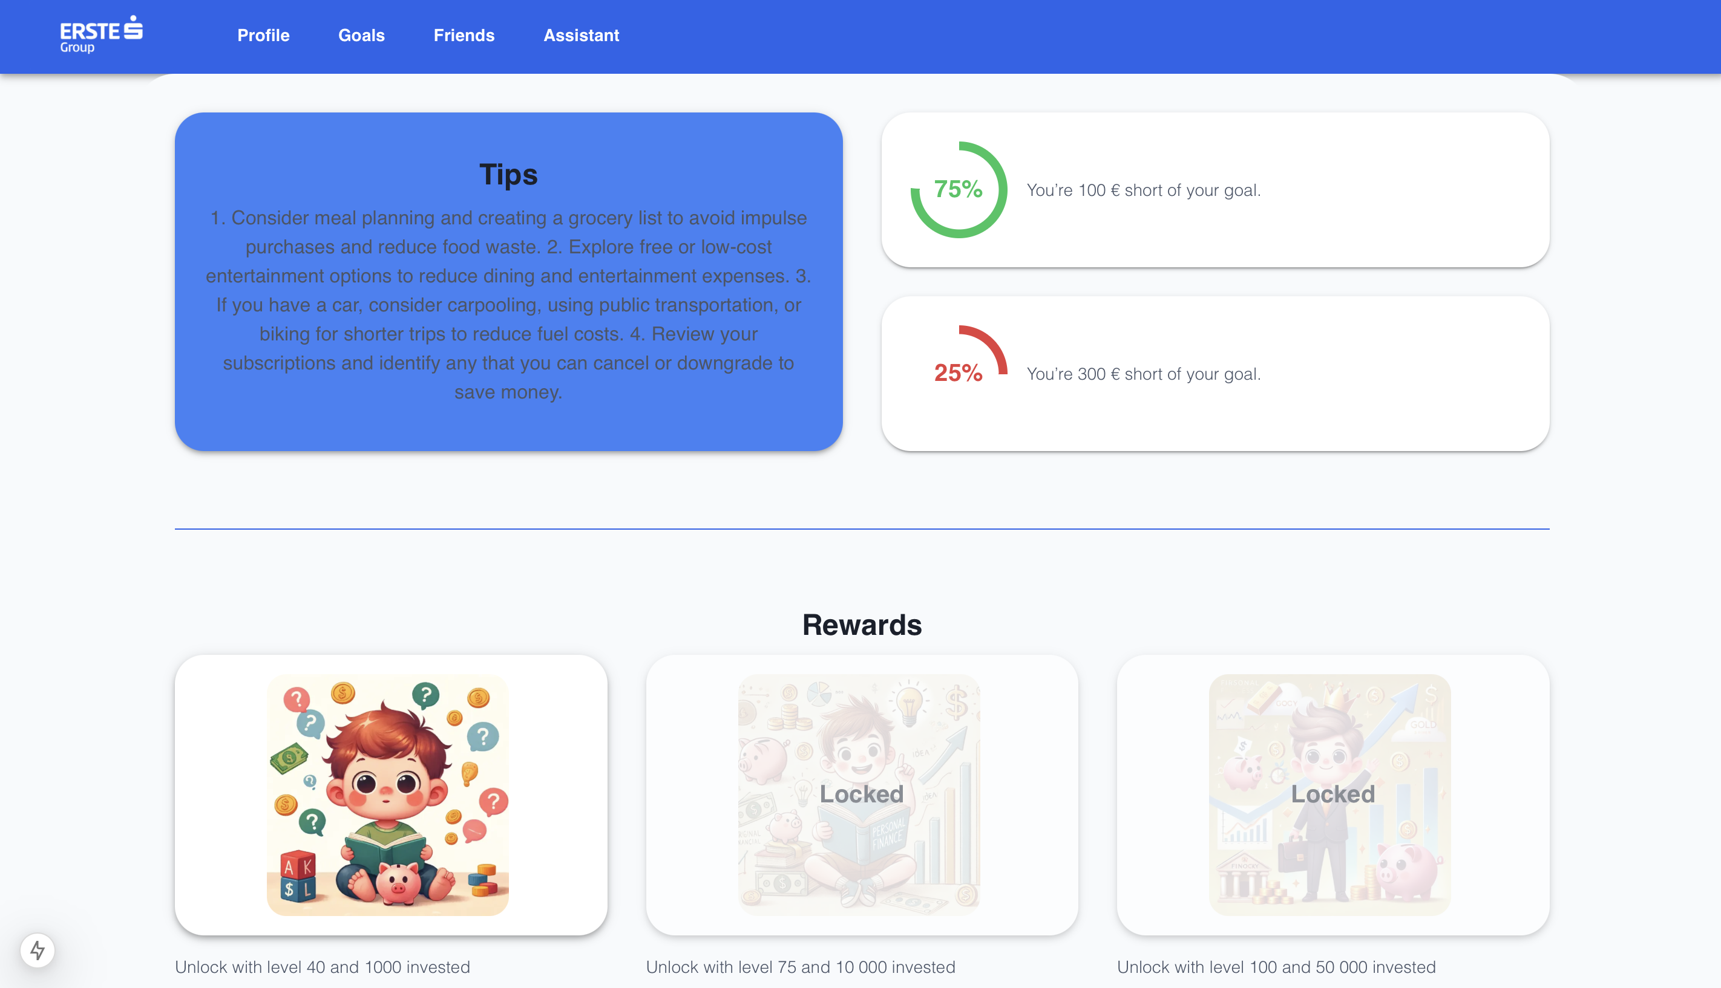
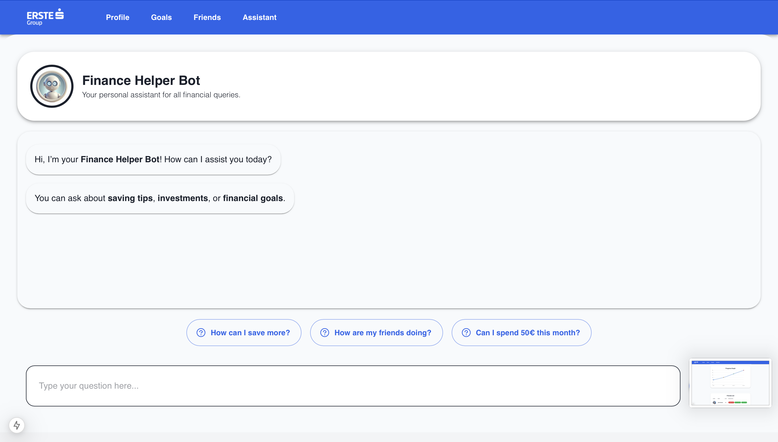
-Simple Dashboard
-Levels
SavErste
-Progress rings
Finance Saver
- Badges

Slide 2
SavErste
Finance Saver
-Simple Dashboard
-Goals

Slide 3
-Simple Dashboard
-Levels
SavErste
-Progress rings
Finance Saver
- Badges

Slide 4
SavErste
Finance Saver
-Personalized tips
-Progress info
-Rewards

Slide 5
SavErste
Finance Saver
-Personalized tips
-Progress info
-Rewards

Slide 6
-Simple Dashboard
-Levels
SavErste
-Progress rings
Finance Saver
- Badges

Slide 7
SavErste
Finance Saver
-Friends progress
-Friends badges
-Friends level

Slide 8
-Simple Dashboard
-Levels
SavErste
-Progress rings
Finance Saver
- Badges

Slide 9
SavErste
Finance Saver
-Personalized communication
-Investment support
-Financial tips

Slide 10
-Simple Dashboard
-Levels
SavErste
-Progress rings
Finance Saver
- Badges

