Slide 1
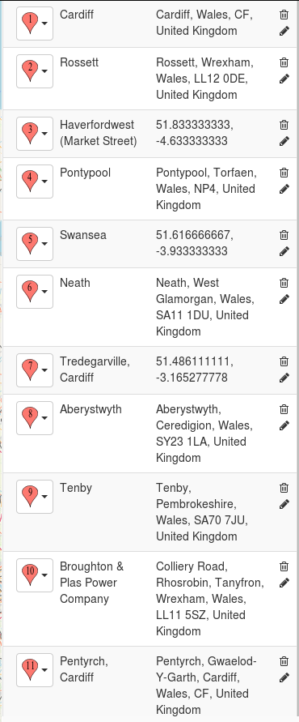
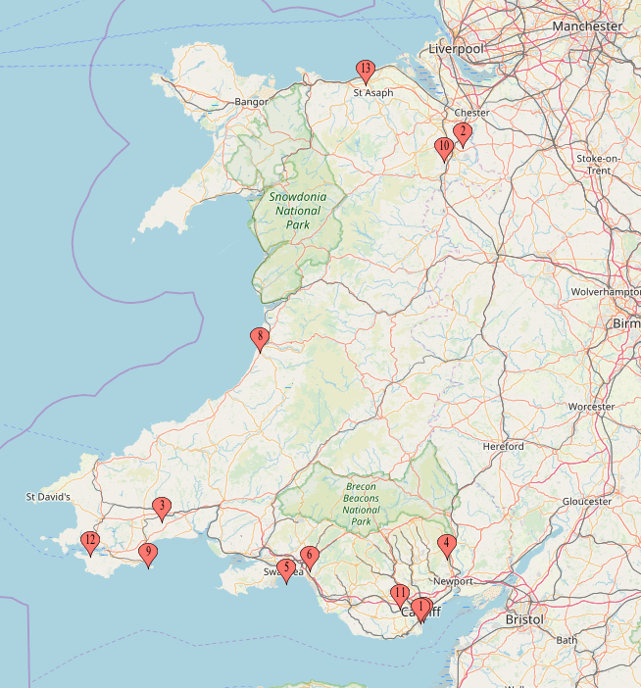
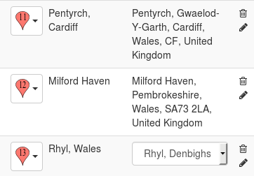
DAILY TO SUB-DAILY DATA IN ONLINE WELSH NEWSPAPERS
1861->
1878->
1891->
1874->
1858->
1837->
1884->
1848->
1822->
1867->

Slide 2
South Wales Daily News 1870-1909
https://newspapers.library.wales/search?range%5Bmin%5D=1804&range%5Bmax%5D=1919&query=%27weather+report%27
Weather Report (Plymouth, Scilly Isles, Bude) 1880->
Meteorological Observations (Cardiff) 1894->
Special Telegrams (Plymouth, Scilly Isles, Bude) 1880->
South Wales Daily Post 1870-1919
Meteorological Report (Swansea) 1910->
Evening Express 1890-1919
https://newspapers.library.wales/search?range%5Bmin%5D=1804&range%5Bmax%5D=1919&alt=&page=1&sort=score&order=desc&rows=12&refine=&query=barometer&publication%5B%5D=Evening+Express
Meteorological Note (Cardiff) 1892->
The Western Mail 1860-1909
https://newspapers.library.wales/search?range%5Bmin%5D=1804&range%5Bmax%5D=1919&alt=&page=1&sort=score&order=desc&rows=12&refine=&query=Meteorological&publication%5B%5D=The+Western+Mail
Meteorological Observations (Cardiff) 1870->
The Cambrian 1800-1919
https://newspapers.library.wales/search?range%5Bmin%5D=1804&range%5Bmax%5D=1919&alt=&page=1&sort=score&order=desc&rows=12&refine=&query=Meteorological&publication%5B%5D=The+Cambrian
Meteorological Table/Meteorological Journal (Swansea/Neath) 1825->
The Cambrian News and Merionethshire Standard 1850-1919
https://newspapers.library.wales/search?range%5Bmin%5D=1804&range%5Bmax%5D=1919&alt=&page=1&sort=score&order=desc&rows=12&refine=&query=Meteorological&publication%5B%5D=The+Aberystwith+Observer&publication%5B%5D=The+Cambrian+News+and+Merionethshire+Standard
Meteorological Register (Aberystwyth) 1874->
The Aberystwyth Observer 1850-1919
https://newspapers.library.wales/search?range%5Bmin%5D=1804&range%5Bmax%5D=1919&alt=&page=1&sort=score&order=desc&rows=12&refine=&query=Meteorological&publication%5B%5D=The+Aberystwith+Observer
Meteorological Register (Aberystwyth) 1874->
Wrexham and Denbighshire Advertiser and Cheshire, Shropshire and North Wales Register 1850-1909
https://newspapers.library.wales/search?range%5Bmin%5D=1804&range%5Bmax%5D=1919&alt=&page=1&sort=score&order=desc&rows=12&refine=&query=Meteorological&publication%5B%5D=Wrexham+and+Denbighshire+Advertiser+and+Cheshire+Shropshire+and+North+Wales+Register
Meteorological Observations (Trevalyn Hall, Rossett) 1861->
Meteorological Table (Broughton & Plas Power Company 53.0603 -3.0478) 1891->
The North Wales Chronicle & Advertiser for the Principality
https://newspapers.library.wales/search?range%5Bmin%5D=1804&range%5Bmax%5D=1919&alt=&page=1&sort=score&order=desc&rows=12&refine=&query=Meteorological+observations+&publication%5B%5D=The+North+Wales+Chronicle+and+Advertiser+for+the+Principality
Meteorological Observations (Aberystwyth) 1914 max & min barometer only
Monmouth Merlin 1820-1889
https://newspapers.library.wales/search?range%5Bmin%5D=1804&range%5Bmax%5D=1919&alt=&page=1&sort=score&order=desc&rows=12&refine=&query=Meteorological+observations+&publication%5B%5D=Monmouthshire+Merlin
Meteorological Register (Pontypool) 1837->
The Cardiff Times 1850-1919
https://newspapers.library.wales/search?range%5Bmin%5D=1804&range%5Bmax%5D=1919&alt=&page=1&sort=score&order=desc&rows=12&refine=&query=Meteorological+observations+&publication%5B%5D=The+Cardiff+Times
Meteorological Report (Tredegarville, Cardiff) 1868->
The Cardiff and Merthyr Guardian Glamorgan Monmouth and Brecon Gazette 1840-1879
https://newspapers.library.wales/search?range%5Bmin%5D=1804&range%5Bmax%5D=1919&alt=&page=1&sort=score&order=desc&rows=12&refine=&query=Meteorological+observations+&publication%5B%5D=The+Cardiff+and+Merthyr+Guardian+Glamorgan+Monmouth+and+Brecon+Gazette
Meteorological Observations (Pentyrch, Cardiff) 1854->
The Pembrokeshire Herald and General Advertiser 1840-1919
https://newspapers.library.wales/search?range%5Bmin%5D=1804&range%5Bmax%5D=1919&alt=&page=1&sort=score&order=desc&rows=12&refine=&query=Meteorological+observations+&publication%5B%5D=The+Pembrokeshire+Herald+and+General+Advertiser&decade%5B%5D=1840
Meteorological Diary (Milford Haven) 1848-
The Weather (Haverfordwest) 1858-
The Tenby Observer Weekly List of Visitors and Directory 1850-1919
https://newspapers.library.wales/search?range%5Bmin%5D=1804&range%5Bmax%5D=1919&alt=&page=1&sort=score&order=desc&rows=12&refine=&query=Meteorological+observations+&publication%5B%5D=The+Tenby+Observer+Weekly+List+of+Visitors+and+Directory
Meteorological Table (Tenby) 1884-
The Rhyl Advertiser 1870-1899
https://newspapers.library.wales/search?range%5Bmin%5D=1804&range%5Bmax%5D=1919&alt=&page=1&sort=score&order=desc&rows=12&refine=&query=Meteorological&publication%5B%5D=The+Rhyl+Advertiser&decade%5B%5D=1870
Meteorological Observations (Rhyl) 1878->

