Slide 1
Private birth date match
Find people with the same birth date as you

Slide 2
1992-05-21
John
1992-05-21
John
1992-05-21
John
1992-05-21
John
1992-05-21
John
1993-06-15
Clara
1992-05-21
John
1998-11-19
Alex
1992-05-21
John
1993-06-15
James
1992-05-21
John
1992-05-21
Alice
Input

Slide 3
1992-05-21
John
1992-05-21
John
1992-05-21
John
1992-05-21
John
1992-05-21
John
1993-06-15
Clara
1992-05-21
John
1998-11-19
Alex
1992-05-21
John
1993-06-15
James
1992-05-21
John
1992-05-21
Alice
Input
Output
Alice
James
:(
Clara
John

Slide 4
NxN 2-party FHE
 | John | Clara | Alex | James | Alice
John |  | X | X | X | X
Clara |  |  | X | X | X
Alex |  |  |  | X | X
James |  |  |  |  | X
Alice

Slide 5

Date A
Date B
Info A
Info B
0
1
...
15
0
1
...
15
...
AND
AND
OR
OR
...
Not match
OR
Match
NOT
Masked info A
Masked info B

Slide 6
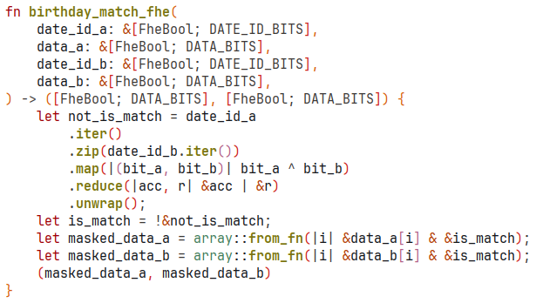
Circuit code

Slide 7
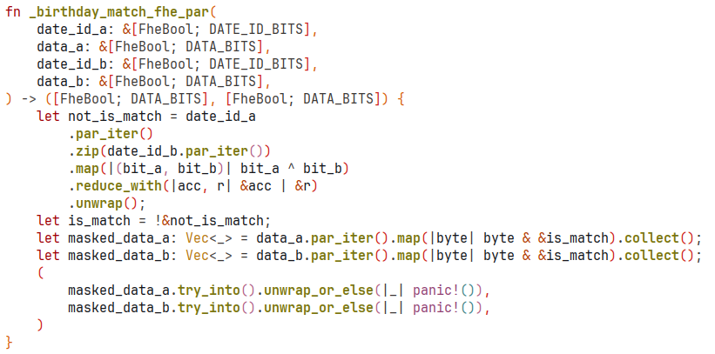
Parallel Circuit code (with rayon’s ParallelIterator)

Slide 8
Benchmarks
On my laptop:
Clients server key share gen time: 1.858942684s
Server key gen time: 40.147093803s
Server cyphertext extract time: 340.136156ms
Birthday match FHE evaluation time:
(serial) 19.285879095s
(parallel) 6.844518074s
Clients decryption share gen time: 19.461518ms
Client decrypt time: 9.832µs

