Slide 1
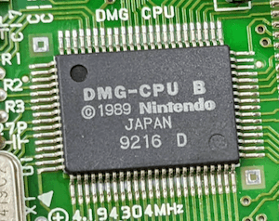
Review of RISCV (and other) zkVMs
by Eduard Sanou from PSE (EF)

Slide 2
Overview
RISCV intro
What is a zkVM
  A note on privacy
Comparison Overview
  Types of zkVM
Architecture
  Let’s take a look
  Continuations
  Coprocesor
Benchmarks

Slide 3
RISCV intro
Open CPU architecture following the Reduced Instruction Set Computer paradigm
  Simpler than ARM64
32 bit and 64 bit flavors
Multiple standard extensions
  I: Base Integer ISA
  M: Integer Multiplication & Division
  A: Atomic
  C: Compressed
  F: Floating Point
Support from major compilers: gcc LLVM (Rust, clang, …), golang
.section .text
.global strlen
strlen:
# a0 = const char *str
li t0, 0 # i = 0
1: # Start of for loop
add t1, t0, a0 # Add the byte offset for str[i]
lb t1, 0(t1) # Dereference str[i]
beqz t1, 1f # if str[i] == 0, break for loop
addi t0, t0, 1 # Add 1 to our iterator
j 1b # Jump back to condition (1 backwards)
1: # End of for loop
mv a0, t0 # Move t0 into a0 to return
ret # Return back via the return address register

Slide 4
What is a zkVM
VM: Machine that behaves like a computer. Can do arithmetic ops, bitwise ops, branching, read/write memory, etc.
zkVM: a system that can generate zk proofs of correct execution under a VM.
  Execution trace: chronological list of instructions (with input-output) that are executed when running a VM program.
  A zkVM requires: a circuit that verifies the correctness of an execution trace of the VM.
    Realized by repeating the following verifying logic on each trace step:
      Fetch, Decode?, Execute, Memory I/O
Notes:
- VM:
- CPU state: registers, stack…
- RAM
- Program
- Instructions from program update the state and RAM
- VM can be a hardware ISA (RISCV, MIPS), VM (WASM) or new zk friendly ISA.
- Why a RISCV zkVM is very interesting?
- No need to write circuits to develop a zkApp
- Just write Rust and use existing libraries
- Great for dynamic programs (with branching)

Slide 5
A note on privacy
Is there really zk in these zkVMs?
No privacy in most of the zkVM projects, so the term zk can be misleading: there's no zero knowledge.
Usually the goal is succintness (the "S" from SNARK).
“Verifiable computing (colloquially mis-termed ZK) is an incredibly powerful technology” [1]
[1] https://a16zcrypto.com/posts/article/building-jolt/

Slide 6
Comparison Overview
Project | ISA | Arithmetization | circuit framework | Proof System | Field
RiscZero | RV32IM | AIR+Plonkish | zirgen [10] | STARK | BabyBear
SP1 | RV32IM | AIR | Plonky3 | STARK | BabyBear
Powdr | RV32IMAC [1] | Plonkish [5] | custom | pluggable [6] | pluggable [7]
Jolt | RV32I | R1CS+lookups | custom | Spartan + Lasso | BN254 scalar
zkm | MIPS32 | AIR | Plonky2 | STARK | Goldilocks
o1VM | MIPS32 | Plonkish | Kimchi | Kimchi (PLONK) | BN254 scalar
zkWASM | WASM | Plonkish | halo2 | halo2 | BN254 scalar
Nexus zkVM | NexusVM [3][4] | R1CS | custom | (Hyper)Nova | 255 bits [9]
CairoVM | Cairo | AIR | custom | STARK | felt252
Valida | Valida [2] | AIR | Plonky3 | STARK | 31 bits [8]
Triton VM | Triton [11] | AIR+AET | custom | STARK | Oxfoi [12]
[1] https://github.com/powdr-labs/powdr/blob/3f771638467a8bd527805239ac614dd56e65f11c/riscv/tests/instruction_tests/README.md
[2] https://github.com/valida-xyz/valida/blob/898d5ce0581095eabdb5c7219f222cb17cdd46a9/opcodes/src/lib.rs
[3] https://docs.nexus.xyz/Specs/nexus-vm#nexus-virtual-machine-instruction-set
[4] https://github.com/nexus-xyz/nexus-zkvm/blob/a3a2b156b90276fc456a58f15fd46b638d2ca010/vm/src/instructions.rs#L22
[5] Powdr uses a PIL-like language, which allows extesions to Air making it Plonkish
[6] Currently implemented: halo2, eSTARK. Work in progresss: SuperNova.
[7] Goldilocks (63 bits) with eSTARK backend, 255+ bit fields with halo2 backend (for example: BN254 scalar field).
[8] Both BabyBear and Mersenne31 are 31 bit fields.
[9] Uses the BN254 and Grumpkin curve cycle
[10] zirgen is closed source. This tool allows compilation of circuits from a high level description; the output generated for RiscZero is public.
[11] https://triton-vm.org/spec/instructions.html
[12] Oxfoi is a 64 bit prime https://triton-vm.org/spec/isa.html#oxfoi
Notes:
- 11 entries! Maybe I’m missing some! In 2023 and 2024 this has exploded.
- RiscZero is the more mature RISCV project, with the initial release in April 2022
- Developed most of the Rust toolchain support that other projects are using
- Powdr is a framework to create zkVMs rather than a zkVM. Reimplements the PIL language and generalizes the zk-asm from Polygon zkEVM
- Jolt brings a novel lookup argument based on the sumcheck that promises excellent performance
- Valida, Triton VM and Cairo VM are different than the rest because they can’t be programmed in regular languages
- Nexus zkVM targets it’s own ISA but facilitates translation from RISCV to that ISA
- zkm and zkWASM picked different ISAs but are conceptually similar to RISCV zkVMs

Slide 7
Types of zkVM
Vitalik defined a classification for zkEVMs [1]. This is my proposal for zkVMs.
Type 1: Follows the full spec of an existing hardware ISA (RISCV, MIPS, etc).
  Includes instruction decoding after fetching from memory.
Type 2: Encodes instructions in a custom format.
  Decoding to custom format done during compilation
  Can’t write to memory and execute it (no JIT / AOT compilation)
Type 2.5: Requires some changes on emitted instructions
  Either via transformation in the decoding step or by patching the compiler.
Type 3: Targets custom ISA (potentially zk friendly) but can be connected to existing compiler framework
  Example: implements an LLVM backend for the custom ISA
Type 4: Targets custom zk friendly ISA and requires custom high level language
[1] https://vitalik.eth.limo/general/2022/08/04/zkevm.html
Note 1: Vitalik’s categories distinguish matching gas cost. We could translate that to CPU cycles, but the RISCV ISA doesn’t specify the cycles per instruction (that’s implementation dependent).
Notes:
- Increment of .5 in Type 2.5 is because the change may not be very meaningful: decoding already gives opportunity to change instructions. Even real CPUs can use microarchitecture where several microinstructions simulate an instruction.
- Type 2.5 vs 2 can mean different more steps for some instructions, which can be seen as cycles. But for example RISCV doesn’t specify cycles per instruction.

Slide 8
Types of zkVM
Follow existing hardware ISA
Skip ISA instruction decoding
Requires changes in emitted instructions
Custom ISA with existing compiler
Custom ISA with custom language
1
2
Compatibility
2.5
zkWASM
3
Jolt
RiscZero
4
Nexus zkVM
Valida
SP1
Powdr
Zkm
o1VM
CairoVM
Triton VM
Performance? [1]
[1] Justin Thaler argues that a zk friendly ISA doesn’t bring better performance https://a16zcrypto.com/posts/article/faqs-on-jolts-initial-implementation/#section--8

Slide 9
Architecture
Main blocks:
  CPU: “Loop” logic that performs Fetch, Decode?, Execute, Memory I/O
    Execute sometimes delegated to other blocks
  Memory: Verify RAM read/write consistency
Extras:
  “std”: heap, stdin, stdout, threads, time, file system, ...
  Continuations
  Coprocessors
Notes:
- Commonly the design involves verifying one instruction per row / step.
- This is very different than hardware, where each instruction takes different number of cycles.

Slide 10
Architecture example: SP1
addSub
joint
lookup
cpu
Each chip defined with AIR constraints
Chips do IO via joint lookup argument
Cpu [1] is the entry point. AIR constraints verify 1 step per row:
  Fetch instruction from program
  Prepare instruction arguments
    Maybe read from memory
  Apply instruction
    Possibly via lookup to another chip
  Update Cpu state (registers, pc, timestamps, clk)
  Maybe write result to memory
bitwise
program
divRem
mul
memory
shiftL
byteLookup
shiftR
lt
precompiles
[1] https://github.com/succinctlabs/sp1/blob/5db203c55647c30618431822d33f419614f9fab6/core/src/cpu/air/mod.rs#L32

Slide 11
Architecture example: Jolt [1]
Built with Lasso lookups
Each RISCV instruction is defined with a decomposable lookup:
  Decompose arguments into bit chunks
  Use chunks for indexed lookups to small subtables
    Tables need to be MLE [3]
  Combine lookups results
Merge all lookups, leading to a single decomposable lookup per instruction.
  Merge all subtables into one
  Merge all combine expressions into one
Use R1CS for glue and some instructions
AND
AND
a
b
result
index
tag
idx
value
EQ8
x
y
x == y
OR8
x
y
x ^ y
AND8
x
y
x & y
LTU8
x
y
x < y
RANGE8
x
0
x
[1] https://people.cs.georgetown.edu/jthaler/Jolt-paper.pdf
[2] https://people.cs.georgetown.edu/jthaler/Lasso-paper.pdf
[3] Table must be the evaluation of a Multi Linear Expression: an expression that takes n bits and can be evaluated in O(n)

Slide 12
Continuations
Long computation may not be feasible in a single proof
  High memory requirements
  Proof system limitations
Split the computation trace into chunks and generate a proof for each one
  Possibly aggregating the proofs later for constant final proof size
  Requires connecting the execution context between continuations
Supported by: RiscZero, zkm, zkWASM, SP1, Powdr, zkWASM, Triton VM, Nexus (via folding) [1]
[1] Probably all zkVMs will end up supporting continuations

Slide 13
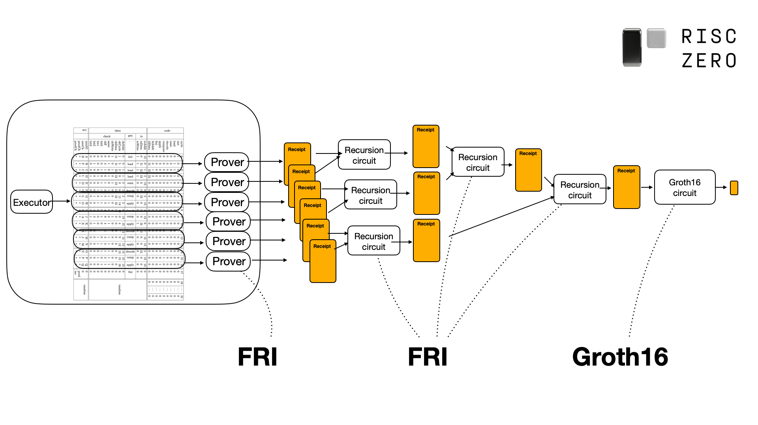
Continuations example: RiscZero
Split execution trace into segments of equal number of cycles (steps)
Between segments, memory is passed via a Merkle Tree in pages
Inside segment:
  Beginnig: used pages are “decommited” from MT
  During: memory ops are verified via permutation check + sorted table [2]
  End: used pages are “commited” to MT
Each segment is proved independently (STARK w/ RISC-V Circuit)
All segment proofs are aggregated recursively (STARK w/ Recursion Circuit)
Recursion proof can be verified via Groth16 for on-chain verification (Groth16 w/ Groth16 Circuit)
[1]
[1] https://dev.risczero.com/proof-system/
[2] “sorting paradigm” in https://eprint.iacr.org/2023/1555.pdf

Slide 14
Coprocessor
Also called “precompiles”
Some programs can take a lot of steps when broken down to RISCV instructions
  Can we accelerate the bottlenecks with custom circuits?
Examples:
  Cryptographic operations that require emulated fields (EC signatures, pairings, etc.)
  Hashing (Keccak, Sha256, Poseidon, etc.)
Supported by [1]: SP1, Nexus, Powdr,
[1] Probably all zkVMs will end up supporting coprocessors

Slide 15
Coprocessor example: SP1 [1]
ISA level: accessed via system calls
Circuit level: implemented with new AIR that shares memory with main VM. Accessed via lookup [2] with IO table.
Example for sha256 compress [3]:
  Cpu chip:
    Lookup with input word memory pointer, sha256 state memory pointer.
    Bumps memory timestamp by the number of memory ops the sha256 compress will do.
  Sha256Compress chip: receives lookup and performs sha256 compression:
    absorb word (read at input word memory pointer)
    do hash operations
    update state (read + write at sha256 state memory pointer)
CPU
Memory
IO
Sha256Compress
[1] https://succinctlabs.github.io/sp1/writing-programs/precompiles.html
[2] Technically it’s a permutation check
[3] https://github.com/succinctlabs/sp1/blob/5db203c55647c30618431822d33f419614f9fab6/core/src/syscall/precompiles/sha256/compress/air.rs#L27

Slide 16
Benchmarks
WARNING: Benchmarking is tricky because there are many subtleties:
  CPU vs GPU implementations
  Better/worse parallelism
  Some zkVMs support continuations and other don’t
  Some zkVMs support recursion and others don’t
  Each zkVM may be in a different stage of optimization

Slide 17
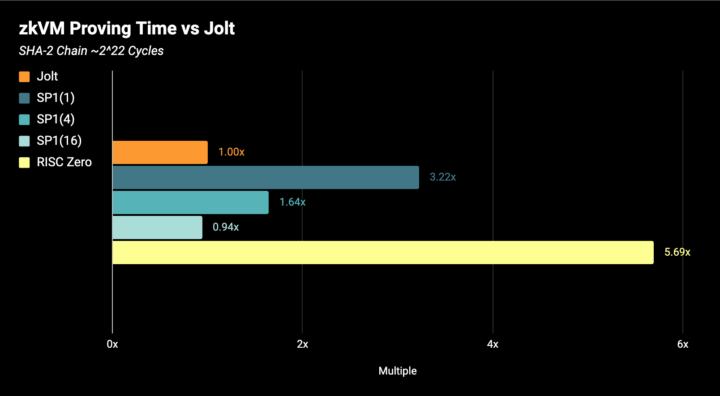
(Partial) Benchmarks
Note: Value in parenthesis is number of shards
Results from https://a16zcrypto.com/posts/article/building-jolt/ at 2024-04-09 obtained via https://github.com/a16z/zkvm-benchmarks

Slide 18
Benchmarks
Jolt can prove 100k instr/sec.
  “[…] over twice the on-board computing power of the Apollo 11 mission.”
  About 30x slower than a TI-84 graphing calculator.
Quote and numbers from Jolt authors at https://a16zcrypto.com/posts/article/building-jolt/ based on benchmarks run on an Apple M3 Max
[1] Jolt article says “150x slower”. But TI-84 uses a z80 @ 15Mhz; and in z80 each instruction takes 4+ cycles.

Slide 19


Questions?

