Slide 1
Increasing Lariat Profits
Edward Williams

Slide 2
Introduction
Lariat had a good year and managed to stay in the black and make profits.
It was a strong year with over eighty-thousand rentals!

Slide 3
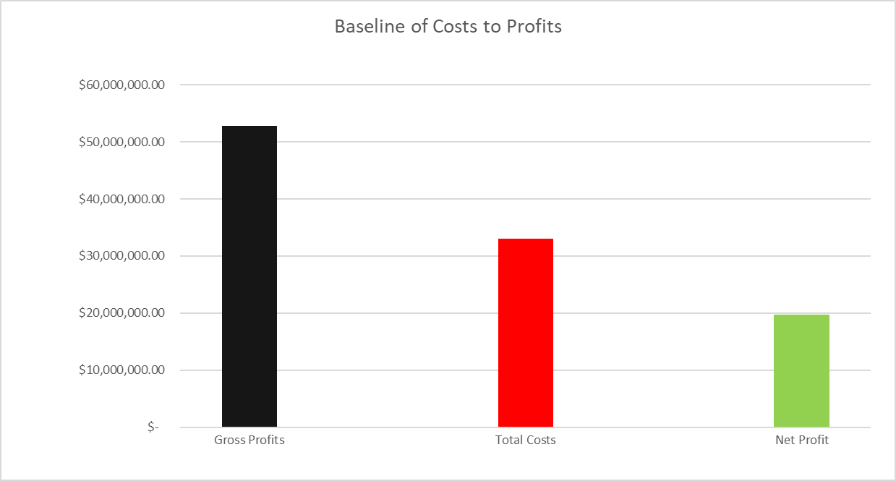
Introduction cont.
Company wants to make higher profits
The Graph below shows the current net profit of just below 20M
Baseline Profit of 19M

Slide 4
Exploring Strategies
Considering an even higher profit is wanted,
The following three strategies will be explored:
Increasing the average Price Per Day (PPD) of cars by a percentage
Increasing the average ratio between the monthly cost of a car and its profits (PPD to Cost ratio)
Increasing the average rental period of cars

Slide 5
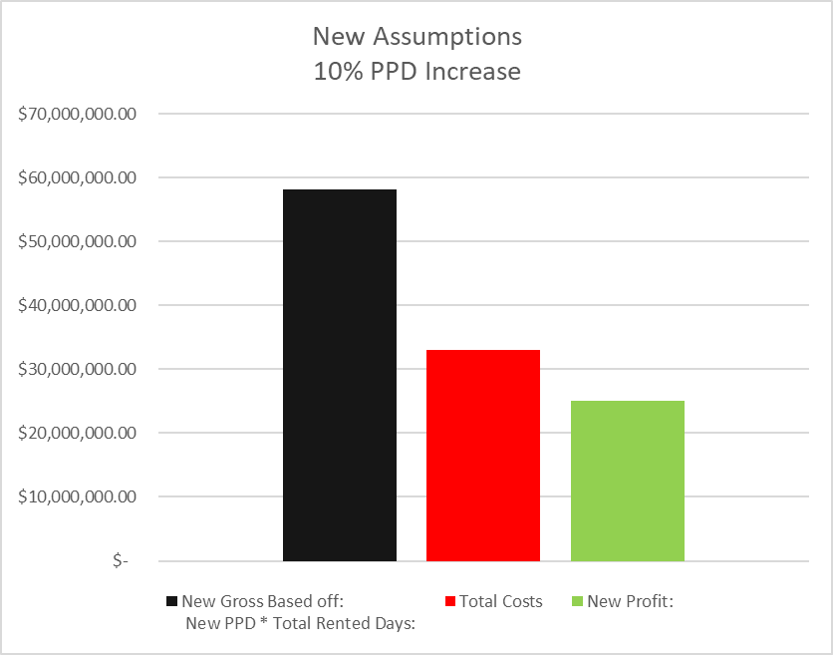
Strategy 1
Increase the Average Price for the Day
The Established Average is: $168
With a 10% average price increase,
profits can go above 25M!

Slide 6
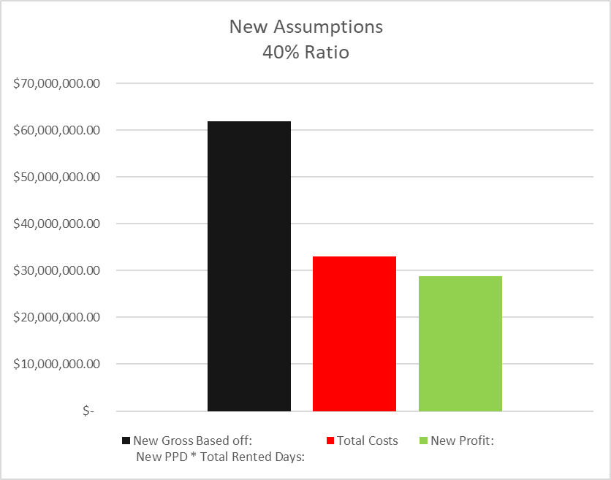
Strategy 2
Use more cars that have a better PPD to monthly cost ratio
Ex. A car with a 50% ratio can pay off its entire monthly costs in a two-day rental period
Note: This strategy requires no changes to pricing or changes in total rentals, it simply aims to focus more on the best cars the company already has!

Slide 7
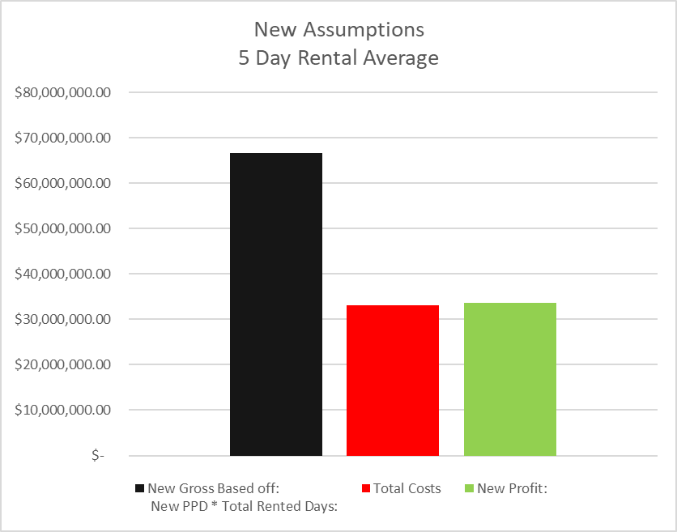
Strategy 3
Increase the minimum rental period
Average rental period was 4 day, the graph show an increase to 5.
New Profit is a whopping 33M vs Original 19M, and sees profits outweighing costs!

Slide 8
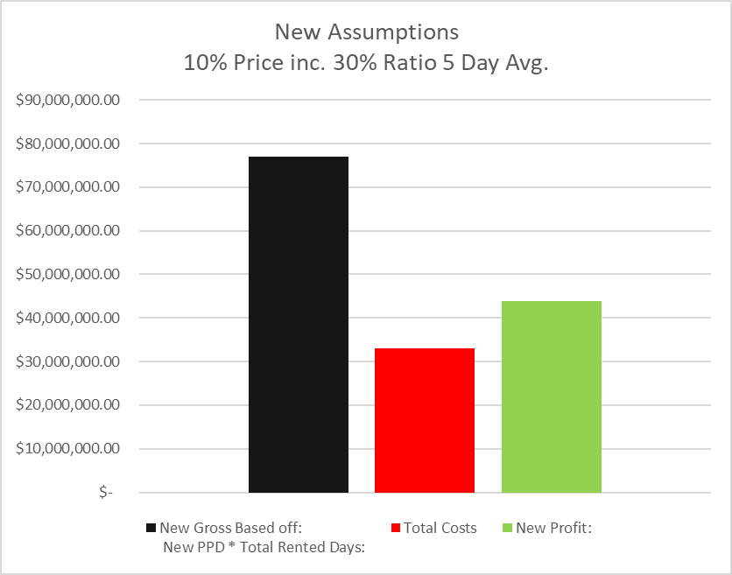
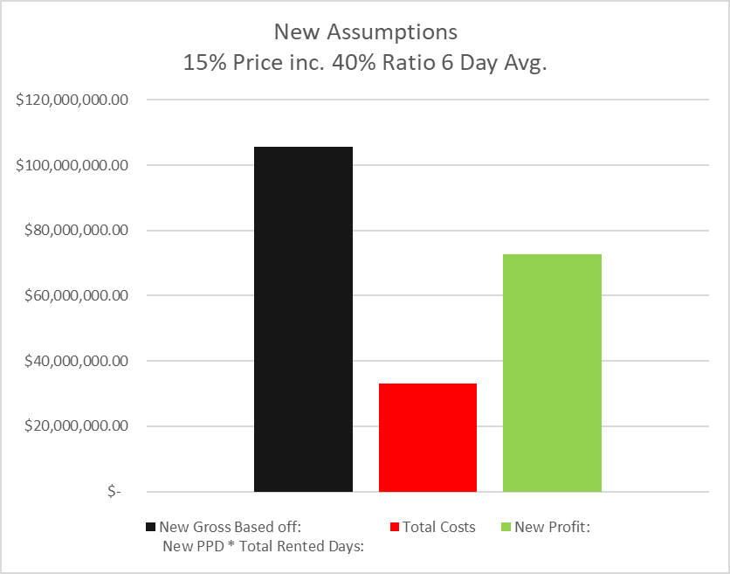
Simulated Projection (Combining all Three)
Modest: (42M Profit) Aggressive: (72M Profit, a 3.7x increase!!)

Slide 9
Side Note 1
Airports, do they make a difference?
Short Answer: No.
Non-Airport locations received more rentals (left chart) and slightly higher gross as well (right chart) but nothing that would signify changing just one and not the other

Slide 10
Side Note 2
The best and worst performing cars
Top 10 cars with highest profit all were above a 40% ratio
Worst 10 had 13% or less
Note the 4/5 of the highest ratio cars were also the most profitable!

Slide 11
Conclusion
While the rental length strategy will increase the profit most, the easiest strategy to implement would be the ratio strategy.
Cars that have sub-par ratios could simply be retired, or even sold for money, and Lariat would see profits increase even without changing other prices or minimum rental periods
However, the ratio strategy in tandem with even just a one day increase in rental periods, profits could easily triple.

