Slide 1
Take-home assignment
By Eric Duncan

Slide 2

Introduction
I am Eric Duncan; I am a recent graduate from Mississippi State University
For this take-home assignment, I decided to create an event planner
The event planner has capabilities of creating, sharing, and deleting events

Slide 3
Tech Stack Overview
Frontend: React.js
Used Vite.js for hot-reloading and dev server capabilities
Mapbox API was used to autofill location information
Backend: Django
Used Django REST framework for REST API endpoints
Deployment: AWS
Frontend: AWS S3
Backend: AWS EC2
Database: AWS RDS

Slide 4
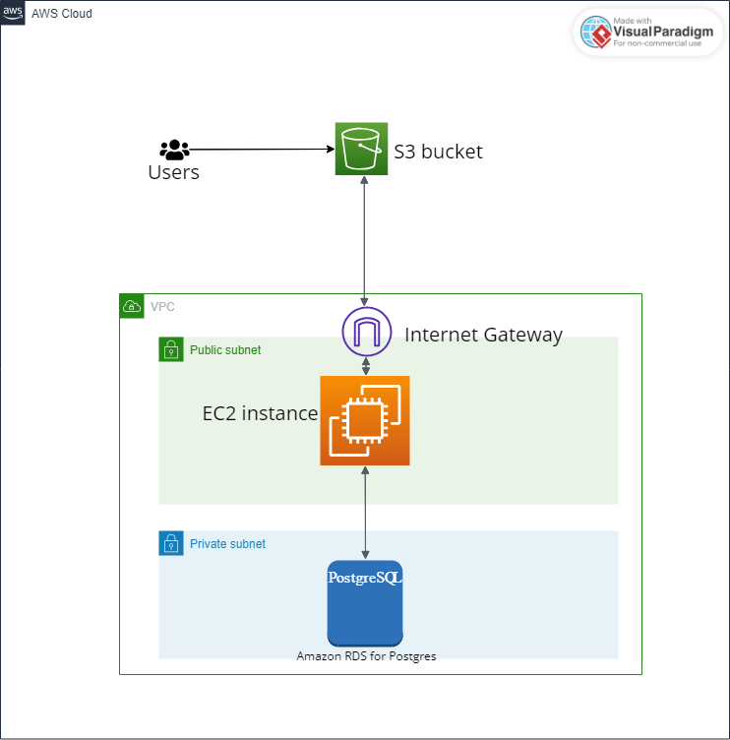
Architecture Overview

Slide 5
Deployment Process to AWS
Frontend Development
Built the React app
Deployed static files to AWS S3 bucket
Configured the bucket for public access
Turned on “Static website hosting”
Backend Development
Deployed Django application on an AWS EC2 instance
Configured security group for EC2 to allow connections on port 8000
Connected Django application to the database

Slide 6
Features and Functionality
Event Creation
Users can create events with details like name, description, location, category, and visibility (public/private)
Event Discovery
Users can search for public events based on various criteria
Following users
Users can follow other users to see their events in a personalized “following” tab.

Slide 7

Live Demo
The website is available at http://event-planner-web-app.s3-website-us-west-2.amazonaws.com

Slide 8

Screenshots

Slide 9
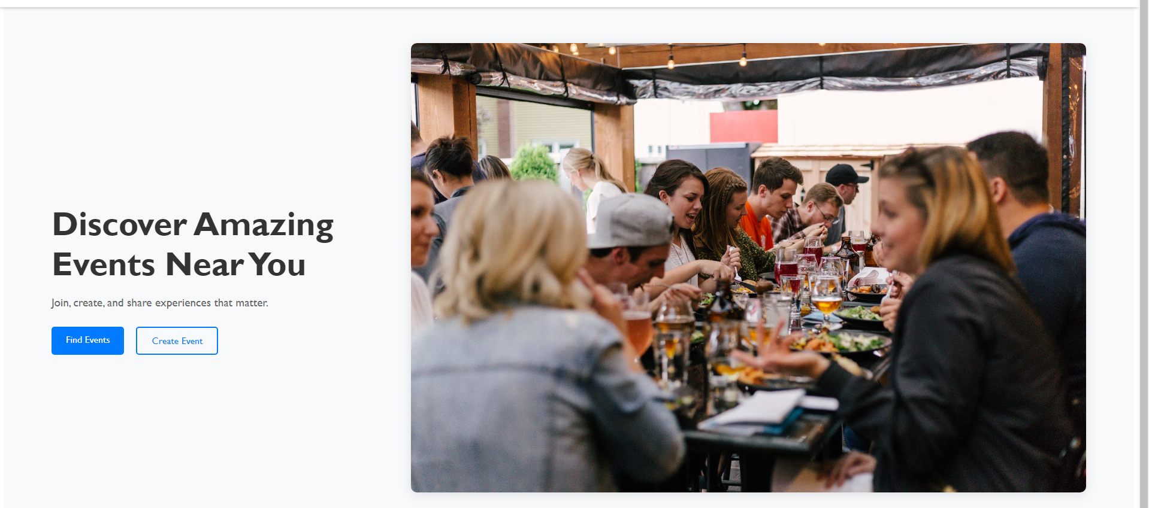
The home page

Slide 10
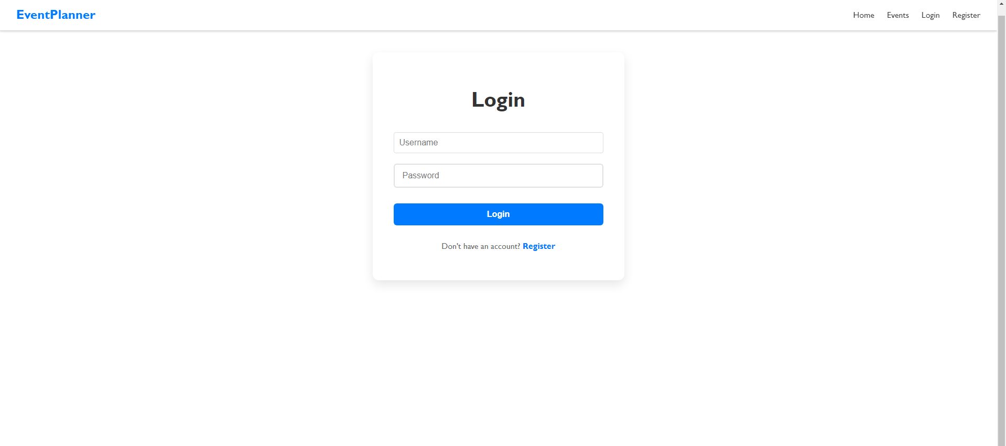
Login page

Slide 11
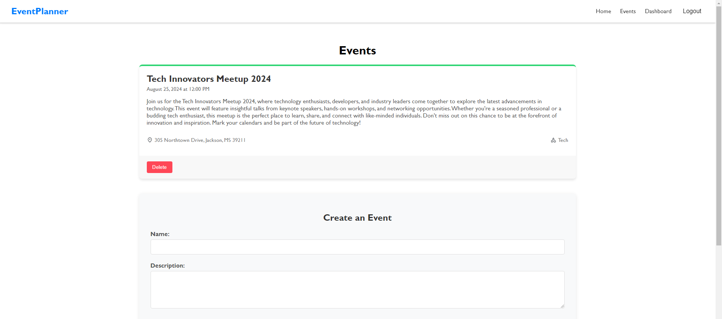
Dashboard page

Slide 12
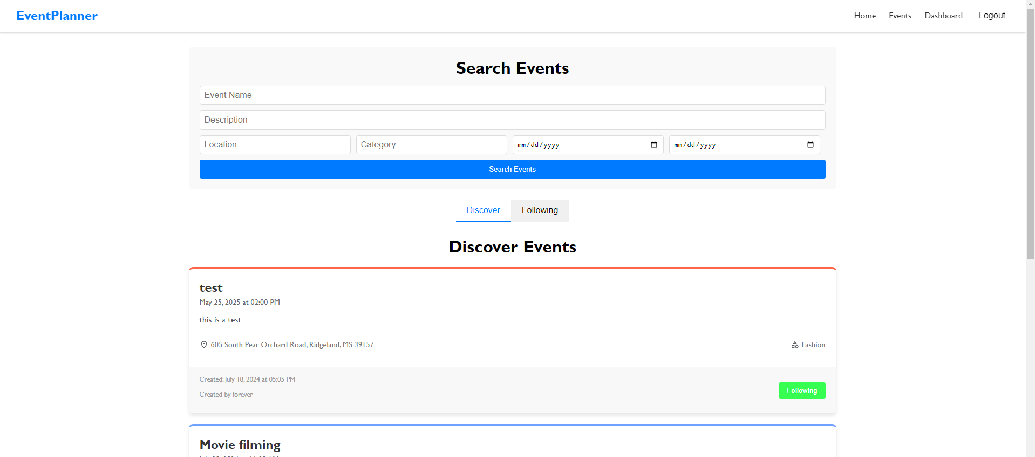
Public events page

Slide 13
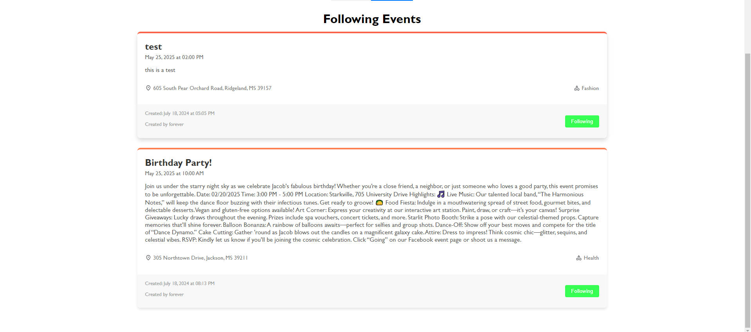
Following tab

Slide 14

Thank you for checking out my website

