Slide 1
Stage 1. Term Generation
Younghoon Kim (nongaussian@hanyang.ac.kr)

Slide 2
Note
The goal of the first stage is
To practice how to write and submit your code

Slide 3
Problem Definition
Given
A string (e.g., sentence, article) of type String
Return
A list of terms which is split by whitespaces and stemmed
Type: List<String>
He likes fried chicken
He, likes,
fried, chicken
he, like,
fri, chicken
Splitting
Stemming

Slide 4
Code Template
We provide a package of
A maven project created in Eclipse
It contains
Template codes (edu.hanyang.submit.TinySETokenizer.java)
TinySE framework (lib/tinyse-0.0.1-SNAPSHOT.jar) ← to be updated on every stage
Interface files (e.g., Tokenizer.java)
Indexer and query processer codes which will complete a search engine by connecting your submissions

Slide 5
To Use Code Template
Download the template Eclipse project
Rename the project directory
2016000000 ➔ [your student ID]
i.e. 2016000000 ➔ 2018123456
[Your student ID] directory
ㄴ .settings
ㄴ lib
ㄴ src
ㄴ target
ㄴ …
[Your student ID] directory
ㄴ2016000000 directory
ㄴ .settings
ㄴ lib
ㄴ src
ㄴ target
ㄴ …
Wrong
Right
Wrong

Slide 6
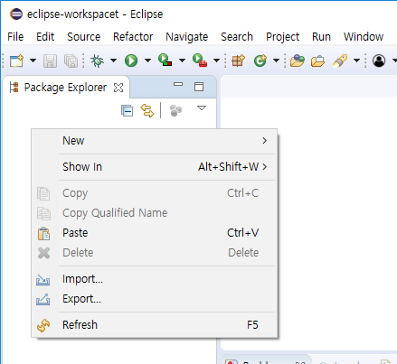
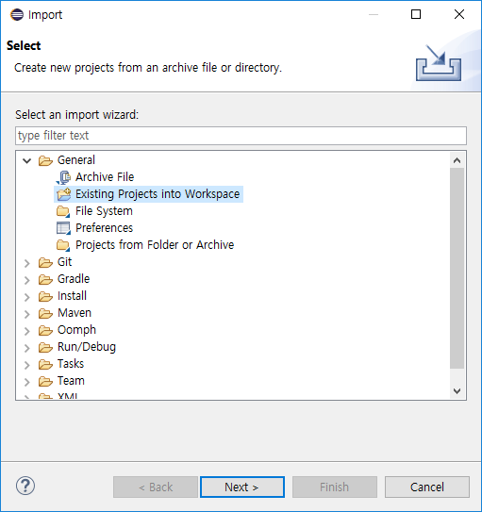
To Use Code Template
Import the project in eclipse IDE
1
2

Slide 7
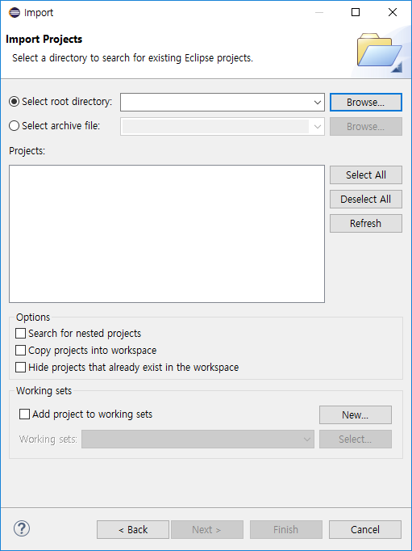
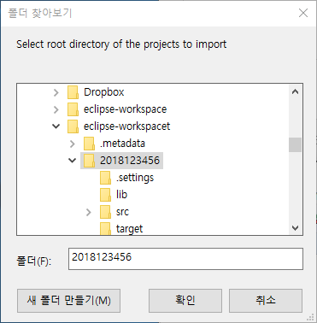
To Use Code Template
Import the project in eclipse IDE
3
4
Your project

Slide 8
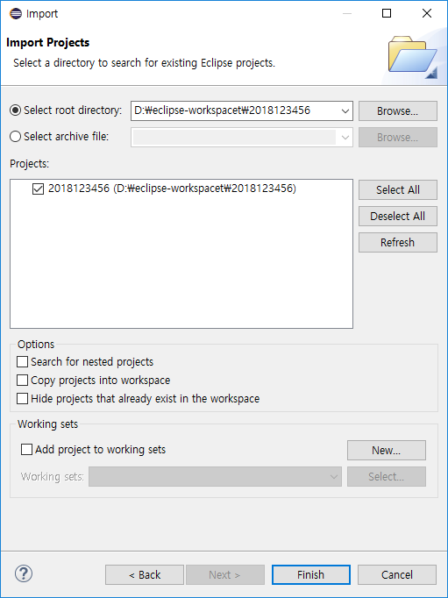
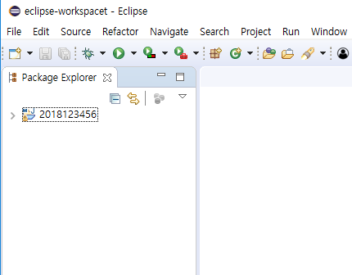
To Use Code Template
Import the project in eclipse IDE
5
6
Import
success

Slide 9
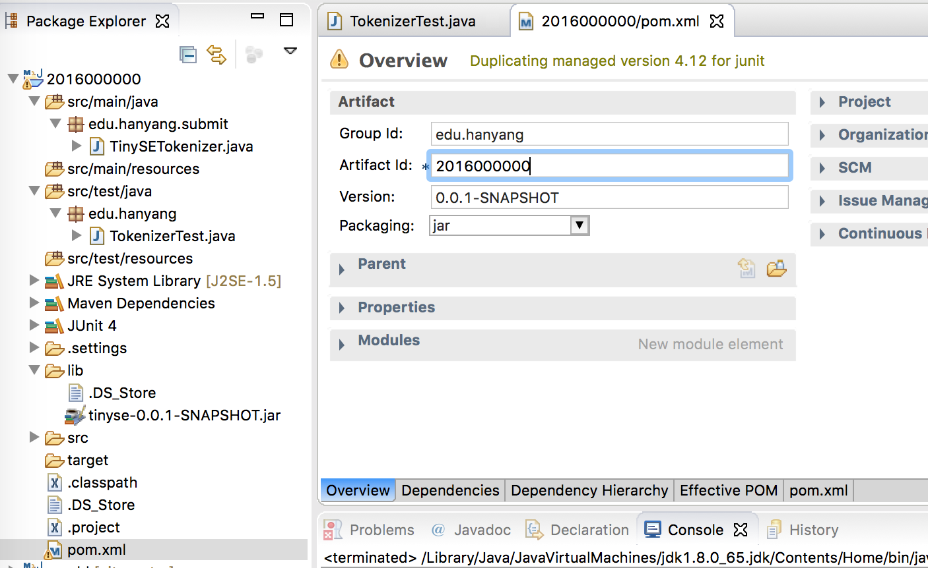
To Use Code Template
Rename Artifact Id to your student ID

Slide 10
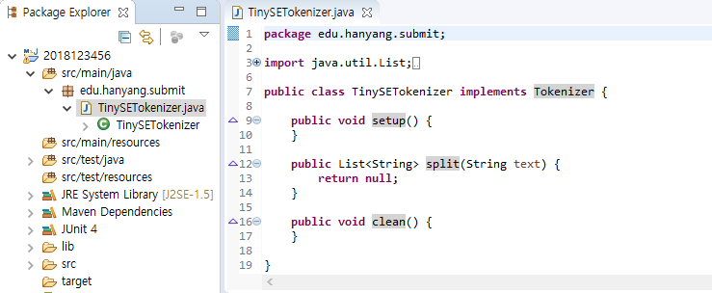
To Use Code Template
Complete edu.hanyang.submit.TinySETokenizer
Open this class
Implement this three method
You use SimpleAnalyzer and PorterStemmer class.
If you use other class, you may get wrong result.

Slide 11
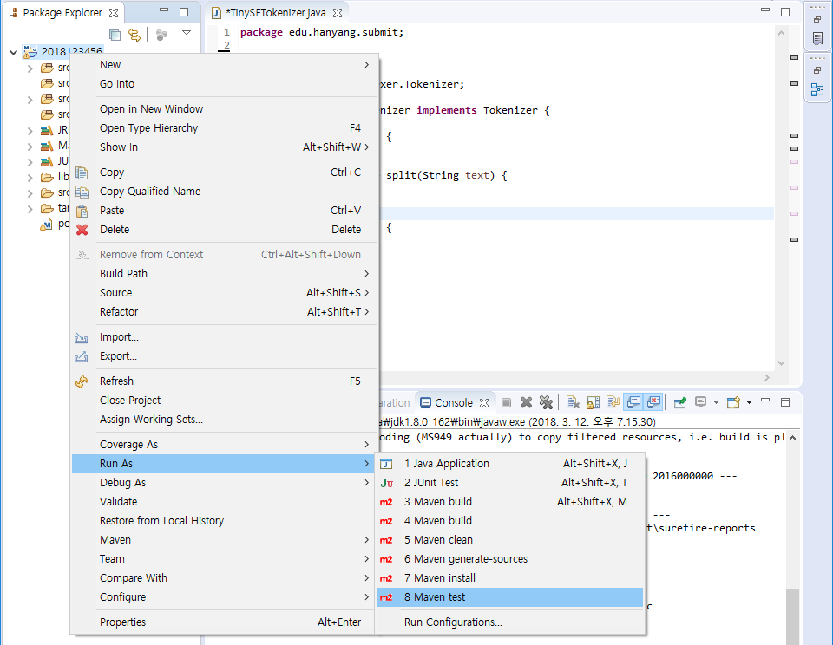
To Use Code Template
6. Test your code

Slide 12
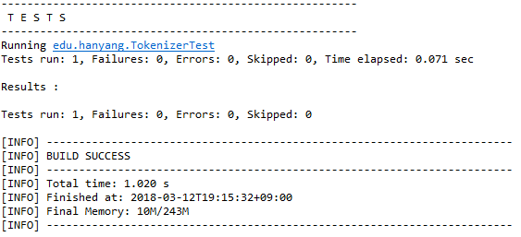
To Use Code Template
6. Test your code
If your code passes our unit test, you can see no failures, no errors and no skipped on console

Slide 13
External Libraries
Use SimpleAnalyzer and PotterStemmer in Lucene 7.2.1
SimpleAnalyzer is a tokenizer that splits a sentence with whitespaces
PotterStemmer is a well-known and simple stemmer for English
JavaDoc
SimpleAnalyzer: https://lucene.apache.org/core/7_2_1/analyzers-common/index.html?org/apache/lucene/analysis/core/SimpleAnalyzer.html
PorterStemmer: https://lucene.apache.org/core/7_2_1/analyzers-common/org/tartarus/snowball/ext/PorterStemmer.html

Slide 14
Constrain & Submit
How to submit
Run “maven package”
Submit <your student ID>-0.0.1-SNAPSHOT.jar file (you can find it from <project dir>/target/)
If any question, contact TA
Keonwoo Kim (김건우)
kdbml314@gmail.com
Room: 4공학관 314호

