Slide 1
Stage 2. External Merge Sort
Younghoon Kim (nongaussian@hanyang.ac.kr)

Slide 2
Goal
Given
A file
Containing a list of triples with 3 integers (e.g., <5, 1, 2>)
For triples, use org.apache.commons.lang3.tuple.MutableTriple
Return
A file
A list of triples sorted in the ascending order by using external merge sort
Sorting criteria
Primarily, sort by the first value
With tuples with an identical first value, use the second value
With tuples with identical first and second values, use the third value
Example
(4,8,4)(4,5,4)(7,9,6)(0,6,5)(6,0,3)(0,5,3)(3,1,7)(5,4,9)(4,6,6)(9,1,1)
(0,5,3)(0,6,5)(3,1,7)(4,5,4)(4,6,6)(4,8,4)(5,4,9)(6,0,3)(7,9,6)(9,1,1)

Slide 3
Code Template
We provide a package of
A maven project created in Eclipse
It contains
Template codes (edu.hanyang.submit.TinySEExternalSort.java)
TinySE framework (lib/tinyse-0.0.1-SNAPSHOT.jar) ← to be updated on every stage
Interface files (e.g., ExternalSort.java)
Indexer and query processer codes which will complete a search engine by connecting your submissions

Slide 4
To Use Code Template
Complete edu.hanyang.submit.TinySEExternalSort
package edu.hanyang.indexer;
public interface ExternalSort {
public void sort(String infile, /* input file path */ String outfile, /* output file path */
String tmpdir, /* temporary directory
for creating intermediate
runs */
int blocksize, /* 8192 bytes */
int nblocks); /* available memory size /
blocksize */
}

Slide 5
Read and Write Buffers
To implement an external sort,
You may need read a given size of blocks sequentially for each run
How do we implement it in Java?
→ Use BufferedReader

Slide 6
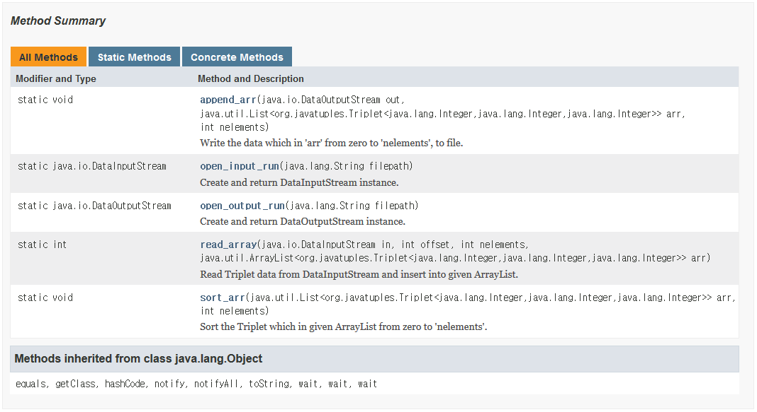
Utility Class
DiskIO.class
edu.hanyang.utils.DiskIO;

Slide 7
Constrain & Submit
How to submit
Run “maven package”
Submit <your student ID>-0.0.1-SNAPSHOT.jar file (you can find it from <project dir>/target/)
If any question, contact TA
Keonwoo Kim (김건우)
kdbml314@gmail.com
Room: 4공학관 314호
Due date
Apr. 17 (11:59pm)
Unit test
The maven project will be updated and provided soon
It will include a unit test code, test and answer files to let you test the correctness of output sorted list
BUT, it does not guarantee whether or not your submit works well with larger files

Slide 8
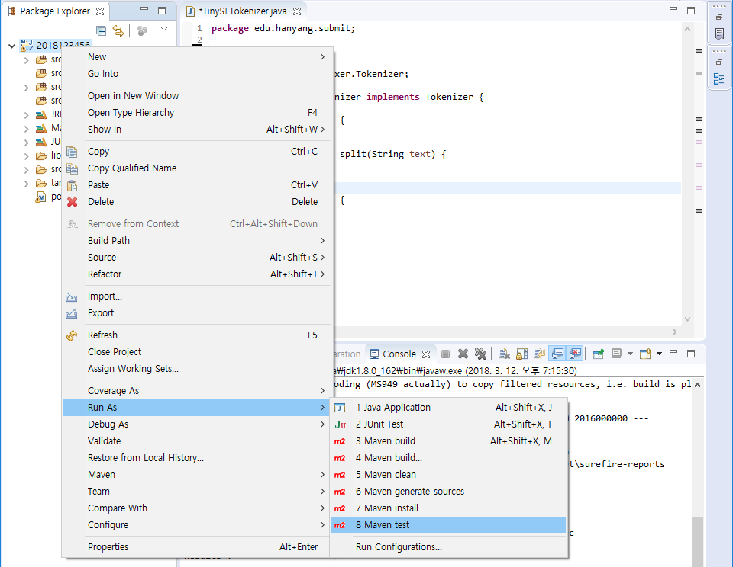
To Use Code Template
Test your code

