Slide 1
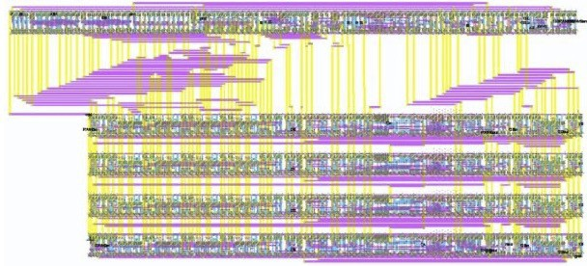
AI-Powered Analog Deep Learning Hardware Accelerator Design
Track: D: AI4AIchips
Zhiyang Ong¹
¹Department of Electrical and Computer Engineering, College of Engineering Texas A&M University
College Station, TX
U.S.A.
June 12, 2026

Slide 2

Copyright © 2026 by Zhiyang Ong and Anuj This work is licensed under a
Creative Commons “Attribution-NonCommercial-NoDerivatives 4.0 International” license.

Slide 3
Acknowledgments (1)
Dr. Francesco Stefanni, former labmate of Zhiyang Ong at University of Verona, who helped him craft L^{A}T_{E}X presentation slides.
The engineers of Mythic AI (Austin, TX) for showing us that analog in-memory computing is plausible, and their inspirational grit, from refusing to let their start-up go bankrupt multiple times, motivates us to be resilient in completing the IEEE SSCS Chipathon 2026 project.
Prof. Kaushik Sengupta at Princeton University and Prof. David Z Pan at The Awesome and Mighty University of Texas at Austin (trolling Aggieland haters, Go Longhorns!!!., Hook’em horns!!!) for inspiring us to craft AI-powered electronic design automation tools to kill IC design jobs.

Slide 4
Acknowledgments (2)
Prof. Mehdi Saligane for showing us how to use LLMs (or even agentic AI) to process IC design files, by working with source/design files in much more common computer languages or dialects/variants thereof, such as Python/PyMTL, instead of Clash/Haskell, Chisel HDL/Scala, or Hardcaml/OCaml. This is from the “IEEE Solid-State Circuits Directions Series, Think Impact with ICs: From Words to Circuits: Agentic AI, Foundation Models, and Open EDA Workshop.”
Prof. Mohsen Imani at UC Irvine for showing us how to use equivalent/approximate circuits to model semiconductor device models of memristors or floating-gate MOSFETs.
Prof. Peng Li at UCSB for showing us how to perform element stamping during the initial phase of circuit simulation, to swap semiconductor device models with their simpler models using approximate circuits.

Slide 5
Project Information
Goal and Application
▶ Goals:
▶ To develop a multi-modal AI-powered analog or radio frequency (RF) IC design flow
▶ To apply the aforementioned AI-powered IC design flow for designing analog deep learning hardware accelerators
▶ Application: Analog deep learning hardware accelerators can be used for environmental monitoring, by training on analog signals captured from the sensors with data conversion between analog and digital signals.

Slide 6
Project Information
Design – High Level Proposal (2-3 sentences + Image)
▶ Use semiconductor device models of memristors and floating-gate MOSFETs to approximate memristive and floating-gate MOSFET -based analog in-memory computing systems
▶ Implement analog in-memory computing systems by replacing SRAM cell in SRAM subsystem with approximate RAM cell circuit model, based on the aforementioned semiconductor device models
▶ Use recursive self-improvement to design the analog
in-memory computing systems, where hardware generators are created to train the AI model (from memory subsystem with memristors or floating-gate MOSFETs to analog in-memory computing systems)

Slide 7
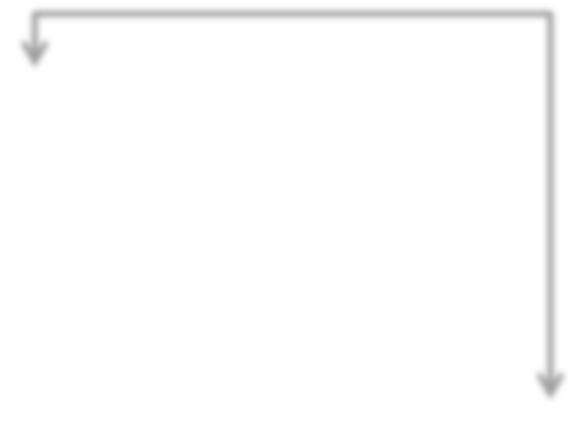


















Slide Title 6
Slide Subtitle 6.
Figure: Caption #2

Slide 8
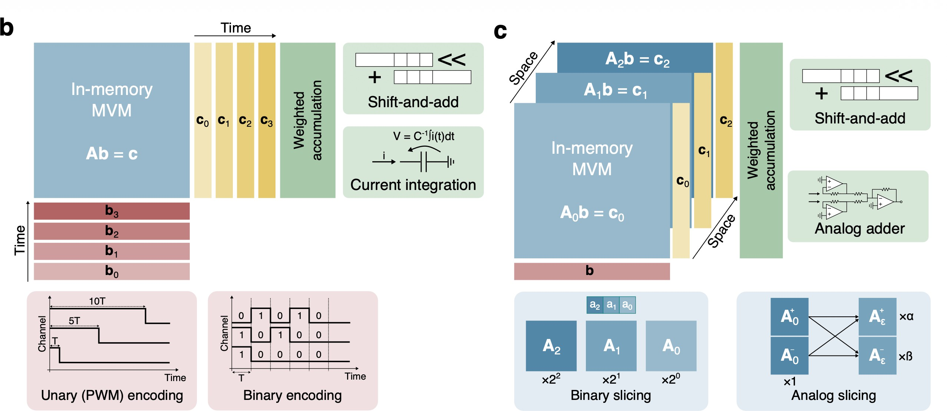
https://doi.org/10.1038/s44335-025-00044-2
“Achieving high precision in analog in-memory computing systems”
Figure: Caption #2

Slide 9
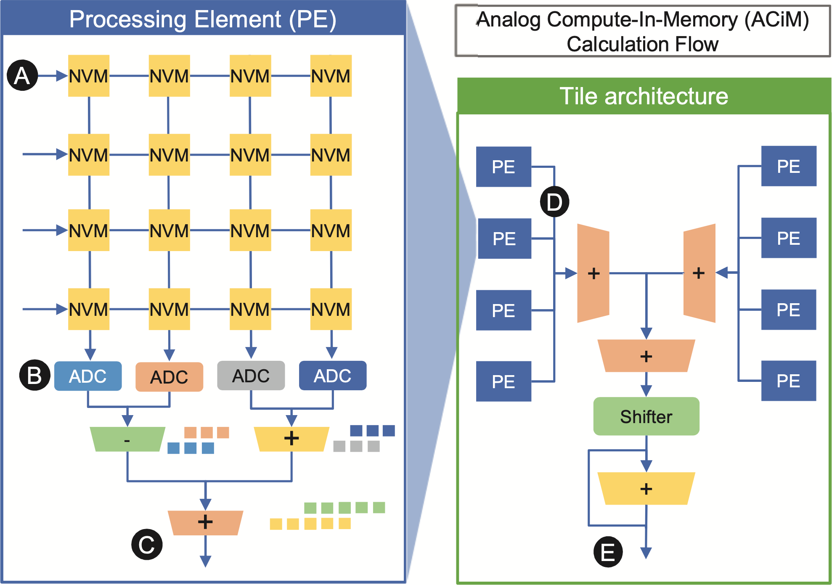
https://doi.org/10.1109/IEDM13553.2020.9372124
“Ultra-Low Power Flexible Precision FeFET Based Analog In-Memory Computing”
Figure: Caption #2

Slide 10
Team Members’ Experiences – Zhiyang Ong
▶ Zhiyang Ong:
▶ 32-kbit synchronous SRAM with 32-bit words
▶ MIPS processor architectures: single cycle, multi-cycle, 5-stage pipelined, 128-bit
▶ Viterbi decoder, and encoder/decoder pairs for linear code
▶ 64-bit Ladner-Fischer tree adder, using skew tolerant domino logic and logical effort
▶ FIR filter from the bilinear transformation of an analog
Butterworth filter
▶ high frequency Colpitts oscillator, with an operating frequency of 20 MHz
▶ audio amplifier: power & pre- amplifiers, active filters, &
RC-filter bridge rectifier
▶ EDA projects: gate sizing,, SRAM CAD for design space exploration, hardware generators for encoder/decoder pairs targeting linear code, logic simulator, PODEM ATPG

Slide 11
Tasks
Search for an analog in-memory computing circuit
If it uses a semiconductor device not supported by the GF180 PDK, we just have to use a semiconductor device model (e.g., a compact model) to approximate the real device. This is also done by circuit simulators anyway.
Use a script to create the Gantt chart for the schedule of expected/required tasks, a critical part of project management that they would want to see in the detailed project proposal document
When we can concur on an analog in-memory computing design to implement, we can specify the block diagram and pin-out.

Slide 12
Tasks
▶ search for data sets of analog signals to test our solution for analog in-memory computing:
▶ environmental data
▶ stock price data, and stock market index data, for financial engineering (can be tested with mock stock market trading platforms)
▶ audio information (avoid human data, except for public data
sets that reflect inclusive diversity, to avoid institutional review board requirements)
▶ thermal measurements
▶ chemical, biochemical, and medical data (avoid human data, except for public data sets that reflect inclusive diversity, to avoid institutional review board requirements)
▶ data related to motion/mechanics, like speed, distance
traveled, and acceleration???

Slide 13
References
https://doi.org/10.1109/IEDM13553.2020.9372124
https://doi.org/10.1038/s44335-025-00044-2 https://doi.org/10.1109/MSSC.2024.3462388

