Slide 1



A Study of the Pleiotropy versus Redundancy Trade-off, using Evolutionary Computation
Andy Hao-Wei Lo and Zhiyang Ong
School of Electrical and Electronic Engineering, and
Centre for Biomedical Engineering,
The University of Adelaide
ahl@ieee.org zhiyang@ieee.org
Notes:
Welcome to the presentation of project on the study of the pleiotropy versus redundancy trade-off, using evolutionary computation.
I am… and this is my partner….

Slide 2
Summary
Introduction
  Motivation
  Background Information
  Objectives
Proposed Approach
  Steady-State Genetic Algorithm
  Genetic operators
  Metrics
Experiments and Results
Project Management
  Difficulties Encountered
  Milestones, Timeline and Division of Work
  Budget
  Risk Management
Future Work
Conclusions
Notes:
I will present you with
-the motivation behind the investigation and why we are using EC
-what has already been done by our predecessors, and
-our main goals
I will also talk about our proposed approach, including
-the type of evolutionary computation chosen
-what operators are used
-how we identify the better networks using cost functions
Zhiyang will then discuss
-the experiments carried out and results obtained
-the management issues, such as difficulties encountered, risk management
He will also speak of the areas worth exploring

Slide 3
Motivation
Market value worldwide telecommunications industry (Deloitte 2005)
  Increased by 28% from January 2003 to December 2004
  Aggregate market capitalization of US$2,349 billion at end of 2004
In 2001-2002, revenue in the Australian telecommunication industry came close to AU$30,000 million (Allen 2003)
Telstra Corp reports for the fiscal year ending June 2004 (Telstra 2004),
  Total operating revenues of AU$21,280 million
  Total operating expenses of AU$11,027 million
Want to find a better network topology to
  Reduce cost and increase profit
  Achieve a desired level of reliability with acceptable (minimal) cost
Notes:
During the recent years, the rapid growth in the telecommunication industry has been motivated by people’s desires to communicate or to connect with each other.
By the end of December 2004, the aggregate market capitalization, worldwide telecommunications industry, reached the value of US$2,349 billion, which is a 28% increase over the period since January 2003.
In 2001-2002, AU$8.09 billion or 27% of the Australian telecommunication revenue is contributed by mobile communication.
Furthermore, Telstra Corp Ltd, Australia has reported an operating revenue and expenses totalling AU$21,280 million and AU$11,027 for the fiscal year ending June, 2004.
Given the global market value and the operating expense of Australia’s telecommunication giant, it is desirable to reduce operating cost and increase revenue. Thus there is a need to improve on the network topology, whilst lowering the cost of operating networks without compromising the reliability of the network.

Slide 4
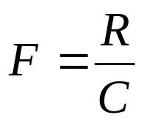
Background Information
Research results were mainly relevant to biomedical sciences
Work done by the predecessors (Berryman 2003, 2004)
  Explored the concepts of the failure and the repair of links, and size of the networks
  Measure the quality of the network, they also formulated a fitness function F:
    Lost of information when using ratios
    Cost, C, of network is minimized, the significance of reliability, R, increases
    Cost is closely correlated with reliability

Slide 5
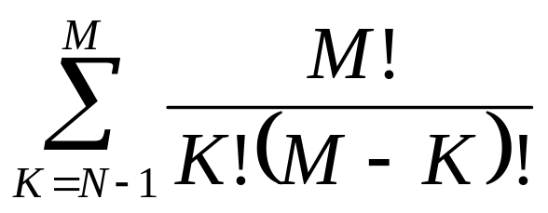
Optimization Methods
For N nodes, there are T possible topologies where T is defined as (Vinntec 1999):
  M is the number of possible connections N*(N-1)/2
  K is the number of connections in a given configuration
Types of optimization techniques:
  Monte Carlo Methods
  Dynamic Programming
  Linear Programming
  Gradient Descent
  Ant Colony Optimization
  Evolutionary Computation
Notes:
Finding an optimal topology is no where near trivial. This equation determines the number of possible topologies for linking N nodes. For example, with 16 Nodes, there are already 1300 billion billion possibilities.
Even though there are many algorithms to solve the optimization problems, given the size of the solution space, heuristics are essential.
Monte Carlo Methods is immediately not considered, as it is non-heuristic and its transition from one solution to another is erratic. Thus we do not know if we have found an optimal solution, until we searched the whole solution space.
Dynamic Programming seemed unsuitable, because the network topology cannot be reduced to optimal substructures [http://en.wikipedia.org/wiki/Dynamic_programming]. That is to say, the growth of the networks is not a sequential process.[zy7,zy8]
Linear Programming is designed for problems in which the objective function and the constraints are all linear. Thus the solution space may not have been adequately searched, as the multiple objects needs to be converted into a structure such as a weighted sum. [zy10,zy11]
Gradient Descent or ascent does not guarantee a global optimum solution.
Ant Colony Optimization searches a solution based on a probabilistic approach based on tracking pheromone concentrates. The probability of shifting from one topology to another cannot be determined.
Evolutionary Computation was chosen for this project, as it can model the incremental growth of the telecommunication networks as a biological process.[zy5,6,13,14] It allows network topologies to adapt, via a learning process, towards cost or fitness functions that can alter independent of the evolution process. Thus this is the best choice to obtain a possible optimal network topology subject to different conditions.

Slide 6
Why use GA?
There are 4 types of evolutionary algorithms (Fogel 2000)
  Evolutionary Programming (EP)
  Genetic Programming (GP)
  Genetic Algorithms (GA)
  Evolutionary Strategies (ES)
EP and GP are used to evolve programs to solve problems
GA and ES are used to find solutions to optimization problems
  But ES
    Only keeps track of one solution (1+1)
    Does not use crossover
GA is a population based approach
  Multiples starting point
  Maintains solution diversity

Slide 7
Objectives
Investigate how different network conditions affect pleiotropy and redundancy
Provide various costs functions for multi-objective optimization
Enhance genetic operators for evolutionary computation
Evolve the networks subject to constraints and conflicting objectives
Notes:
The aim of this project is to investigate the optimum ratio of pleiotropy and redundancy for telecommunication networks to perform efficiently under different network conditions.
Although this is a continuation of work by our predecessors, we shall use steady-state genetic algorithm as other evolutionary algorithm, and our main focus shall be on multi-objective optimization.
Thus several costs functions will be formulated as objectives and the genetic operators for the evolution process will be enhanced.
The network topologies will be observed as they are evolved towards the conflicting objectives under a variety of constraints.

Slide 8
Proposed Approach
Steady-State GA
  Population vary only slightly in each generation
  Higher chance of retaining good solutions in the population
  May need more generations to achieve the same population drift as classical GA
Reinsertion
  A small number of chromosomes are generated
  Inserted back to the original population via local reinsertion or replacement strategy (Obitko 1998)
Notes:
The method of steady-state genetic algorithm (SSGA) only varies the population very slightly in each generation. This differs from the classical GA mentioned above, as a small number of chromosomes are generated, are inserted back to the original population local reinsertion or replacement strategy.[21] Consequently, SSGA provides a higher chance of retaining good solutions in the population.
The selective pressure and diversity of the population is governed by on the replacement algorithm.[22][23] Thus to speed up the process, tournament selection can be used. Overall, this is a more manageable approach in terms of population diversity, but it may require many more generations to achieve the same population drift as classical GA due to the slow state change. This method is extremely beneficial when fitness evaluations are computationally expensive.[22]

Slide 9
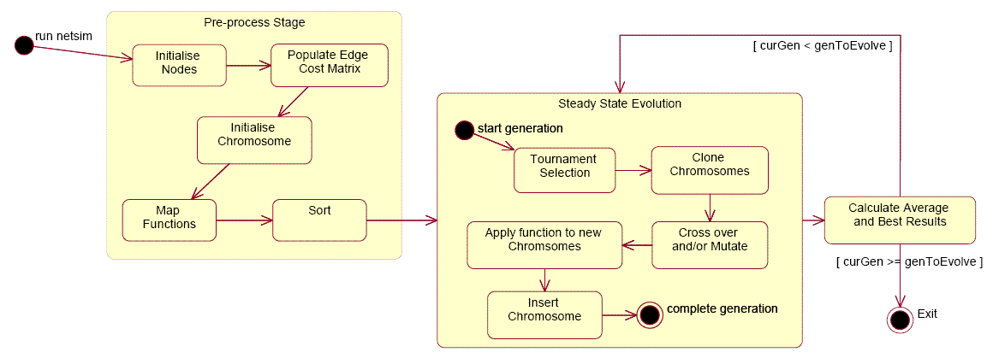
Proposed Approach
State chart for Steady-State GA

Slide 10
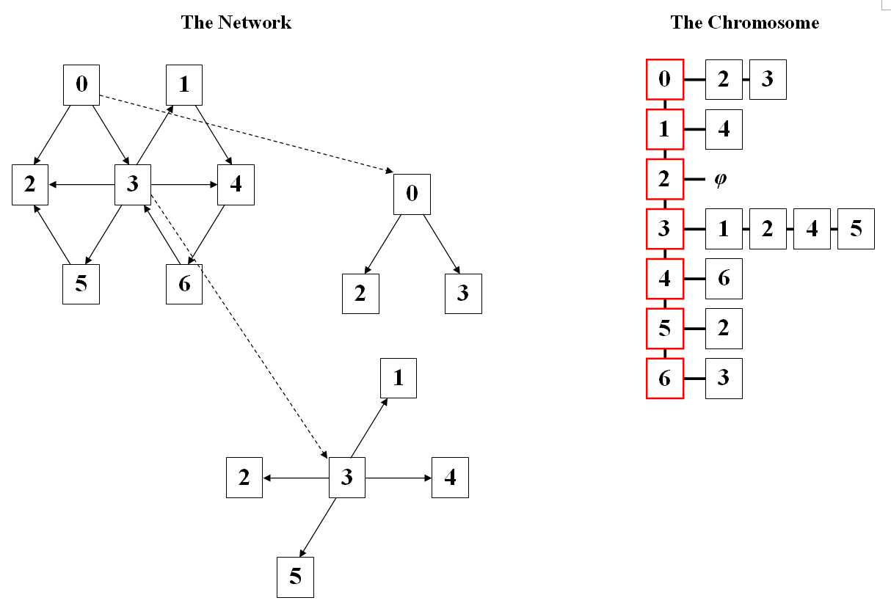
Chromosome
Representation of the Network Topology
Networks can be represented by graphs (Barabasi 2003)
Adjacency lists stores destinations for each node
  Each destination symbolises an edge
Notes:
Graph theory is the basis of networks. Thus we used the graph data type to represent network topology. However it is impractical to store the graphs as is, due to memory efficiency. Also, adjacency matrices are not suitable, as space will be wasted to store infinity when there are no edges between two nodes. Thus adjacency lists are used, where only references of destination nodes are stored.
In this example network, one can see that node 0 connects node 2 and 3. These are the adjacent nodes for node 0, and can be stored in the adjacency list. Similarly, node 3 has node 1, 2, 4 and 5 as adjacent nodes. When this information is collected for each node in the network, this can be combined and the network can be described by these adjacency lists. This forms the basis for the structure of our chromosomes. Conversely, from this list, each destination for a node symbolizes an edge.
Note that, in designing the structure of the chromosomes, it is desired that each chromosome will maintain the same number of nodes with the same properties, while being evolved independently. Thus all the nodes in each of the chromosomes shall reference a list nodes containing information that is shared by all the networks. This will allow the latest information regarding the nodes to propagate to all chromosomes immediately.

Slide 11
Genetic Operators
Selection
  process of choosing chromosomes for evolution
Crossover
  Models the mating process of two selected parent chromosomes
Mutation
  Random changes within a chromosome
  Regulates diversity in the population (Pohlheim 2005)
Symbiosis
  Relationship that influences chromosomes
Notes:
Crossover emulates the mating process of two selected parent chromosomes. The chromosome offsprings produced inherit parents’ characteristics.
The implemented crossover function is a version of fixed-length two-point crossover, where half the number of adjacency list of destination nodes will be swapped between a pair of chromosomes. (Then describe the diagram)
The mutation operator is used to maintain the diversity in a population, by altering the direction of search slightly. This is because heuristic search might fall in the trap of a local optimum, and this can result in early convergence to a non-global optimum solution.

Slide 12
Selection
Selective pressure & Control of diversity
Rank-based Selection
  Selection probability assigned based on its rank in terms of fitness
  Effective way to control selective pressure
  Careful choice of a probability distribution function (PDF) is required to ensure diversity
Tournament Selection
  Does not require a PDF
  Chromosomes (usually 2) are selected from the population, and the best are chosen to participate in evolution (Pohlheim 2005)
  Controls the diversity of the population.
Notes:
Provides appropriate selective pressure and bias towards the fitter chromosomes without too much loss of diversity

Slide 13
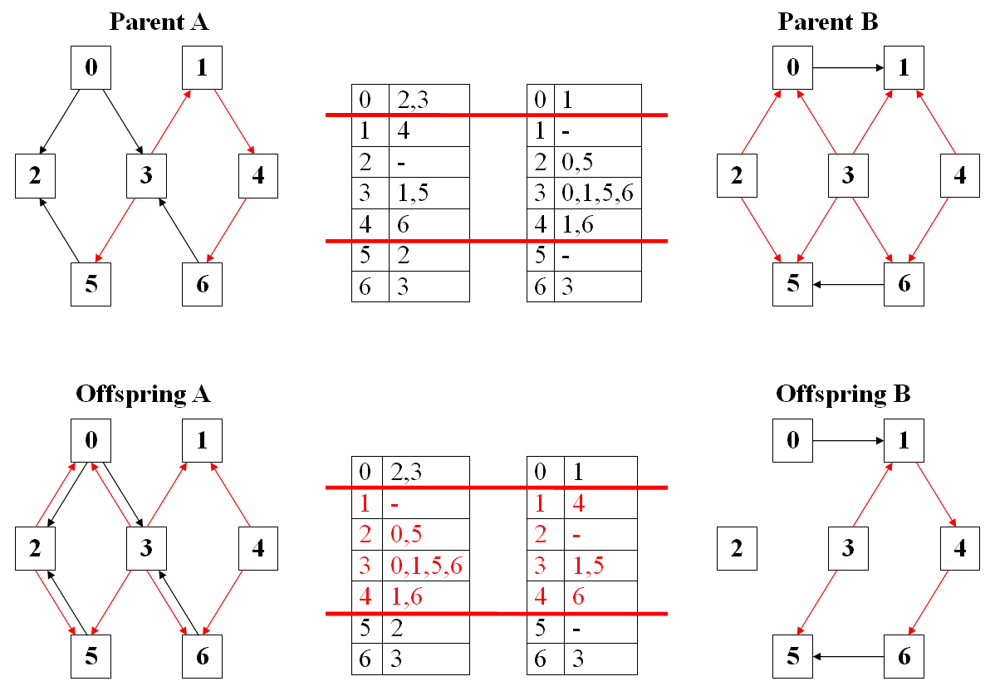
Crossover
  For a pair of selected network,
    A range of nodes is determined
    Adjacency lists of corresponding nodes are swapped

Slide 14
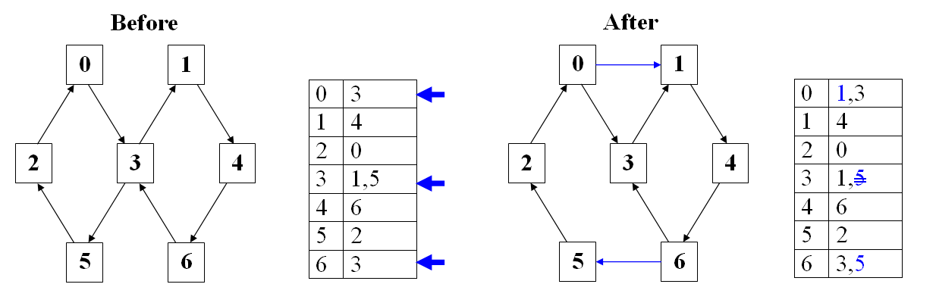
Mutation
  For a selected network
    Random adjacency lists are selected
    Random nodes are added or removed from the adjacency list
Notes:
The mutate method will randomly add or remove destination nodes for each cell (node) in a chromosome. The number of cells to modify will vary from generation to generation. (Then describe the diagram)

Slide 15
Symbiosis
Telecommunication networks have layers
  E.g. ISO’s Open Systems Interconnection (OSI) model
  Companies providing services for each layer interact and cooperate
Symbiosis
  Interactions and inter-dependency amongst entities within an environment.
  Beneficial relationships are modelled as:
    Commensalism
    Mutualism
Notes:
Telecommunication networks can be abstracted into different layers, such as in ISO’s Open Systems Interconnection model (or the OSI 7-level model). Not only that each of these layers interfaces with each other, different companies providing services within the individual layers also interact and cooperate to provide better services.
Symbiosis captures the interactions and inter-dependency amongst entities within the same environment. These interactions may be beneficial or detrimental. We modelled the part of these relationships that have no adversary effects, through commensalism and mutualism.
Commensalism is where some parties in the relationships benefit from their interactions. We emulated the interaction where one chromosome is the benefactor and the other is influenced by it.

Slide 16
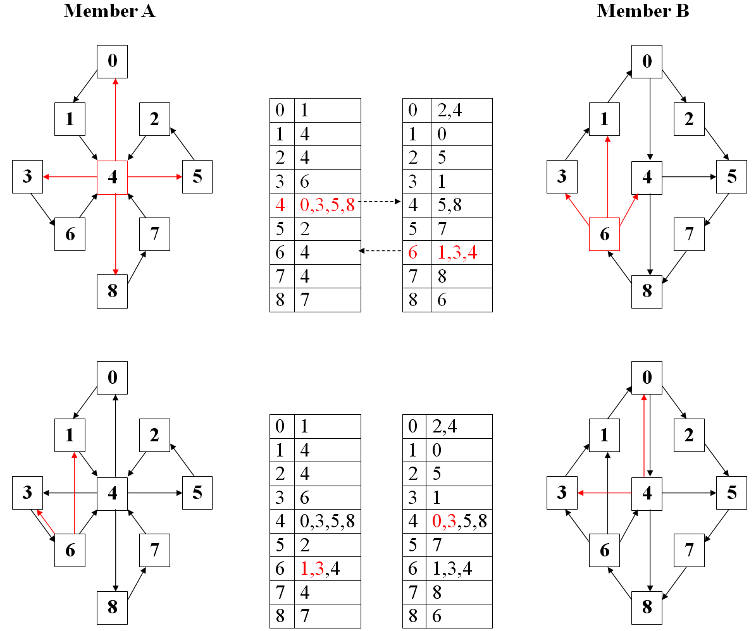
Symbiosis
Notes:
A pair of chromosomes was selected. For one of the chosen pair, 5 nodes with the highest clustering coefficient, or with the most connections, were determined. The adjacency lists of these nodes are copied over to the other chromosome at the corresponding location. In effect, this is a Union operation on the adjacency lists.
On the other hand, mutualism is where chromosomes benefit each other in their relationship. Thus the operation explained are carried out for both chromosomes.

Slide 17
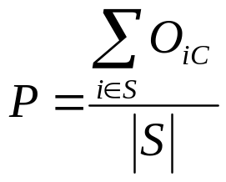
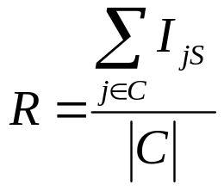
Pleiotropy & Redundancy
Pleiotropy
  A server provides services to multiple clients
Where O_{iC} is the number of out-going edges to a client
Redundancy
  A client receives services from multiple servers
Where I_{jS} is the incoming edges from a servers
Notes:
Pleiotropy is an indicator of ability to provide services. The more pleiotropic a server is, the more money can be saved. However if the server failed, the system collapses.
We model this as the average number of connections issued to a client of each server. This assumes information usually flows from a server to a client, and same amount of data is sent in each connection.
Redundancy is a measure for robustness, but having many servers serving just one client could be costly.
This can be modelled as the average number of connections received from the server

Slide 18
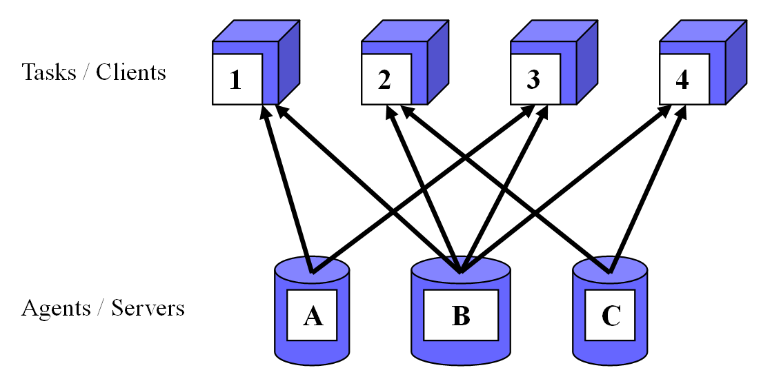
Combining Pleiotropy & Redundancy
Notes:
We want to find a balance between reliability and low cost, so combining the approaches yields a hybrid structure. As you can see in this example, server B works much harder than the other two, so there would be a heavy impact on the network’s operation if this server fails. However in this system, when any of the servers fails, the clients are still supported.

Slide 19
Distance Products Matrix
Performs the min-plus (min,+) matrix operation (Zwick 2000)
  Standard matrix multiplication is (Σ,×)
Approximation of Dijkstra’s Algorithm (Berryman 2004)
Time order complexity of O(n³ log n)
Results give the shortest distances between nodes using the minimal spanning tree

Slide 20
Total Edge Costs
Sum the cost of each edge in the network.
Operating cost of running the connections
  Assume each link is operating at 100% efficient at all times

Slide 21
Minimal Spanning Tree
The set of edges that required to connect all nodes, with the least cost
Distance product function is used to find the MST
  Compare the result to the original adjacency matrix of the network
  Identify entries that have not changed in value
  These are the irreducible paths (shortest distance between two points), hence are edges in MST.
This will determine the subset of edges that is used most often
  The lower the cost is the better
  If MST cost is very low compared to the total edge cost
    Many edges may be redundant, if there is little communication
    Otherwise, edges may be heavily loaded
Notes:
The quality of each chromosome can be measure by different cost functions, and the costs can be collated to determine of overall fitness.

Slide 22
Degree of Separation
First applied to social networks
  Anyone is connected to any other person via a chain of at most five acquaintances (Six Degrees of Separation)
  Even for a network that seems large and sparse, nodes are not too far away from each other.
Can be calculated using the distance products with unit edge cost.
Describes how far the network spans,
Measures the number of hops from one node in the network to another
  Significant if the propagation delay is much less than the data forwarding delay

Slide 23
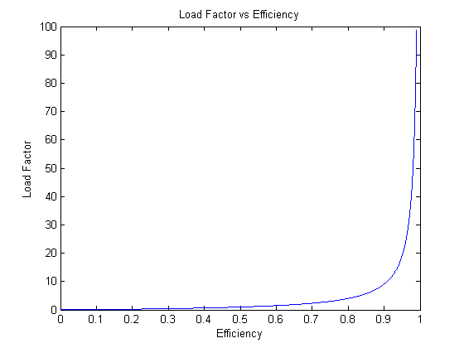
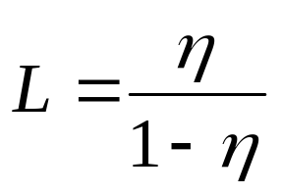
Average Load Factor
Resources are consumed when initiating and receiving connections
The load factor, L, for operating at efficiency, η, is determined as:
Not desirable for any node to be heavily loaded
This shall promote load balancing

Slide 24
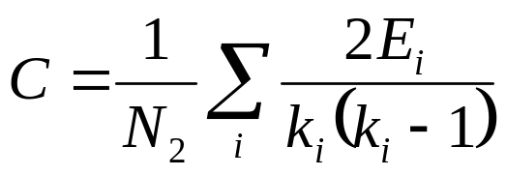
Average Clustering Coefficients
Used to measure how closely coupled nodes are (Barabasi 2003)
Describes the nature of small-world (social) networks, where people tend to crowd together
Applicable to any telecommunication network
  telecommunication networks are formed by social rules (Boykin 2005)
The average, C, of this coefficient measures the fraction of neighbours shared by each node
  where: N₂ is the number of nodes with out-degree or 2 or higher,
  E_{i} is the number of out-going edges (out-degree) of node i,
  k_{i} is the number of nodes in its neighbourhood

Slide 25
Resistance in Network
Data packets travel in different paths on the network
  More are transmitted through links with less traffic
Model telecommunication networks as resistor network between two nodes
Resistance
  Between a node and itself is 0
  Between unreachable nodes infinite
R
R
C
A
B
Vs
R
Vout
Notes:
more current will flow through a path with less resistance
same as summing resistance in series.
sum conductance like in resistor networks.

Slide 26
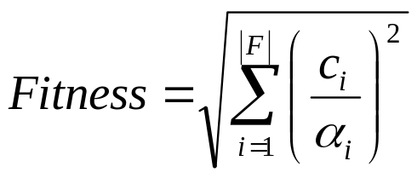
Fitness Function
Many cost function, but one cost function.
We defined fitness by
  Considering results of each cost function are on a separate orthogonal axis
  Cost is normalised by the respective sum of the cost over the population
  Take the Pythagorean sum
where: |F| is the number of cost function selected,
c_{i} is the i^{th} cost value of the chromosome,
α_{i} is the normalising factor calculated as the sum of the costs for i^{th} cost function for each chromosome
Notes:
Since there are many cost function in NetSim, the software must account for an arbitrary number of cost functions at the same time.
The proposed method considers the results of each cost function as values on a separate axis, and will be normalised with the respective sum over the population. Then the resulting fitness value, for a chromosome, is calculated as the Pythagorean some of the normalised fitness values.
In effect, the fittest chromosome will be that closest to the origin of the |F|-degree space. However note, it is assumed that the cost functions are lowly correlated and they will not produce negative results (costs).
With the cost and fitness functions defined, the chromosomes can adapt different optimization conditions via the evolution algorithms.

Slide 27
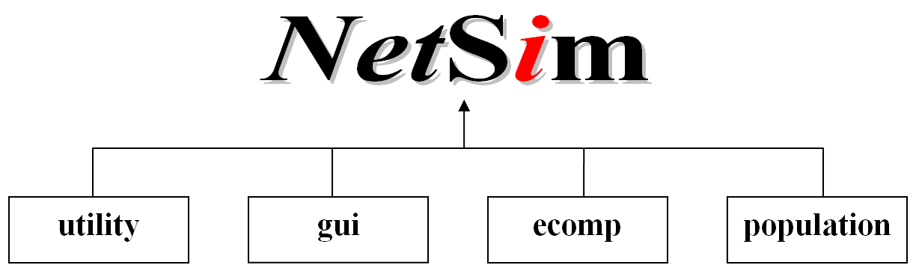
Software Architecture
Some attributes of a good architecture (Kontio 2004, Hewlett Packard 2000)
  Simplicity
  Loose coupling
  Extensibility
  Portability
NetSim’s Hierarchy:
Notes:
Software architecture describes the structure of tour software. A good architecture should be no more complex than it should be. The components need to be loosely coupled, so that any changes would only be confined to a small set of components. Functionality should be added to it without any difficulties. It would be best if the software is portable to any system.
We have defined a simple architecture that can be easily maintained. The NetSim software is partitioned into FOUR main packages according to their functionality. The packages are namely utility, ecomp, population and GUI, where Graph is a sub-component of the population package. Each package has its designated purpose, such that the communication across packages is minimal.
For example, the purpose of the utility package is to provide for robustness in the software. It contains tools to check for assertions, precondition and post-condition when each method is called. And also, the GUI package manages all the user interactions.
To make the software highly extensible we used clearly defined interfaces, so that the software can be easily modified. Since we are using Java, the portability is achieved by a variety of Java Virtual Machine available for different system platforms. We have also documented our codes adequately, to help future researchers who wish to this software.

Slide 28
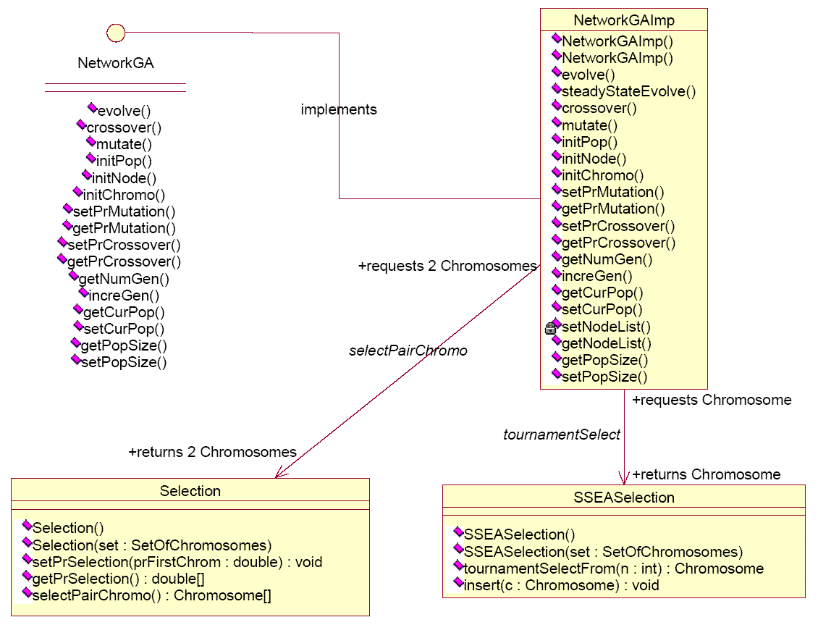
Package ecomp
Responsible for evolution process
  NetworkGAImp: contains the genetic operators
  SSEASelection: tournament selection and reinsertion
Notes:
I would like to talk about two of the packages in particular.
Ecomp package is responsible for evolving networks.
NetworkGAImp contains algorithms for both classical and steady-state GA. The genetic operators such as cross over and mutation (symbiosis?) are included in there. It is also used to initialize the population of network topologies in the
SSEASelection provides for tournament selection from any arbitrary number of candidates, although usually only a pair is used. The closest fitness insertion algorithm is also stored here.
Note that Selection class implements rank selection, which not used due to computation complexity.

Slide 29
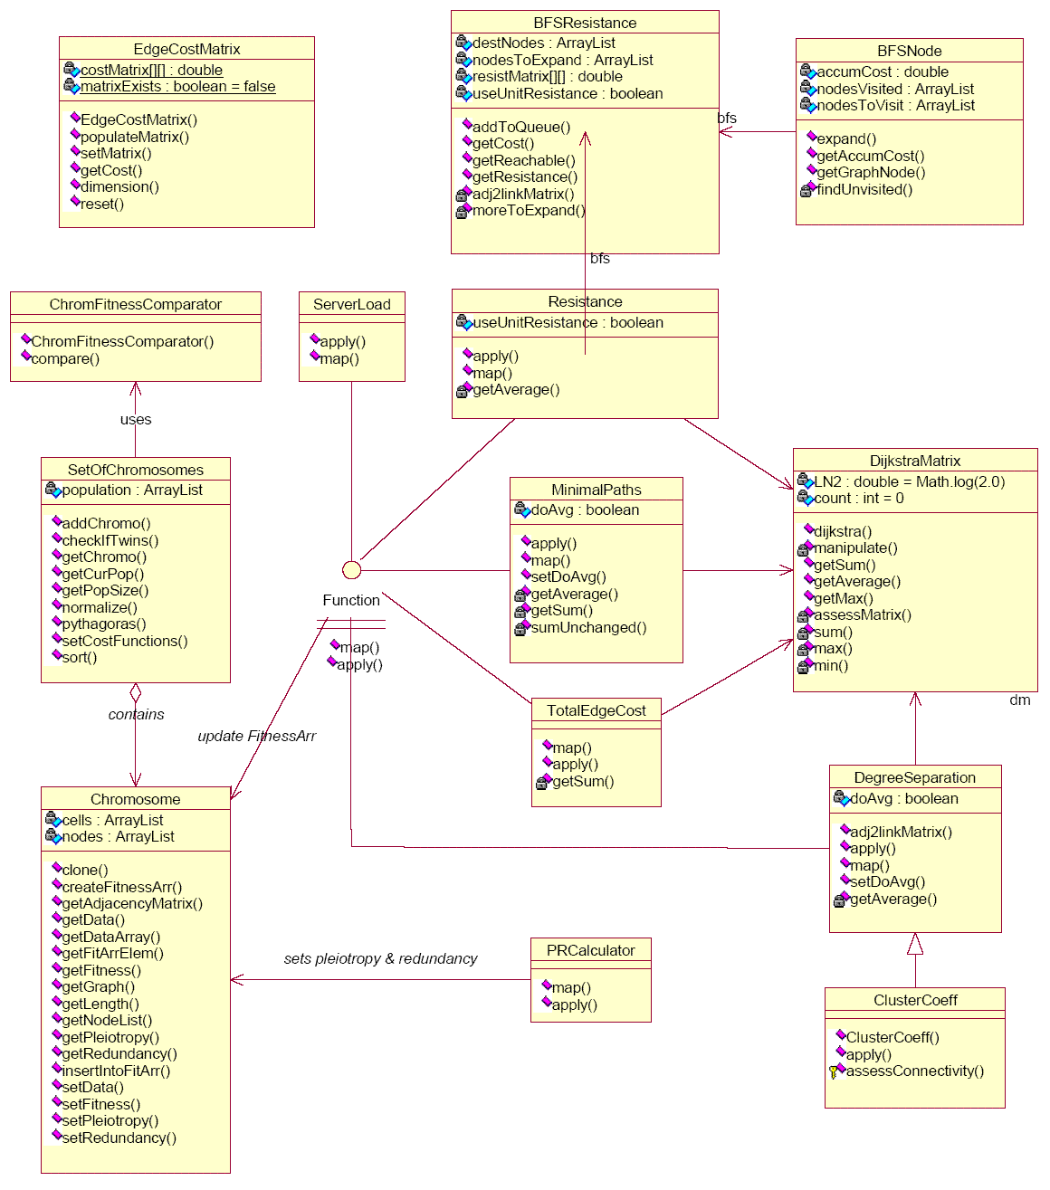
Package population
Structure governing to our solutions
  Chromosome contains the network topologies
  SetOfChromosomes keeps a sorted population of chromosomes
  DijkstraMatrix calculates the all-pair shortest paths.
Design patterns are used to simplify architecture (Grand 2002)
  Strategy allows cost functions to be attach or detached easily
  Adaptor allows many classes to use the same object
Notes:
The population is our set of solutions. Some of the important classes include the chromosome class, which is a one-to-one mapping of our graphs. SetOfChromosomes class stores a set of chromosomes. The DijkstraMatrix class contains the algorithms for the distance product.
We have used design patterns to simplify the development of NetSim.
Strategy design pattern accounts for the variety of different cost functions to measure the networks. The functions can be encapsulated in a common interface, so that they can be added, removed or altered independent of the evolutionary algorithms. The use of this pattern is apparent around the Function interface HERE.
The Adapter structure is used to allow classes containing the cost functions to use DijkstraMatrix[POINT] differently, because this class contains generic functions that operate on any square matrices. This is effective since it is not practical for including the methods in the classes that use them.

Slide 30
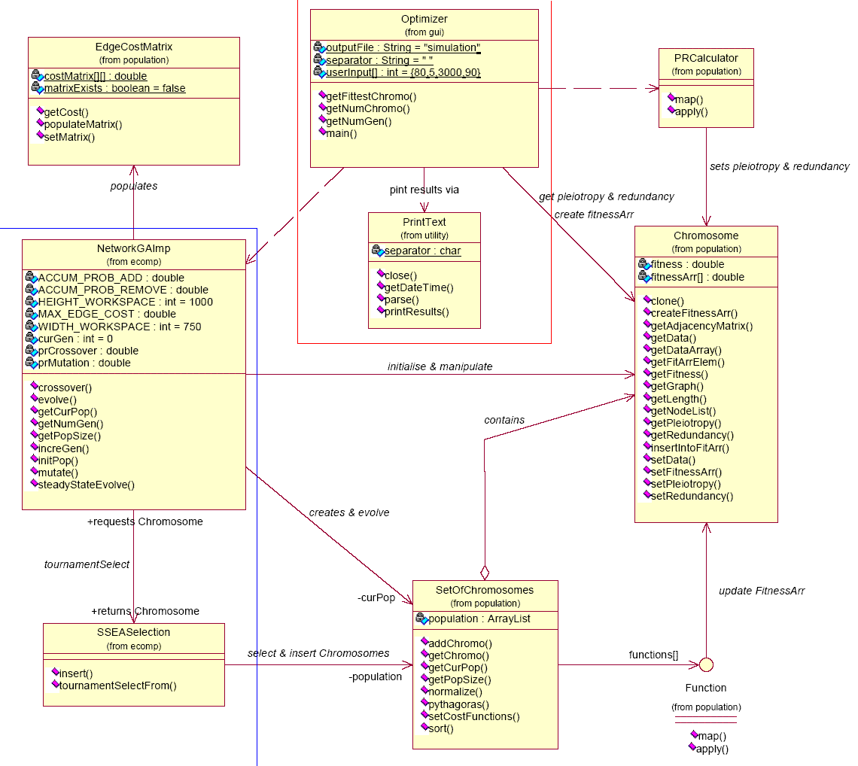
Architecture Overview
The top level interaction:
Notes:
This shows the top level interaction of NetSim.
The blue line marks the portion from the ecomps package.
The red line marks the interfacing classes from gui and utility. Optimizer is the driver for the software.
As you can see, the structure is simple, and there is very little interaction amongst the packages.
I would like to ask Zhiyang to continue this presentation, experiment

Slide 31
Test Environments
Apple PowerBook G4 notebook computer
  MacOS X
  1.5Ghz PowerPC G4 Processor
  1GB DDR RAM
Desktop computers
  Gentoo Linux 1.4
  Intel 3.0Ghz Pentium 4 (Prescott)
  512MB DDR RAM
Hydra Linux Cluster (SAPAC 2004)
  IBM eServer 1350 Linux cluster
  128 nodes and a head node for cluster management
  Each of the 128 nodes has dual Intel 2.4Ghz Xeon Processors
  Each node has 2GB DDR RAM

Slide 32
Experiments
Initial simulation results
  Total Cost of Edges in the Network
  Maximum Degree of Separation
  Average Load factor of servers
Correlation Test
  Fitness function used Pythagorean sum, assuming independence of cost functions
  Simulations carried for individual functions with same parameters
Pleiotropy and Redundancy under different conditions
  Tested for cases where there are more servers than clients, and more clients than servers
  Tested for all possible pairs of cost functions
Simulation of Symbiosis genetic operator

Slide 33
Results
Cost Function Correlation:
Cost Function Pair | Correlation
(1,2) | 0.3330
(1,4) | -0.1260
(1.6) | -0.2696
(1,7) | 0.2882
(2,4) | 0.1932
(2,6) | 0.0990
(2,7) | 0.1465
(4,6) | 0.2292
(4,7) | 0.1772
(6,7) | -0.1432

Slide 34
Summary Pleiotropy and Redundancy
Nodes |  | Pleiotropy |  | Redundancy
Clients | Servers | Avg | Stdev | Avg | Stdev
5 | 20 | 1.23 | 0.182 | 4.92 | 0.728
10 | 40 | 2.24 | 0.262 | 8.96 | 1.046
20 | 5 | 1.32 | 0.840 | 0.33 | 0.201
20 | 80 | 4.22 | 0.365 | 16.88 | 1.462
20 | 180 | 7.30 | 0.448 | 65.70 | 1.032
40 | 10 | 3.33 | 0.812 | 0.833 | 0.203
80 | 20 | 5.18 | 1.014 | 1.295 | 0.253
160 | 40 | 10.48 | 1.237 | 2.62 | 0.309

Slide 35
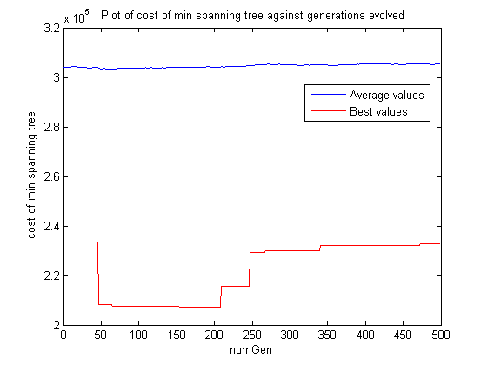
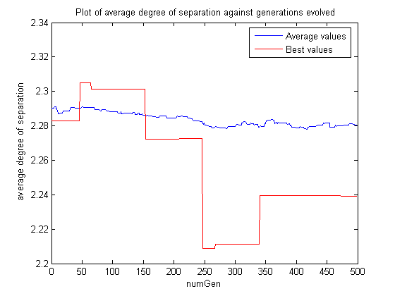
Cost of Minimal Spanning Tree vs Average Degree of Separation (1)

Slide 36
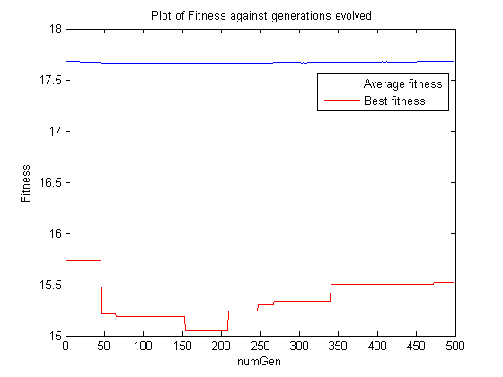
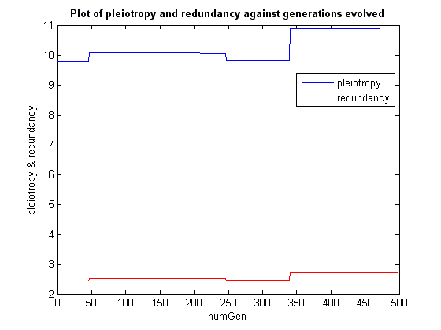
Cost of Minimal Spanning Tree vs Average Degree of Separation (2)

Slide 37
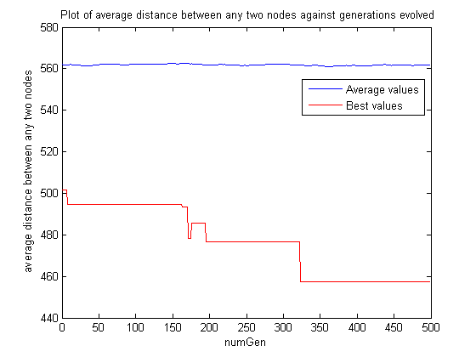
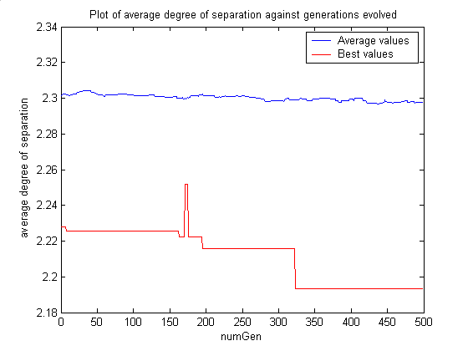
Average Distance between any two nodes vs Average Degree of Separation (1)

Slide 38
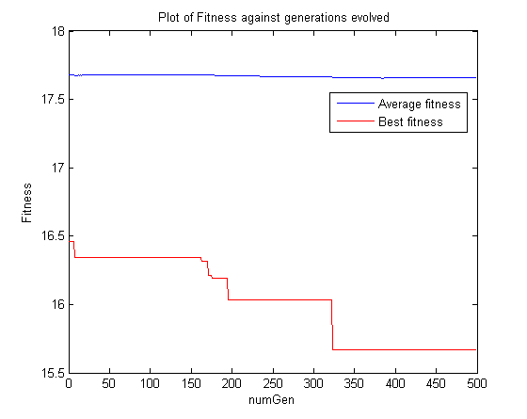
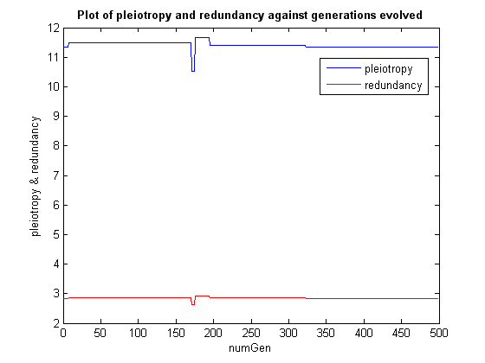
Average Distance between any two nodes vs Average Degree of Separation (2)

Slide 39
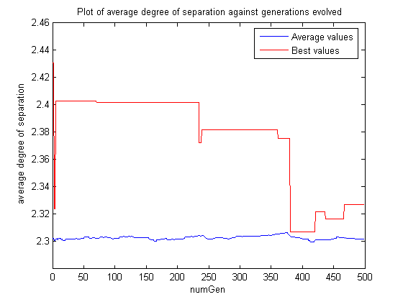
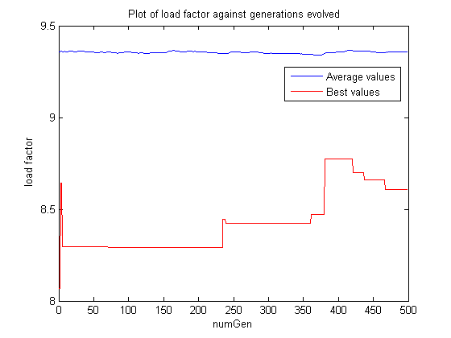
Average Degree of Separation vs Load factor (1)

Slide 40
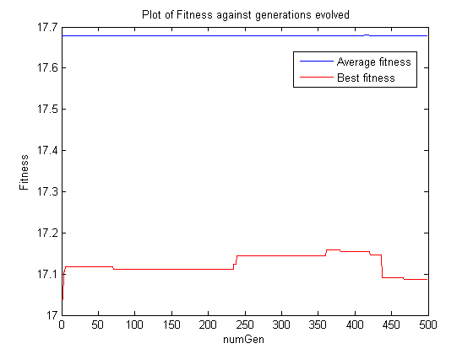
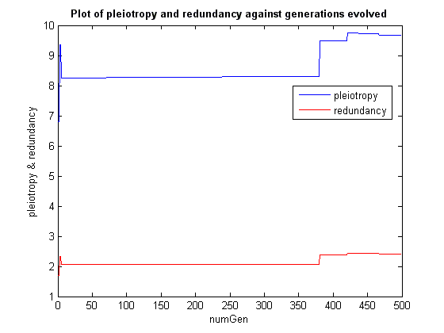
Average Degree of Separation vs Load factor (2)

Slide 41
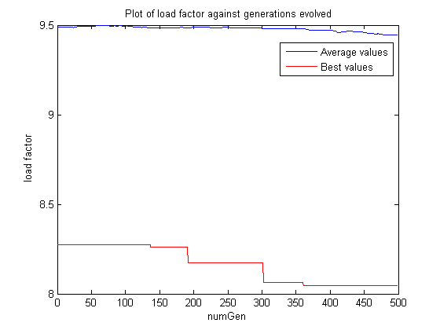
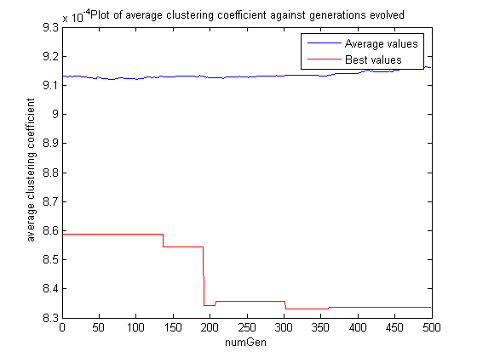
Load factor vs Average Clustering Coefficient (1)

Slide 42
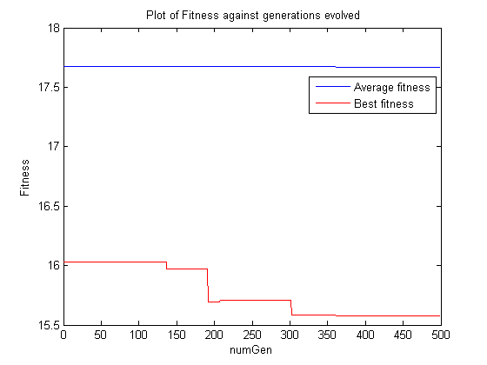
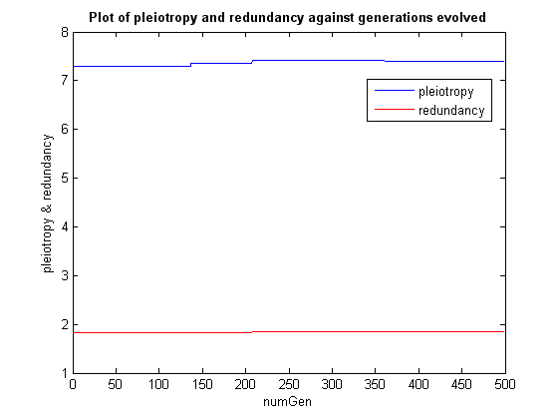
Load factor vs Average Clustering Coefficient (2)

Slide 43
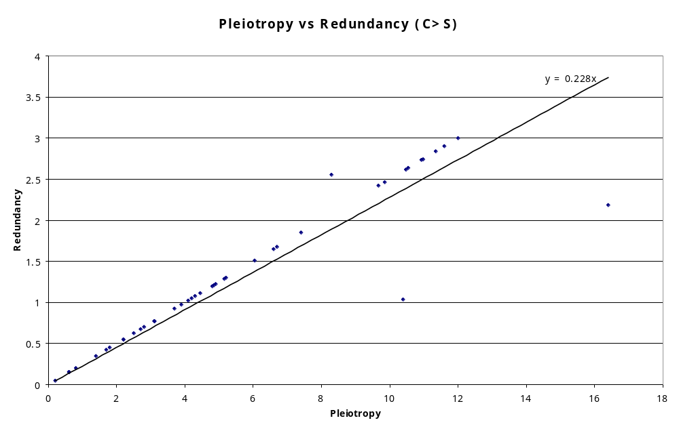
Pleiotropy vs Redundancy

Slide 44
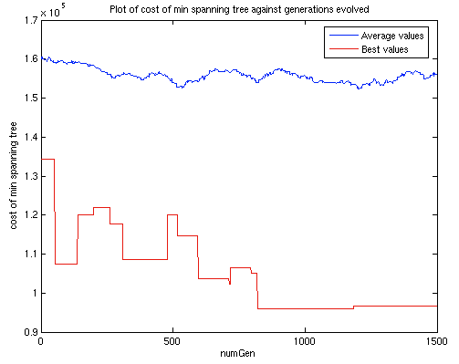
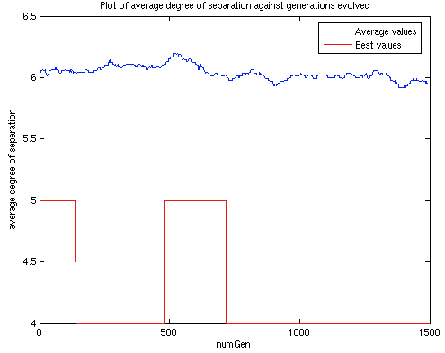
Symbiosis (1)

Slide 45
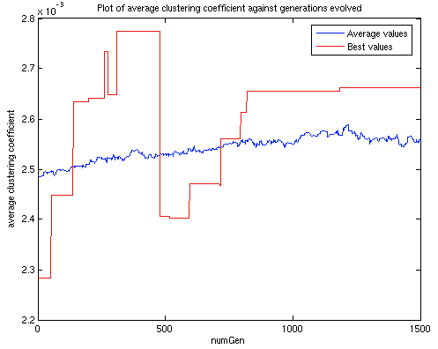
Symbiosis (2)

Slide 46
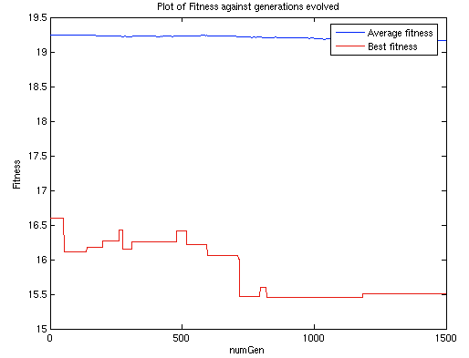
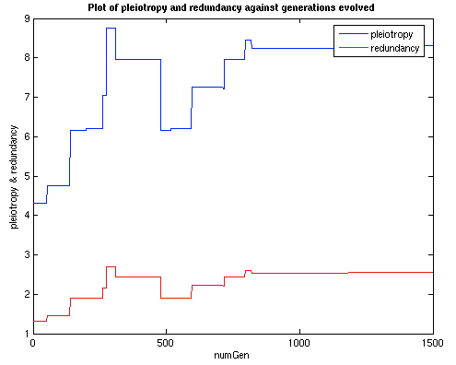
Symbiosis (3)

Slide 47
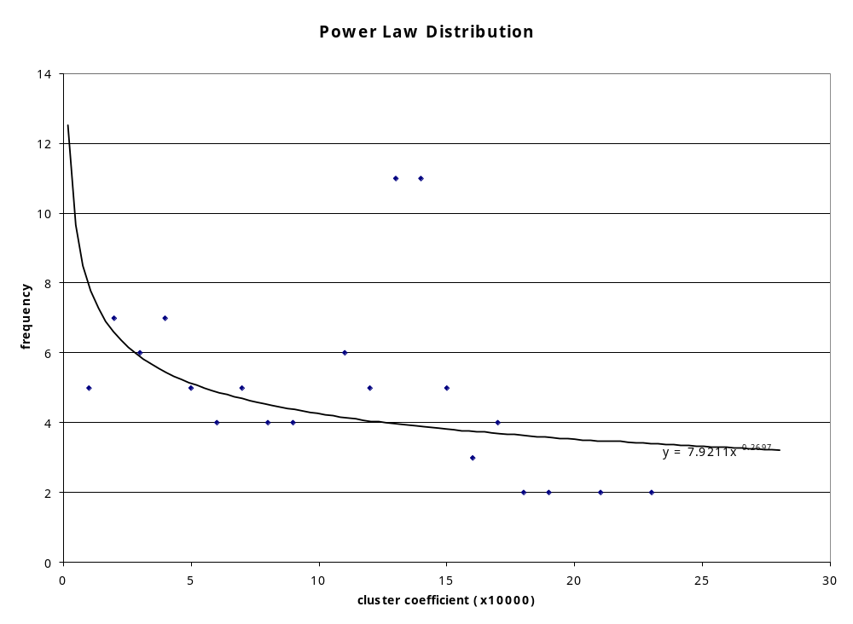
Power Law Distribution

Slide 48
Project Management
Difficulties Encountered
Configuration Management
  Denial of access to the “hatty” server during the summer break
  Disrupted computer support for the provision of Subversion
High memory requirements of NetSim simulations
  Simulated population of 80 chromosomes with 90 nodes
  Completed simulation runs for 3000 generations in an hour
Development of GUI for NetSim
  View of the network topology’s evolution
  User interaction via STOP, PAUSE and PLAY commands
  Importance of simulation results compared to GUI development

Slide 49
Milestones and Division of Work
Project Documentations
  Project proposal
  Project Reports
  Log books
  Technical paper
NetSim software
  Version 1.0
    Delivered 9 academic weeks late
    Completed with 4 more objective functions than targeted
    Determined failure and repair rates for the clients and servers using uniform distribution
    Accomplished the milestones for the first two versions of the software
  Version 2.0
    Delivered 6 weeks late
    Completed within expected time frame
    Added two additional cost functions

Slide 50
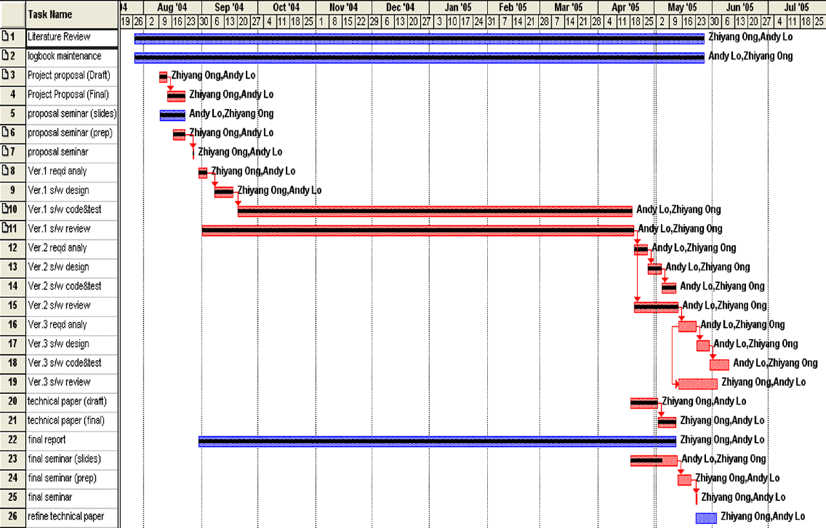
Timeline

Slide 51
Software Development Process Model
Software Development Process Model
  Values of Extreme Programming adhered to:
    Communication
    Feedback
    Simplicity
    Courage
  Software Quality Assurance
    Automated Unit and Functional Testing
    Informal code reviews
Budget
Risk Management
Side Tasks

Slide 52
Future Work
Improvement of Graph traversal algorithms
Modelling of telecommunication network routing
Application of conventional telecommunication network performance metrics
Multi-objective optimization of multi-layered telecommunication networks
Model amensal and parasitic relationships in the evolution of networks
Extend this research for social-economic networks and enhancement of current research in biological systems
Improvement to the GUI and feature of the NetSim software

Slide 53
Conclusion
Eight cost functions was provided to simulate a single layer network
  Discovered 5 are applicable
Pleiotropy and redundancy do not vary significantly due to SSGA
  Better if cost function used have negative correlation
Further investigation on optimization with EC with conflicting objectives is desired
This project could be applied to a multitude of networks

Slide 54
Demonstration

Slide 55
Questions?
Feel free to contact us by Email:
  ahl@ieee.org
  zhiyang@ieee.org

Slide 56
References (1)
Allen Consulting Group 2003, Executive Summary in Australian Mobile Telecommunication Industry, Australian Mobile Telecommunications Association, viewed 9 May 2005, available online: <http://www.amta.org.au/amta/site/amta/downloads/pdfs_2003/Executive%20summary.pdf>
Barabasi, Albert-Laszio April 2003, 'Second Link: Random Universe' in Linked: How Everything Is Connected to Everything Else and What It Means for Business, Science, and Everyday Life, Penguin Group Inc., USA
Barabasi, Albert-Laszio April 2003, 'The Last Link: Web Without a Spider' in Linked: How Everything Is Connected to Everything Else and What It Means for Business, Science, and Everyday Life, Penguin Group Inc., USA, p235
Berryman, MJ, Allison, A & Abbott, D 2004, 'Optimizing genetic algorithms strategies for evolving networks' in Proceedings of SPIE: Noise in Communication, L. B. White, Ed., vol. 5473, Maspalomas, Gran Canaria, Spain, 27-27 MAy 2004, available online: <http://arxiv.org/PS_cache/cs/pdf/0404/0404019.pdf>

Slide 57
References (2)
Berryman, MJ, Khoo WL, Nguyen H, Neill EO, Allison A & Abbott D 2003, 'Exploring tradeoffs in pleiotropy and redundancy using evolutionary computating' in Proceedings of SPIE: BioMEMS and Nanotechnology, D. V. Nicolau, Ed., vol. 5275, Perth, Australia, 10-12 December 2003
Deloitte 2005, Global telecommunications industry index 2005: Reconnected to growth, Deloitte Touche Tohmatsu, Zurich, viewed 30 April 2005: <http://deloitte.com/dtt/cda/doc/content/Global%20Telco%20Index%202005%282%29.pdf>
Fogel, DB 2000, Evolutionary Computation: Toward a New Philosophy of Machine intelligence, 2nd ed, Piscataway, NJ: IEEE Press
Grand, Mark 2002, Patterns in Java: Volume 1, 2nd edition, Wiley Publishing Inc, Indiana, pp209-216 & pp413-418
HP Architecture 2000, 'HP Architecture Overview', Hewlett Packard Company, viewed 22 May 2005: <http://www.architecture.external.hp.com/Overview/arch_what_architect.htm>
Kontio, Mikko 2004, 'Architectural manifesto: Designing software architectures, Part 1', developerWorks, IBM, viewed 22 May 2005: <http://www-128.ibm.com/developerworks/library/wi-arch7/>

Slide 58
References (3)
Obitko, Marek 1998, Selection, Introduction to Genetic Algorithms, Czech Technical University, viewed 9 May 2005: <http://cs.felk.cvut.cz/~xobitko/ga/selection.html>
Pohlheim, Hartmut, Genetic and Evolutionary Algorithms: Principles, Methods and Algorithms, viewed 9 May 2005, online: <http://www.systemtechnik.tu-ilmenau.de/~pohlheim/GA_Toolbox/algindex.html>
SAPAC, Hydra User's Guide - Cluster Hardware, South Australian Partnership for Advanced Computing, Australia, Viewed 2 May 2005: <http://www.sapac.edu.au/hydra/Hardware.html>
SAPAC, Hydra User's Guide - Overview, South Australian Partnership for Advanced Computing, Australia, Viewed 2 May 2005: <http://www.sapac.edu.au/hydra/Overview.htmll>
Telstra 2004, Annual report 2004: Operating and Financial Review and Prospectus, Telstra Corporation Limited, Melbourne, viewed 30 April 2005: <http://telstra.com.au/communications/shareholder/docs/operating.pdf>
Vinntec 1999, Networking Topologies, Vinntec Local Links Business Library, viewed 10 May 2005: <http://www.vinntec.co.uk/llnlnet8.htm>

Slide 59
References (4)
Zwick, Uri 2000, 'All Pairs Shortest Paths using Bridging Sets and Rectangular Matrix Multiplication', Journal of the ACM, vol. 49, issue 3, pp289-317, May 2002, available online: <http://arxiv.org/PS_cache/cs/pdf/0008/0008011.pdf>

