Slide 1
Toxic Comment Classification
CS 6120 - Data Analytics II
By Eda Bakir

Slide 2

Introduction
Toxic comments contains foul language, derogatory remarks
This could lead to
- Spread of hatred - Spread of racial slur - Overall tension communities - Attack in individual
It is abuse of freedom of speech
Thus, has to be monitored and censored on leading social networking sites

Slide 3
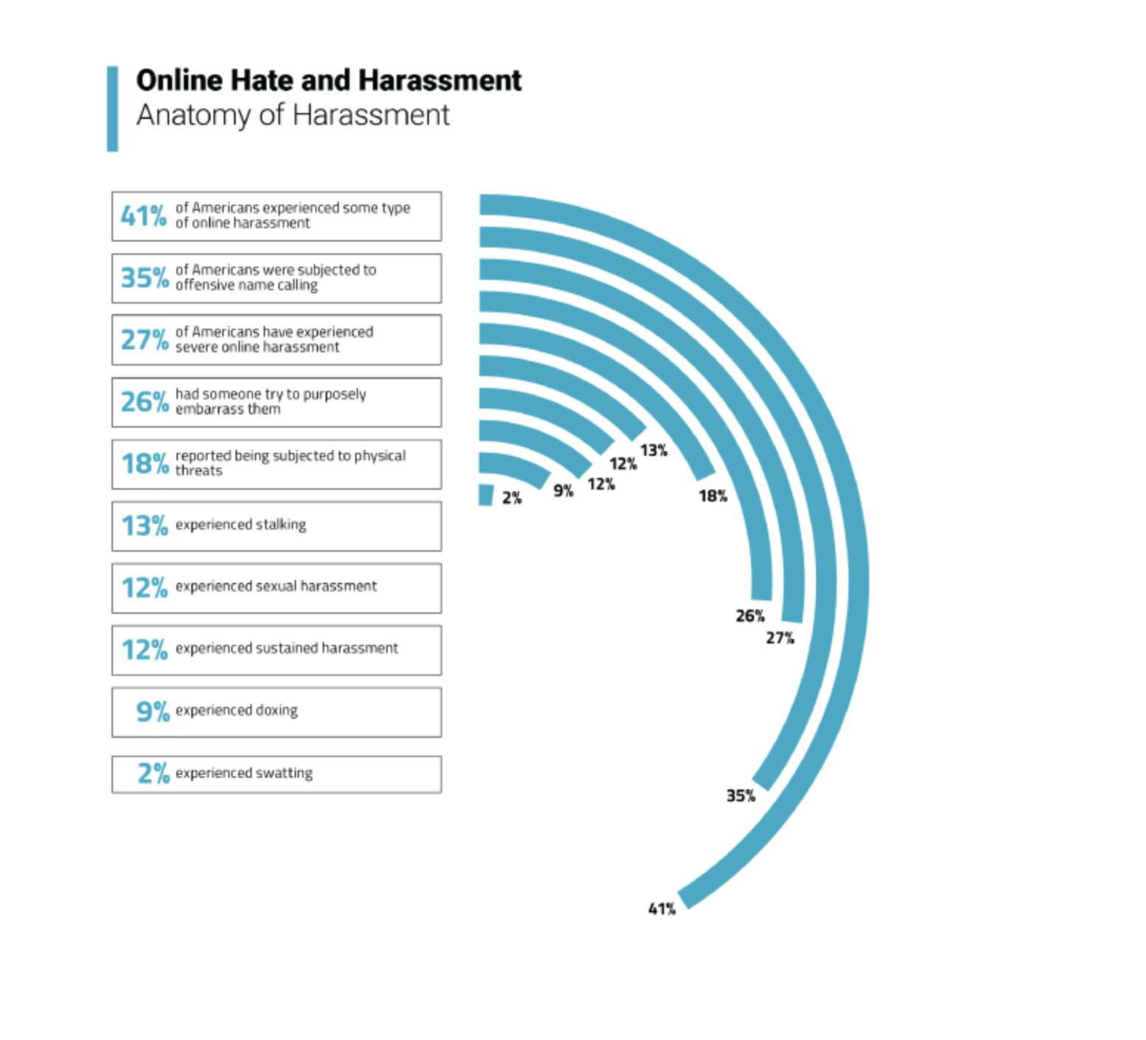
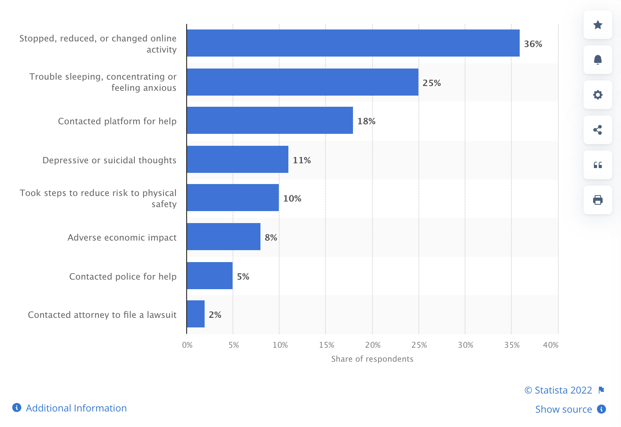
Why is it significant ?
Consequences of online hate and harassment according to internet users in the United States as of January 2020

Slide 4

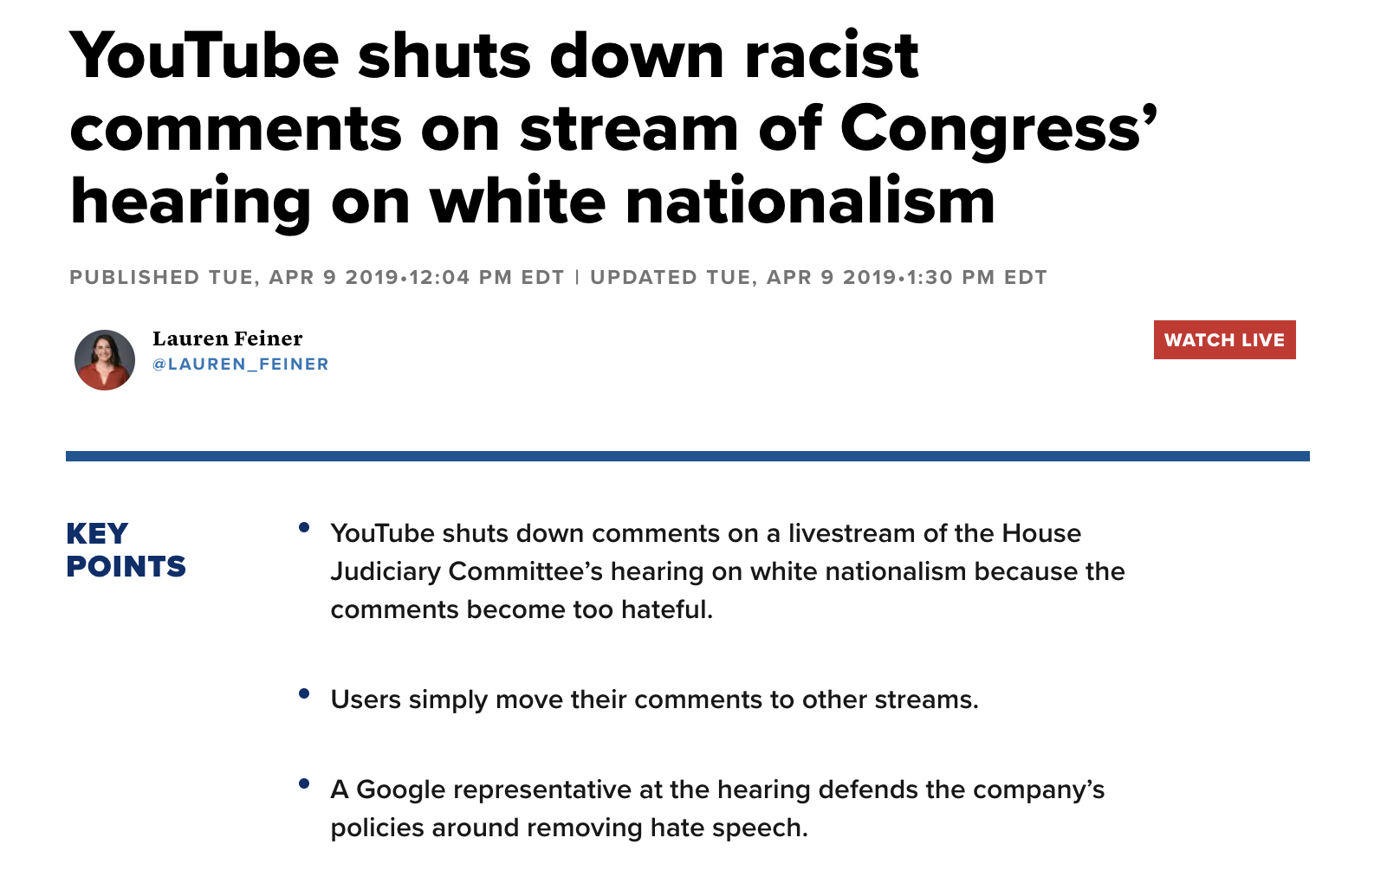
Why is it significant ?

Slide 5
Literature Review
The main contributions of this paper are following:
There are boundless posts from Facebook, Twitter, Instagram, and so on. However, some of them might include violence, obscene, threat, insult, etc. In order to efficiently identify and remove these posts and/or messages which violate the terms of service, we need some trained models to support spotting them out.

Slide 6

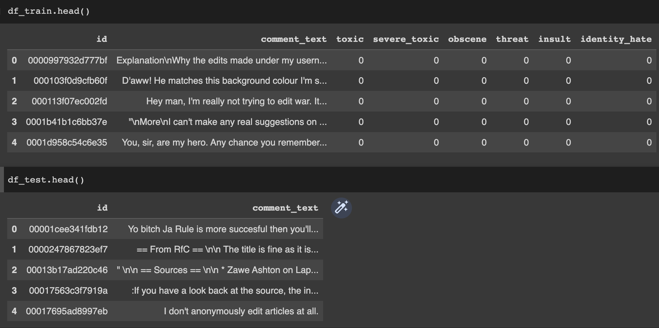
Toxic Comment Classification Dataset

Slide 7
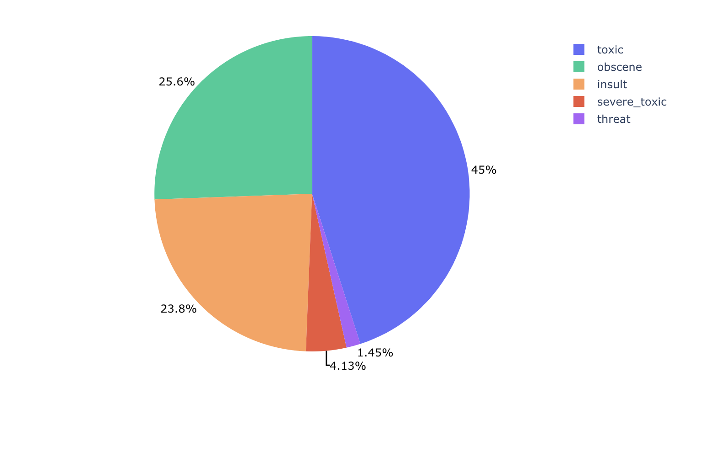
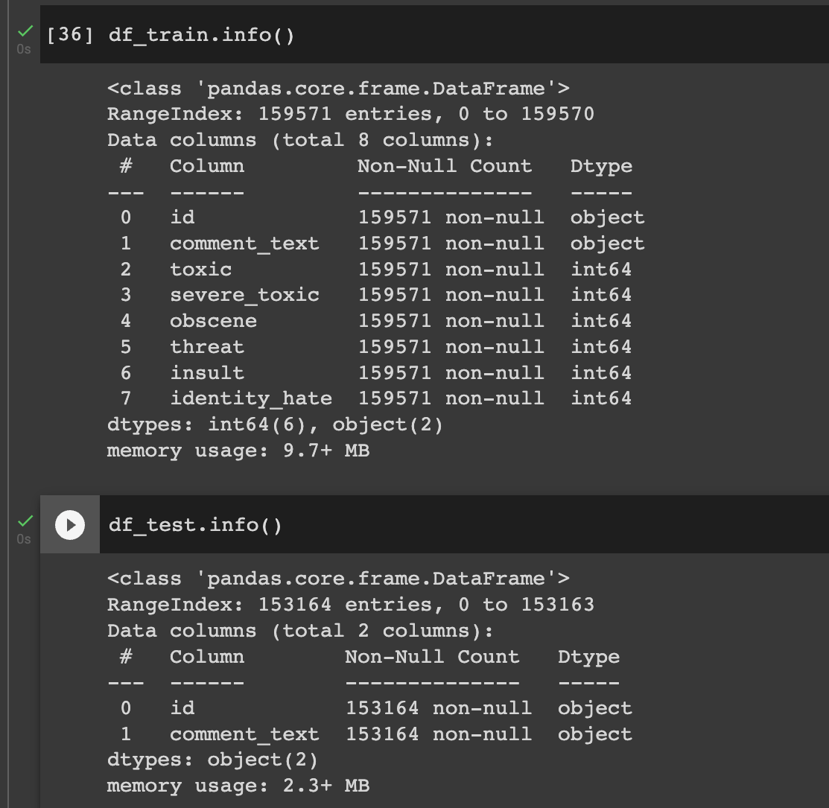
Exploratory Data
Analysis

Slide 8
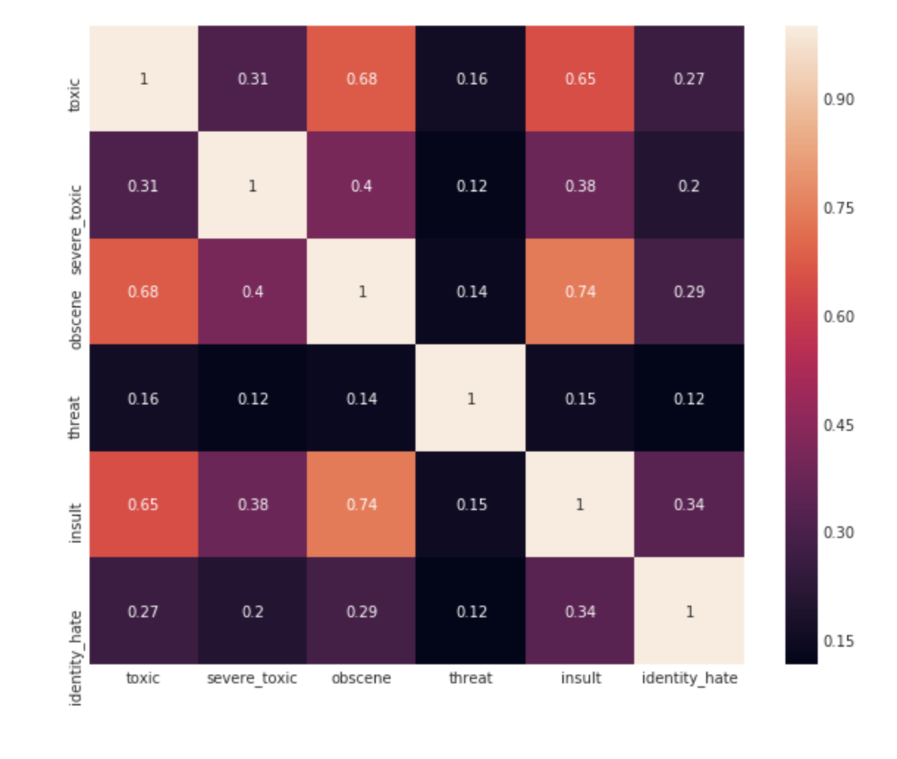
Correlation matrix for categories

Slide 9
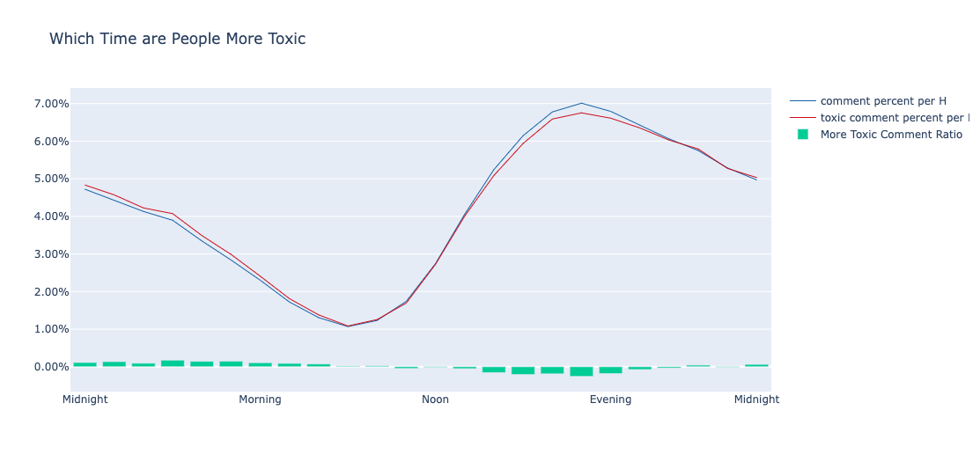
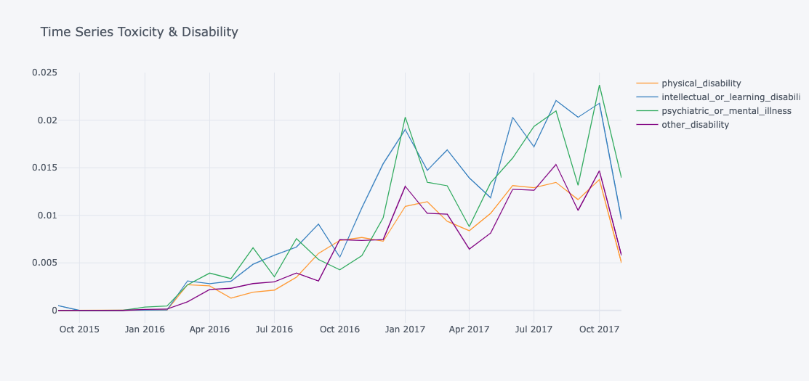

Slide 10
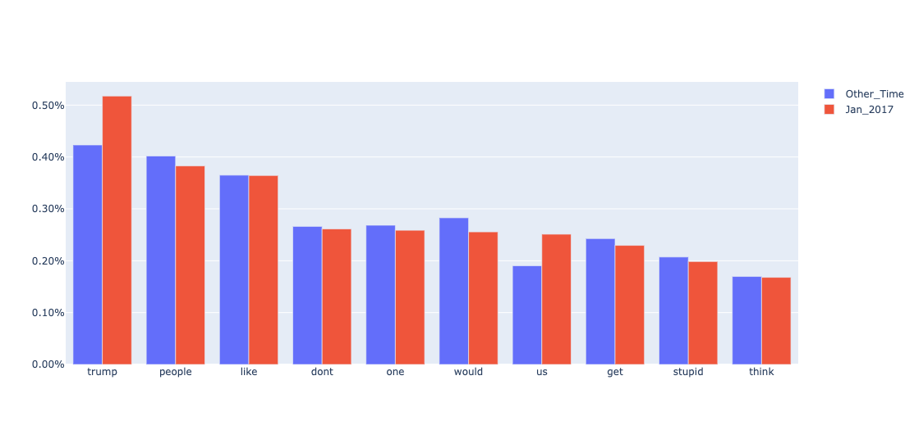
Word appears Top 10 in January 2017

Slide 11
DATA PRE-PROCESSING
Tokenization, which breaks down the sentence into unique words. E.g., ”AI is the future and ML is the future” becomes [”AI”, ”is”, ”the”, ”future”, ”and”, ”ML”]
Indexing, which makes the words in a dictionary like structure and assigns each of them an index. E.g., {1: ”AI”, 2: ”is”, 3: ”the”, 4: ”future”, 5: ”and”, 6: ”ML”}
Text to Sequence, which represents the sequence of words in the comments in the form of index and feed this series of index into the model. E.g., the original sentence becomes [1, 2, 3, 4, 5, 6, 2, 3, 4]

Slide 12
FEATURE GENERATION
TFIDF
Word Embeddings

Slide 13
METHODS
Long Short-Term Memory (LSTM)
Convolutional Neural Network (CNN)
Naïve Bayes - Support Vector Machine (NB-SVM)

Slide 14
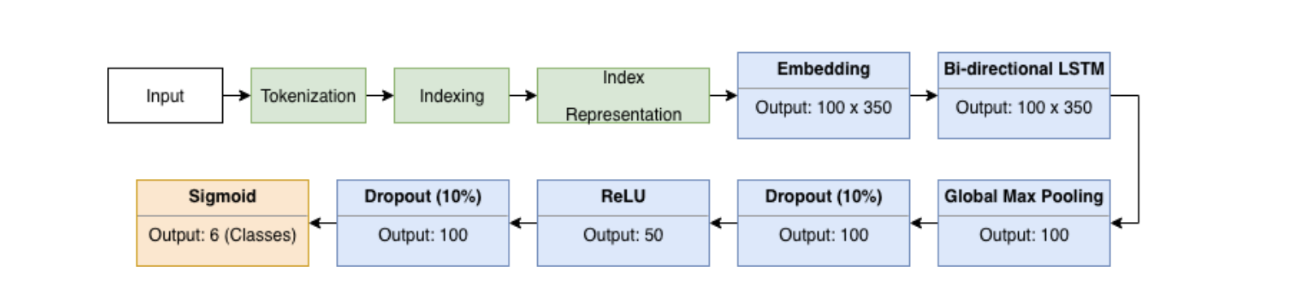
LSTM STRUCTURE

Slide 15
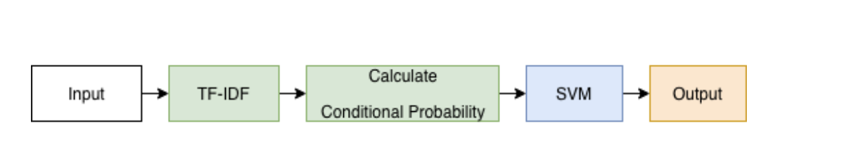
NB-SVM STRUCTURE

Slide 16
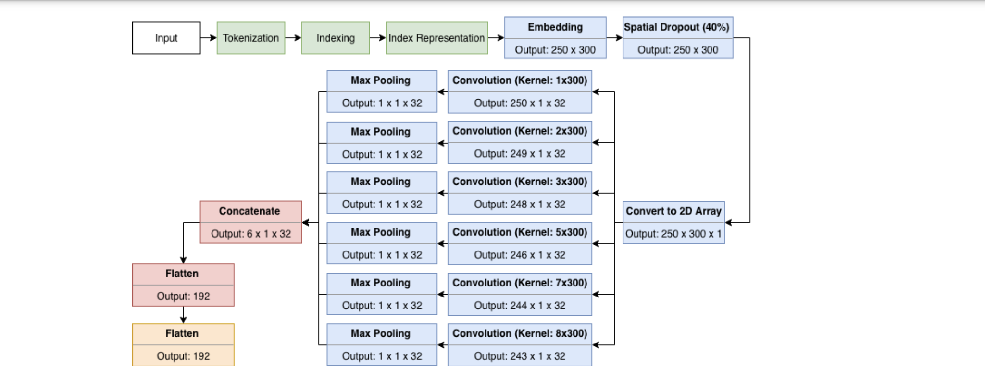
CNN STRUCTURE

Slide 17
Accuracy results were obtained:
Model | Accuracy | Loss
LSTM | 0.9860 | 0.0446
NBSVM | 0.9701 | 0.0428
CNN | 0.9652 | 0.0902
Literature Results:
Model | Accuracy | Loss
LSTM | 0.9832 | 0.0449
NBSVM | 0.9994 | 0.0127
CNN | 0.9946 | 0.0554

Slide 18
ANY FEATURE IMPROVEMENTS?
Special words like ’I’m’, ‘what’s’ maybe hard for the model to interpret on its own.
Six independent models were developed each for a label considering they are independent of each other.

