Slide 1
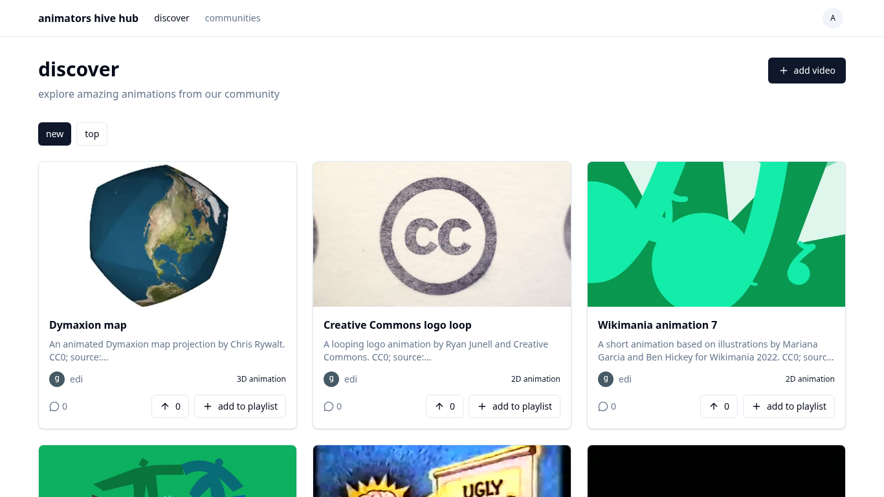
Animators Hub
A web platform for sharing and discovering animation
Computing Project presentation
Level 5 Diploma in Computing
Edem Angel Edem Hogan (P00193366)
AfriHUB · Supervisor: Mrs. Nkechi Ajaegbo
Notes:
Good day. My name is Edem Angel Edem Hogan. My project is Animators Hub, a web platform where animators share their work and viewers discover it. In the next ten minutes I will cover the background, the analysis and design, the testing, and a critique of how the project went.

Slide 2
Animation gets lost on general platforms
1
Competing with everything
On YouTube, Instagram and X, animation competes with every other kind of video.
The answer
A platform built only for animation
2
Ranking favours the already popular
Recommendations depend on how well a video already holds viewers (YouTube, 2026).
It ranks animation by its own criteria, so that less popular animators are found sooner.
3
AI-generated animation
Work made by animators can be overshadowed by AI-generated animation.
Notes:
Animators publish on YouTube, Instagram and X. There, animation competes with every other kind of video. YouTube says its recommendations depend on how well a video already holds viewers, which works against an animator with no following. A second concern is AI-generated animation, which can overshadow work made by animators. My answer is a platform built only for animation.

Slide 3
One aim and five objectives
Aim: to design and develop a web-based platform that allows animators to share their work and allows viewers to discover it easily.
O1
O2
O3
O4
O5
Upload
Discover
Respond
Collect
Connect
A video of up to 50 MB with a title, description and custom thumbnail
Browse by newest or most upvoted, and search by title and description
Upvote and comment on videos, and delete own comments
Create playlists and add videos to them
Join a community and post messages to it
Out of scope: private messages, video transcoding, native mobile apps, monetisation and live streaming.
Notes:
The aim was to design and develop a web-based platform that lets animators share their work and lets viewers discover it easily. There were five measurable objectives: upload, discover, respond, collect and connect. Some things were left out of scope on purpose, such as private messages, video transcoding and native mobile apps.

Slide 4
Method: iterative build with MoSCoW
Why not waterfall?
Must
Should
Won’t (this time)
Waterfall fixes requirements first and suits a stable platform.
This platform changed: React and Supabase in 2025, SvelteKit and Cloudflare in 2026.
Agile values responding to change (Beck et al., 2001).
Accounts
Upload
Discover feed
Animation page
Upvotes and comments
Playlists
Communities and messaging
Profiles
Owner edit and delete
Google sign-in
Reporting and moderation
Follows and notifications
Password reset
Email verification
Each small step had to pass a check, such as a successful build or a passing test, before it was marked done.
Notes:
I used an agile, iterative approach with MoSCoW priorities, not waterfall. Waterfall fixes the requirements first, and it suits a stable platform. My platform was not stable: the first build in 2025 used React and Supabase, and the final build in 2026 used SvelteKit and Cloudflare. MoSCoW made sure the Must features were built first. Each small step had to pass a check before I marked it done.

Slide 5
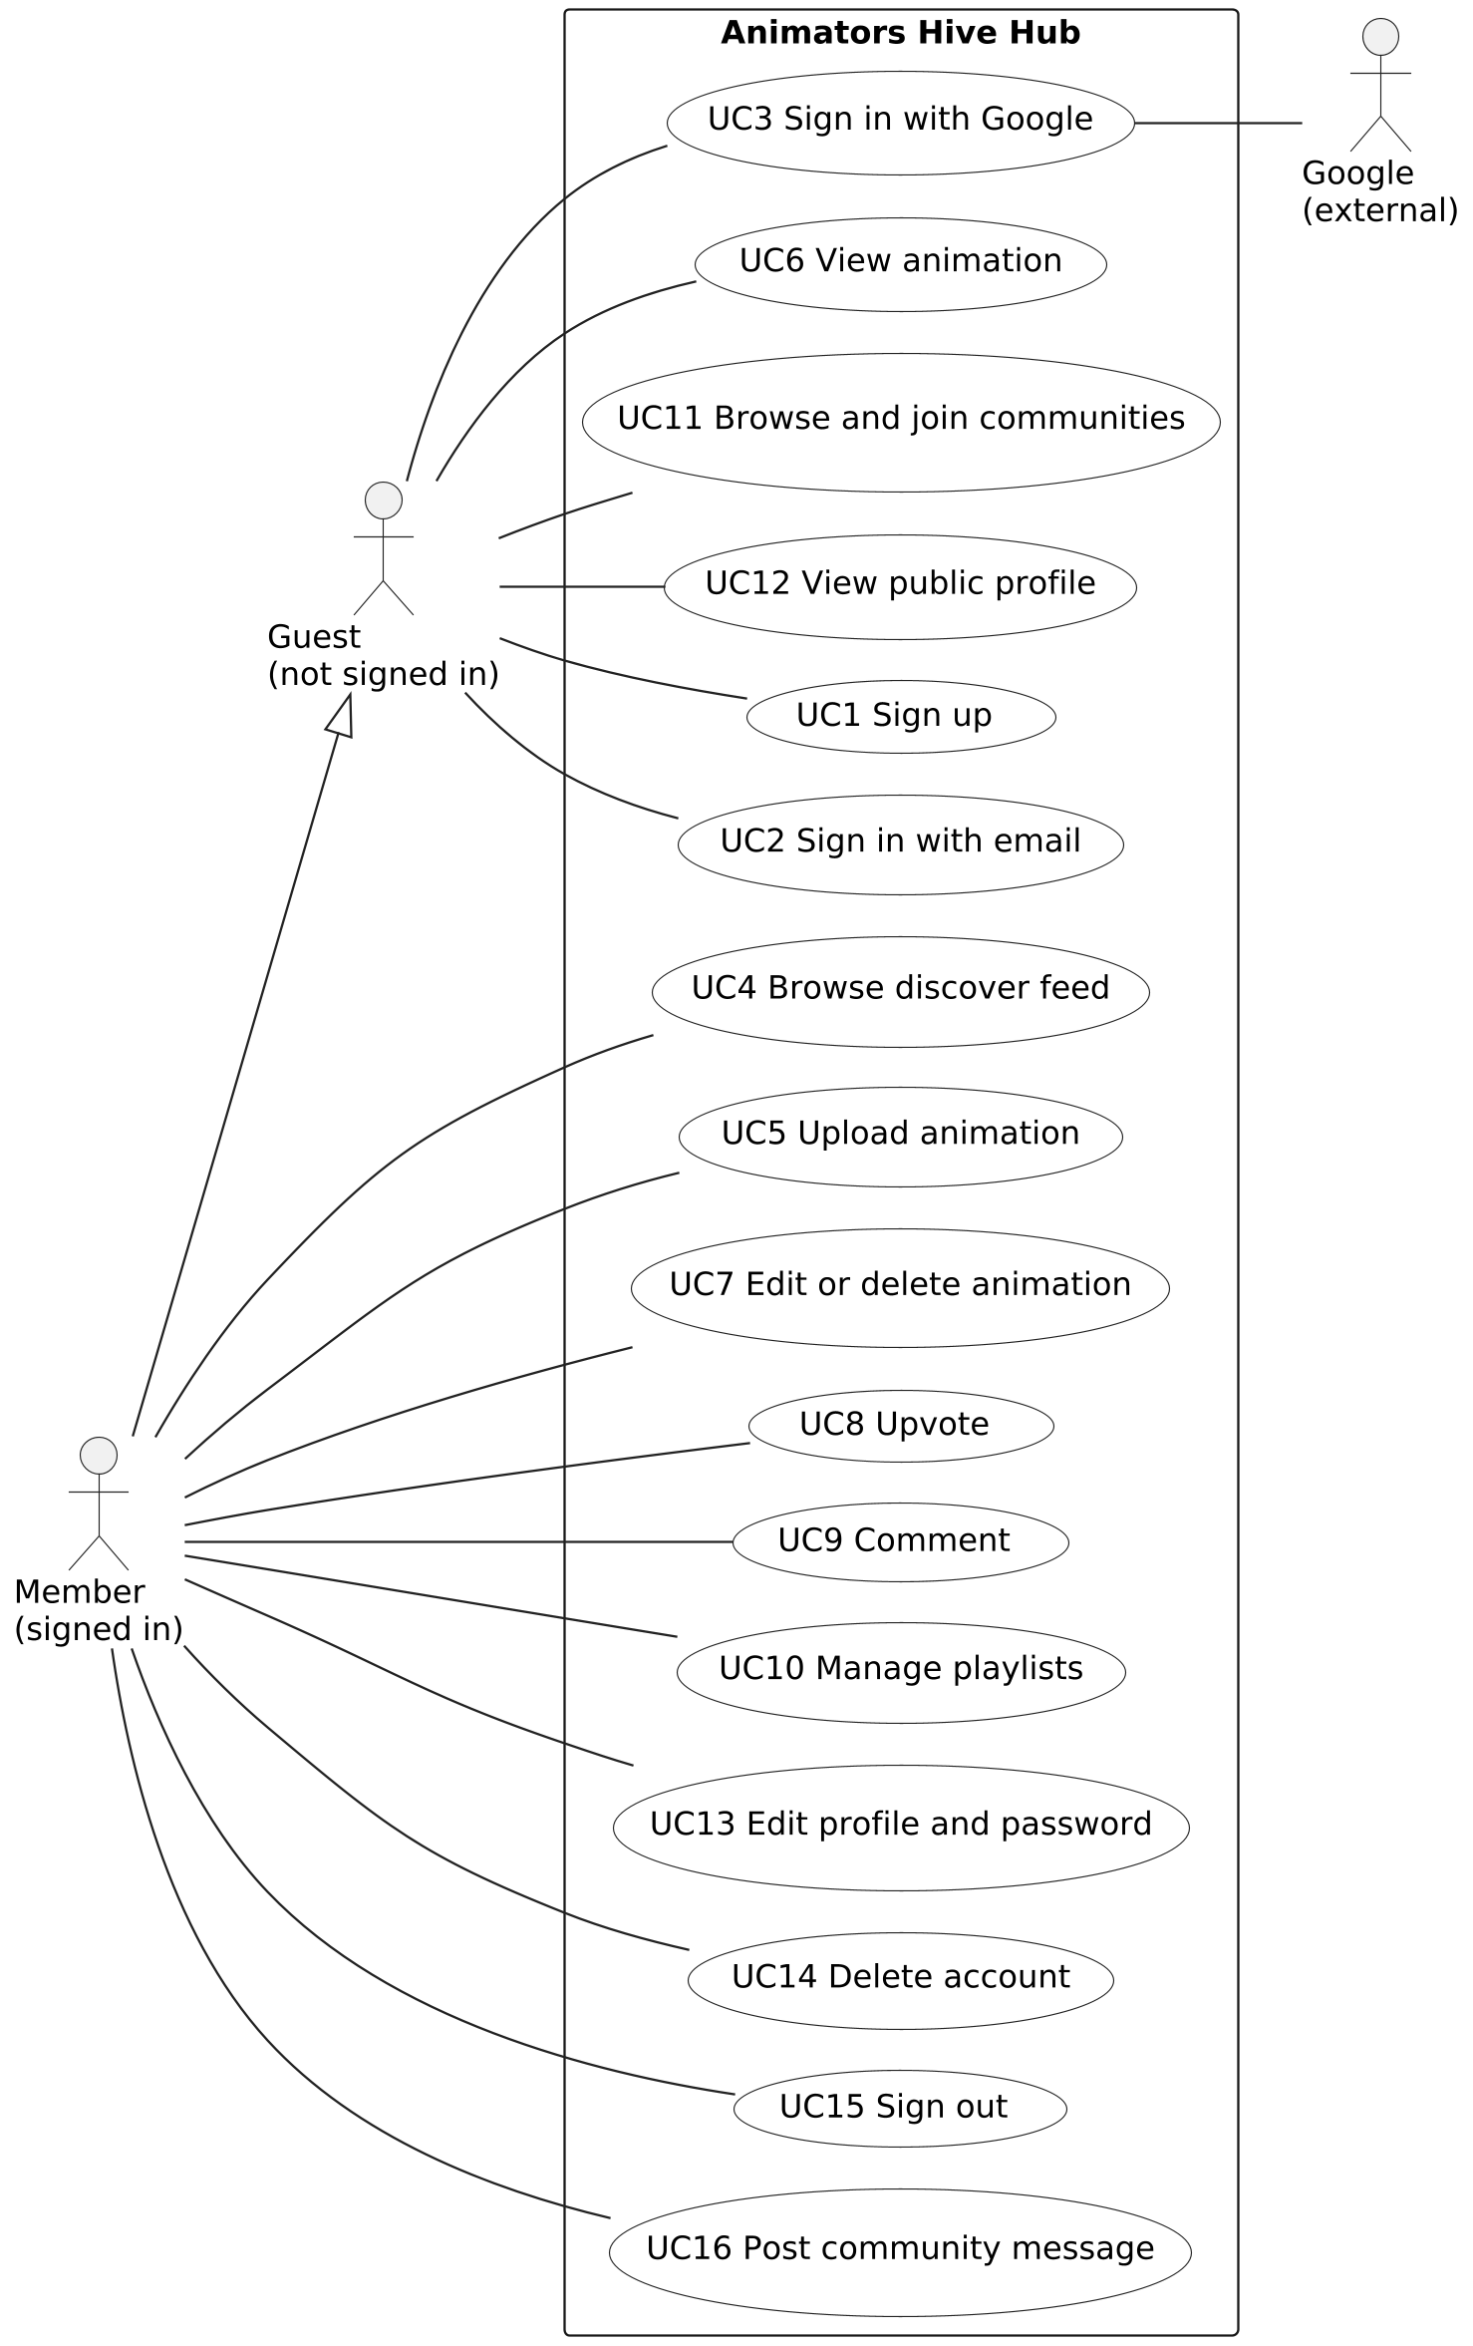
Analysis: requirements and use cases
14
functional requirements, each with a MoSCoW priority
10
non-functional requirements, each with a measurable target
16
use cases, each traced to a requirement
Three actors: Guest, Member and Google (sign-in only).
A guest can discover work; only a member can change data.
Security targets follow the OWASP Top 10 (2021).
Notes:
The analysis produced 14 functional requirements, each with a MoSCoW priority, and 10 non-functional requirements, each with a measurable target. The security requirements follow the OWASP Top 10. The use case diagram has three actors. A guest can discover work before signing up. Only a member can change data. Google is an external actor used only for sign-in. The requirements came from the proposal and my own judgement, because I did not interview animators.

Slide 6
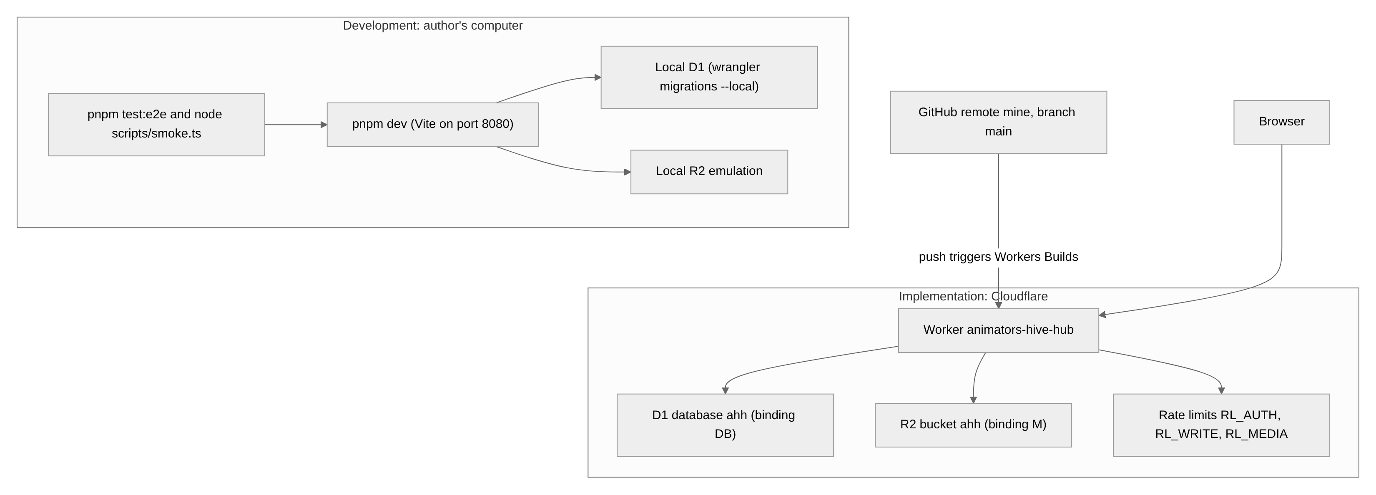
Architecture: one Worker guards all data
Browser
Cloudflare Worker
D1 and R2
Shows pages; sends forms and files
Builds pages; checks every request
D1 holds records; R2 holds media
Notes:
This is the technical architecture. On the left is the development computer. On the right is the implementation on Cloudflare. The browser shows the pages. A Cloudflare Worker builds each page, checks each request and applies the rules. The D1 database holds the records and R2 storage holds the videos and images. Only the Worker reads or writes the data, so every request passes the same checks. Google is used only for sign-in.

Slide 7
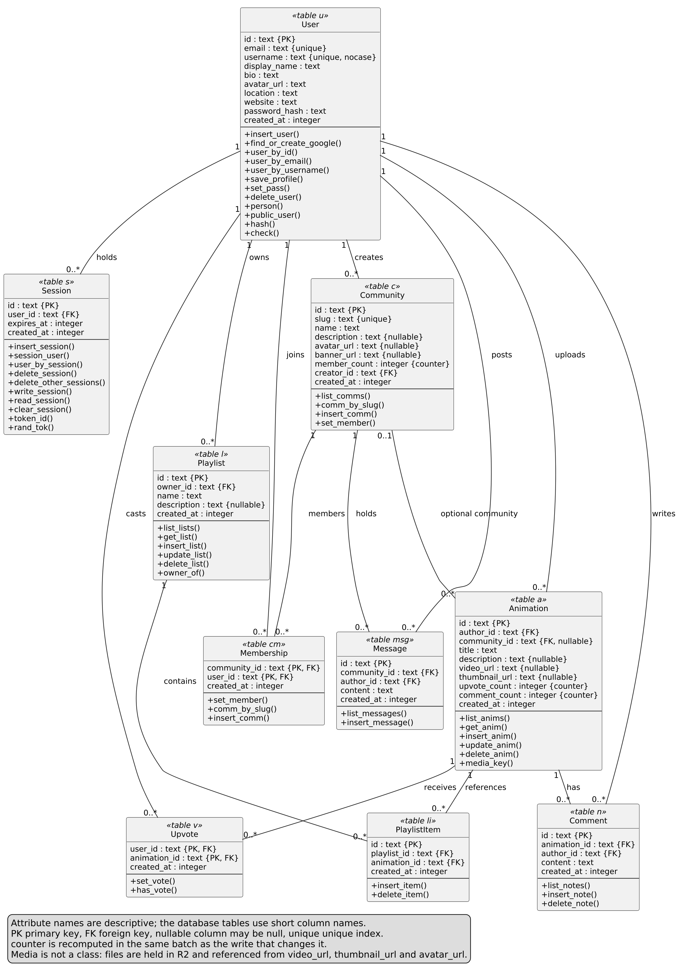
Design: the structural model
1
Ten classes, one per database table
Each association was checked against its foreign key.
2
Session class
Sign-out and password change end a session at once.
3
Membership and Message classes
They link each user to communities and their messages.
4
Stored counters
Upvotes, comments and members are recounted with each write.
Notes:
The structural model is a class diagram with ten classes. I built it by mapping each database table to a class and checking each association against its foreign key. Compared with the first class diagram, the design added a Session class, stored counters, an explicit Membership class, and a Message class for community messaging. Deleting a user removes everything that user owns.

Slide 8
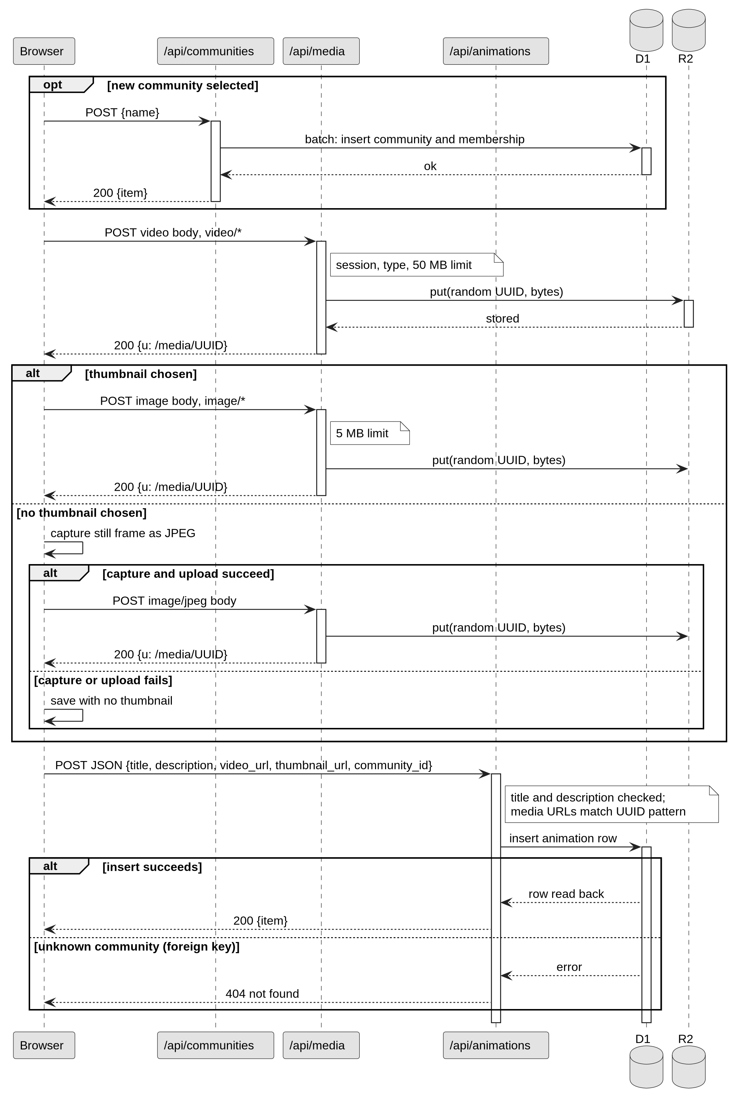
Design: behaviour and key decisions
Pages are built on the server
A shared animation link shows a preview without script.
Sessions are stored in the database
Sign-out ends them at once, for one lookup per request.
One hook checks every write
The session and the rate limit cannot be forgotten on a new route.
Media in R2, records in D1
The server accepts only media addresses that it issued.
Notes:
The behavioural model has three sequence diagrams: animation upload, Google sign-in and the upvote toggle. This one is the upload. The video goes to the server first, which checks its type and size and stores it. Then the title and description are saved, and the server confirms that the media address is one it issued. On the right are the four key design decisions and the reason for each.

Slide 9
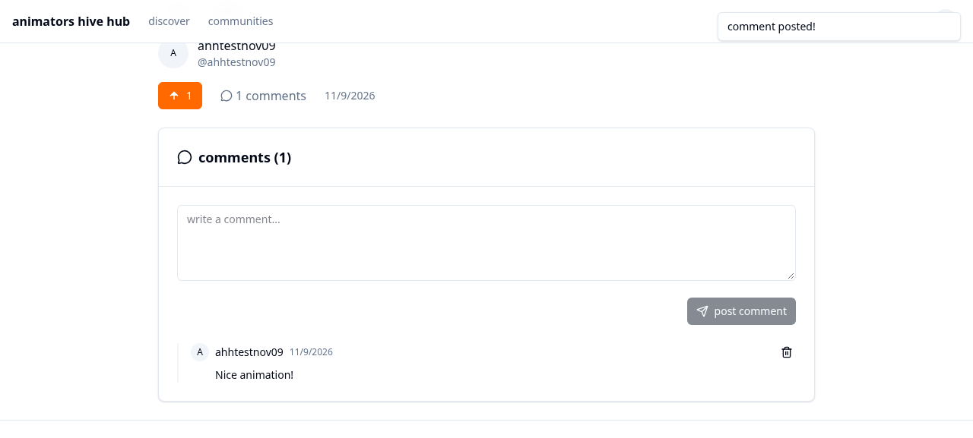
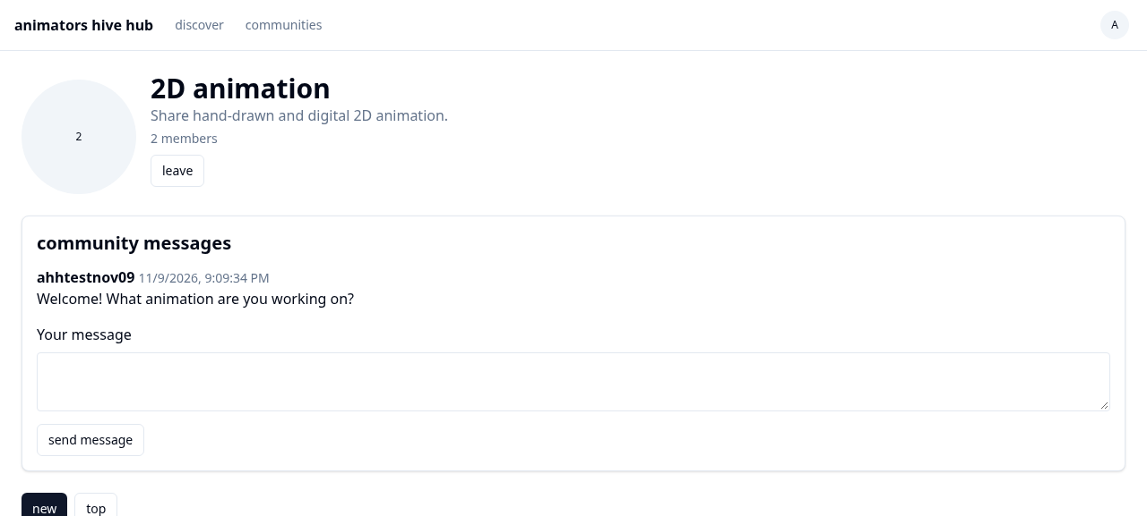
The solution: a live, deployed system
Discover feed
SvelteKit 2 · Svelte 5 · TypeScript · Tailwind CSS 4 · Cloudflare Workers, D1 and R2
Animation page (top) and community messages (bottom)
Notes:
This is the final system. It is live at animatorshub.apexlinks.org. It is built with SvelteKit, Svelte and TypeScript, styled with Tailwind CSS, and it runs as a Cloudflare Worker with D1 and R2. A push to the main branch on GitHub builds and deploys it. You saw these screens in the demonstration: the discover feed, the animation page with upvotes and comments, and a community with its messages.

Slide 10
Testing: black-box at three levels
Unit
9 scripts, one for each main class, run by hand and with curl
Integration
3 suites: member flow, security, and usability and accessibility
System
End-to-end browser suite (4 of 4), smoke script of 60+ API checks, type check, lint and build
84 of 87
cases passed. Every Must requirement works as specified.
Every case is traced to a requirement.
Notes:
Testing was black-box, as the module requires. Every test case checks what the system does against a requirement, so each case can be traced. There were three levels. Unit testing used nine scripts, one for each main class. Integration testing used three suites: the member flow, security, and usability. System testing used an end-to-end browser suite, a smoke script of more than sixty API checks, and the type check, lint and build. In total, 84 of 87 scripted cases passed.

Slide 11
Testing: what the results mean
84
1
2
passed
failed
not run
Accounts, upload, discover, upvotes, comments, playlists, communities, messaging and profiles work as specified.
Case 1.2.1: the sign-in rate limit is approximate. A first burst of 31 requests was not refused, so brute-force attacks are slowed, not stopped.
Google sign-in cases 2.4 and 2.5 need a real Google account. The flow was checked by reading the code.
Conclusion: the core features are correct. The tests were scripts that I ran myself, mostly on a local server, so they do not show behaviour under load, and no real users took part.
Notes:
What do the results mean? All the Must requirements work. One case failed: the sign-in rate limit. In a first burst of 31 sign-in requests, none was refused. This matters because it is the protection against brute-force password attacks, so I need to fix it and test it again. Two Google sign-in cases need a real Google account and were not run in the test session. My conclusion is that the system is correct for its core features, but the tests were scripts that I ran myself, so they do not show how the site behaves under load.

Slide 12
Critique: the plan against what happened
May
Jun
Jul
Aug
Sep
Oct
Nov
Planned
10 May to 7 September: 18 weeks
Actual
Rebuild, 26 Sep to 21 Oct: about 4 weeks. Messaging in Nov.
What went well
What did not go well
The move to SvelteKit and Cloudflare: one platform, fast pages
All five objectives were met
Security controls were built in from the start
Decisions were written down as they were made
The first build and its data were lost
Every objective was met after the planned date
Testing ran once at the end, not alongside the build
Reporting and administrator removal were forgotten
No animators were asked what they wanted
Notes:
Now the critique of the process. The proposal planned 18 weeks, from 10 May to 7 September 2026. The work started earlier, with the first version, but I had to redo it, and the rebuild ran from 26 September to 21 October, about four weeks. Community messaging followed in November. What went well: the new platform, the five objectives, the security controls, and my notes on decisions. What did not go well: the first build and its data were lost, every objective was met late, testing ran once at the end, and I forgot the reporting and administrator features.

Slide 13
What I learned and would change
What I learned
Next time I will
1
Back up work often
The first version and its data existed only in a hosted service.
Do user research first
Ask animators what they want before fixing the requirements.
2
Plan realistic time with buffers
Redoing work took the time meant for testing and debugging.
Manage my time
No important part of the project is rushed or left incomplete.
3
Test each feature when it is built
Make it more interactive
The rate limit problem was found only in the final test run.
For example, direct messages between users.
Notes:
What did I learn? First, to back up my work more often and be more responsible for it, because my first version and its data were lost. Second, that time management needs realistic planning and early buffer periods, especially for testing and debugging. Third, to write and run each test as soon as its feature is built. Next time I will do user research first, manage my time so that no part is rushed, and make the project more interactive for its audience, for example with direct messages. The skill I improved most was report writing.

Slide 14
Further work and conclusion
Further work
Animators Hub is live
1
Reporting, administrator removal, terms of use and copyright confirmation
Animators upload their work. Viewers discover it, upvote it, comment on it, collect it in playlists and talk in communities.
2
A checker for AI-generated animation at upload
3
Direct messages between users
All five objectives were met, later than planned.
4
An exact sign-in rate limit, and password reset by email
Thank you. Questions?
Notes:
To conclude. The first item of further work is what the proposal promised and I did not build: reporting of content and removal by an administrator. Next come a checker for AI-generated animation at upload, direct messages between users, an exact sign-in rate limit, and password reset by email. Animators Hub is live. Animators can upload their work, and viewers can discover it, upvote it, comment on it, collect it in playlists and talk in communities. All five objectives were met, although later than planned. Thank you. I am happy to take your questions.

