Slide 1
Homebook A home-repair services app
Team Name: GG
Contributors:
Yaman Malik, Eric Dam, Shumael Syed, Arjuunan Arulnamby

Slide 2
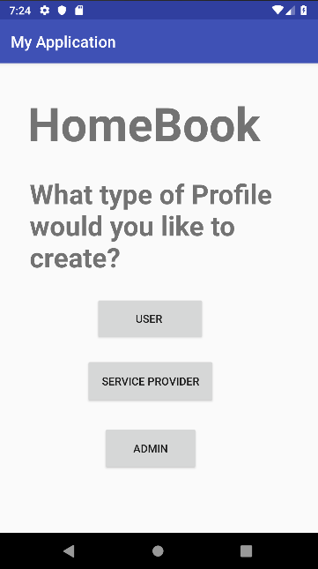
Main menu
Seen upon opening of the app
Includes three buttons on the screen to allow account creation
User button redirects to page for User account creation
Service Provider button redirects to Service Provider Account creation
Admin button redirects to Admin account creation

Slide 3
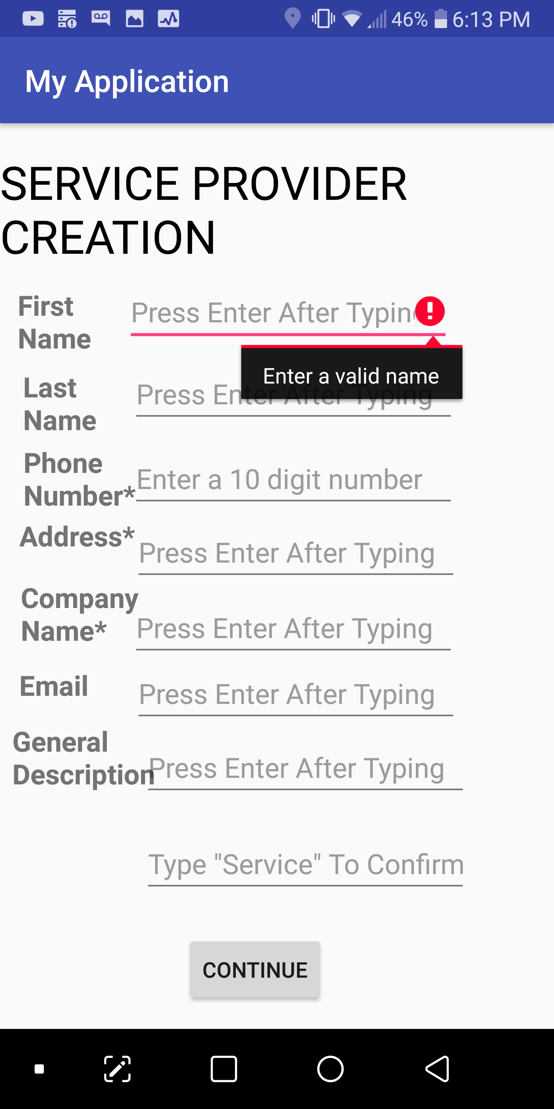
Service provider initial screen
Account creation screen for Service Provider
Prompts the service provider to enter their information, first name, last name, etc.
Fields are validated to ensure continue button cannot redirect until all fields have input
Phone number field is validated to ensure only 10 digit phone number can be entered
Continue button redirects to Service Provider main screen

Slide 4
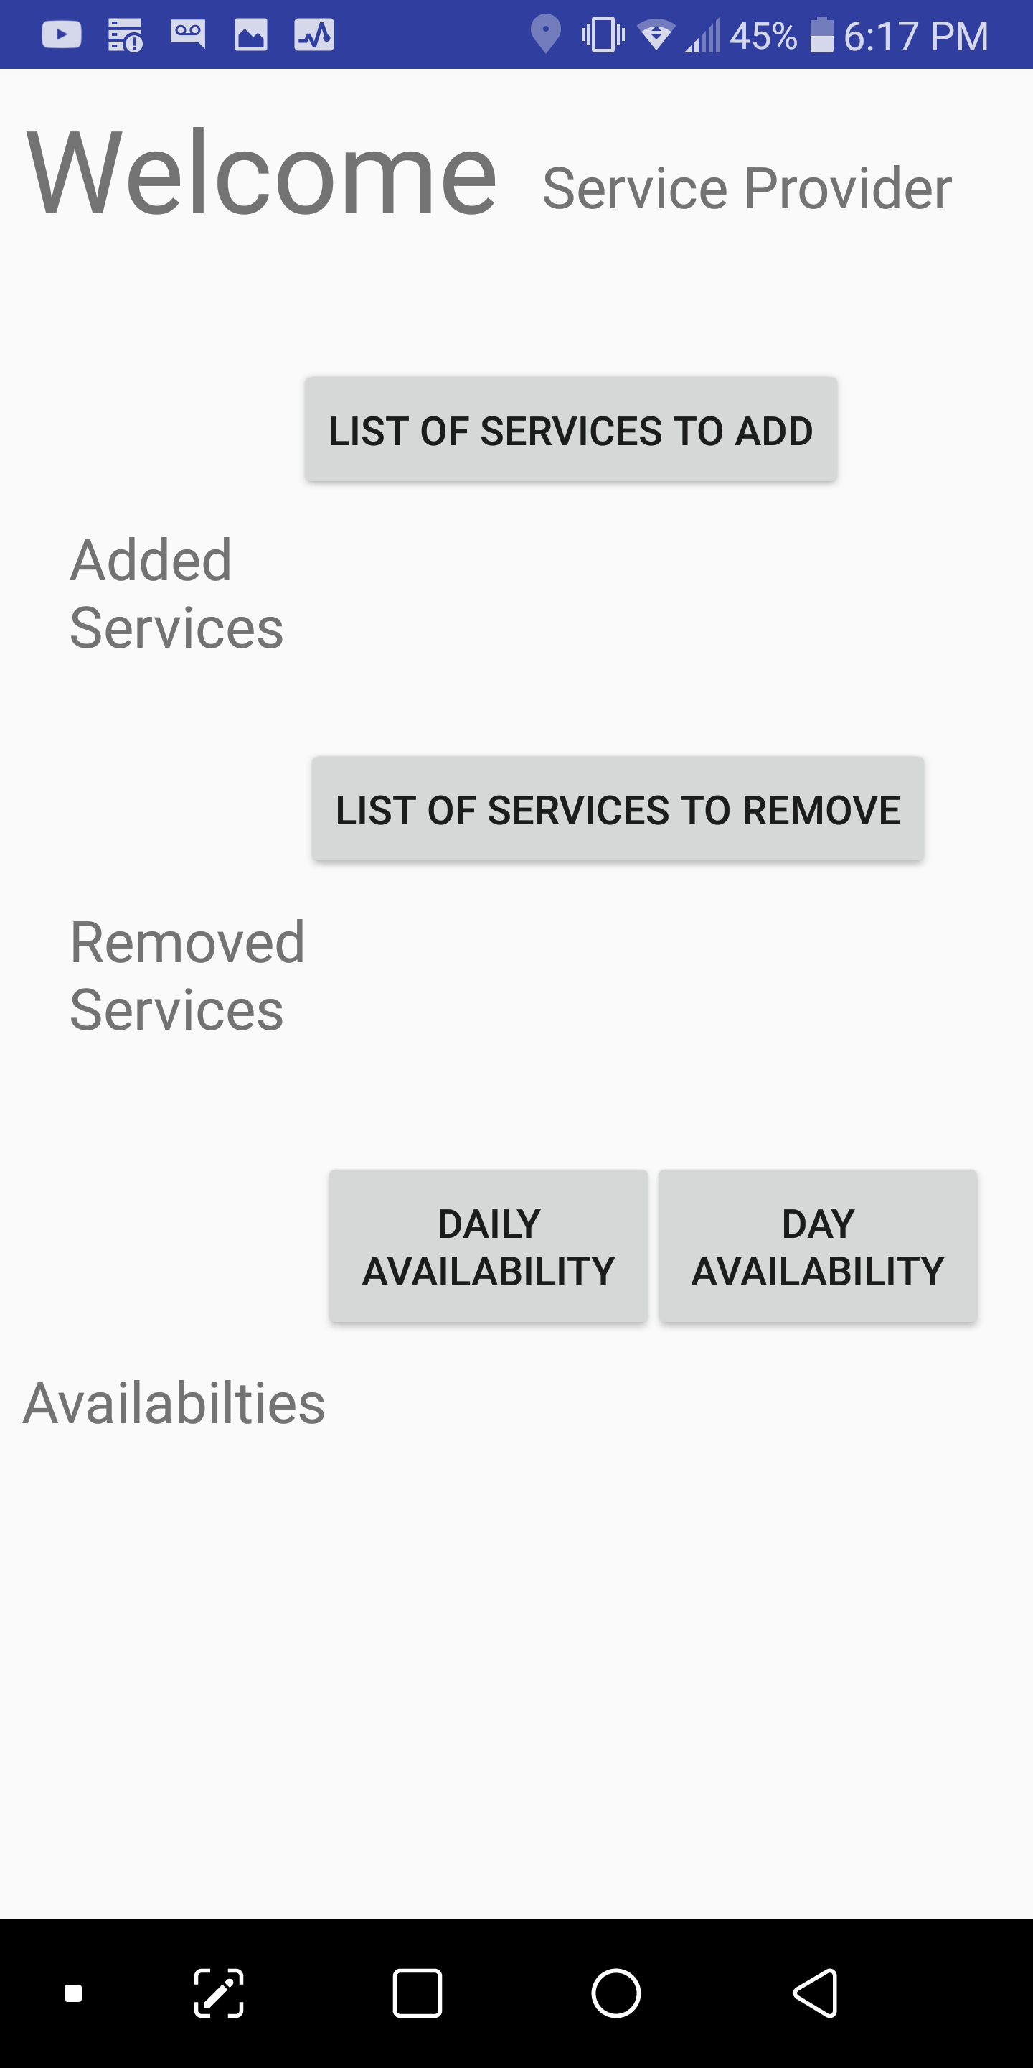
Service provider main screen
After Service Provider enters information, continue button redirects here
Includes button to allow Service Provider to add services
Includes button to allow Service Provider to remove services
Buttons are dropdowns to allow Service Provider to select multiple options, shown next slide

Slide 5
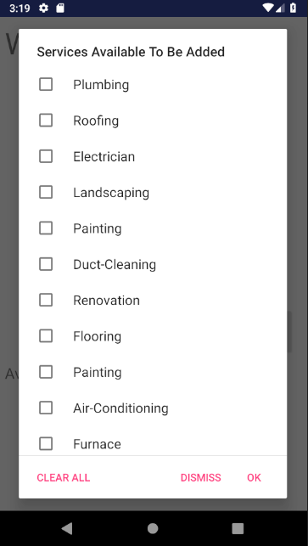
Dropdown menu for adding new services
Upon clicking the button, dropdown menu appears as pop-up
Checklist format allows Provider to select multiple at once
Clear All button clears all selected choices
Ok button confirms choices
Dismiss button closes pop-up dropdown without confirming

Slide 6
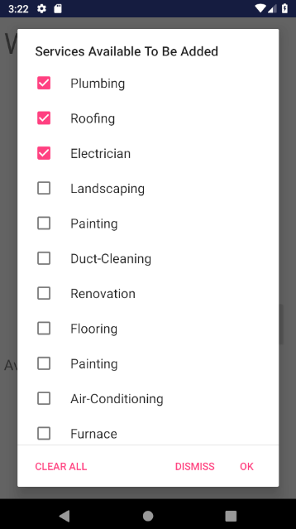
Services selected as an example
Screenshot of dropdown menu with options selected

Slide 7
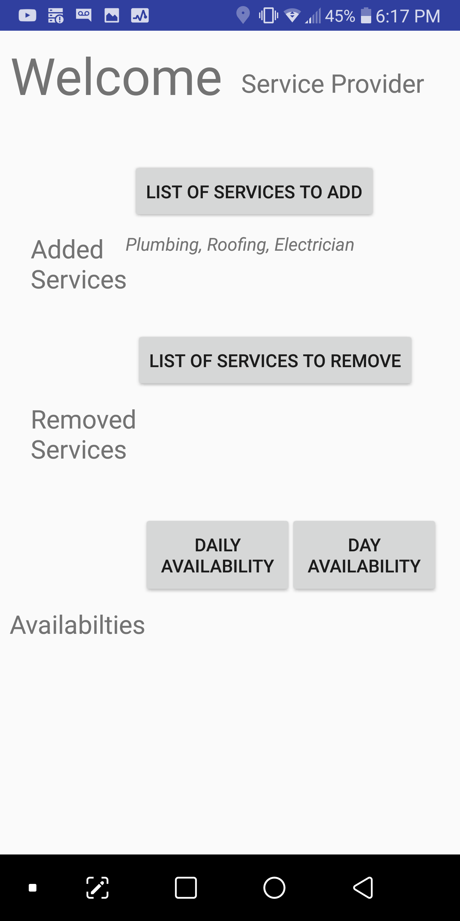
Services selected as an example
Service Provider screen after three options were confirmed
Selected options are displayed in a TextView below the button

Slide 8
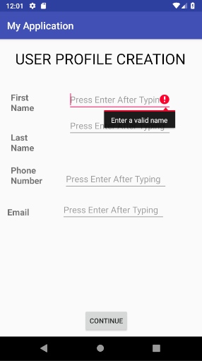
User main screen
User button from Main Screen redirects here
Users prompted to enter their information
First Name, Last Name, Email, fields validated to check if input provided
Phone Number field validated to ensure 10-digit phone number entered
Continuing takes user to Service searching screen

Slide 9
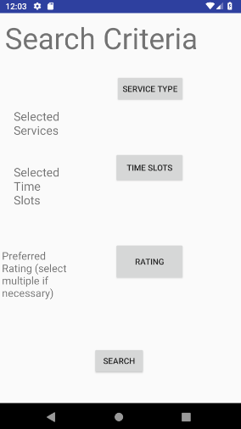
Searching for a service
Three dropdowns on this screen to allow User to search for a service
User can select Service Type from a dropdown
User can select a time slot from a dropdown
User can select a star rating they prefer the service provider to have (eg. 4.0 star and above)
Search button takes User to Booking screen

Slide 10
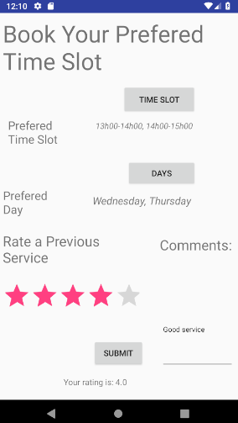
Booking a service
User can select their preferred time and day to book a service on this screen
Dropdown menus present to select a preferred time and day
Example shown with 1-3PM on Wednesday and Thursday selected
Second half of screen allows user to provide a star rating for one of their previous service experiences and provide a comment about it

Slide 11
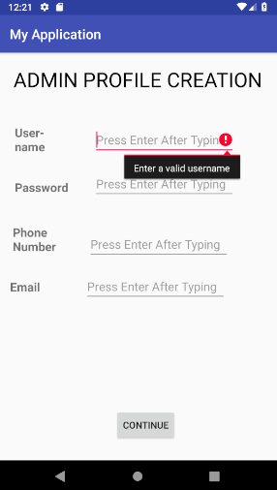
Admin main screen
Admin button from main screen redirects here
Admin can create an account and create their desired credentials here
Fields are validated to ensure input is entered
Phone Number field validated to ensure 10-digit phone number is entered

Slide 12
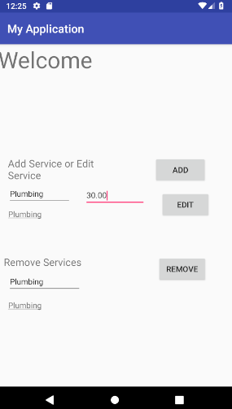
Admin edit service screen
Admin can add/edit or remove services from this screen
Typing in the service Admin wants to add is confirmed in the TextView below the EditText
Typing in the service Admin wants to remove is confirmed in the TextView below the EditText
Admin can also type the hourly rate associated with the service

Slide 13
Thank you

