Slide 1
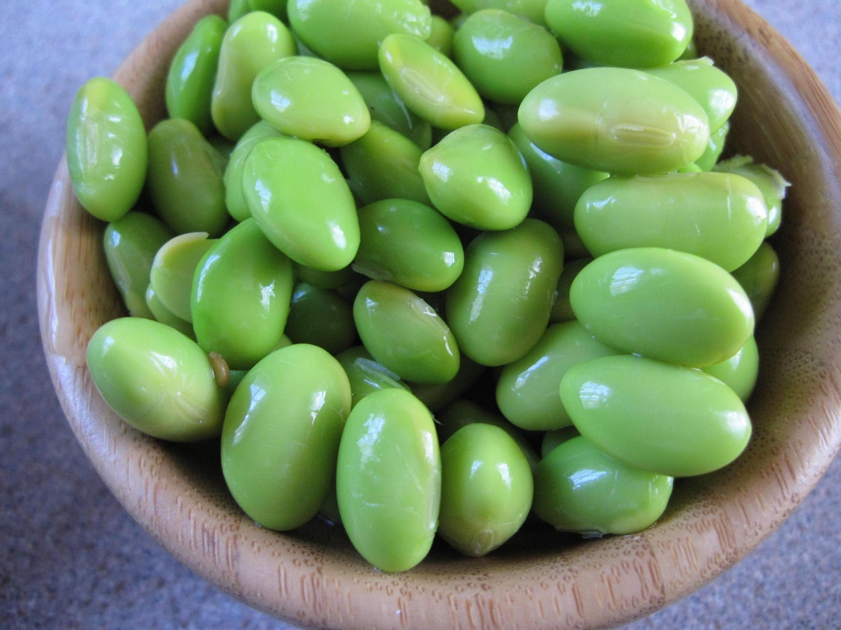
Explorations in Data Analyses for Metagenomic Advances in Microbial Ecology
20 June – 01 July 2015
Kellogg Biological Station
Michigan State University

Slide 2
Overview Lecture
What are our loftiest goals for EDAMAME?
Course logistics: Schedule and expectations
Getting warmed up: What is a microbial community?
Traits of microbial communities
The ”OTU”
Our Tutorial Dataset for the Week

Slide 3
What are the Burning Questions in microbial ecology?
Exploration: describing patterns, understanding diversity, discovery (e.g., rare biosphere, dark matter)
Community structure – function relationships
Sequencing SOP – active area of research. How can we use this technology to answer our burning questions?
Host – microbe relationships
…many more!

Slide 4
Our goals for YOU
Be audacious in the face of analyses!
Analysis is hard. Have no fear. It is completely normal to struggle.
Understand the problem in the pipeline /where the workflow was breaking down
Be able to find resources to fix problems
Where to find help and how to ask for help optimally
Learn how to critique and test others’ analyses pipelines

Slide 5
Our goals
Provide a safe & welcoming place to learn
Lots of help from many people with different backgrounds
Many guests to provide insight into different tools and research areas
Research specific help when possible

Slide 6
Our expectations
Ask lots of questions, and try really hard to get all you need to execute analyses independently when you return to your group
Don’t be afraid to ask for help when you need it! (we all have to do this sometime)
Acceptance (in both directions)

Slide 7
Our hopes
Enthusiasm!
Engagement!
Fearlessness!
Fun!

Slide 8
A Snapshot of our action packed days (tentative)
7-8: Breakfast. Head’s up: They close promptly.
9:00 am-ish – Lecture
10:30 am – Morning Tutorial
12-1 pm – Lunch
1:15 pm – Afternoon Tutorial
4 pm – Break
5-6:30 – Dinner
8 pm – Guest lecture
9 pm- ? – Social time, fire pit

Slide 9
WHO
Prof. Ashley Shade - MSU
Dr. Josh Herr -MSU
Dr. Jin Choi - Iowa State
Siobhan Cusack - MSU
Dr. Sang-Hoon Lee – MSU & Korea University
Jackson Sorensen - MSU
Paul Wilburn –KBS local – ask him for the insider’s scoop!

Slide 10
Our Esteemed Guest Lecturers
Pat Schloss University of Michigan
Jay Lennon Indiana University
Stuart Jones University of Notre Dame
Jim Tiedje Michigan State University
Jim Cole Michigan State University
Dirk Colbry Michigan State University
Ariane Peralta East Carolina University
Vincent Denef University of Michigan
Sarah Evans Kellogg Biological Station
Matt Scholz MSU HPCC

Slide 11
Food and drink
Most meals will be at the KBS dining hall. Over the weekend they will be closed for a few meals. We will arrange for group meals; please do your part to chip in – we’ll keep the cost as economical as possible.
We can also make group arrangements to head to “town” – check with one of the TAs. You might want to head to the market on your own. Kalamazoo is not too far away.

Slide 12
Recreational stuff
Some options at KBS are volleyball, frisbee, frisbee golf, bocci ball, etc…
You may have to check with the KBS office for some of the options.
There are good places to run, to swim, to hike, to bike, to fish, to boat…
There is also a few laundry rooms

Slide 13
WIFI
MSUnet Guest 3.0

Slide 14
Red/Green stickies...
Red sticky means “I am in need of help...”
Green means “I’m doing ok”
You don’t have to use them all the time, but we may ask some of you to put them up so we can get an assessment of where we are at as a group.

Slide 15
Course materials!
Use the website: edamame-course.org
All the material is on our github site:
github.com/edamame-course
Do you tweet: Let’s use #edamame2015
By the way, we’re @ashley17061, @number_three

Slide 16
Code of Conduct
Please read the course code of conduct:
https://github.com/edamame-course/docs/blob/gh-pages/extra/edamame_code_of_conduct.md
Bottom line:
Let’s all be nice to one another. Disrespectful conduct is grounds for immediate dismissal.

Slide 17
Our Support comes from
The BEACON Center for the study of evolution in action (MSU)
MO-BIO (t-shirts!)
Amazon Web Services
MSU Office of Vice President for Research and Graduate Studies
… Thank your Sponsors! tweet, blog, etc

Slide 18
Mo BIO
Blogging opportunity!
Emelia DeForce is REALLY excited to have EDAMAME guest post!

Slide 19
Any questions or comments?

Slide 20
Concluding thoughts
We want you to come out of this course with the confidence to try to tackle difficult things.
...these things might not be easy and there will be hurdles, but we know you can handle it because you all are talented.
We’ll all work together to learn, question, analyze, and troubleshoot.
We’re going to have a lot of fun.

Slide 21
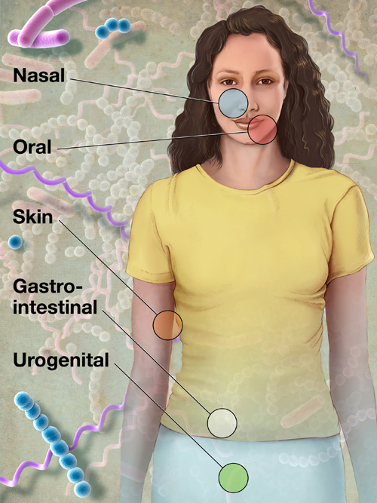
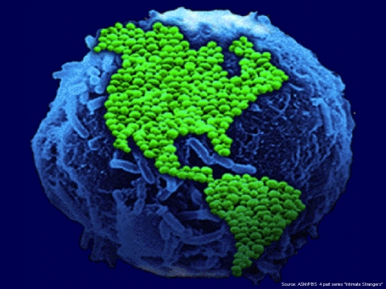
What is a microbial community?
C₆H₁₂O₆
CH₄
CO₂
CO₂
C₂H₃O₂⁻
Acyl-HSL
O₂
HPO₄²⁻
NH₄⁺
H₂
NO₃⁻
N₂
MeS
SO₄²⁻
HS⁻
Me²⁺

Slide 22
What is a microbial community?
Many taxa (species; >2)
Exist in the same locality
Interact with each other and/or with the environment

Slide 23
The “OTU” operational taxonomic unit
Species = basic unit of classification
Defined somewhat arbitrarily
Typical = 97% sequence identity
Originally, identity based on full length 16S rRNA gene
roughly equivalent to genus level
Does not well-distinguish “taxa” for all bacteria (e.g., Streptomyces)

Slide 24
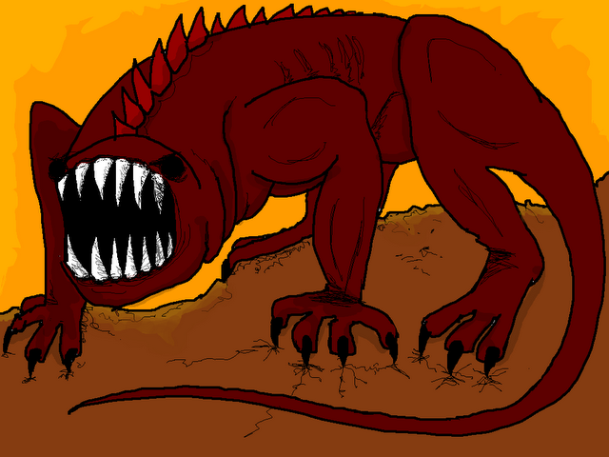
Ecological traits of microbial communities
Understand the Nature of the Beast. Microbial community data are:
“Species” rich
Depend on operational taxonomic unit (OTU) definitions
Dynamic : sensitive to environmental changes
Distinctive: even very similar habitats “house” distinct microbial communities (e.g., every human has her own gut community)
Influenced by dispersal?
Influenced by gene-swapping (phage, HGT)
Large proportion of dormant members
Large proportion of rare members
(A beast, hyperboleandahalf.blogspot.com)

Slide 25
What are our options for sequencing and analysis?
What sequencer?
If amplicon, which gene? Which variable region?
What quality control options?
Defining OTUs
Describing communities
Testing hypotheses
Visualizing results

Slide 26
Introduction to our Tutorial Dataset
Motivation : get an idea of a complete analysis from start to finish
Everyone working on the same dataset helps the instructors maximize their time when helping students to troubleshoot
There is time dedicated to apply what you learned on the tutorial dataset to your own dataset

Slide 27
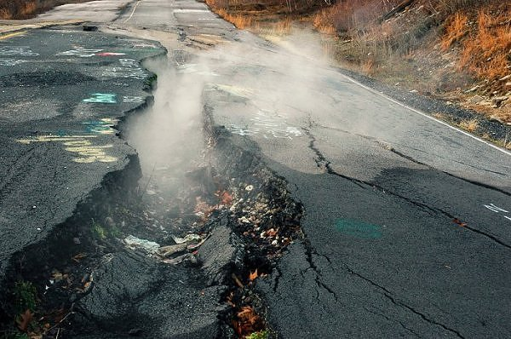
Centralia, PA: burning since 1962
Nowiknow.com

Slide 28
Key Questions
What is the diversity and structure of microbial communities in Centralia soils?
Do temperature/geochemical gradients or historical fire activity explain differences in community structure?
Stability: resistance and resilience
What are the lifestyles of organisms in fire-affected sites?
Thermophiles: dormancy strategies, cellulose degradation, thermal tolerance and stress responses
Bioremediative organisms: heavy metals and other coal combustion products
Novel antibiotic producers? Lantibiotics.
Is Centralia a site of novel microbial diversity?

Slide 29
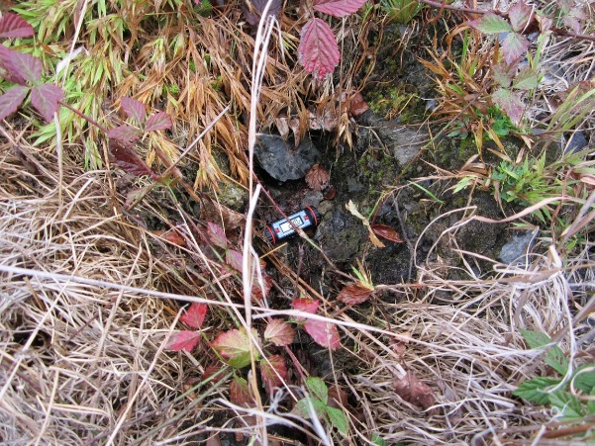
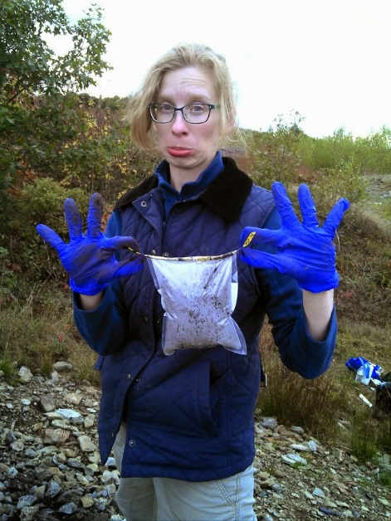
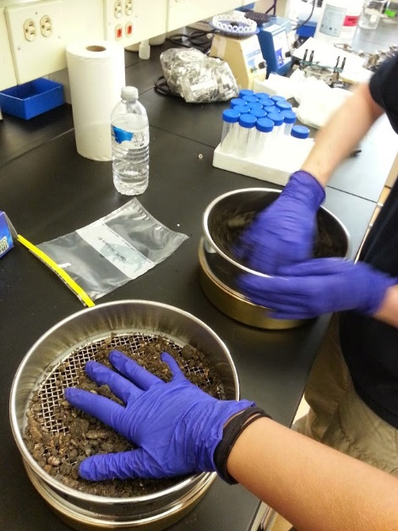
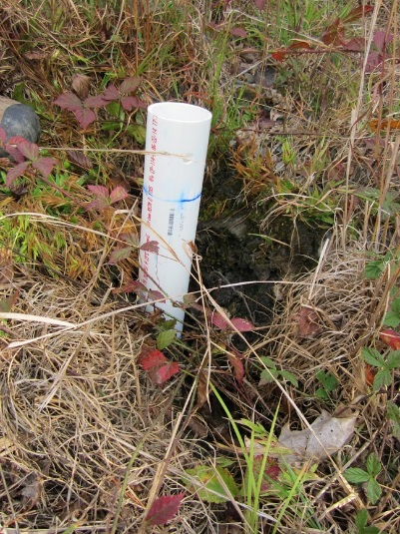
Sample collection
Sieved (4 mm pore)

Slide 30
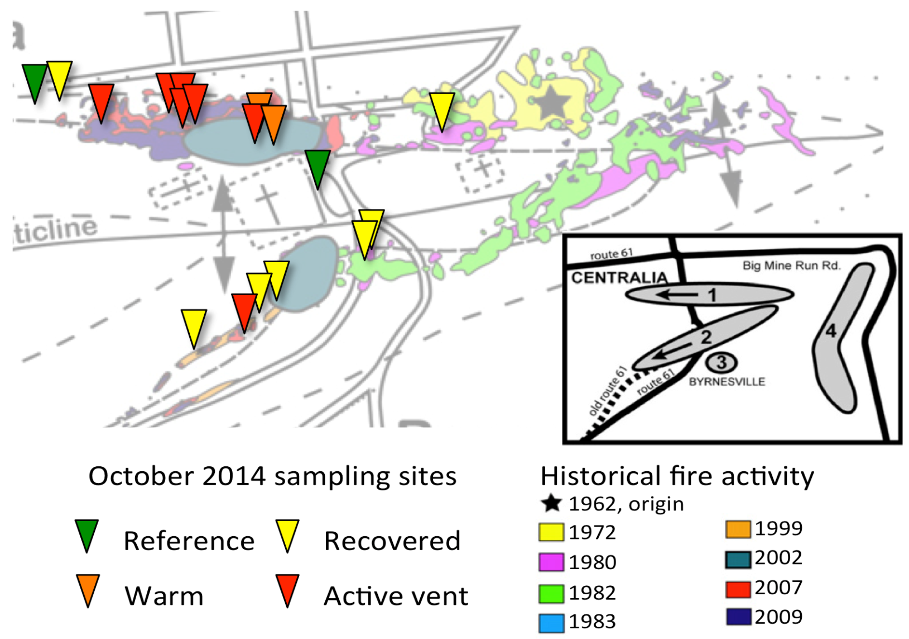
Underground coal mine fire
Recovered : 7
ActiveVent : 7
Warm : 2
Reference : 2
1
C08
C07
C12
C11
C09
C16
C18
C13
C10
C15
C14
C17
C02
C01
C04
C05
C03
C06
2
Sampling Period: Oct. 5-6, 2014
Figure 1. Sampling sites

Slide 31
Datasets for the week
18 soils (0-20 cm cores) along active fire fronts 1 and 2
Illumina paired-end V4 16S rRNA amplicon sequencing on each of 3 replicate DNA extractions. 54 total samples
Soil chemistry and contextual data on each core – 18 total soils with measurements
Metagenome sequencing on the DNA extracted from the soil of an active vent sample, Cen13 (temperature = 57 C) – 1 sample
Metagenome sequencing on a pool of thermophiles cultivated on TSA - 60Celsius from the soil from Cen13 – 1 sample

Slide 32
Other things you should know about these datasets
Sequenced VERY deeply – we will be working with a smaller dataset subsampled randomly from the full dataset

