Slide 1
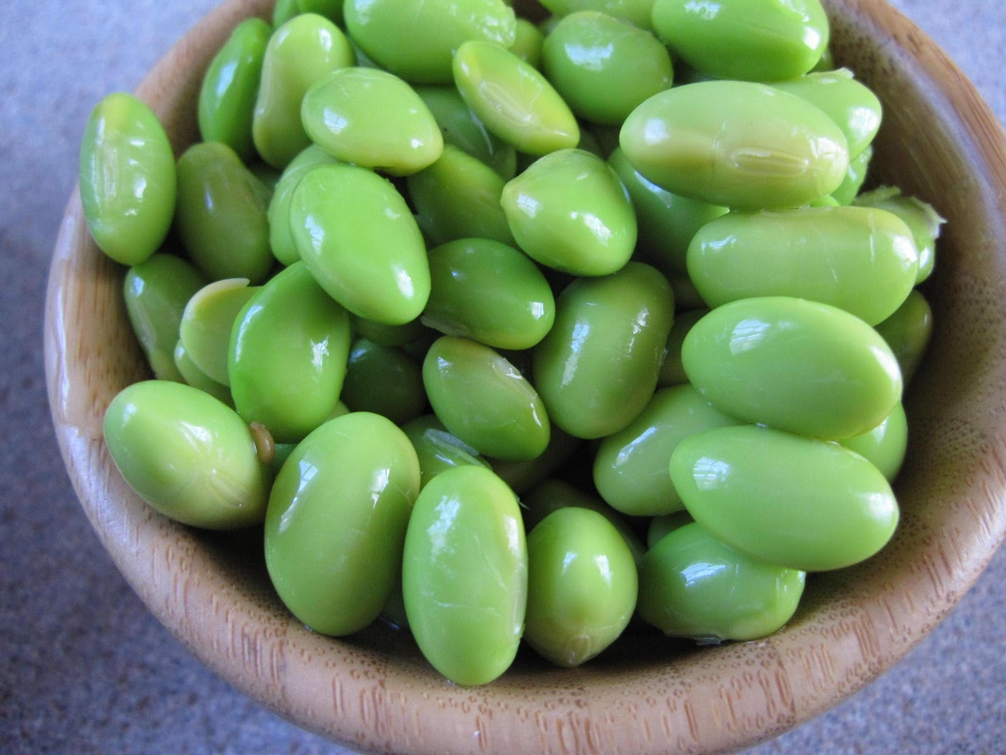
Explorations in Data Analyses for Metagenomic Advances in Microbial Ecology
13-20 August 2014
Kellogg Biological Station
Michigan State University

Slide 2
Review from QIIME Intro
Microbial communities are local assemblages of microorganisms that interact with each other or with their environment
“OTUs” – operational taxonomic units – as a microbial species definition (97% identity 16S rRNA)
Next gen. sequencing offers a cost-effective way to assay metagenomic DNA of microbial communities from any environment
There are lots of choices for analyzing 16S high-throughput sequencing data – choice of seq. platform, primers, variable region; depth of sampling; analysis methods – most of these can be reasonably informed by the community of interest, the scientific question, and the experiment design

Slide 3
Tutorial review: What happened yesterday?
Merged paired-end reads: pandaseq
Picked OTUs: based on 97% sequence identity: pick_otus.py
Picked one sequence to represent each OTU: pick_rep_set.py
Make an alignment of those representative sequences for future tree building and other analyses: align_seqs.py

Slide 4
Questions from yesterday?
?

Slide 5
Lecture 2: Alpha Diversity
Alpha diversity in all of its glory
The advantage of phylogenetic information
Rarefaction
What does a community look like, data-style?
A note on the .biom v. OTU table format

Slide 6
Alpha diversity in all of its glory
“Diversity” is a vague word. In ecology, it has there are many types of diversity (e.g., alpha, beta, gamma), and there are many components to that contribute to those types.
Alpha diversity refers to the diversity inherently descriptive of one sample.

Slide 7
Alpha diversity
Alpha diversity includes:
Richness (number of taxa)
Evenness (distribution of the abundances of taxa)
Phylogenetic diversity (breadth of phylogenetic representation)
*Composition (who’s there – identity of the taxa)
Combinations of the above components are used to calculate other diversities: Shannon diversity, Simpson, etc.

Slide 8
Whittaker introduces alpha, beta, gamma diversity (1972)

Slide 9
Alpha (within-sample) diversity
Information about the community that we can glean from metagenomic sequencing
A certain number of OTUs- richness
Each OTU is present in a certain abundance- collectively, evenness
Each OTU has a taxonomic assignment- composition
C₆H₁₂O₆
CH₄
CO₂
CO₂
C₂H₃O₂⁻
Acyl-HSL
O₂
HPO₄²⁻
NH₄⁺
H₂
NO₃⁻
N₂
MeS
SO₄²⁻
HS⁻
Me²⁺

Slide 10
Alpha diversity
Richness: How many OTUs?
OTU
Richness = 11 OTUs

Slide 11
Alpha diversity
Evenness: What is the distribution of abundances in the community?
OTU
Count:
No. seq, no. individuals (e.g., FISH), biomass, etc.
6
1
4
8
1
5
3
13
5
1
2

Slide 12
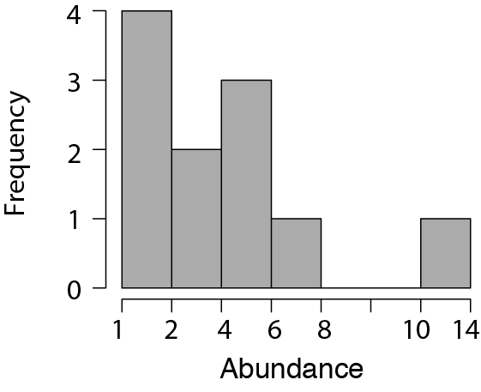
Alpha diversity
Evenness: What is the distribution of abundances in the community?
OTU
Count:
13
8
6
5
5
4
3
2
1
1
1

Slide 13
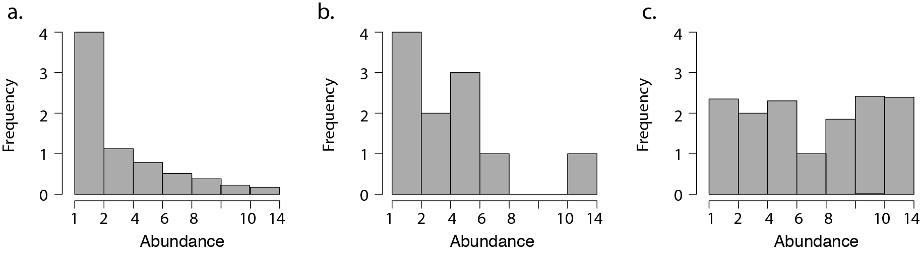
Alpha diversity
Evenness: What is the distribution of abundances in the community?
Less even
More even
Common metric = Pielou’s evenness

Slide 14
Alpha diversity
Composition: What is the distribution of taxonomic affiliations?
OTU
Count:
13 Alpha-proteobacteria
8 Firmicutes
6 Beta-proteobacteria
5 Bacteroidetes
5 Actinobacteria
4 TM7
3 Alpha-proteobacteria
2 Gamma-protobacteria
1 Bacteroidetes
1 Bacteroidetes
1 Verrucomicrobia

Slide 15
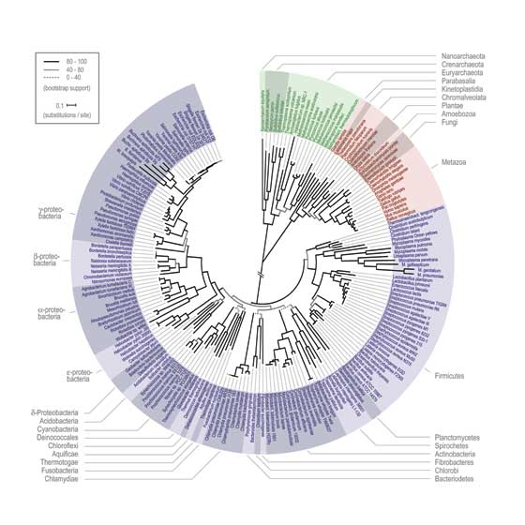
Alpha diversity: The advantages of phylogenetic information
Phylogenetic diversity: What is the breadth of phylogenetic representation?
OTU
Count:
Common metric =
Faith’s phylogenetic diversity
13 Alpha-proteobacteria
8 Firmicutes
6 Beta-proteobacteria
5 Bacteroidetes
5 Actinobacteria
4 TM7
3 Alpha-proteobacteria
2 Gamma-protobacteria
1 Bacteroidetes
1 Bacteroidetes
1 Verrucomicrobia

Slide 16
Rarefaction exercise

Slide 17
Rarefaction
Because of sequencing artifacts and experimental design, there can be quite a range of quality sequences returned for each sample.
Rarefaction : Sub-sampling of sequences to achieve an even number across all samples within a dataset.
This is very important for being able to compare diversity across samples.
Choose a rarefaction depth that maximizes the number of samples that can be included at the most informative sequencing depth.

Slide 18
What does a community look like, data-style?
“OTU table” – the original
.Biom table – more concise & faster computing for extra large datasets
New formats : biom2, coming online RIGHT NOW

Slide 19
Kinds of Community matrix/ OTU Table
 | Caterpillar 1 | Caterpillar 2 | Caterpillar 3
OTU 1 | 0 | 3000 | 23
OTU 2 | 1 | 5 | 5
OTU 3 | 20 | 100 | 100
Raw
Straight up counts*
*note: sequencing data must be rarefied (re-sampled) to an equal sequencing effort!
 | Caterpillar 1 | Caterpillar 2 | Caterpillar 3
OTU 1 | 0 | 0.966 | 0.179
OTU 2 | 0.047 | 0.002 | 0.039
OTU 3 | 0.953 | 0.032 | 0.782
Relative
Percent or proportion
(Standardizes for sampling effort?
 | Caterpillar 1 | Caterpillar 2 | Caterpillar 3
OTU 1 | 0 | 1 | 1
OTU 2 | 1 | 1 | 1
OTU 3 | 1 | 1 | 1
Binary
(presence/absence)

Slide 20
Information in an OTU table
Number of occurrences (per sample and for the whole dataset)
Total no. OTUs observed in the dataset
Average abundance of OTUs
Richness (no. OTUs per sample, mean, max, min, range)
Number of singletons (OTUs detected only once in a dataset)
Calculate: Diversity, Evenness (equitability of OTU abundances, including rarity and dominance)
Number of samples (communities) in your dataset

Slide 21
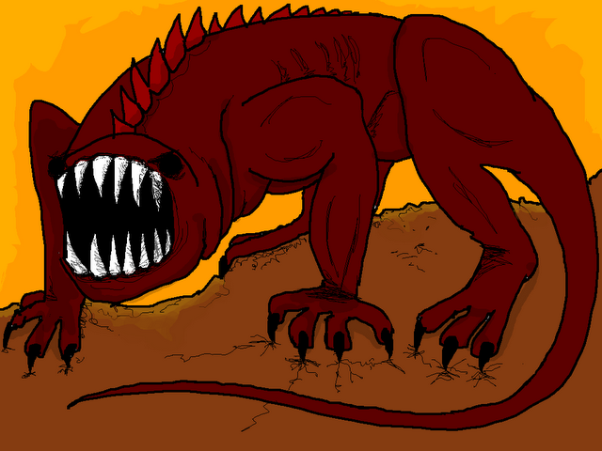
Common features of microbial OTU tables
Redundant: more than one taxa has the exact same pattern
Unknown underlying distribution
Contain many “zeros”
Many samples and OTUs; computationally large
(A beast, hyperboleandahalf.blogspot.com)

Slide 22
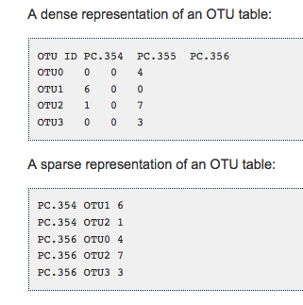
Biom formatted OTU tables
.biom format
Link:
http://biom-format.org
This is all changing! Biom formats are improved, keep up with when changes are anticipated
Old-style OTU table - lots of 0’s
.biom formatted – only list present taxa

