Slide 1
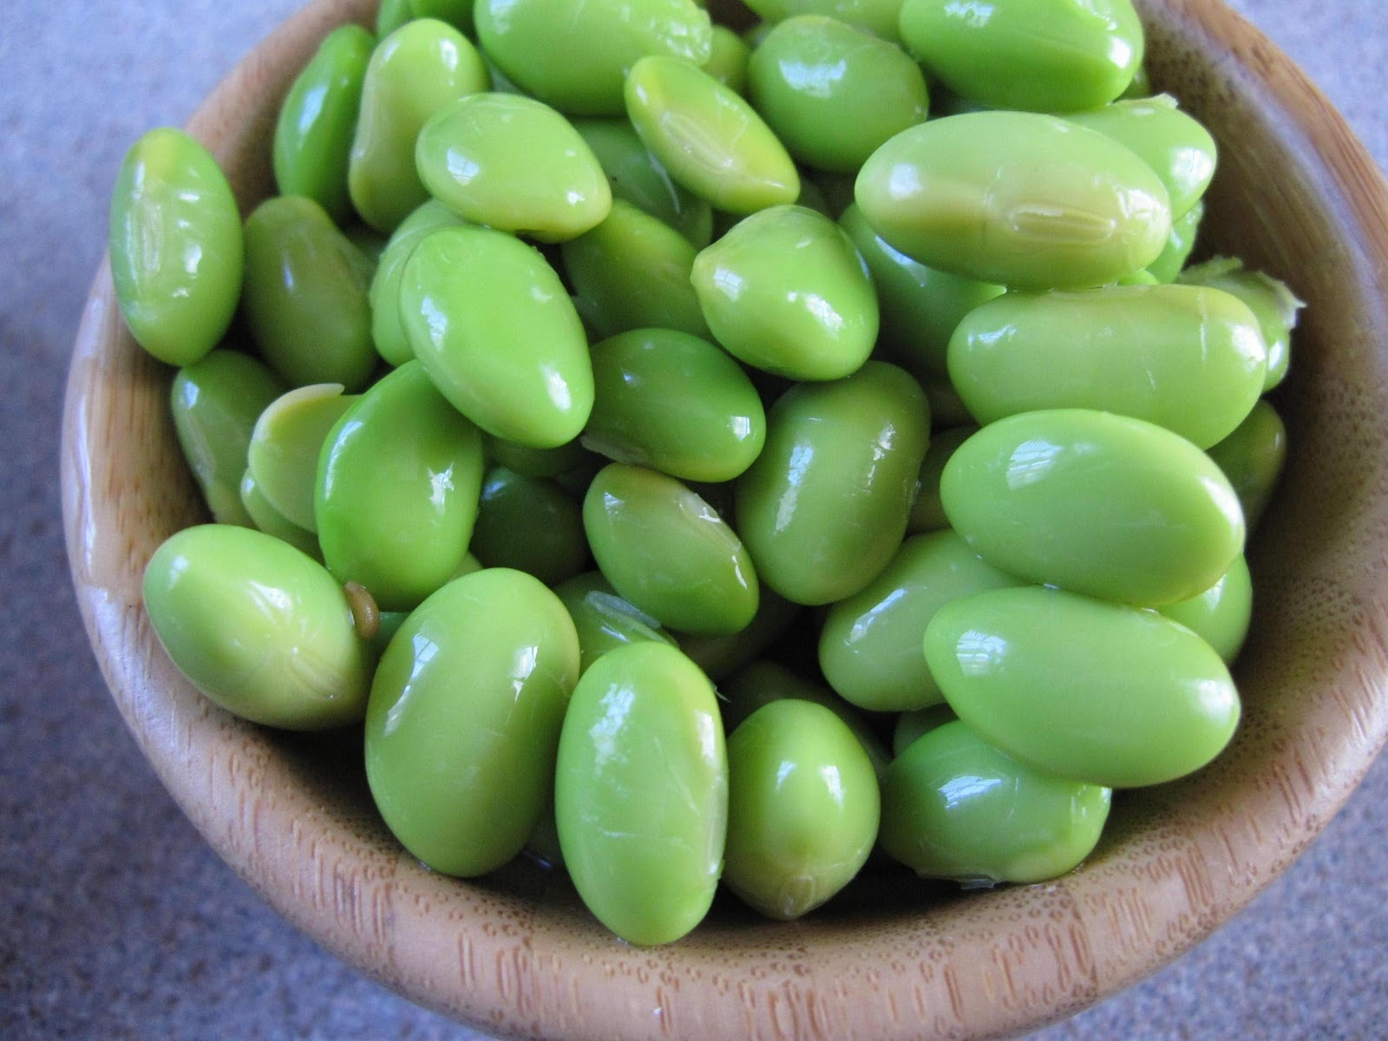
Explorations in Data Analyses for Metagenomic Advances in Microbial Ecology
13-20 August 2014
Kellogg Biological Station
Michigan State University

Slide 2
Review from Lecture 2
Alpha diversity describes a single community/ sample, and includes metrics of richness, evenness, phylogenetic diversity, and other summative metrics of diversity.
Because sequencing success can be highly variable, rarefaction is used to ensure an even-depth of sequences across communities that will be compared.
An OTU table is the input file for community analyses. It contains information about the abundance of each OTU within every sample. OTU tables can be (classic, .txt) or (.biom) format.

Slide 3
Tutorial: what did we do?
Made taxonomic assignments of our sequences: assign_taxonomy.py
Made OTU tables (biom + classic): make_otu_table.py
Made a phylogenetic tree of our representative sequences: make_phylogeny.py
Rarefied to an equal sequencing depth: alpha_rarefaction.py
Calculated & visualized alpha diversity: alpha_diversity.py, summarize_taxa_through_plots.py

Slide 4
Questions from this morning?
?

Slide 5
Lecture 3: Beta diversity
What questions can you ask about your microbial communities?
Beta-diversity
Gradients versus categories (clusters)
Introduction to community resemblance
Visualizing microbial communities

Slide 6
Questions about microbial communities
Summary information for each community: Alpha diversity
Differences between communities: Beta diversity

Slide 7
Comparative diversity
Space / Time
Categories (e.g., treatment v control)
Gradients/empirical measurements (e.g., pH, blood sugar levels, temperature)
Look forward to the R lecture on category/gradient analyses!

Slide 8
Beta diversity requires a measure of pair-wise community resemblance
Resemblance = distance, similarity, dissimilarity
Important decisions in choosing a resemblance metric:
Weighted v. Unweighted
Phylogenetic v. Taxonomic
All pairs of resemblances are included in a sample by sample resemblance (distance/similarity) matrix
Simplifies the data and the analysis
Choice of resemblance metric will influence the outcome of community analysis

Slide 9
Making a Resemblance Matrix
1. OTU table (usually relativized)
 | Caterpillar 1 | Caterpillar 2 | Caterpillar 3
OTU 1 | 0 | 0.966 | 0.179
OTU 3 | 0.047 | 0.002 | 0.039
OTU 3 | 0.953 | 0.032 | 0.782
2. Chose appropriate resemblance (e.g., Bray Curtis, Unifrac)
 | Caterpillar 1 | Caterpillar 2 | Caterpillar 3
Caterpillar 1 | 0
Caterpillar 2 | 0.966 | 0
Caterpillar 3 | 0.179 | 0.787 | 0
3. Create a square (observation x observation) resemblance matrix from pair-wise comparisons.
Notes:
The purpose of a resemblence matrix is to reduce complexity in the dataset so that it can be used for hypothesis testing or exploration analyses

Slide 10
Examples of Resemblance metrics
Weighted metrics
Unweighted metrics
Phylogenetic metrics
Taxonomic metrics
Metric name Accounts for | Sørenson | Bray-Curtis | Weighted Unifrac | Unweighted Unifrac
Composition | X | X | X | X
OTU abundances? |  | X | X
Phylogenetic diversity? |  |  | X | X

Slide 11
What is the purpose of the analysis?
Exploration: hypothesis generating, perfect for observational studies, includes visualizations like ordinations and clustering
Hypothesis testing: address a specific question (e.g., are there differences among treatment groups?), and usually permutation-based p-value

Slide 12
Visualizing communities: ordination
Legend
Treatment 1
Control
Axis 2: 6% variance explained
Axis 1: 50% variance explained
2 or 3 dimensional representation of the data
Each symbol is one community (compared by the chosen resemblance metric)
The distance between symbols represents the extent of differences between communities
First axis often explains most variance in the data, should be labeled.

Slide 13
Types of ordinations
Non-metric multidimensional scaling (NMDS)
Principle coordinates analysis (PCoA)
Correspondence analysis (CA)
Avoid: Principle components analysis (PCA), Redundancy analysis (RDA) in some situations, and constrained analyses unless you really know what you are doing

Slide 14
How do we look at ordinations?
Think about: CENTROID (mean) or DISPERSION (spread, variability)
A. Different centroid, same spread
B. Different centroid, different spread
C. Same centroid, different spread

Slide 15
Types of ordinations
Non-metric multidimensional scaling (NMDS)
Principle coordinates analysis (PCoA)
Correspondence analysis (CA)
Avoid: Principle components analysis (PCA), Redundancy analysis (RDA) in some situations, and constrained analyses unless you really know what you are doing

Slide 16
Visualizing communities: clustering
A different way of visualizing the same data
=
Legend
0%
Treatment 1
Control
Resemblance
50%
100%
Notes:
Note: cluster is not the same as phylogenetic analysis.

