Slide 1

Explorations in Data Analyses for Metagenomic Advances in Microbial Ecology
13-20 August 2014
Kellogg Biological Station
Michigan State University

Slide 2
Analysis of beta-diversity is informed by:
Associated environmental/quantitative variables*
Examples: red blood cell counts, glucose levels, dissolved oxygen, temperature, acidity, time, % mortality, etc.
Associated categorical/descriptive/qualitative variables*
Examples: treatment groups, male/female, control/treatment, age groups, before/after
* Environmental and categorical variables often are linked to samples in a single “mapping file”

Slide 3
Clusters & Gradients
Clusters = Are categorical groups of communities different? (e.g., Treatment v. Control)
Also called: factors, qualitative variables
Gradients = Do communities change with known environmental changes? (e.g., over time?)
Also called: continuous, quantitative, vector variables

Slide 4
Clusters: Testing for effects of treatment
Permutation-based analyses to test hypotheses about group differences in CENTROID (mean) or DISPERSION (spread, variability)
A. Different centroid, same spread
Test name | Centroid (mean) | Spread (variability)
PERMANOVA | X | X
MRPP | X | X
ANOSIM | X | X
PERMDISP |  | X
B. Different centroid, different spread
C. Same centroid, different spread

Slide 5
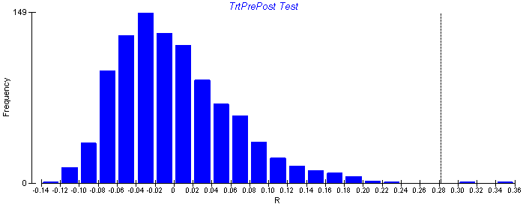
Non-parametric hypothesis tests
Non-parametric tests are used to test hypotheses of multivariate data when the underlying distribution of the data is unknown.
Non-parametric tests randomly re-sample the dataset to create a re-shuffled distribution, calculate a test statistic for each random distribution, and then ask the probably of finding the actual statistic given the random re-sampling distribution of the data.
It is important to use these tests for microbial beta diversity, as the assumptions of underlying normal distributions of most parametric tests (e.g., ANOVA) are violated.

