Slide 1
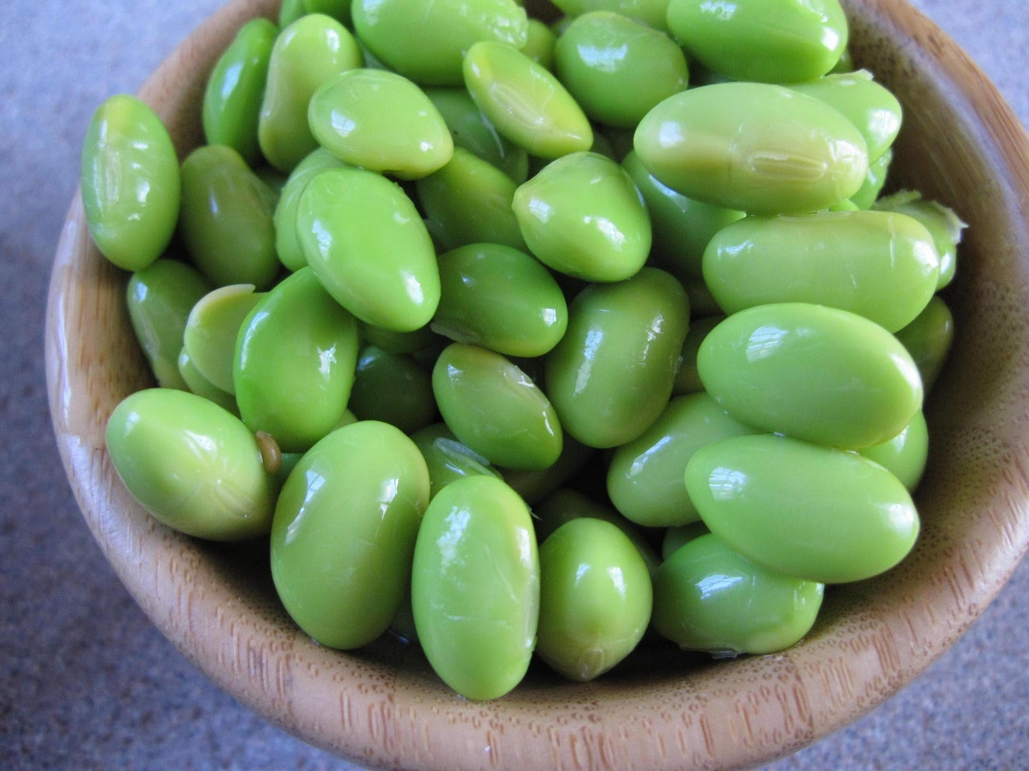
Explorations in Data Analyses for Metagenomic Advances in Microbial Ecology
13-20 August 2014
Kellogg Biological Station
Michigan State University

