Slide 1
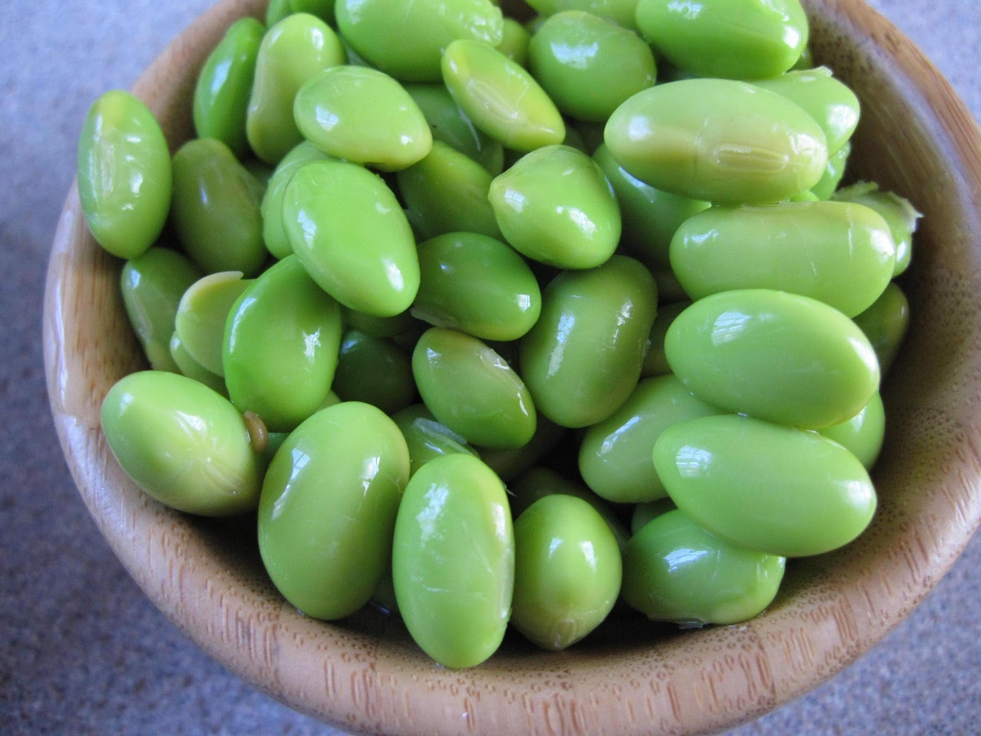
Explorations in Data Analyses for Metagenomic Advances in Microbial Ecology
20 June – 01 July 2015
Kellogg Biological Station
Michigan State University

Slide 2
Review
Beta diversity describes comparative diversity between communities or changes in a community
Resemblance indices quantify pair-wise differences between communities, and can include information about OTU abundances & phylogenetic representation. Choice of resemblance matters for interpretation!
An resemblance matrix is a square, sample-by-sample table of all pairs of resemblance.
We can visualize communities using ordinations, dendrograms, and heatmaps.
We can test for differences in the mean and dispersion of a priori groups.
We can relate environmental gradients to changes in community structure.

Slide 3
Computing Workflows for Biologists
Papers of interest:
Wilson et al. 2014. Best practises for Computing. PLoS Computational Biology
Nobel 2009. Organizing Computational Biology Projects. PLoS Computational Biology
Sandve et al. 2013. Ten simple rules for reproducible computational research. PLoS Computational Biology.
All of these references are posted in our Mendeley group

Slide 4
How to Do the Best Job You Can with Analysis
Adopt a systematic, iterative exploration of parameter space.
Include “sanity checks”
Focus on exploring the parameters that matter for your objective/hypothesis
Organize your output and input for someone who isn’t you
Work towards an optimized, seamless workflow.
Implement reproducibility check-points.
Maintain computing notes just as you would experimental notes
Do your part: cultivate a shared responsibility for reproducibility of results and data management

Slide 5
Workflow
Exactly what you tell the computer to execute the analysis
Each optimized step in a computing analysis
Verbatim scripts that were executed
Annotated:
Software versions used
Description of what the software is doing/goal of that step
Brief notes on deviations from default options
Workflows can include different software (e.g., PANDAseq to QIIME to R), and should also include all “formatting steps” needed to move between tools – hopefully you don’t need to manually format too much; avoid if possible

Slide 6
Workflows should be mindlessly complete
The Peanut Butter and Jelly Robot
https://www.youtube.com/watch?v=leBEFaVHllE

Slide 7
Reproducibility check point

