Slide 1
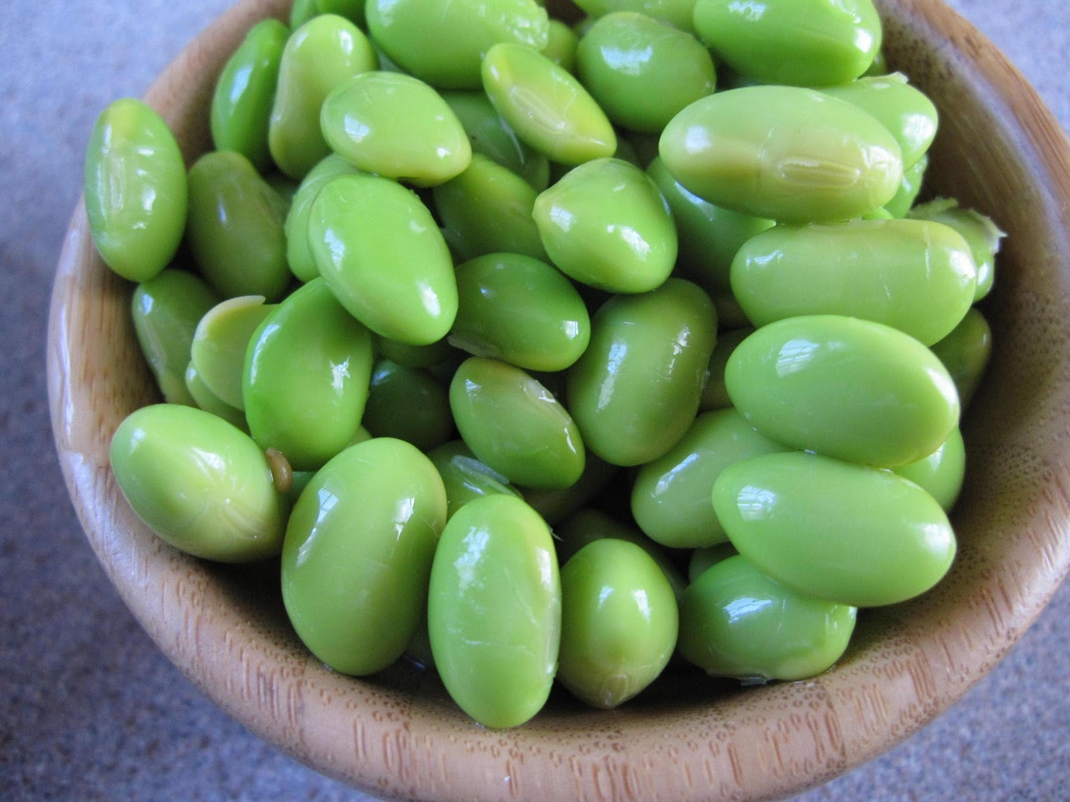
Explorations in Data Analyses for Metagenomic Advances in Microbial Ecology
13-20 August 2014
Kellogg Biological Station
Michigan State University

Slide 2
Overview Lecture
What are our loftiest goals for EDAMAME?
What is a microbial community?
Traits of microbial communities
The "OTU"
How does Illumina sequencing work?

Slide 3
What are the Burning Questions in microbial ecology?
Exploration: describing patterns, understanding diversity, discovery (e.g., rare biosphere, dark matter)
Community structure – function relationships
Sequencing SOP – active area of research. How can we use this technology to answer our burning questions?
Host – microbe relationships
…many more!

Slide 4
Our goals for YOU
Be audacious in the face of analyses!
Analysis is hard. Have no fear. It is completely normal to struggle.
Understand the problem in the pipeline /where the workflow was breaking down
Be able to find resources to fix problems
Where to find help and how to ask for help optimally
Learn how to critique and test others’ analyses pipelines

Slide 5
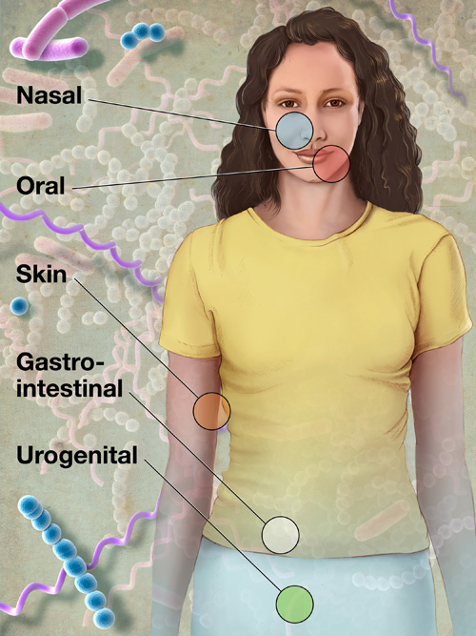

What is a microbial community?
C₆H₁₂O₆
CH₄
CO₂
CO₂
C₂H₃O₂⁻
Acyl-HSL
O₂
HPO₄²⁻
NH₄⁺
H₂
NO₃⁻
N₂
MeS
SO₄²⁻
HS⁻
Me²⁺

Slide 6
What is a microbial community?
Many taxa (species; >2)
Exist in the same locality
Interact with each other and/or with the environment

Slide 7
The “OTU” operational taxonomic unit
Species = basic unit of classification
Defined somewhat arbitrarily
Typical = 97% sequence identity
Originally, identity based on full length 16S rRNA gene
roughly equivalent to genus level
Does not well-distinguish “taxa” for all bacteria (e.g., Streptomyces)

Slide 8
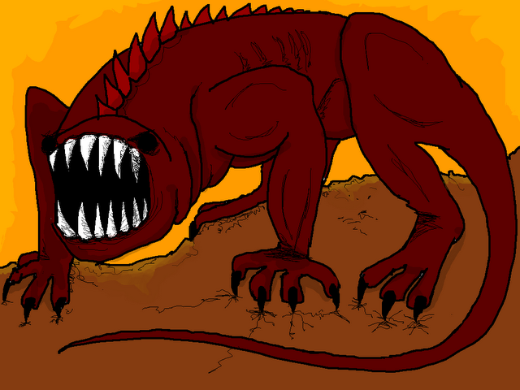
Ecological traits of microbial communities
Understand the Nature of the Beast. Microbial community data are:
“Species” rich
Depend on operational taxonomic unit (OTU) definitions
Dynamic : sensitive to environmental changes
Distinctive: even very similar habitats “house” distinct microbial communities (e.g., every human has her own gut community)
Influenced by dispersal?
Influenced by gene-swapping (phage, HGT)
Large proportion of dormant members
Large proportion of rare members
(A beast, hyperboleandahalf.blogspot.com)

Slide 9
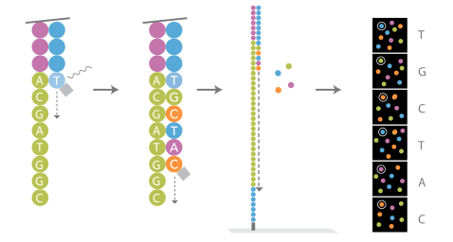
How does Illumina sequencing work?
Illumina: sequencing by synthesis
Short reads : ~125 bp
Lots of data

Slide 10
Informative Video!
www.youtube.com/watch?v=tuD-ST5B3QA&noredirect=1

Slide 11
Naming Samples Other Stories
Examples of a a good name
20_A_T1_R1 (translation : subject 20, treatment A, timepoint 1, rep1 )
Example : A bad name
Ashley’s sample/A
Example : kind of bad names
ALS1, ALS2, ALS3….ALS10, ALS11
Improved:
ALS01, ALS02, ALS03…ALS10, ALS11

Slide 12
A look at python syntax & common arguments in QIIME
Python script
Input file
filter_fasta.py -f rep_set_aligned.fasta -o non_chimeric_rep_set_aligned.fasta -s chimeric_seqs.txt -n
Output file
Other arguments, specific to the script
Other common QIIME arguments
-m analysis method, metric (sometimes map file)
-t tree file
-a alignment template file
-v verbose = good for troubleshooting
-h help
-f force overwrite of an existing directory

