Slide 1
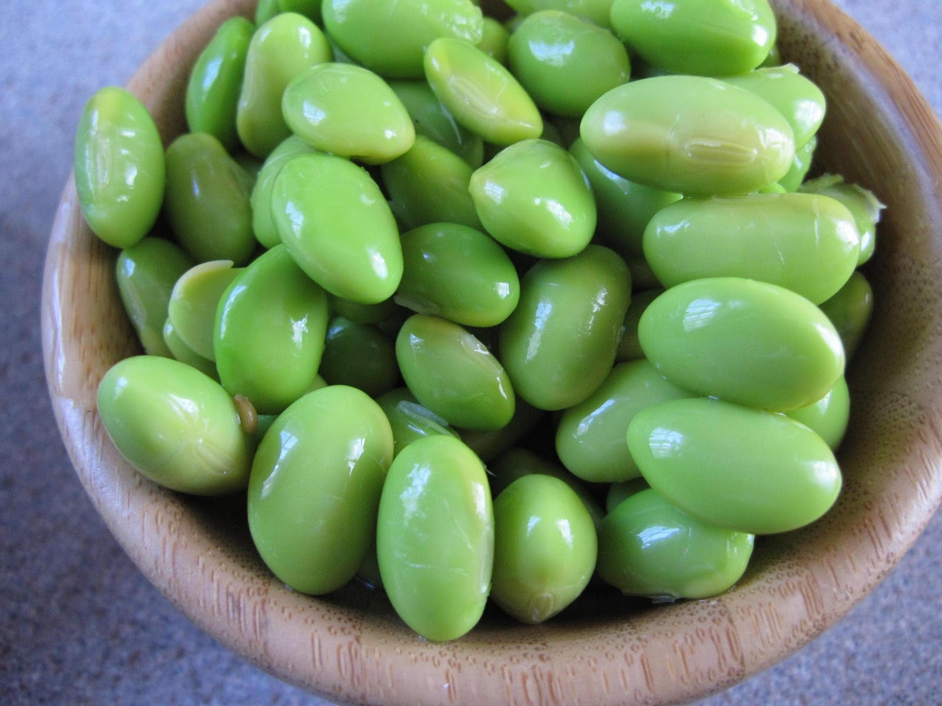
Explorations in Data Analyses for Metagenomic Advances in Microbial Ecology
13-20 August 2014
Kellogg Biological Station
Michigan State University

Slide 2
Review
Beta diversity describes comparative diversity between communities or changes in a community
Resemblance metrics quantify pair-wise differences between communities, and can include information about OTU abundances & phylogenetic representation
An resemblance matrix is a square, sample-by-sample table of all pairs of resemblance

Slide 3
Questions about beta diversity?
?

Slide 4
Overview Day 4
Using categorical and quantitative variables to explore community patters
Non-parametric tests
Hypothesis tests for clusters: dispersion versus centroids
Visualization: ordinations, heatmaps, clusters
Linking quantitative metadata data to community patterns

Slide 5
Analysis of beta-diversity is informed by:
Associated environmental/quantitative variables*
Examples: red blood cell counts, glucose levels, dissolved oxygen, temperature, acidity, time, % mortality, etc.
Associated categorical/descriptive/qualitative variables*
Examples: treatment groups, male/female, control/treatment, age groups, before/after
* Environmental and categorical variables often are linked to samples in a single “mapping file”

Slide 6
Clusters & Gradients
Clusters = Are groups different? (e.g., Treatment v. Control)
Also called: factors, qualitative variables
Gradients = Do communities change with known environmental changes? (e.g., over time?)
Also called: continuous, quantitative, vector variables

Slide 7
Clusters: Testing for effects of treatment
Permutation-based analyses to test hypotheses about group differences in CENTROID (mean) or DISPERSION (spread, variability)
A. Different centroid, same spread
Test name | Centroid (mean) | Spread (variability)
PERMANOVA | X | X
MRPP | X | X
ANOSIM | X | X
PERMDISP |  | X
B. Different centroid, different spread
C. Same centroid, different spread

Slide 8
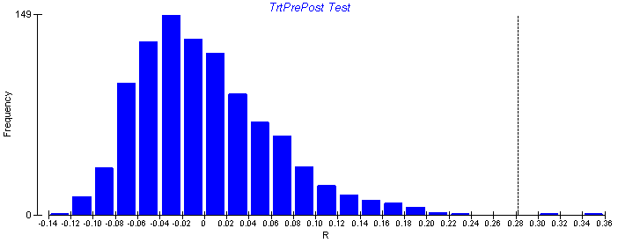
Non-parametric hypothesis tests
Non-parametric tests are used to test hypotheses of multivariate data when the underlying distribution of the data is unknown.
Non-parametric tests randomly re-sample the dataset to create a re-shuffled distribution, calculate a test statistic for each random distribution, and then ask the probably of finding the actual statistic given the random re-sampling distribution of the data.
It is important to use these tests for microbial beta diversity, as the assumptions of underlying normal distributions of most parametric tests (e.g., ANOVA) are violated.

Slide 9
A paper where every hypothesis test is used with every resemblance. Ever.
(just kidding)
(kind of)
The methods are useful.
Shade et al. 2013 AEM

Slide 10
Useful community visualization tools
Ordination : Calculated from community resemblance; relationships are represented by distances between symbols
Heatmap : Calculated from count/abundance data; The abundance of each taxon relative to the others depicted by color
Dendrogram: Calculated from community resemblance; similar communities fall into same cluster.

Slide 11
Ordination
Legend
Treatment 1
Control
Axis 2: 6% variance explained
Axis 1: 50% variance explained
2 or 3 dimensional representation of the data
Each symbol is one community (compared by the chosen resemblance metric)
The distance between symbols represents the extent of differences between communities
First axis often explains most variance in the data, should be labeled.

Slide 12
Cluster analysis
=
Legend
0%
Treatment 1
Control
Resemblance
50%
100%
Notes:
Note: cluster is not the same as phylogenetic analysis.

Slide 13
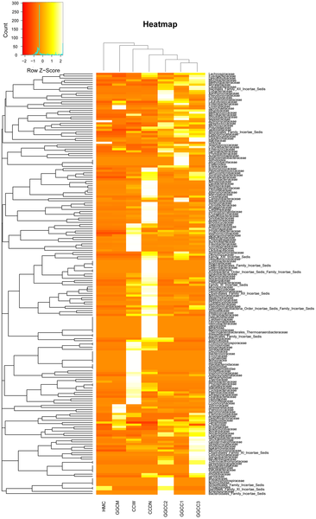

Figure 6. Bacterial distribution among the seven samples.
Wu S, Wang G, Angert ER, Wang W, et al. (2012) Composition, Diversity, and Origin of the Bacterial Community in Grass Carp Intestine. PLoS ONE 7(2): e30440. doi:10.1371/journal.pone.0030440
http://www.plosone.org/article/info:doi/10.1371/journal.pone.0030440

Slide 14
Linking environmental and community data
1. Mantel Test
2. Vector fitting to ordination axis score
Community Resemblance
 | Caterpillar 1 | Caterpillar 2 | Caterpillar 3
Caterpillar 1 | 0
Caterpillar 2 | 0.966 | 0
Caterpillar 3 | 0.179 | 0.787 | 0
Pearson’s correlation
Permuted p value
Axis 2
Time
Time / environ. distance
Temperature
 | Caterpillar 1 | Caterpillar 2 | Caterpillar 3
Caterpillar 1 | 0
Caterpillar 2 | 1 | 0
Caterpillar 3 | 10 | 3 | 0
Axis 1

