Slide 1
Runtime Security for Agentic Systems
A Practical Two-Plane Approach for OpenClaw, Cursor, and Claude Code | Frank Lyonnet, Antoine Clerget | EDAMAME Technologies | March 2026

Slide 2
The Problem: Runtime Security Gap
AI agents execute high-impact ops: network access, file mutation, credential handling
Pre-install scanning (S1) and config hardening (S2) are necessary but insufficient
Runtime divergence (S3) -- what the agent does vs. what it declared -- is unaddressed
Real incidents: OpenClaw mailbox deletion, CVE-2026-25253 browser token exfiltration
S1: Supply-chain controls (signed artifacts, SBOM)
S2: Configuration controls (localhost MCP, PSK auth)
S3: Runtime behavior controls (intent-behavior correlation)
S1+S2 cannot detect runtime-only divergence when setup looks acceptable

Slide 3
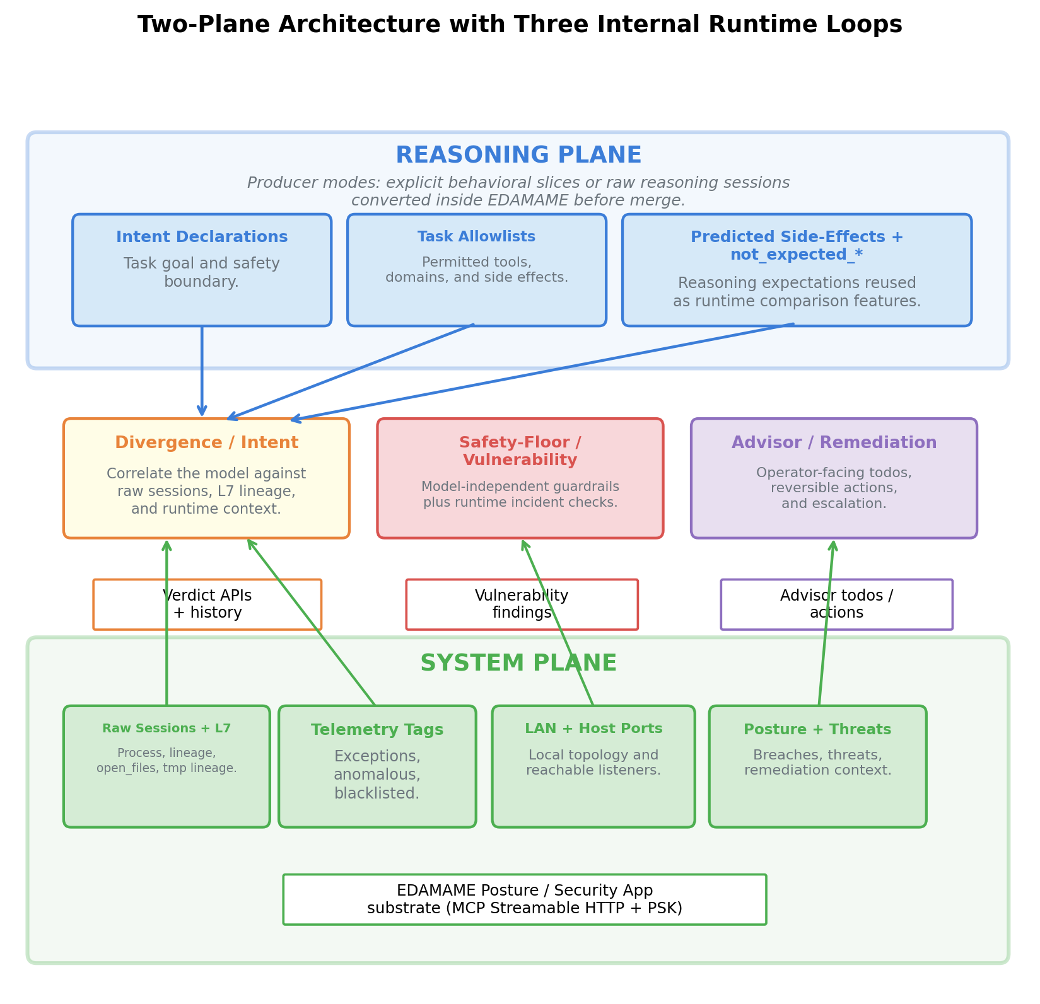
Two-Plane Architecture

Slide 4
How It Works: Correlation Loop
Reasoning Plane (what the agent says):
Intent statement, tool plan, predicted side effects
Task-conditioned allowlists (processes, domains, paths)
System Plane (what the host sees):
Network sessions with L7 process attribution
Host LAN visibility, posture score deltas
Divergence loop -- correlates model vs telemetry; CLEAN or DIVERGENCE
Safety-Floor -- model-independent guardrails (CVE, /tmp lineage, creds)
Advisor -- operator-facing todos with reversible actions
Verdicts: CLEAN | DIVERGENCE | NO_MODEL | STALE
Critical signals non-downgradable (LLM cannot override)

Slide 5
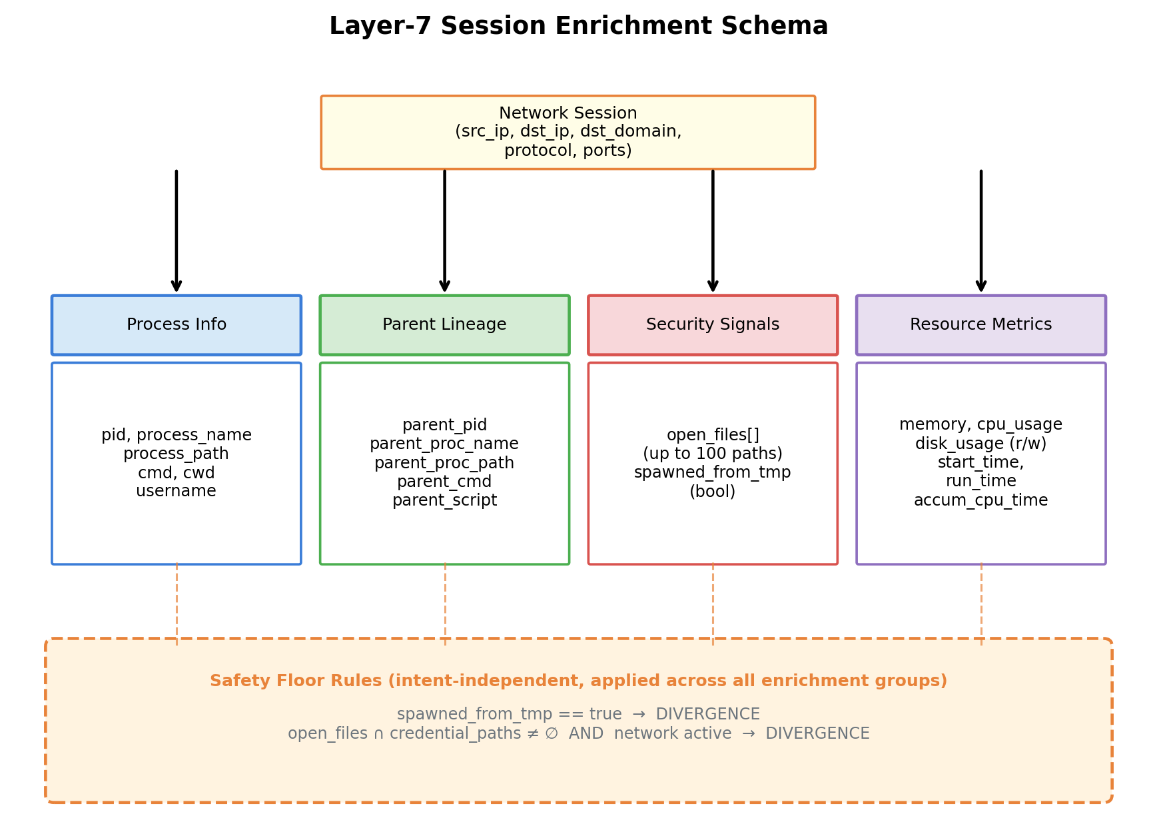
Process Attribution

Slide 6
MCP as the Security Interface
Structured semantics -- typed JSON responses reduce parsing ambiguity
Transactional actions -- execute/rollback patterns make checks composable
Framework portability -- same tools for OpenClaw, Cursor, Claude Code
Local PSK-authenticated endpoint (127.0.0.1:3000/mcp)
Observer-owned merge: EDAMAME merges agent-tagged slices centrally
Signal Hierarchy (strongest to weakest):
Blacklisted sessions (known-bad C2, malware IPs)
Anomalous sessions (ML-flagged, unexpected destinations)
Exception sessions (allowed but noted)
Normal sessions
Non-downgradable: blacklisted cannot be reclassified by LLM

Slide 7
Three Agent Integrations
OpenClaw -- Autonomous agents in Lima VMs
Extrapolator reads transcripts, publishes prebuilt behavioral model
MCP plugin bridges all 31 EDAMAME tools
Cursor -- Developer workstations (macOS/Windows)
Transcript parsing from ~/.cursor/projects/agent-transcripts/
Raw-session ingest; EDAMAME app as MCP host
Claude Code -- Developer workstations (CLI)
Same architecture as Cursor; marketplace plugin install

Slide 8
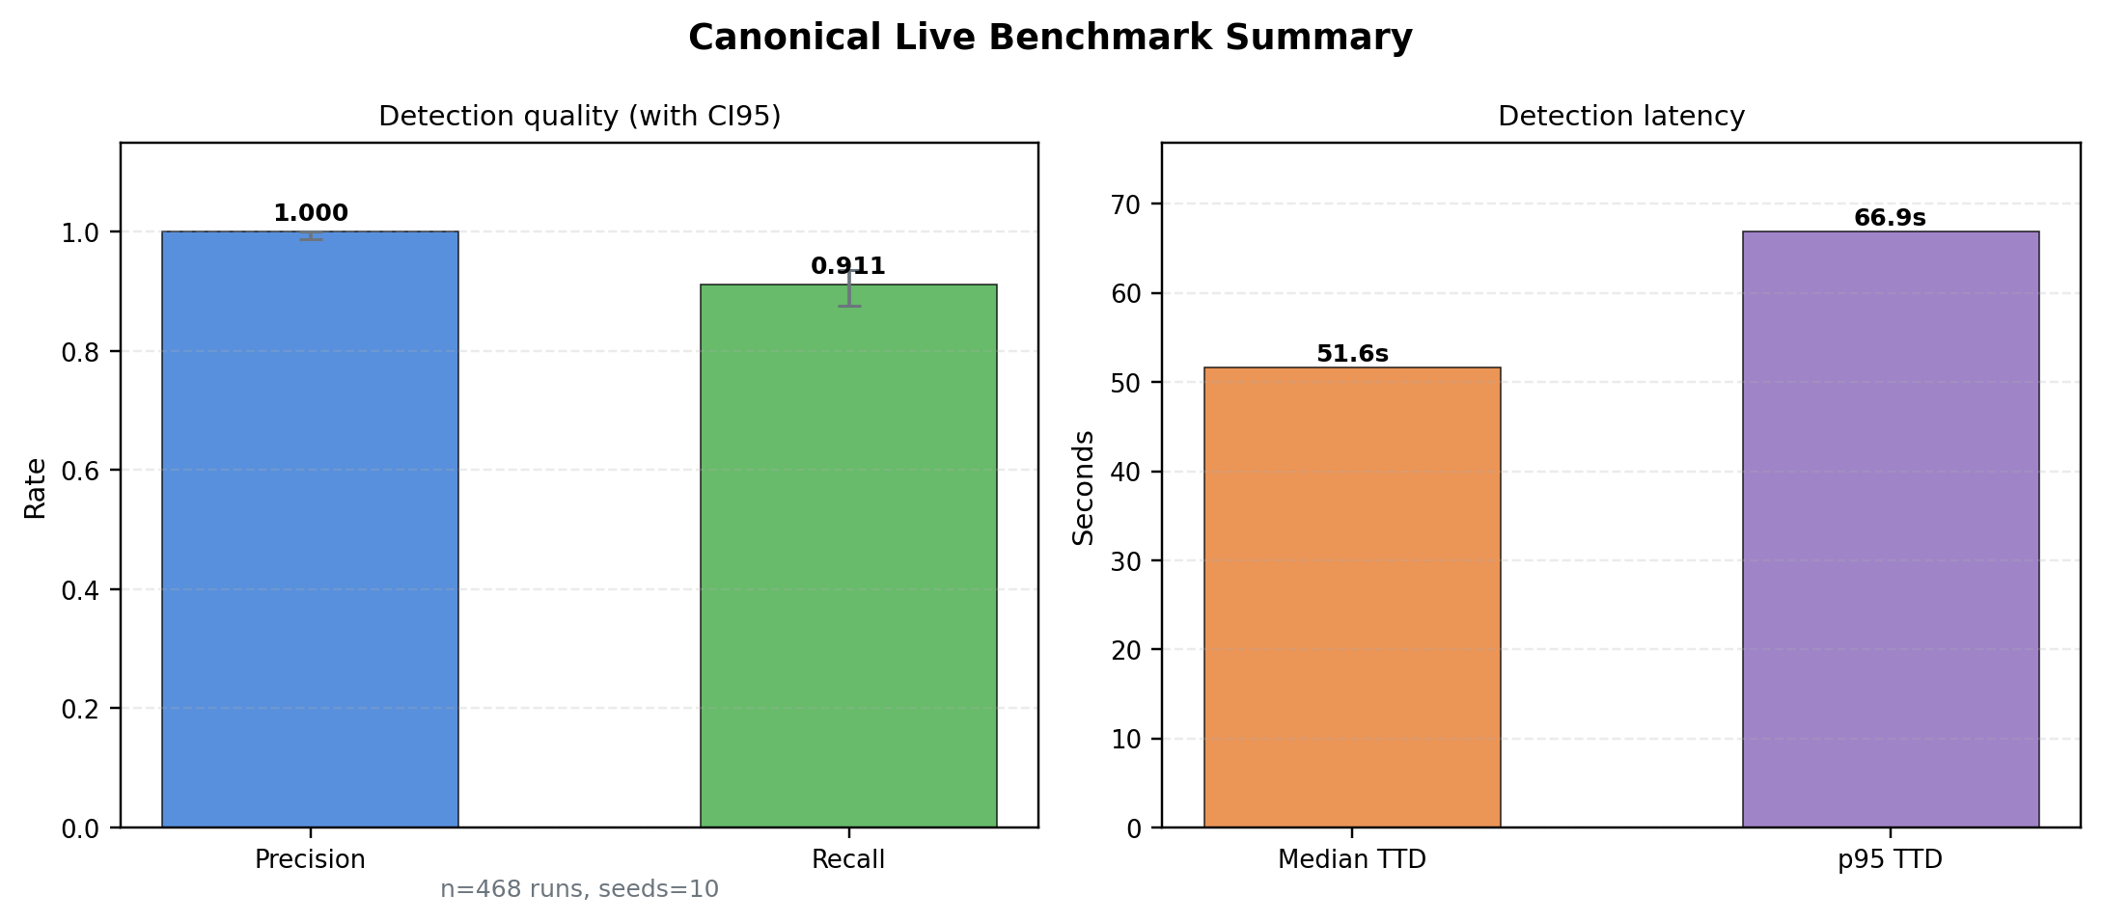
Benchmark Results (468 Runs)

Slide 9
Quantitative Snapshot (468 Runs, 10 Seeds)
Precision: 1.000 (CI95: [0.988, 1.000])
Recall: 0.911 (CI95: [0.876, 0.937])
FPR: 0.000 (Zero false positives)
Median TTD: 51.6 s (p95: 66.9 s)
Rollback: 100% (317/317 successful)
Per-Category Breakdown
Network Intent Correlation -- 160 runs, Recall 0.990
Process Lineage Verification -- 59 runs, Recall 1.000
Credential Theft Detection -- 30 runs, Recall 1.000
Adversarial Evasion (LotL) -- 80 runs, Recall 0.625
Noisy Benign -- 60 runs, FPR 0.000

Slide 10
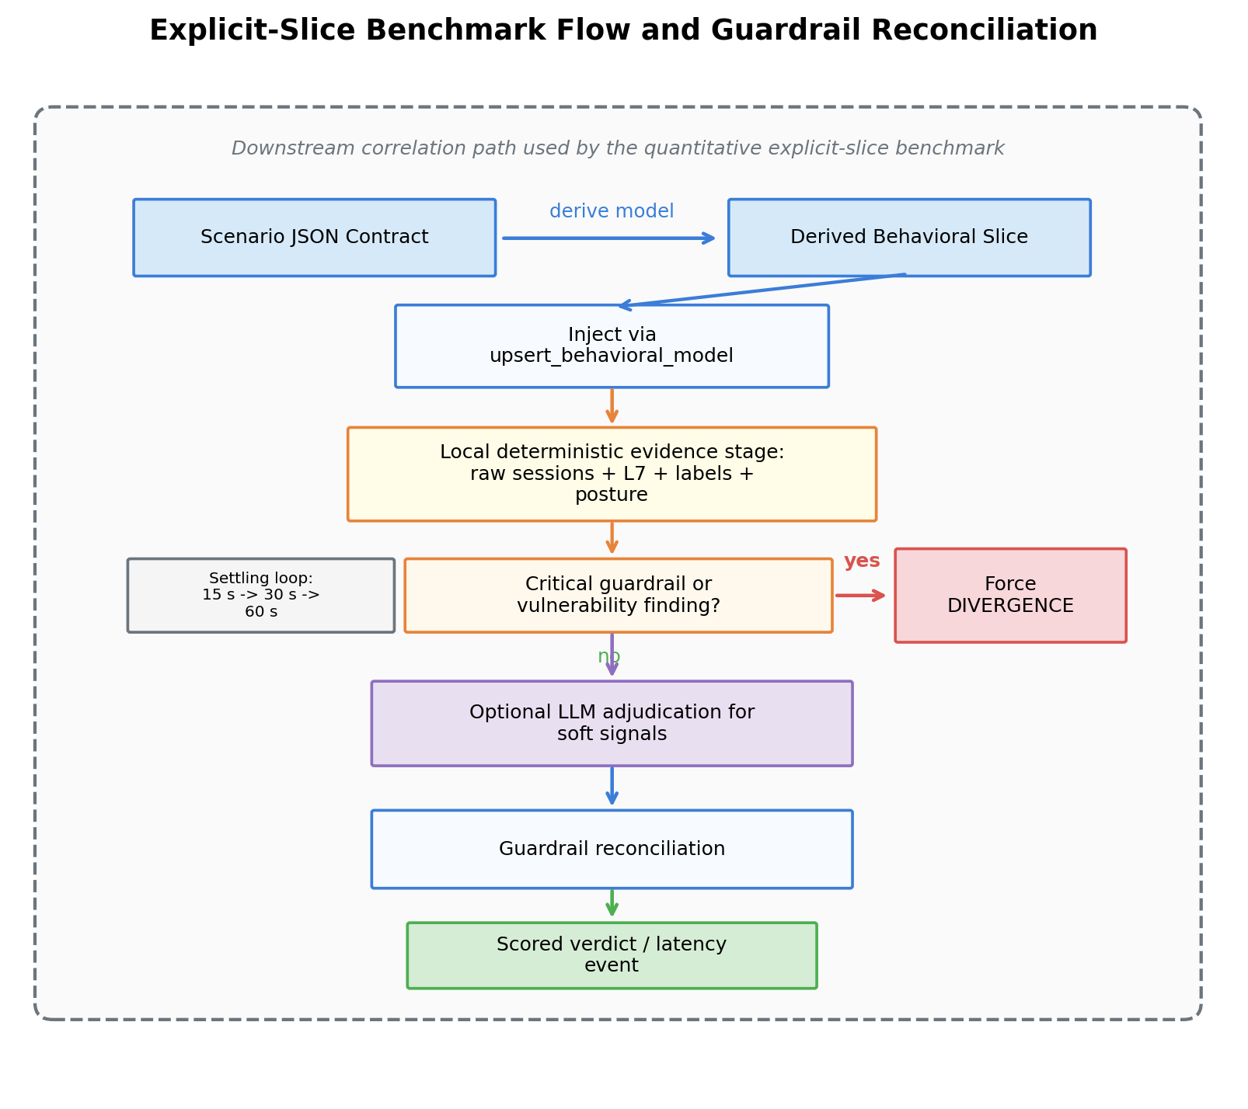
Decision Flow and Guardrails

Slide 11
Known Limitations and Mitigations
Explicit Limitations
Reactive latency -- median detection ~52 s under accelerated cadence
Living-off-the-land -- allowed process + allowed destination invisible (recall 0.625)
Transcript integrity -- depends on platform-controlled session logs
Observer integrity -- assumes trustworthy host process
Mitigations and Roadmap
Shorter enrichment intervals and sticky process-context retention
Proactive Rule B gating for MCP-mediated operations
Intent-declaration anomaly tracking (allowlist budget expansion)
Watchdog heartbeat and cryptographic attestation

Slide 12
Key Takeaways
Two-plane correlation closes the S3 runtime gap that static controls cannot address
MCP-native deployment enables framework-portable security across OpenClaw, Cursor, Claude Code
Process-attributed telemetry is the differentiator -- destination-only checks are insufficient
Observer-owned state prevents model poisoning and verdict tampering
Precision 1.000, Recall 0.911 on 468 live runs -- practical early-warning layer

