Slide 1
OpenClaw CVEs and EDAMAME Detection
How EDAMAME detects and mitigates real agentic CVEs | EDAMAME Technologies | March 2026

Slide 2
OpenClaw CVE Landscape
Critical CVEs
CVE-2026-24763 -- PATH injection runs attacker binaries in sandbox
CVE-2026-25253 -- Malicious URL steals browser token and triggers RCE
CVE-2025-52882 -- WebSocket auth bypass enables credential theft
CVE-2025-59536 -- Config hook spawns attacker processes before auth
Additional CVEs
CVE-2026-2256 -- Command injection for AI-driven lateral movement
CVE-2026-21852 -- Config redirect exfiltrates API keys
VirusTotal -- weaponized skills steal creds via file reads + egress
STRIKE -- network-exposed gateways expose agent control plane

Slide 3
CVE-2026-24763: PATH Injection
Attack Mechanism
Attacker places binary in PATH before legitimate tool
Agent executes compromised binary in trusted sandbox
Outbound traffic from /tmp process lineage observed
Static pre-install scanning cannot detect runtime substitution
EDAMAME Detection
L7 process attribution links outbound traffic to /tmp binary
Safety-floor rule rejects non-standard lineage paths
Divergence engine: expected tool vs observed /tmp process
Result: DIVERGENCE verdict + advisor todo for operator

Slide 4
CVE-2026-25253: Token Exfiltration
Attack Mechanism
Malicious URL triggers browser token read
Token exfiltrated via outbound TLS to attacker
Gateway RCE possible with stolen token
Single URL click initiates full attack chain
EDAMAME Detection
Session tracking: anomalous outbound after token access
Behavioral model: no outbound predicted, TLS observed
Credential access + outbound = compound signal
Non-downgradable: blacklisted destination blocks override

Slide 5
STRIKE and VirusTotal Threats
STRIKE: Gateway Exposure
STRIKE: gateway binds 0.0.0.0 exposing MCP to LAN
Any LAN host can invoke agent tools via exposed port
No authentication on default gateway config
LAN neighbors list reveals exposure scope
VirusTotal: Weaponized Skills
Weaponized skills read credential files silently
Creds exfiltrated via allowed outbound channels
File-read + egress pattern is the compound signal
L7 open_files field provides evidence chain

Slide 6
WebSocket and Config Hook CVEs
WebSocket Hijack
CVE-2025-52882: WebSocket server lacks authentication
Browser JS can connect and invoke privileged operations
SSH key read + anomalous outbound TLS is compound evidence
Anomaly ML flags unusual destination as supporting signal
Config Hook RCE
CVE-2025-59536: config hook runs before user authenticates
/tmp script spawns curl loop to attacker endpoint
L7 matches not_expected_process_paths (curl) and /tmp parent
Safety-floor catches pre-auth process injection

Slide 7
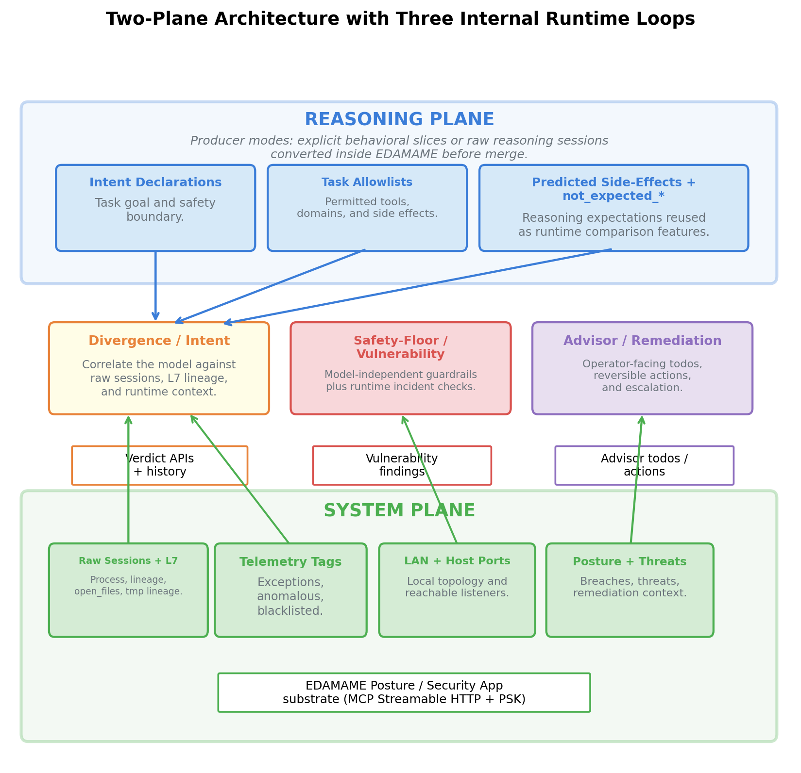
Two-Plane Detection Architecture

Slide 8
EDAMAME Detection Capabilities
Network sessions with L7 process attribution (PID, cmdline, open_files)
ML anomaly detection (Extended Isolation Forest, 12 dimensions)
Blacklist/whitelist matching against known-bad IPs and domains
LAN topology awareness for lateral movement detection
Behavioral model correlation: declared intent vs observed reality

Slide 9
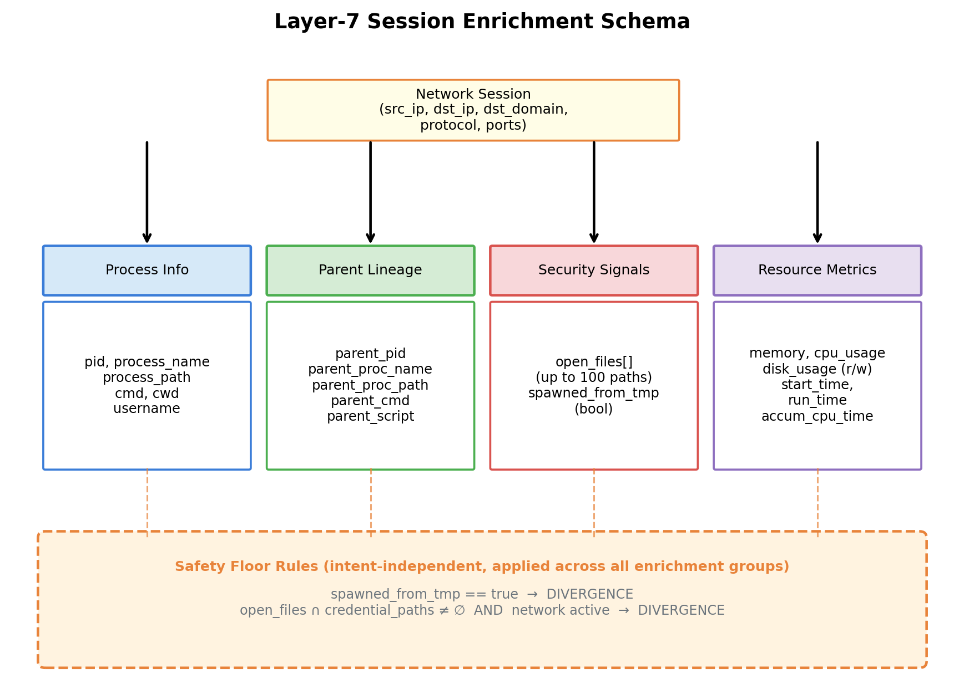
L7 Process Attribution

Slide 10
Detection Results by CVE
Automated Detection
CVE-2026-24763: Recall 1.000, Precision 1.000 (process lineage)
CVE-2026-25253: Recall 0.990, Precision 1.000 (token exfil)
CVE-2025-52882: Recall 1.000, Precision 1.000 (WebSocket)
CVE-2025-59536: Recall 1.000, Precision 1.000 (hook RCE)
Extended Coverage
CVE-2026-2256: DEFERRED (requires LAN device injection API)
CVE-2026-21852: Recall 1.000, Precision 1.000 (config exfil)
VirusTotal skills: Recall 1.000 (credential theft pattern)
STRIKE: Detected via LAN open-port + gateway bind check

Slide 11
Three-Loop Separation
Divergence loop -- correlates behavioral model vs live telemetry
Safety-floor loop -- model-independent guardrails (CVE, lineage, creds)
Advisor loop -- operator-facing todos with reversible remediation actions
Critical signals (blacklisted, /tmp lineage) are non-downgradable
LLM cannot reclassify blacklisted sessions or override safety-floor verdicts

Slide 12
Key Takeaways
Every OpenClaw CVE maps to a concrete EDAMAME detection rule
L7 process attribution is the differentiator: destination-only checks are insufficient
Compound signals (file access + outbound traffic) catch credential theft patterns
Observer-owned state prevents model poisoning and verdict tampering
Practical early-warning: Precision 1.000, Recall 0.911 on 468 live runs

