Slide 1
Javascript

Slide 2
What Is Javascript
ECMAScript
Other languages follow the ECMAScript specs to some degree or another
Jscript.NET, Typescript, etc.
Some Languages “Compile” to Javascript
Coffeescript, Dart, etc.
Not just for Browsers
Server (Node.js), Native applications (React Native, Apache Cordova, Pebble), etc.

Slide 3
What Is Javascript
Multi-paradigm
Dynamic type system
Automatic type conversion
Interpreted? Compiled? Depends on environment
Ecosystem

Slide 4
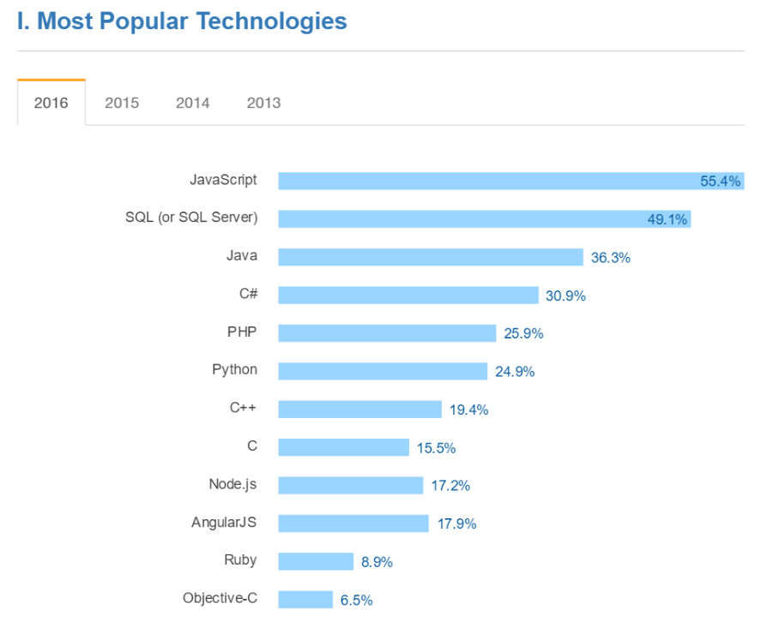
Why Javascript
Simplicity
Popularity
Transferability

Slide 5
General End Goals
Understand the fundamentals of the language and be able to write, refactor, and debug JS code
Understand conventions, patterns, and anti-patterns
Be able to use javascript tooling
Be familiar with the general structure and pros/cons of popular frameworks
Design and create a useful product (ideas)

Slide 6
Demo

