Slide 1
Declarative vs Imperative
Programming Paradigms

Slide 2
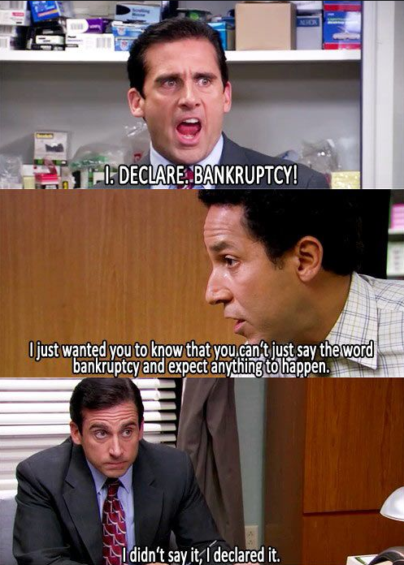

Slide 3
What is Declarative Programming?

Slide 4
Declarative Programming
“a style of building the structure and elements of computer programs that expresses the logic of a computation without describing its control flow”

Slide 5

Examples

Slide 6

Examples

Slide 7
Demos

Slide 8
Can it go to far?
When imperative programming is better

Slide 9
Considerations
Performance
Good vs Bad Complexity
The Inner Platform Effect

Slide 10
Philosophical Question

Slide 11


Is HTML a Programming Language?

