Slide 1
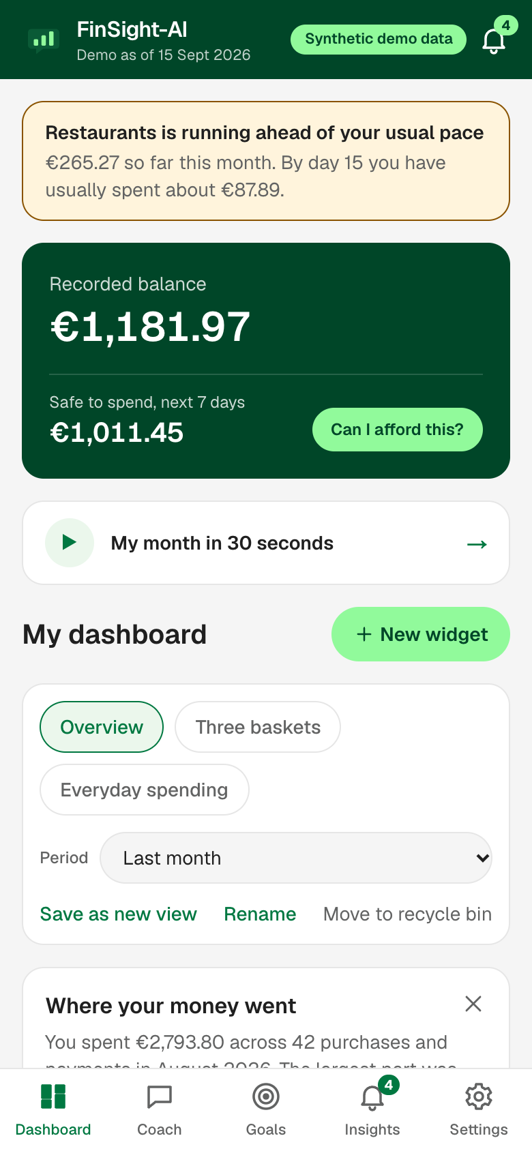
How FinSight-AI works out its answers
The logic, the formulas and the statistics behind the coach
Notes:
Opening slide. Every number in this deck is a rule or threshold in the code; nothing is illustrative unless it says worked example.

Slide 2
The AI chooses, the code calculates, a check verifies
1 The AI chooses
2 The code calculates
3 A check verifies
It reads the question and picks one of 16 calculations. It sees totals, never transactions.
Deterministic code runs on our server in integer cents. Same input, same answer, every time.
Every euro amount in the AI's wording must be one the calculation produced, or the wording is dropped.
answer shown ⇔ { € amounts in the wording } ⊆ { € amounts the calculation produced }
With AI switched off, declined or failing, keywords pick the calculation instead. Steps 2 and the charts are identical.
Notes:
The one idea to take away. The language model never does arithmetic. It picks which calculation to run and writes the sentence around the result. The calculation is ordinary tested code in integer cents. Then the wording is checked against the calculated figures.

Slide 3
From a question to an answer: three routes
Outside the coach's maths
(loans, insurance, taxes)
Question sorted into a theme
Staff taught an answer for it?
Their answer, word for word
Label: bank's team
AI route
(consent given, AI on, under the daily limit)
Model picks a calculation
Server runs it in integer cents
Model writes 2–4 sentences
Grounding check on every € amount
Label: AI coach
model fails or times out
Basic mode
(no consent, AI off, or the model failed)
Keywords in EN / FI / SV pick it
Server runs it in integer cents
The calculation's own sentence
Label: basic mode
The customer always gets an answer, and every answer says which route produced it.
Notes:
Three lanes. Top: subjects the coach cannot calculate, where staff have taught an answer. Middle: the AI route, used only with the customer's consent. Bottom: basic mode by keywords, which is also the fallback whenever the model fails or times out.

Slide 4
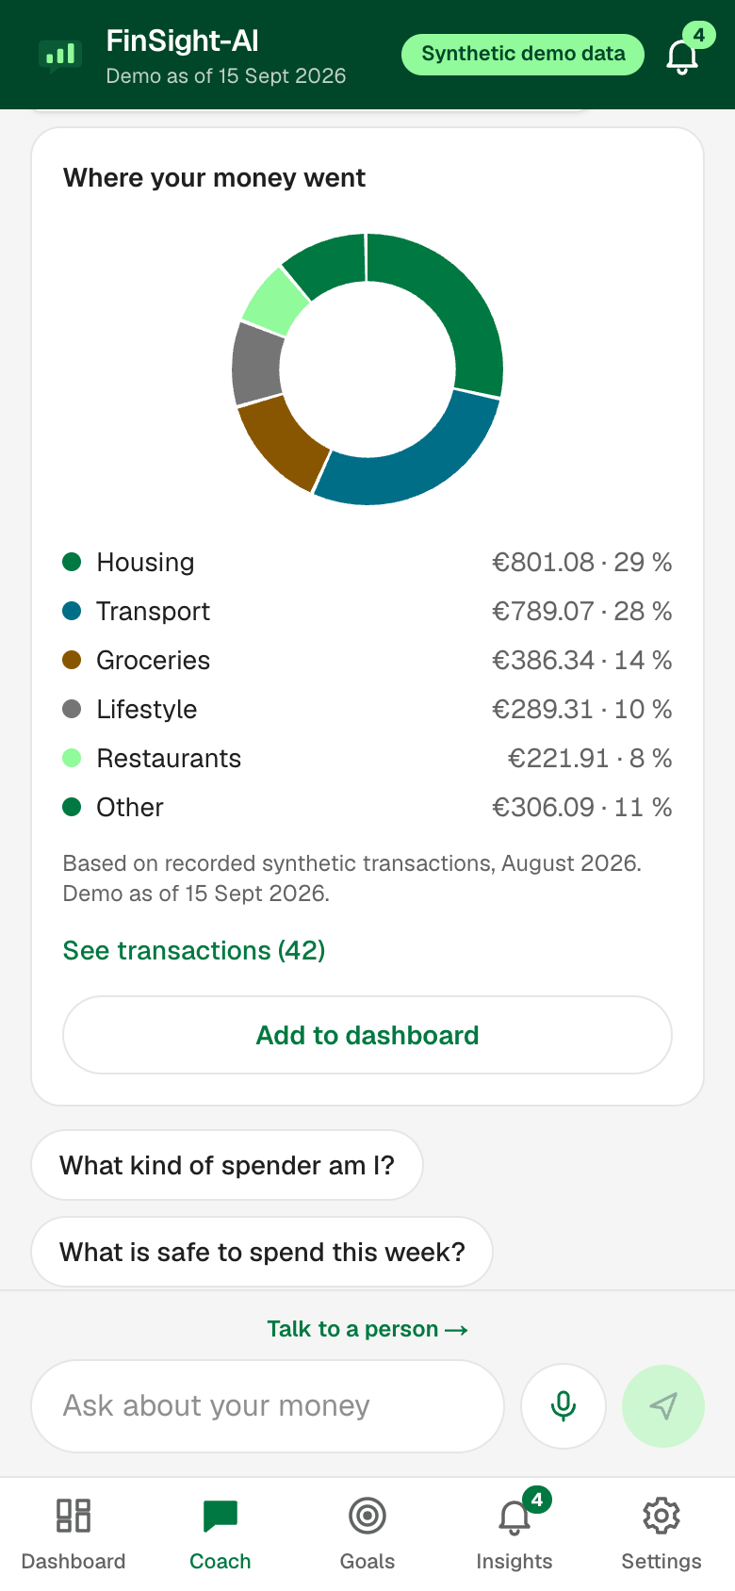
The grounding check keeps the AI honest
1
Find every amount in the wording
€1,011.45 · 1 011,45 € · 300 euros
2
Parse each to integer cents
1 011,45 € → 101145
3
Look it up in the calculated set
exact, or the same figure rounded to whole euros
All supported
→ show the AI's wording
Any unsupported
→ use the calculation's sentence
grounded ⇔ ∀ a ∈ A(text): a ∈ S ∨ a = round€(s), s ∈ S
Every figure opens its transactions
Notes:
After the model writes, we find every euro amount in its text, parse it to cents, and look it up in the set of amounts the calculations returned. One unsupported amount and the model's wording is thrown away in favour of the calculation's own sentence. The admin area counts how often that happens.

Slide 5
How a transaction is categorised
purchase · utilities · housing payment
Consumption
salary · other income
Income
Transaction
Type?
investment deposit / withdrawal
Investing
anything else
Left out, shown as unclassified
Consumption only
Category has a rule?
(10 categories)
Merchant code overrides it?
(taxis, repairs, parking)
Basket + necessity + a reason in words
Notes:
Three fields decide everything: the transaction type, the category, and the merchant category code. Only consumption is ever placed in a basket. Salary, investing and transfers are never counted as spending. Every result carries its reason in plain words.

Slide 6
The three baskets, and how necessary each purchase is
Category | Basket | Necessity | Merchant-code override
Housing, Utilities | Regular bills | Essential | —
Health | Irregular essentials | Essential | —
Home & Tech | Irregular essentials | Unknown | Home supplies, hardware → essential
Groceries | Everyday spending | Essential | —
Transportation | Everyday spending | Essential | Taxis → free choice · parking → unknown
Restaurants, Entertainment | Everyday spending | Free choice | —
Lifestyle, Travel | Everyday spending | Free choice | —
Essentials are never suggested as savings
“Unknown” is said out loud, not guessed
The customer's own correction wins
Notes:
The brief describes three kinds of spending. We map the dataset's ten categories onto them and add a second dimension: essential, free choice, or unknown. Unknown is a real answer: a laptop may be a need or a treat and the data cannot tell. Only free-choice spending is ever suggested as a saving. The customer can correct any of it.

Slide 7
Safe to spend is the lowest point of a day-by-day walk
safe = max( 0 , min over days d of H(d) )
H(d) = B − P − R − X − Σ (e + s + billsᵢ), i = 1…d
Worked example: headroom, €
1400
1360
1324
B
recorded balance
P
protected: money set aside for goals
706
634
R
reserve: mean monthly irregular essentials × days ÷ 30
X
a planned purchase (“can I afford…?”)
e
everyday essentials per day (3-month average)
s
bills spread over the month, per day
Start
Reserve
Day 2
Day 3
rent
Day 7
billsᵢ
bills that fall due on day i
Lowest point = safe to spend: €634
Notes:
Start from the recorded balance. Take off the protected amount, a reserve for irregular essentials and any planned purchase. Then walk forward day by day taking off everyday essentials and bills as they fall due. The lowest point is what is free. Expected income is not counted until it arrives, so a payday next week cannot hide a shortage this week. Worked example on the right: balance 1,400, 18 a day of essentials, 40 reserve, rent 600 on day 3.

Slide 8
Finding regular bills, paydays and subscriptions
Regular bills
Payday
Subscriptions
Regular-basket category, last 6 full months
Seen in ≥ 3 of the months
Amount = median monthly total
One payment a month → day = median day
Several a month → spread: monthly ÷ 30 a day
Salary transactions, last 6 full months
Days grouped: 1st, end of month, or nearest 5
A group seen ≥ 3 times is a payday
Amount = median salary
Not counted in safe to spend until it arrives
Same merchant, last 6 full months
Exactly one payment in a month
Seen in ≥ 3 months
(max − min) ÷ median ≤ 10 %
Yearly cost = 12 × median amount
next expected date = the typical day, in the first month where that day is still ahead
Notes:
The data has no payee names, so recurrence is inferred and shown as a suggestion the customer can correct. Medians are used, not means, so one odd month does not shift the result.

Slide 9
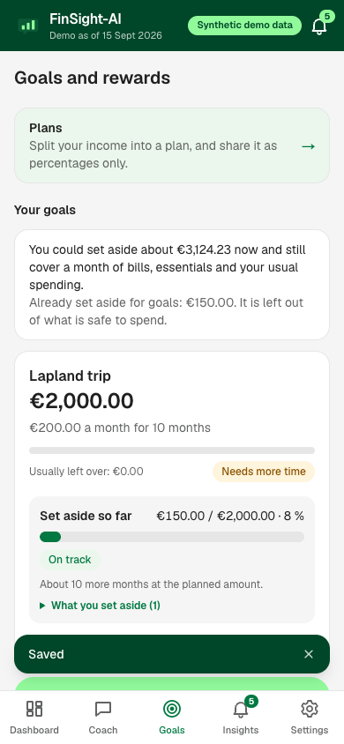
What-if, goals and safe to save
What if I cut restaurants by 20 %?
saving = baseline × p
per year = saving × 12
Can I reach this goal?
monthly = ⌈ target ÷ months ⌉
room = mean income − mean spending (6 months)
gap = max( 0 , monthly − room )
How much can I save?
safe to save = max( 0 , H₃₀ − usual free-choice month )
progress = set aside ÷ target
Room covers it → fits
Trims of 10–30 % close it → a stretch
Still short → say so
Notes:
Three formulas. What-if is always hypothetical: what a cut would have been worth. A goal is funded from the usual monthly room first, then from trims to free-choice spending of at most 30 percent, largest category first; essentials are never trimmed. Safe to save keeps a usual month of free-choice spending in place, and setting money aside never moves money.

Slide 10
Peer benchmarks: the middle half of your age group
5,100 customers · 3.6 M transactions
Where a customer sits in their group
You
Per customer: average month over 12 full months, per metric
Lower than most
In the typical range
Higher than most
Per age band: 25th, 50th, 75th percentile (nearest rank)
P25
P50
P75
position = lower if x < P25
typical if P25 ≤ x ≤ P75, higher if x > P75
Fewer than 30 in a group → dropped
Used in: the “people my age” answer, one insight (above P75), one recommendation (move halfway to P50), one admin chart.
Stored: percentiles only. No row is a person
Notes:
Built once when the data is loaded. For each customer we take the average month over 12 full months for each metric, place them in an age band, and keep only the 25th, 50th and 75th percentile per band. Groups under 30 are dropped. No row describes a person. Percentiles, not an average, because a few very high spenders pull a mean up.

Slide 11
Statistics Finland gives national context, and decides nothing
Source
Statistics Finland, table 14q4
Our category | National (COICOP) division
Groceries | 01 Food and non-alcoholic drinks
Health | 06 Health
Transportation | 07 Transport
Entertainment | 09 Recreation and culture
Restaurants | 11 Restaurants and accommodation
Year
2022
Measure
€ per month per consumption unit
Licence
CC BY 4.0
Shown as context only.
Never used to rank, alert or recommend.
One account is not a whole household and the categories differ slightly, so the app says: read this as context, not a ranking.
Notes:
One line of context under a peer comparison. Table 14q4 of the household budget survey, 2022, consumption expenditure per consumption unit, which adjusts for household size. Only five of our categories are close enough to a national division to compare. It never ranks a customer, triggers an insight or produces a recommendation. The app reads a saved snapshot; it never calls the service while answering.

Slide 12
Recommendations: six rules, ranked by monthly value
# | Fires when | Suggestion | Monthly value
1 | A free-choice category is above the age group's P75 | Move halfway to the middle | (own − P50) ÷ 2
2 | Largest free-choice category is over €50 a month | A modest trim | 15 % of it
3 | 8 or more free-choice purchases under €15 last month | Notice the small ones | 25 % of their total
4 | Essential irregular costs in the last 12 months | Reserve of the 12-month total ÷ 12 | protection
5 | Balance below one month of regular bills | Build a one-month buffer | protection
6 | Over €100 left each month and nothing invested | Put the surplus to work | protection
Rewards use the same data, and compare a customer only with their own earlier months, never with other people.
Notes:
Six rules run over the customer's data. Each that applies produces a suggestion with an estimated monthly value; the list is sorted by that value and the top five are shown. Three of them are about protection rather than saving, so their value is shown as zero.

Slide 13
Insights and reminders: what triggers each one
Insight | Fires when
Possible shortfall | The 7-day walk goes below zero
Thin buffer | Balance < one month of regular bills
Habit going the wrong way | From day 7: free-choice category ≥ €30 and ≥ 25 % ahead of usual
Bill due | A regular bill is expected within 10 days
Category spike or drop | Last month ± 25 % and ± €30 vs its 3-month mean
Small purchases add up | 8+ free-choice purchases under €15
Above the age group | A free-choice category above P75
Goal reminder | Once a month, per goal
Every morning
Work out today's insights
Anything new that needs attention?
Send one: title only, no amount
Notes:
Each insight is calculated from the customer's own data and opens the coach on that topic. With device notifications on, a daily job sends at most one, with a title only and never an amount.

Slide 14
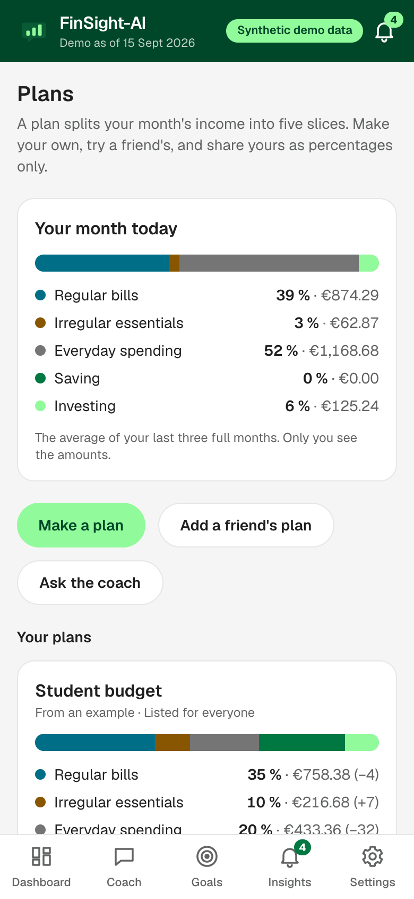
A plan is five percentages, so it can be shared without amounts
pᵢ = ⌊ 100 · aᵢ ÷ Σa ⌋ , then +1 to the largest remainders
until Σ pᵢ = 100
Worked example: income €2,500 a month
Slice | € | Exact % | Floor | Final
Regular bills | 900 | 36.0 | 36 | 36
Everyday spending | 655 | 26.2 | 26 | 26
Irregular essentials | 70 | 2.8 | 2 | 3
Saving | 875 | 35.0 | 35 | 35
Others see: the name and five percentages
Never: income, any amount, balance, name, age, customer number
Notes:
A plan splits a month's income into five slices in whole percentages that add up to exactly 100, using the largest-remainder method. A plan has no field that can hold an amount. Sharing publishes the name and the percentages under a random code with no link to the customer. A friend who copies it sees those percentages worked out on their own income.

Slide 15
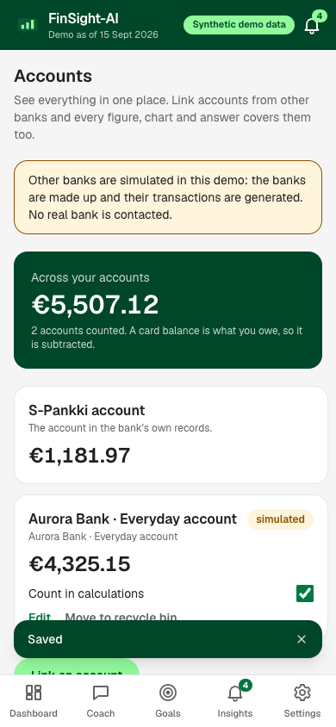
One picture of the customer, built before any calculation runs
Bank record
(one sealed ledger)
Merge by date and time
Apply corrections
Protect set-asides
Linked accounts
(simulated, labelled)
Every calculation, chart, insight and answer
The customer's corrections
Money set aside for goals
combined balance = Σ latest balance of each counted account
Notes:
Everything the customer adds on top of the bank's record is applied in one place: accounts linked from other banks, which are a labelled simulation here; their own corrections to baskets and bills; and money they have set aside for goals. The combined balance is the sum of each counted account's latest balance, and a card balance is negative.

Slide 16
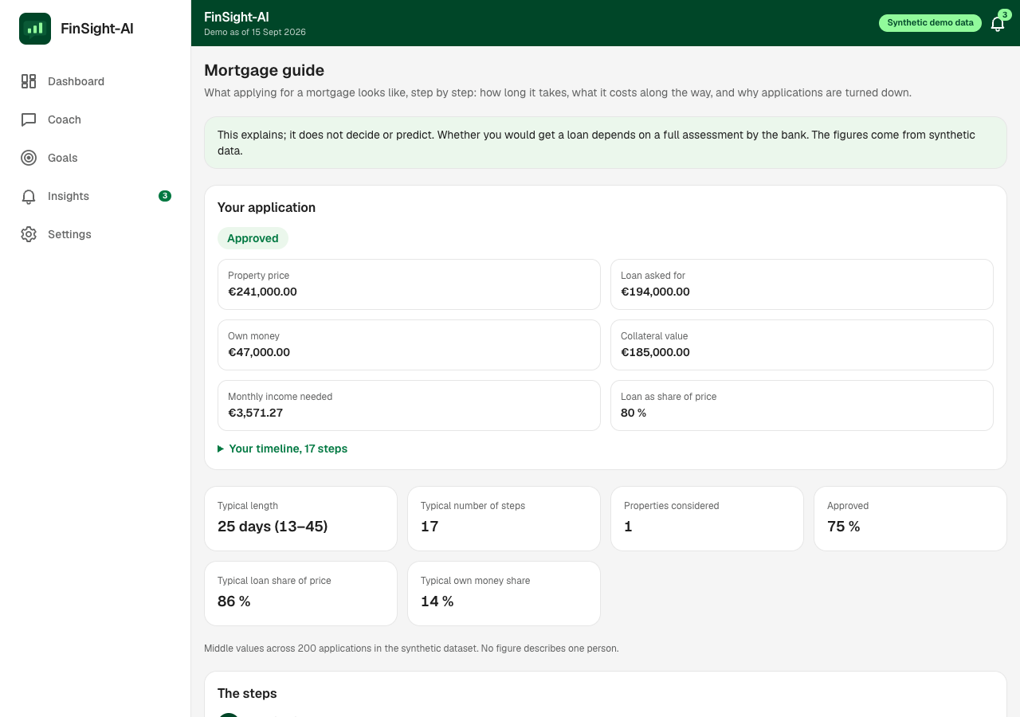
The mortgage guide teaches from 200 applications
25 days
typical length (13–45)
17
typical number of steps
75 %
approved
86 %
typical loan share of price
each figure = median across applications
step day = median day of first occurrence
Why not approved, among the 50: collateral 68 %, income 16 %, own money 12 %, existing debt 4 %.
Explains. Never predicts approval.
Notes:
The dataset has an event history for 200 mortgage applications and each outcome. We use it for teaching only: the steps, how long they take, what it costs along the way, and why applications are turned down. A customer with an application also sees their own. Nothing here predicts or judges whether anyone would get a loan.

Slide 17
Nothing a customer owns is stored unencrypted
Customer ID
HMAC-SHA-256
→ blind index
HKDF
→ this customer's key
gzip + AES-256-GCM
One sealed ledger per customer
ref = HMAC(index key, customer ID) key = HKDF(master key, ref)
sealed = AES-256-GCM(key, gzip(ledger), context)
The AI sees
The AI never sees
Staff see
The question, recent turns and totals. Only with consent.
Transactions, customer ID, age, postal code.
Counts by topic and day. Never who asked or what they typed.
Notes:
The customer ID is never stored. It is turned into a keyed digest, the blind index, which is the only form in which a customer is looked up. A key for that one customer is derived from the master key, and their whole transaction history is compressed and sealed as a single value. The database cannot see how many transactions a customer has, what they bought or when.

Slide 18
What is behind the answers, in numbers
5,100
customers loaded
3,626,755
transactions, sealed per customer
16
calculations the coach can run
15
chart types to draw them
3
languages, text and voice
100
automated tests
Advice you can check: every answer opens the transactions it was calculated from.
Notes:
Closing slide. The whole synthetic dataset is loaded and encrypted; the maths is tested; and the product still answers with the AI switched off.

