Slide 1
Beyond Traditional Forecasting: Machine Learning-Driven Predictions of Earth's Climatic Changes
Frontier Tech Leaders Programme Global Cohort 1
Tarik Solomon Teshome
12/12/2023

Slide 2
Outline
Frontier Tech Leaders Programme Global Cohort 1
Concept note and implementation plan:
Background
Objectives
SDG Relation
Data
Data Collection
Exploratory Data Analysis (EDA) and Feature Engineering
Model Selection and Training
Model Evaluation and Hyperparameter Tuning
Results
Future Work

Slide 3
Concept note and implementation plan
Frontier Tech Leaders Programme Global Cohort 1

Slide 4
Background
Frontier Tech Leaders Programme Global Cohort 1
Brief Project Overview: This project aims to harness machine learning algorithms to predict future temperature trends, a crucial element in the fight against climate change.
Provide Brief Background: Leveraging historical climate data, the model seeks to anticipate temperature changes, enabling proactive environmental and social planning.
Importance of the Problem Being Solved: Accurate temperature predictions are vital for agriculture, health, and urban development, directly influencing sustainable living and resource management.

Slide 5
Objectives
Frontier Tech Leaders Programme Global Cohort 1
Clearly State the Project Objectives:
To develop a predictive model capable of forecasting future temperatures.
To analyze historical climate data and identify trends using machine learning algorithms.
Outline What the Machine Learning Model Aims to Achieve:
Generate accurate temperature predictions to aid in climate resilience planning.
Provide data-driven insights for policymakers and scientists in climate-related fields.

Slide 6
SDG Relation
Frontier Tech Leaders Programme Global Cohort 1
Our project aligns with SDG 13: Climate Action, by enhancing predictive capabilities for climate-related hazards.
It supports SDG 11: Sustainable Cities and Communities, through aiding urban planning for climate resilience.
Contributes to SDG 2: Zero Hunger, by forecasting weather patterns that affect food security.
Aids in SDG 3: Good Health and Well-being, by predicting heatwaves and other health-related climate events.
Furthers SDG 15: Life on Land, by informing biodiversity conservation efforts in changing climates.

Slide 7
Data
Frontier Tech Leaders Programme Global Cohort 1

Slide 8
Data Collection
Frontier Tech Leaders Programme Global Cohort 1
Source of the Dataset:
The primary dataset is the Earth Surface Temperature Data, obtained from Kaggle, providing historical temperature records in CSV format.
Scope of the Data:
The dataset encompasses global geographic locations, offering extensive coverage over various periods for a comprehensive analysis.
Preprocessing Steps During Data Collection:
Data cleaning will involve removing inaccuracies and correcting format inconsistencies.
Normalization will be applied to standardize temperature readings across different scales.
Handling Missing Values, Outliers, etc.:
Missing values will be addressed through imputation techniques suitable for time-series data.
Outlier detection and handling will be performed to maintain the integrity of temperature trends.

Slide 9
Exploratory Data Analysis (EDA) and Feature Engineering
Frontier Tech Leaders Programme Global Cohort 1
Explain the Process of Creating or Transforming Features:
Feature engineering involved extracting meaningful information from the dataset, such as converting dates into separate year and month columns to capture seasonal effects on temperature trends.
Rationale Behind Feature Engineering Decisions:
The rationale for feature engineering was to enhance the model’s ability to detect patterns. For instance, isolating the month from a date allows the model to understand better and predict seasonal temperature variations.
Describe Scaling, Normalization, Encoding, etc.:
Scaling and normalization were applied to bring all numerical features to a common scale without distorting differences in the ranges of values, which is essential for models that are sensitive to input magnitude.

Slide 10
Model
Frontier Tech Leaders Programme Global Cohort 1

Slide 11
Model Selection and Training
Frontier Tech Leaders Programme Global Cohort 1
Rationale for Choosing Specific Models:
Selected models balance complexity and interpretability, from baseline Linear Regression to more sophisticated Random Forest and Gradient Boosting.
Comparison of Models:
Linear Regression acts as a benchmark; however, tree-based models have shown superior performance due to their ability to model non-linear relationships. Random Forest and Gradient Boosting, in particular, have lower error metrics and higher R² scores.

Slide 12
Model Selection and Training
Frontier Tech Leaders Programme Global Cohort 1
Strengths and Weaknesses of Models:
Linear Regression: Quick, interpretable, and less complex. Weak against non-linearity.
Decision Tree: Good for non-linear patterns, but can overfit.
Random Forest: Averages multiple trees to reduce overfitting, good generalization.
Gradient Boosting: Sequentially builds trees to improve on errors, typically high performance.
Training and Hyperparameters:
Models were trained with a split of training and testing data. Default hyperparameters were employed for initial training to establish a baseline performance.

Slide 13
Model Evaluation and Hyperparameter Tuning
Frontier Tech Leaders Programme Global Cohort 1
Evaluation Metrics:
Assessment of models was done using MSE, RMSE, MAE, R² Score, and NSE to gauge accuracy and efficiency.
Visualizations:
Scatter plots illustrate the fit between actual and predicted temperatures, showcasing the models' precision.
Heat map compares the key metrics across all models, providing a clear performance overview.

Slide 14
Results
Frontier Tech Leaders Programme Global Cohort 1

Slide 15
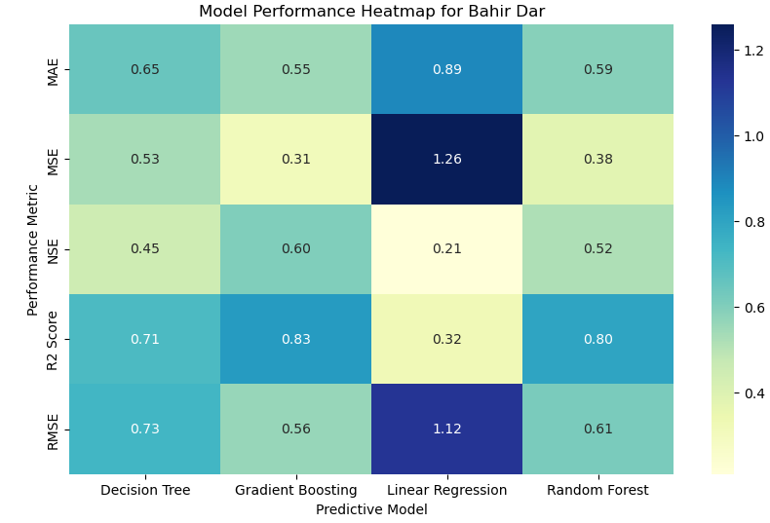
Evaluation Results
Frontier Tech Leaders Programme Global Cohort 1
Top Performers:
Gradient Boosting and Random Forest models exhibit superior performance with high accuracy and efficiency.
Accuracy Indicators:
Gradient Boosting has the highest R² Score (0.83) and low errors (MAE of 0.55, RMSE of 0.56), indicating excellent model fit.
Random Forest follows closely with an R² Score of 0.80 and comparable error rates (MAE of 0.59, RMSE of 0.61).
Model Efficiency:
Gradient Boosting leads with an NSE of 0.60, demonstrating its efficiency in predicting temperatures.
Random Forest also shows strong efficiency with an NSE of 0.52.

Slide 16
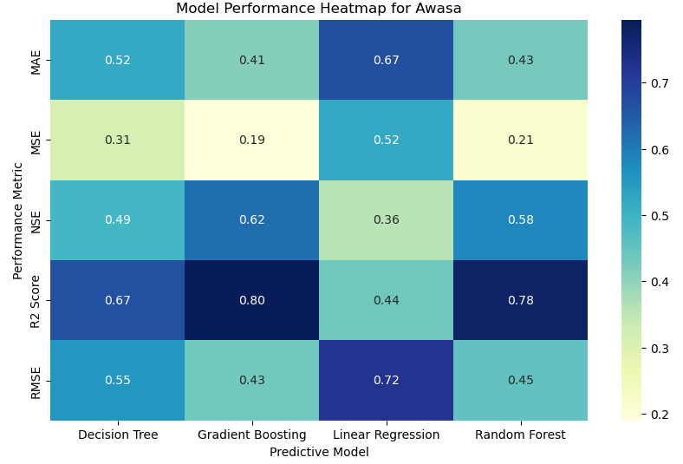
Evaluation Results
Frontier Tech Leaders Programme Global Cohort 1
Top Performers:
The Gradient Boosting model stands out for its high accuracy and efficiency in predicting temperatures for Awasa.
Random Forest also delivers strong performance with metrics closely following those of Gradient Boosting.
Accuracy Indicators:
Gradient Boosting achieves the highest R² Score (0.80) among all models, indicating a strong correlation between predicted and observed temperatures.
Random Forest, with an R² Score of 0.78, demonstrates similarly accurate predictions, corroborating the effectiveness of ensemble methods.
Model Efficiency:
With an NSE of 0.62, Gradient Boosting not only predicts accurately but also efficiently captures the variance of the actual temperatures.
Random Forest exhibits a commendable NSE of 0.58, reinforcing its reliability as a predictive model.

Slide 17
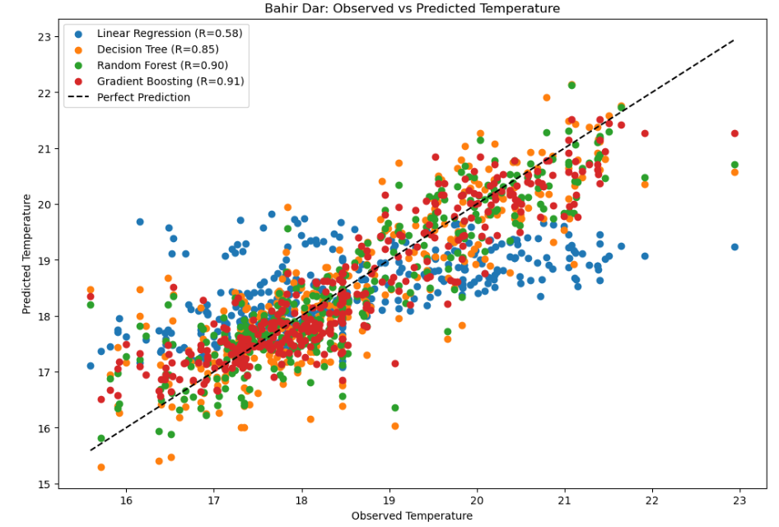
Evaluation Results
Frontier Tech Leaders Programme Global Cohort 1
Model Accuracy Summary:
Gradient Boosting leads with the highest accuracy (R=0.91), closely mirroring actual temperature trends.
Random Forest is a close second (R=0.90), demonstrating reliability and consistency in predictions.
Decision Tree shows decent accuracy (R=0.85), but with more variance than ensemble models.
Linear Regression trails behind (R=0.58), suggesting limitations in handling this dataset's complexity.
Key Takeaway:
Ensemble methods, especially Gradient Boosting, outshine simpler models, highlighting the importance of model selection in climate predictions.

Slide 18
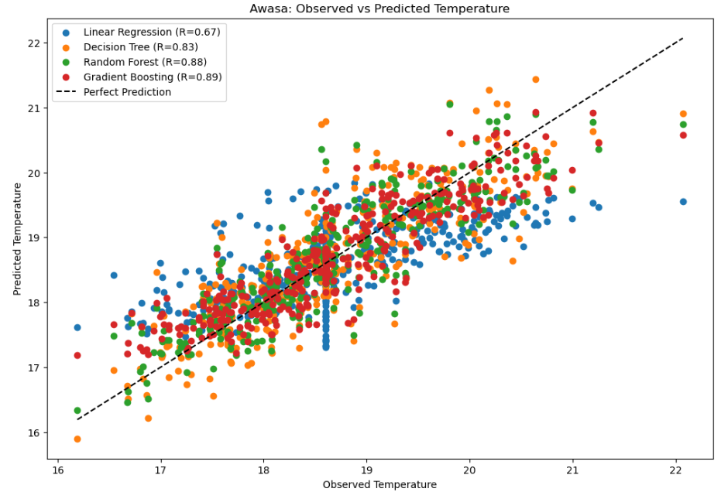
Evaluation Results
Frontier Tech Leaders Programme Global Cohort 1
Accuracy at a Glance:
Gradient Boosting (R=0.89) and Random Forest (R=0.88) closely align with the perfect prediction line, signifying high accuracy.
Decision Tree (R=0.83) displays competent but less consistent predictions.
Linear Regression (R=0.67) shows the broadest scatter, indicating lower predictive accuracy.
Consistency Across Cities:
Findings align with Bahir Dar's data, suggesting the robustness of ensemble models in varied geographic contexts.

Slide 19
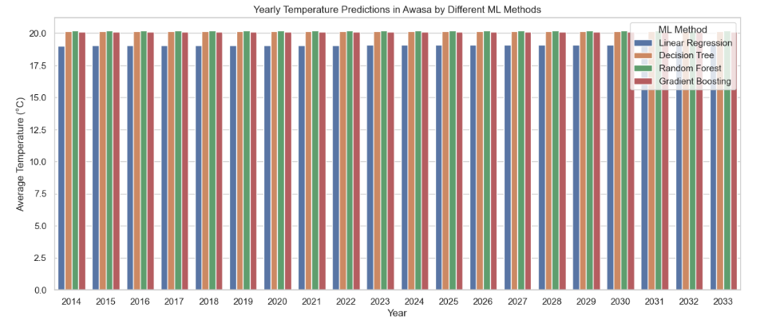
Evaluation Results
Frontier Tech Leaders Programme Global Cohort 1

Slide 20
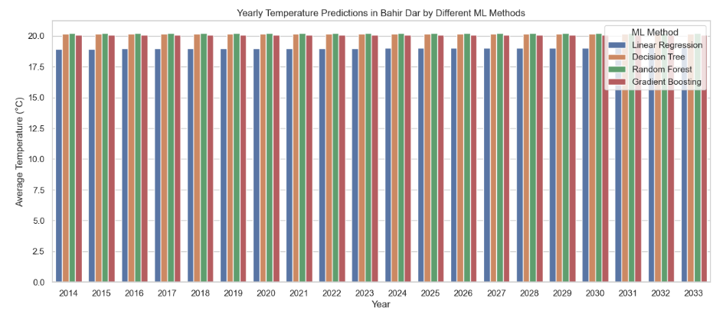
Evaluation Results
Frontier Tech Leaders Programme Global Cohort 1

Slide 21
Future Work
Frontier Tech Leaders Programme Global Cohort 1
We will explore advanced machine learning algorithms and deep learning models to further enhance prediction accuracy.
Incorporation of additional climatic factors such as humidity, wind speed, and solar radiation to improve the robustness of the model.
Expansion of the dataset with more granular geographic data or longer time horizons to capture more trends and patterns.

Slide 22
References
Frontier Tech Leaders Programme Global Cohort 1
Mansfield, L.A., Nowack, P.J., Kasoar, M. et al. Predicting global patterns of long-term climate change from short-term simulations using machine learning. npj Clim Atmos Sci 3, 44 (2020). https://doi.org/10.1038/s41612-020-00148-5
Ise T and Oba Y (2019) Forecasting Climatic Trends Using Neural Networks: An Experimental Study Using Global Historical Data. Front. Robot. AI 6:32. doi: 10.3389/frobt.2019.00032
Gibson, P.B., Chapman, W.E., Altinok, A. et al. Training machine learning models on climate model output yields skillful interpretable seasonal precipitation forecasts. Commun Earth Environ 2, 159 (2021). https://doi.org/10.1038/s43247-021-00225-4
Hanoon, M.S., Ahmed, A.N., Zaini, N. et al. Developing machine learning algorithms for meteorological temperature and humidity forecasting at Terengganu state in Malaysia. Sci Rep 11, 18935 (2021). https://doi.org/10.1038/s41598-021-96872-w

Slide 23


Thank you!
Frontier Tech Leaders Programme Global Cohort 1

