Slide 1
Machine Learning-DrivenWeather Forecasting In Bahir Dar And Awasa
Frontier Tech Leaders Programme Global Cohort 1
Tarik SOLOMON
12/16/2023

Slide 2
Outline
Frontier Tech Leaders Programme Global Cohort 1
Concept note and implementation plan:
Background
Objectives
SDG Relation
Data
Methodology
Results
Deployment
Future Work

Slide 3
Concept note and implementation plan
Frontier Tech Leaders Programme Global Cohort 1

Slide 4
Background
Frontier Tech Leaders Programme Global Cohort 1
Brief Project Overview: This project aims to harness machine learning algorithms to predict future temperature trends, a crucial element in the fight against climate change.
Provide Brief Background: Leveraging historical climate data, the model seeks to anticipate temperature changes, enabling proactive environmental and social planning.
Importance of the Problem Being Solved: Accurate temperature predictions are vital for agriculture, health, and urban development, directly influencing sustainable living and resource management.

Slide 5
SDG Relation
Frontier Tech Leaders Programme Global Cohort 1
Our project aligns with SDG 13: Climate Action, by enhancing predictive capabilities for climate-related hazards.
It supports SDG 11: Sustainable Cities and Communities, through aiding urban planning for climate resilience.
Contributes to SDG 2: Zero Hunger, by forecasting weather patterns that affect food security.
Aids in SDG 3: Good Health and Well-being, by predicting heatwaves and other health-related climate events.
Furthers SDG 15: Life on Land, by informing biodiversity conservation efforts in changing climates.

Slide 6
Objectives
Frontier Tech Leaders Programme Global Cohort 1
Clearly State the Project Objectives:
To develop a predictive model capable of forecasting future temperatures.
To analyze historical climate data and identify trends using machine learning algorithms.
Outline What the Machine Learning Model Aims to Achieve:
Generate accurate temperature predictions to aid in climate resilience planning.
Provide data-driven insights for policymakers and scientists in climate-related fields.

Slide 7
Data Collection
Frontier Tech Leaders Programme Global Cohort 1
Source of the Dataset:
The primary dataset is the Earth Surface Temperature Data, obtained from Kaggle, providing historical temperature records in CSV format.
Scope of the Data:
The dataset encompasses global geographic locations, offering extensive coverage over various periods for a comprehensive analysis.
Preprocessing Steps During Data Collection:
Data cleaning will involve removing inaccuracies and correcting format inconsistencies.
Normalization will be applied to standardize temperature readings across different scales.
Handling Missing Values, Outliers, etc.:
Missing values will be addressed through imputation techniques suitable for time-series data.
Outlier detection and handling will be performed to maintain the integrity of temperature trends.

Slide 8
Exploratory Data Analysis (EDA) and Feature Engineering
Frontier Tech Leaders Programme Global Cohort 1
Bahir Dar Dataset:
Basic Inspection: The dataset includes columns for date (dt), average temperature, temperature uncertainty, city, country, latitude, and longitude.
Summary Statistics: The average temperature in Bahir Dar (counting available data) is around 18.47°C with a standard deviation of 1.45°C.
Missing Values: There are 191 missing values in both the AverageTemperature and AverageTemperatureUncertainty columns.
Awasa Dataset:
Basic Inspection: Similar structure to the Bahir Dar dataset, with corresponding columns.
Summary Statistics: The average temperature in Awasa is approximately 18.60°C with a standard deviation of 1.02°C.
Missing Values: There are 286 missing values in both the AverageTemperature and AverageTemperatureUncertainty columns.

Slide 9
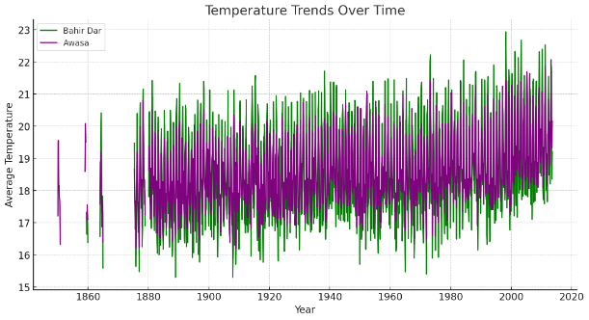
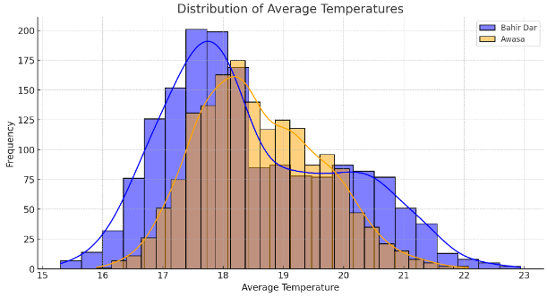
Exploratory Data Analysis (EDA) and Feature Engineering
Frontier Tech Leaders Programme Global Cohort 1
Temperature Trends Over Time: The line plot shows the trends in average temperatures over time for both cities. There's a visible trend and seasonality in the temperatures.
Distribution of Temperatures: The histogram indicates the distribution of average temperatures in both cities, showing a relatively normal distribution with some skewness.

Slide 10
Model Selection and Training
Frontier Tech Leaders Programme Global Cohort 1
Rationale for Choosing Specific Models:
Selected models balance complexity and interpretability, from baseline Linear Regression to more sophisticated Random Forest and Gradient Boosting.
Comparison of Models:
Linear Regression acts as a benchmark; however, tree-based models have shown superior performance due to their ability to model non-linear relationships. Random Forest and Gradient Boosting, in particular, have lower error metrics and higher R² scores.

Slide 11
Model Selection and Training
Frontier Tech Leaders Programme Global Cohort 1
Strengths and Weaknesses of Models:
Linear Regression: Quick, interpretable, and less complex. Weak against non-linearity.
Decision Tree: Good for non-linear patterns, but can overfit.
Random Forest: Averages multiple trees to reduce overfitting, good generalization.
Gradient Boosting: Sequentially builds trees to improve on errors, typically high performance.

Slide 12
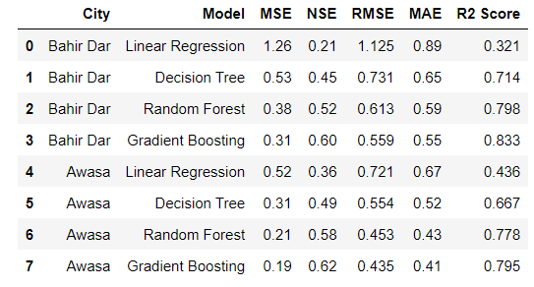
Evaluation Results
Frontier Tech Leaders Programme Global Cohort 1
Top Performers:
The Gradient Boosting model stands out for its high accuracy and efficiency in predicting temperatures for Awasa.
Random Forest also delivers strong performance with metrics closely following those of Gradient Boosting.
Accuracy Indicators:
Gradient Boosting achieves the highest R² Score (0.80) among all models, indicating a strong correlation between predicted and observed temperatures.
Random Forest, with an R² Score of 0.78, demonstrates similarly accurate predictions, corroborating the effectiveness of ensemble methods.
Model Efficiency:
With an NSE of 0.62, Gradient Boosting not only predicts accurately but also efficiently captures the variance of the actual temperatures.
Random Forest exhibits a commendable NSE of 0.58, reinforcing its reliability as a predictive model.

Slide 13
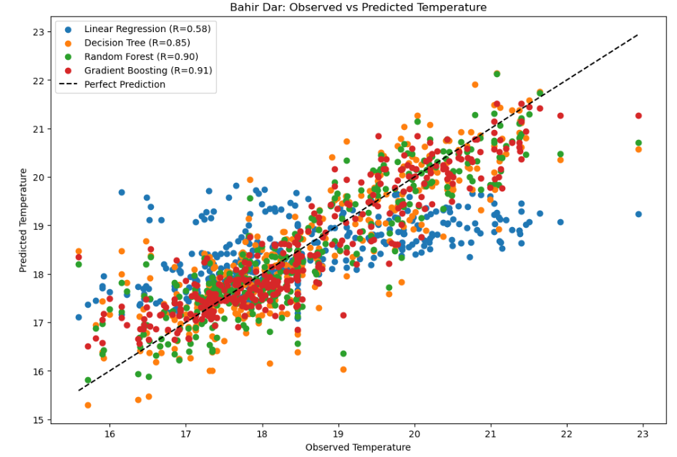
Evaluation Results
Frontier Tech Leaders Programme Global Cohort 1
Model Accuracy Summary:
Gradient Boosting leads with the highest accuracy (R=0.91), closely mirroring actual temperature trends.
Random Forest is a close second (R=0.90), demonstrating reliability and consistency in predictions.
Decision Tree shows decent accuracy (R=0.85), but with more variance than ensemble models.
Linear Regression trails behind (R=0.58), suggesting limitations in handling this dataset's complexity.
Key Takeaway:
Ensemble methods, especially Gradient Boosting, outshine simpler models, highlighting the importance of model selection in climate predictions.

Slide 14
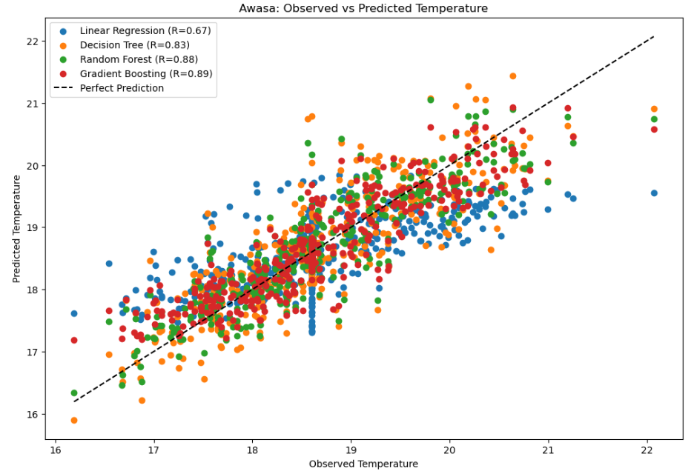
Evaluation Results
Frontier Tech Leaders Programme Global Cohort 1
Accuracy at a Glance:
Gradient Boosting (R=0.89) and Random Forest (R=0.88) closely align with the perfect prediction line, signifying high accuracy.
Decision Tree (R=0.83) displays competent but less consistent predictions.
Linear Regression (R=0.67) shows the broadest scatter, indicating lower predictive accuracy.
Consistency Across Cities:
Findings align with Bahir Dar's data, suggesting the robustness of ensemble models in varied geographic contexts.

Slide 15
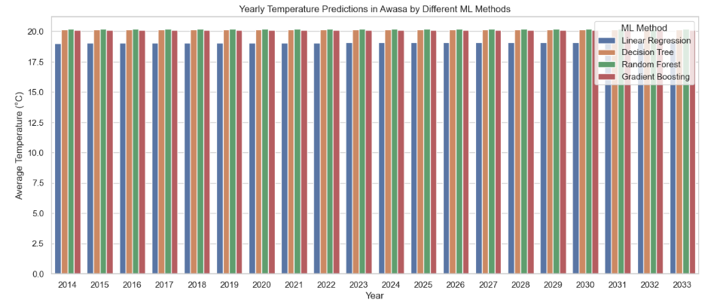
Evaluation Results
Frontier Tech Leaders Programme Global Cohort 1

Slide 16
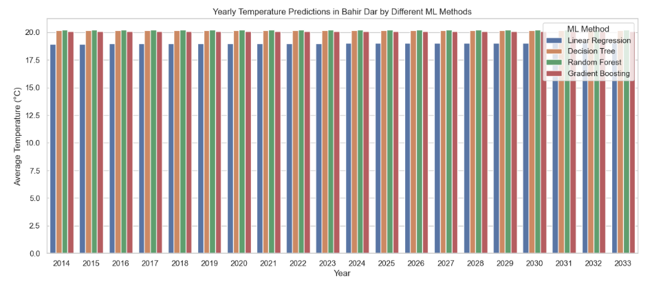
Evaluation Results
Frontier Tech Leaders Programme Global Cohort 1

Slide 17
Deployment
Frontier Tech Leaders Programme Global Cohort 1
Objective: Transition to a production-ready web app for temperature forecasting in Bahir Dar and Awasa.
Serialization: Use Python's Pickle for efficient model serialization, ensuring easy storage and rapid deployment.
Serving: Deploy with Flask/Django within Docker containers on platforms like AWS or Heroku for robust scalability.
APIs: RESTful endpoints for user interaction, with clear documentation on data submission and forecast retrieval.
Security: Implement HTTPS, API tokens/OAuth for access control, input validation, and encryption of stored data.
Monitoring: Utilize tools like Prometheus for real-time monitoring of key performance metrics and system health.

Slide 18
Future Work
Frontier Tech Leaders Programme Global Cohort 1
We will explore advanced machine learning algorithms and deep learning models to further enhance prediction accuracy.
Incorporation of additional climatic factors such as humidity, wind speed, and solar radiation to improve the robustness of the model.
Expansion of the dataset with more granular geographic data or longer time horizons to capture more trends and patterns.

Slide 19
References
Frontier Tech Leaders Programme Global Cohort 1
Mansfield, L.A., Nowack, P.J., Kasoar, M. et al. Predicting global patterns of long-term climate change from short-term simulations using machine learning. npj Clim Atmos Sci 3, 44 (2020). https://doi.org/10.1038/s41612-020-00148-5
Ise T and Oba Y (2019) Forecasting Climatic Trends Using Neural Networks: An Experimental Study Using Global Historical Data. Front. Robot. AI 6:32. doi: 10.3389/frobt.2019.00032
Gibson, P.B., Chapman, W.E., Altinok, A. et al. Training machine learning models on climate model output yields skillful interpretable seasonal precipitation forecasts. Commun Earth Environ 2, 159 (2021). https://doi.org/10.1038/s43247-021-00225-4
Hanoon, M.S., Ahmed, A.N., Zaini, N. et al. Developing machine learning algorithms for meteorological temperature and humidity forecasting at Terengganu state in Malaysia. Sci Rep 11, 18935 (2021). https://doi.org/10.1038/s41598-021-96872-w

Slide 20


Thank you!
Frontier Tech Leaders Programme Global Cohort 1

