Slide 1

Developing a Machine Learning System for Detecting and Mitigating Phishing Attacks.
Frontier Tech Leaders Programme Global Cohort 1
Oudoum Ali Houmed
10/12/2023

Slide 2
Outline
Frontier Tech Leaders Programme Global Cohort 1
Concept note and implementation plan:
  Background
  Objectives
  SDG Relation
Data
  Data Collection
  Exploratory Data Analysis (EDA) and Feature Engineering
Model Selection and Training
  Model Evaluation and Hyperparameter Tuning
  Model Refinement and Testing
Results
Deployment
Future Work

Slide 3
Concept note and implementation plan
Frontier Tech Leaders Programme Global Cohort 1

Slide 4
Background
Frontier Tech Leaders Programme Global Cohort 1
Phishing, a prevalent cyberattack tactic where attackers impersonate legitimate entities to extract sensitive data, poses a growing threat in the digital era. This project addresses the urgent need to combat these attacks, which frequently target login details, financial information, and personal data. The significance of tackling phishing lies in safeguarding individual privacy and maintaining organizational security. By addressing this issue, the project aims to mitigate the risks associated with these deceptive practices, emphasizing the importance of protecting personal and corporate data integrity in our increasingly online world.

Slide 5
Objectives
Frontier Tech Leaders Programme Global Cohort 1
The primary goal of this project is to create a sophisticated machine learning model designed to accurately identify and mitigate phishing attacks, thus safeguarding vital user information. Simultaneously, a significant aspect of the project is to enhance user awareness regarding phishing risks. This dual approach not only focuses on technological defenses against cyber threats but also emphasizes educating users about these dangers. The end objective is to cultivate a heightened sense of online security awareness, enabling users to navigate the digital space more safely and informedly.

Slide 6
SDG Relation
Frontier Tech Leaders Programme Global Cohort 1
My capstone project is dedicated to addressing the pervasive issue of phishing, a prevalent form of cyberattack. This project aligns with the Sustainable Development Goals (SDGs), particularly:
Goal 9: Industry, Innovation, and Infrastructure.
Goal 16: Peace, Justice, and Strong Institutions.
By enhancing cybersecurity, it contributes to building resilient infrastructure and promoting inclusive and sustainable industrialization, as well as fostering peaceful and inclusive societies for sustainable development

Slide 7

Data
Frontier Tech Leaders Programme Global Cohort 1

Slide 8
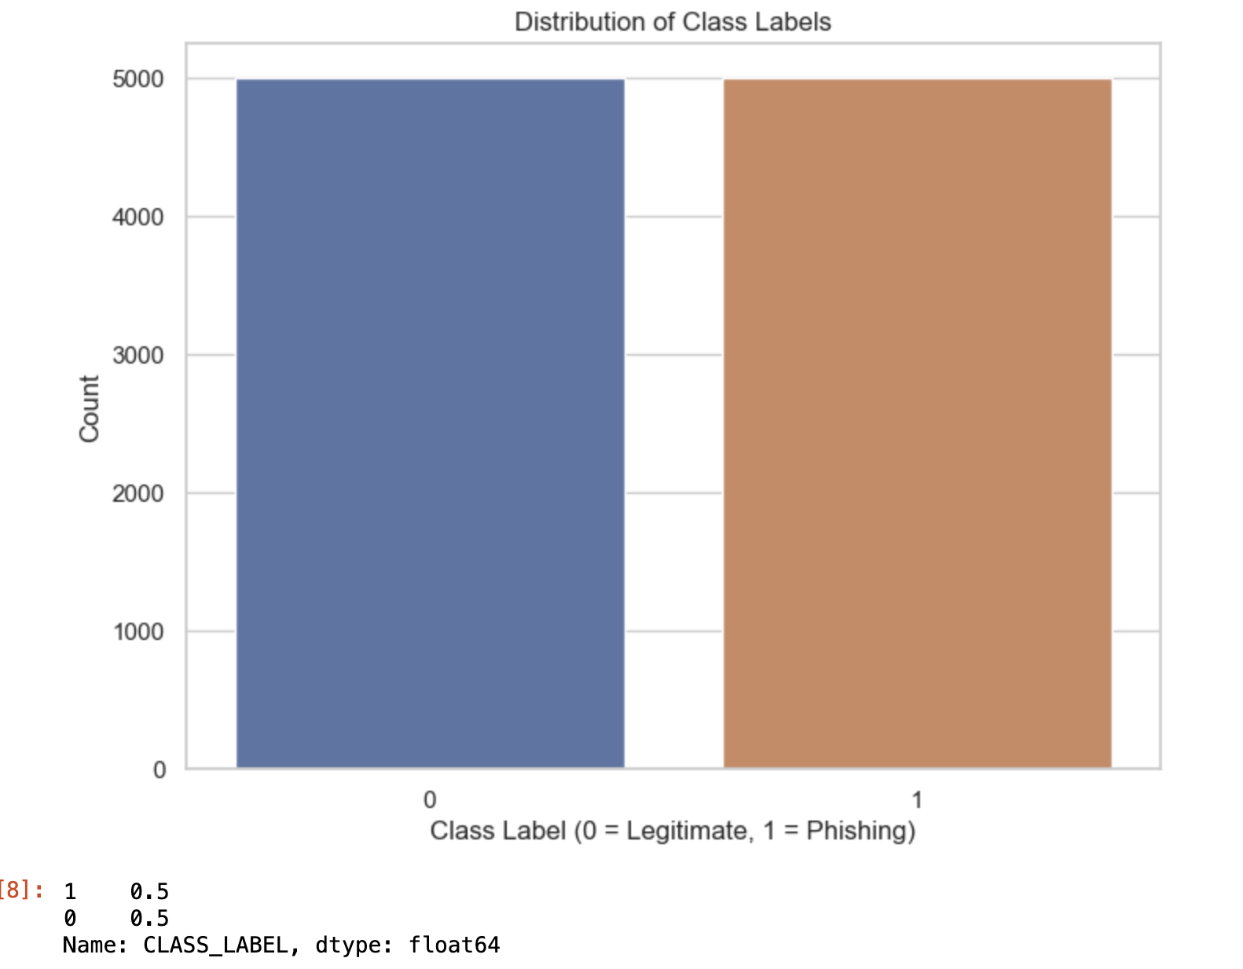
Data Collection
Frontier Tech Leaders Programme Global Cohort 1
Data Source: It's a dataset that comes from Kaggle.
Data Format: The data is in CSV format.
Data Size: The dataset contains 10,000 rows and 50 columns.
I selected this dataset for its perfect fit with my project 'Developing a Machine Learning System for Detecting and Mitigating Phishing Attacks'. Its detailed website characteristics are ideal for training models to distinguish between phishing and legitimate sites, aligning closely with my cybersecurity goals.

Slide 9
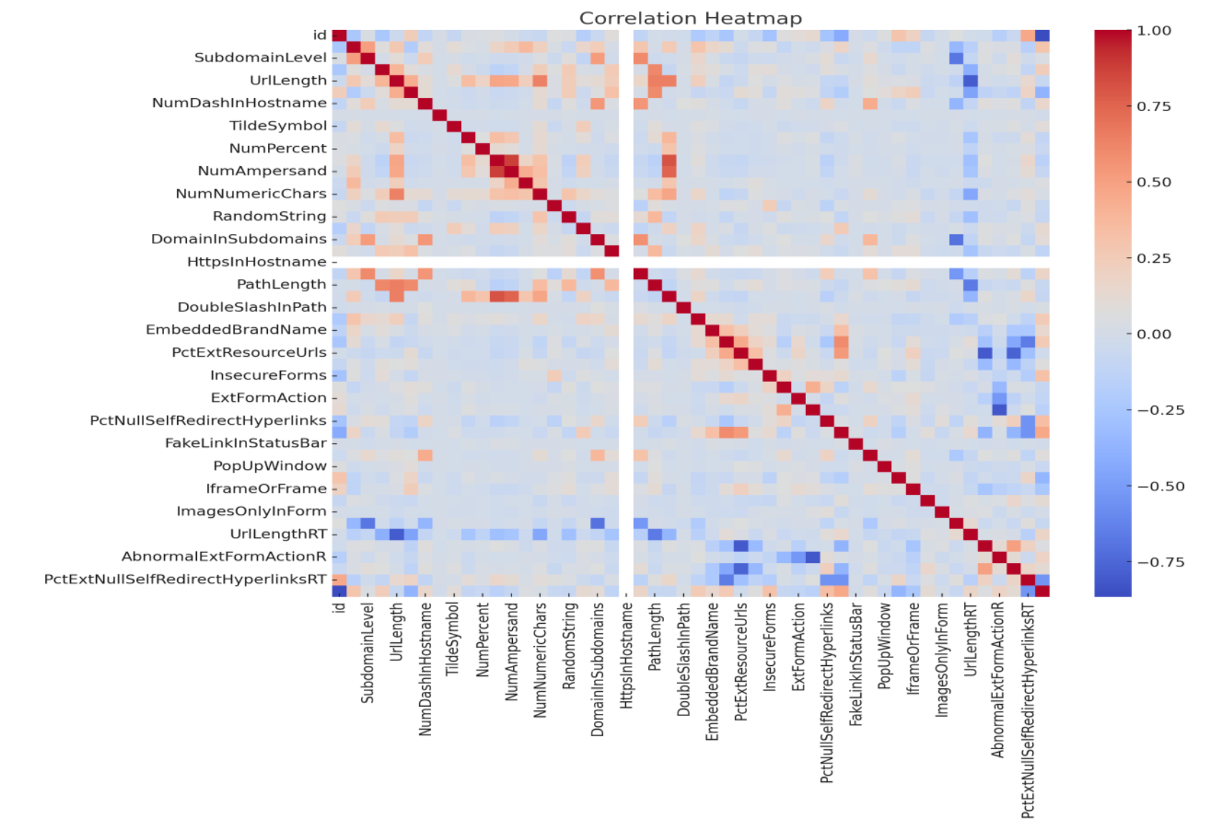
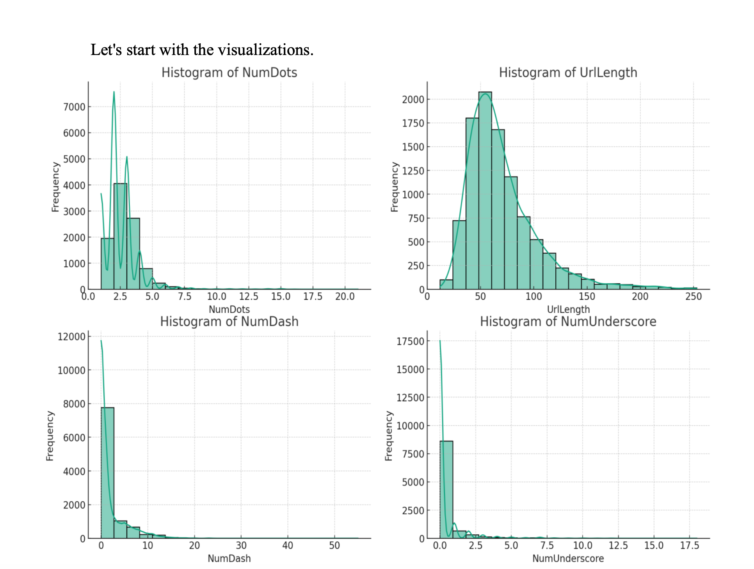

Exploratory Data Analysis (EDA) and Feature Engineering
Frontier Tech Leaders Programme Global Cohort 1

Slide 10

Model
Frontier Tech Leaders Programme Global Cohort 1

Slide 11


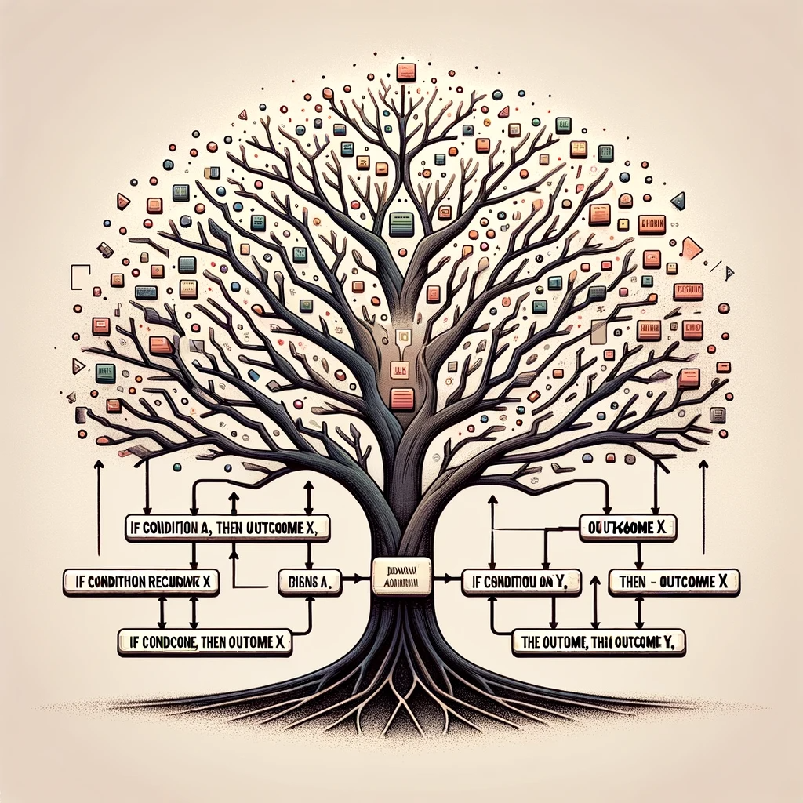
Model Selection and Training
Frontier Tech Leaders Programme Global Cohort 1
Logistic Regression
Random Forest
Decision Tree

Slide 12
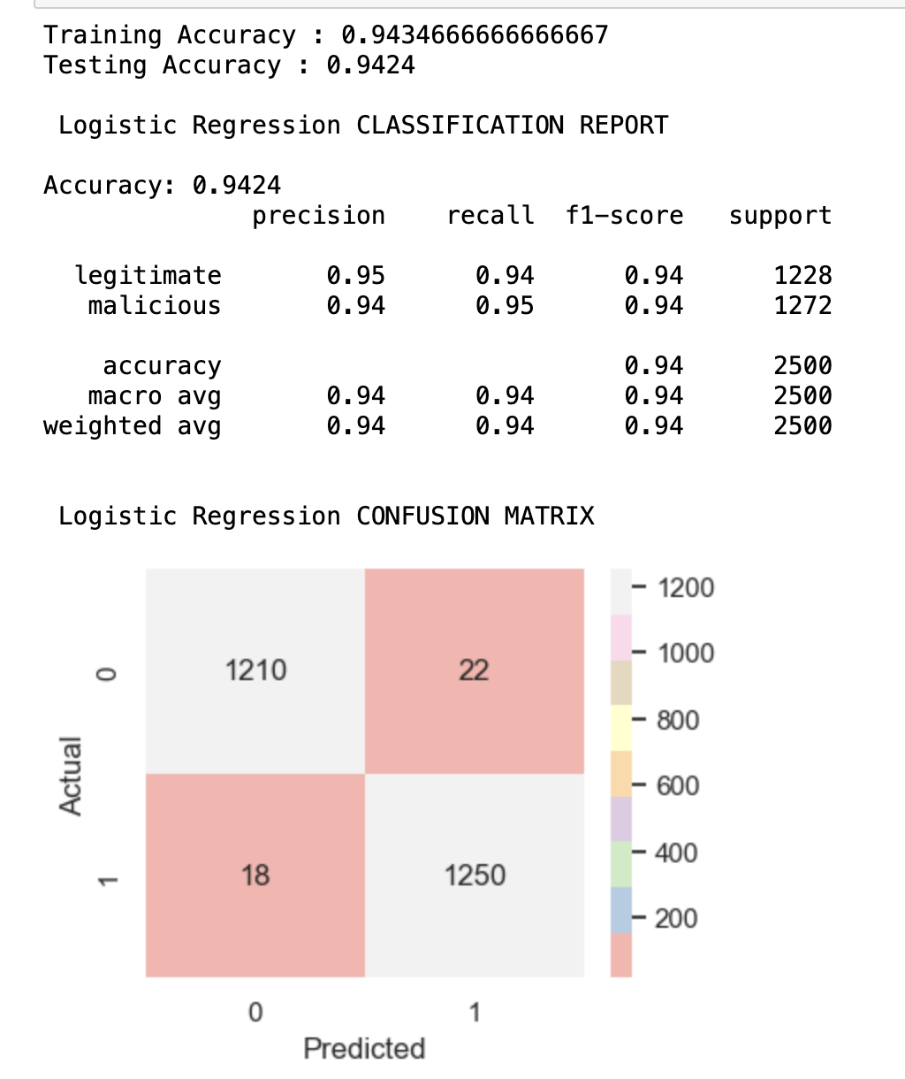
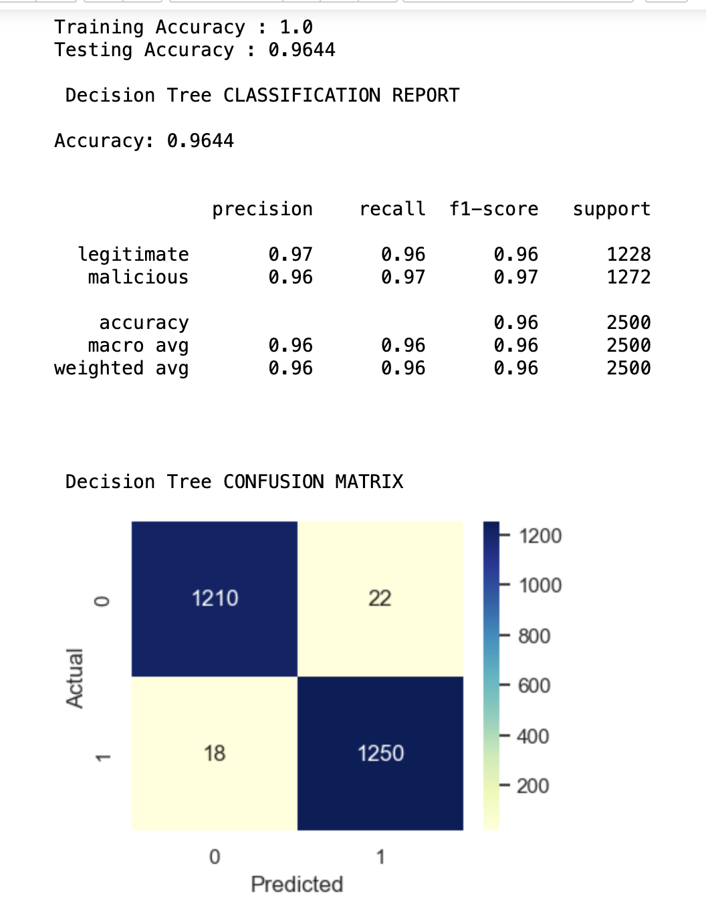
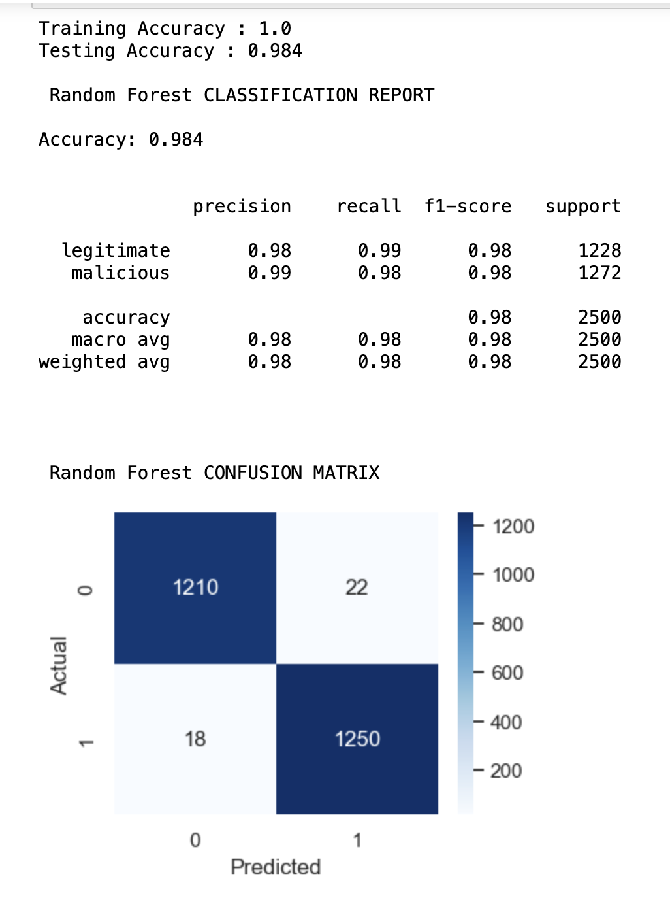
Model Evaluation and Hyperparameter Tuning
Frontier Tech Leaders Programme Global Cohort 1
Logistic Regression
Decision Tree
Random Forest

Slide 13
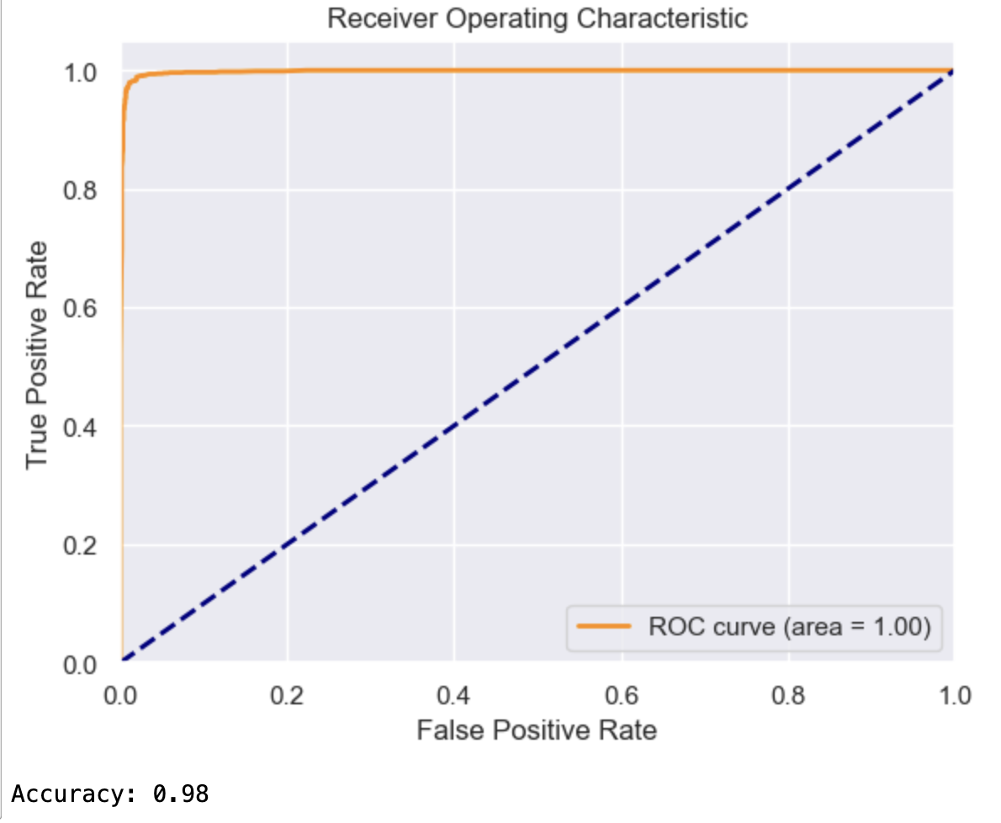
Model Refinement and Testing
Frontier Tech Leaders Programme Global Cohort 1

Slide 14
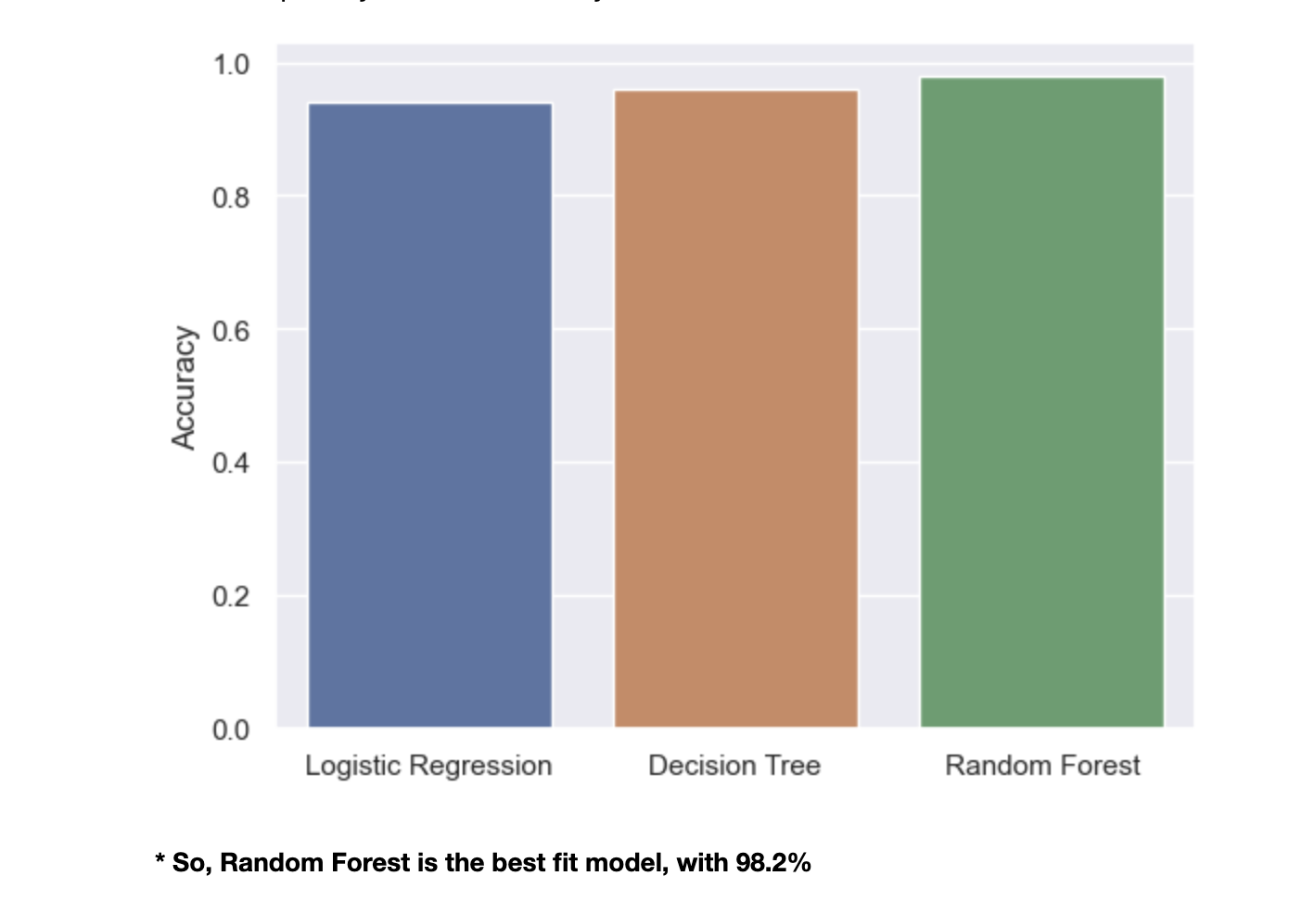
Results
Frontier Tech Leaders Programme Global Cohort 1

Slide 15
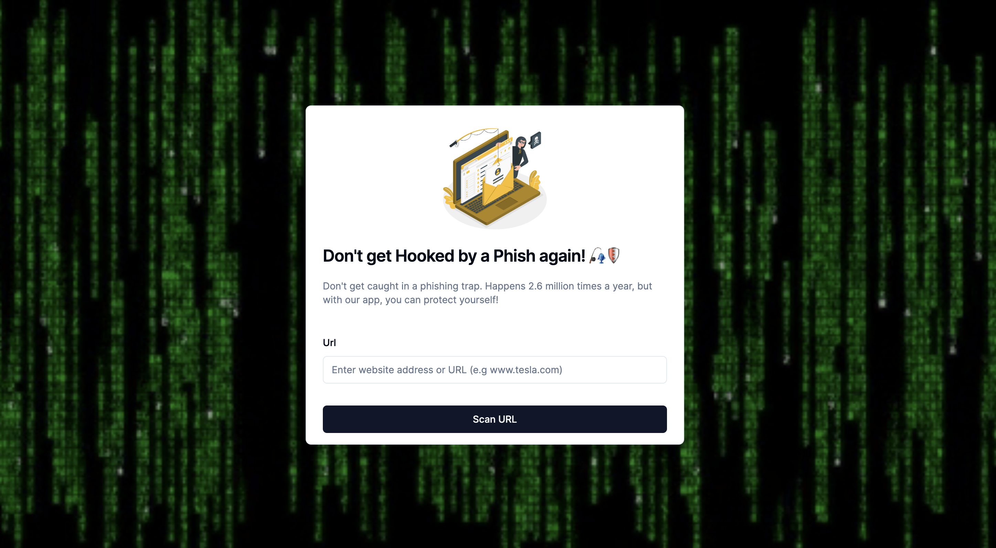
Evaluation Results
Frontier Tech Leaders Programme Global Cohort 1

Slide 16
Deployment
Frontier Tech Leaders Programme Global Cohort 1
Here’s how my process works:
- The prediction service starts by deserializing the model (using pickle.load in Python, for instance) to reconstruct the trained model object.
- This model is then kept in memory, ready to make predictions.
- A common approach is to set up a RESTful API using web frameworks like Flask
or Django for Python.
- The API defines endpoints that receive data, pass it to the model for prediction, and
return the prediction results.
The service listens for incoming prediction requests, which could be HTTP requests containing new data points.
- Upon receiving a request, the service processes the data (ensuring it’s in the correct format for the model), makes a prediction, and sends back the result.
- Cloud Services: Platforms like Netlify offer robust, scalable, and flexible hosting solutions.

Slide 17
Future Work
Frontier Tech Leaders Programme Global Cohort 1
For future work, expanding the dataset to include more diverse phishing scenarios and incorporating real-time data could enhance model robustness. Exploring advanced machine learning algorithms like deep learning and neural networks could potentially improve detection accuracy. Implementing Natural Language Processing (NLP) techniques might offer insights into phishing tactics within textual content. Additionally, integrating user behavior analytics could provide a more comprehensive defense mechanism. Collaborating with cybersecurity experts to refine features and continuously updating the model with emerging phishing trends would ensure its relevance and effectiveness in evolving digital landscapes.

Slide 18
References
Frontier Tech Leaders Programme Global Cohort 1
Dada, E. G., Bassi, J. S., Chiroma, H., Abdulhamid, S. M., Adetunmbi, A. O., & Ajibuwa, O. E. (2019). Machine learning for email spam filtering: review, approaches and open research problems. Heliyon, 5(6), e01802. https://doi.org/10.1016/j.heliyon.2019.e01802
Phishing Attacks Detection using Machine Learning Approach. (2020, August 1). IEEE Conference Publication | IEEE Xplore. https://ieeexplore.ieee.org/document/9214225
Survey on Detection and Prevention of Phishing Websites using Machine Learning. (2021, March 4). IEEE Conference Publication | IEEE Xplore. https://ieeexplore.ieee.org/document/9404714?denied=
A. S. N. Aski A, «Proposed efficient algorithm to filter spam using machine learning techniques,» Pacific Science Review A: Natural Science and Engineering, vol. 18, pp. 145-149, 2016.
A. A. A. M. O. W. A. K. Alauthman M, «Machine Learning for Phishing Detection and Mitigation,» Machine Learning for Computer and Cyber Security, pp. 48-74, 2019.
S. Alzahrani, «Social Engineering Attack Detection Using Machine Learning: Text Phishing Attack,» ndian Journal of Computer Science and Engineering (IJCSE), vol. 9, 2021.

Slide 19


Thank you!
Frontier Tech Leaders Programme Global Cohort 1

