Slide 1
Machine Learning in Breast Cancer Diagnosis
Frontier Tech Leaders Programme Global Cohort 1
M Zaker Humayoon AMIN Hamda ABDI
12.12.2023

Slide 2
Outline
Frontier Tech Leaders Programme Global Cohort 1
Concept note and implementation plan:
Background
Objectives
SDG Relation
Data
Data Collection
Exploratory Data Analysis (EDA) and Feature Engineering
Model Selection and Training
Model Evaluation and Hyperparameter Tuning
Model Refinement and Testing
Results
Deployment
Future Work

Slide 3
Concept note and implementation plan
Frontier Tech Leaders Programme Global Cohort 1

Slide 4
Background
Frontier Tech Leaders Programme Global Cohort 1
Breast Cancer Diagnosis from FNA images
Breast Cancer
2nd Deadliest cancer in women in the world
In 2020 (WHO):
2.3 million women were diagnosed,
685,000 deaths, globally
FNA: Fine Needle Aspiration Biopsy
Alternatives:
CNB (Core Needle Biopsy), Open Surgical Biopsy, Excisional Biopsy
Image-Guided Biopsy

Slide 5
Objectives
Frontier Tech Leaders Programme Global Cohort 1
To build a machine learning model that accurately classifies a given breast mass from the attributes extracted from a FNA image as being malignant or benign.
Improve diagnostic accuracy, enabling early detection of breast cancer.
Contribute to the global effort to strengthen breast cancer diagnosis and treatment strategies.
Mitigate the risk of cancer recurrence through timely and accurate classification.

Slide 6

SDG Relation
Frontier Tech Leaders Programme Global Cohort 1
SDG 3
Early Detection and Diagnosis
Universal Health Coverage
Promoting Well-being

Slide 7
Literature Review
Frontier Tech Leaders Programme Global Cohort 1

Slide 8
Literature Review
Frontier Tech Leaders Programme Global Cohort 1
Al-sammarraie, L. H. A. Predicting Breast Cancer in Fine Needle Aspiration Images Using Machine Learning (Doctoral dissertation, Altinbas University). Istanbul, Turkey
Shetty, Simitha (2020) Breast Cancer Analysis and Prognosis Using Machine Learning. Masters thesis, Dublin, National College of Ireland
Yue, W., Wang, Z., Chen, H., Payne, A., & Liu, X. (2018). Machine Learning with Applications in Breast Cancer Diagnosis and Prognosis

Slide 9
Data
Frontier Tech Leaders Programme Global Cohort 1

Slide 10
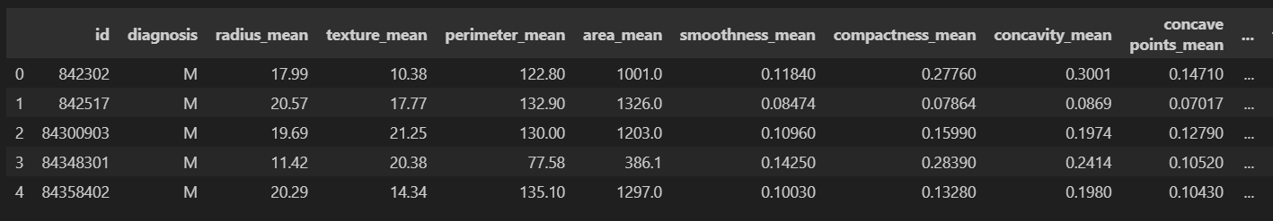
Data Collection
Frontier Tech Leaders Programme Global Cohort 1
Breast Cancer Wisconsin (Diagnostic) Data Set
33 Columns
Target: Diagnosis (M or B)
357 M, 212 B
Total: 569
Number of Features: 32
No null values (except the last column)

Slide 11
Data Collection
Frontier Tech Leaders Programme Global Cohort 1
Data Preprocessing
Removing unwanted features
Encoding Categorical Variables: Malignant as 1 and Benign as 0.
Logarithmic Transformation
Z-Score Normalization

Slide 12
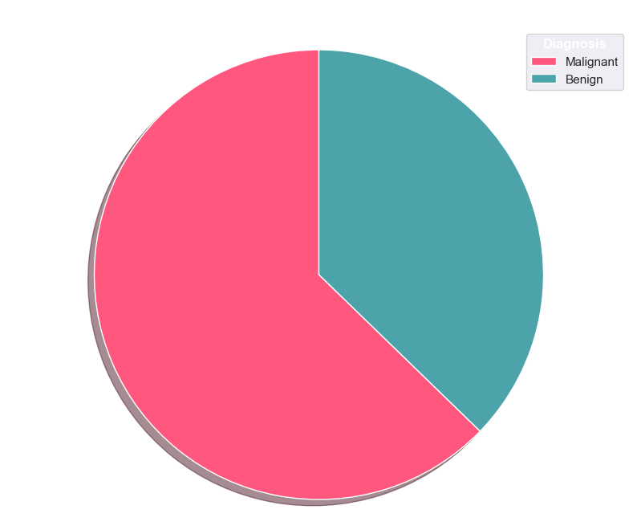
Exploratory Data Analysis (EDA) and Feature Engineering
Frontier Tech Leaders Programme Global Cohort 1
Malignant or Benign

Slide 13
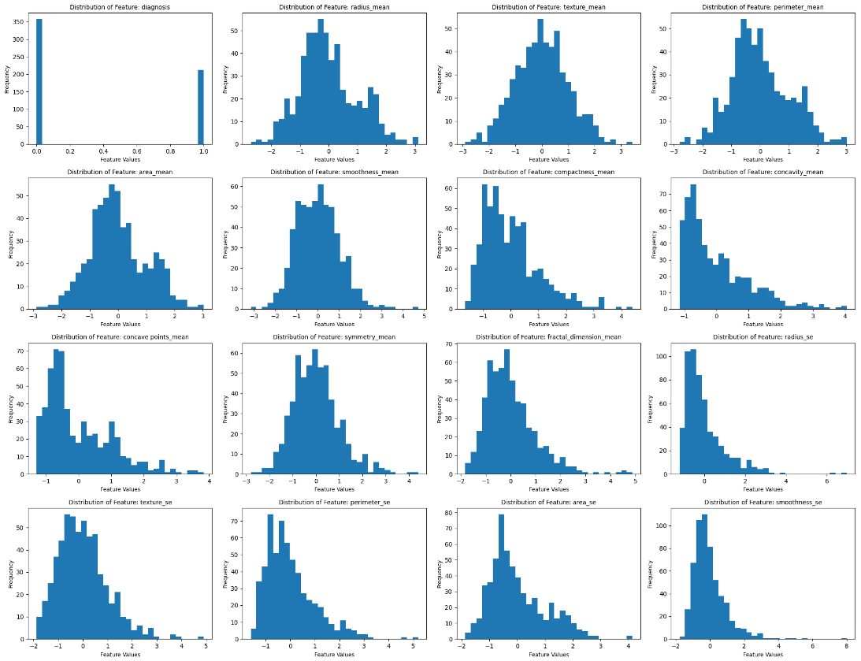

Exploratory Data Analysis (EDA) and Feature Engineering
Frontier Tech Leaders Programme Global Cohort 1
Fairly uniform distribution

Slide 14
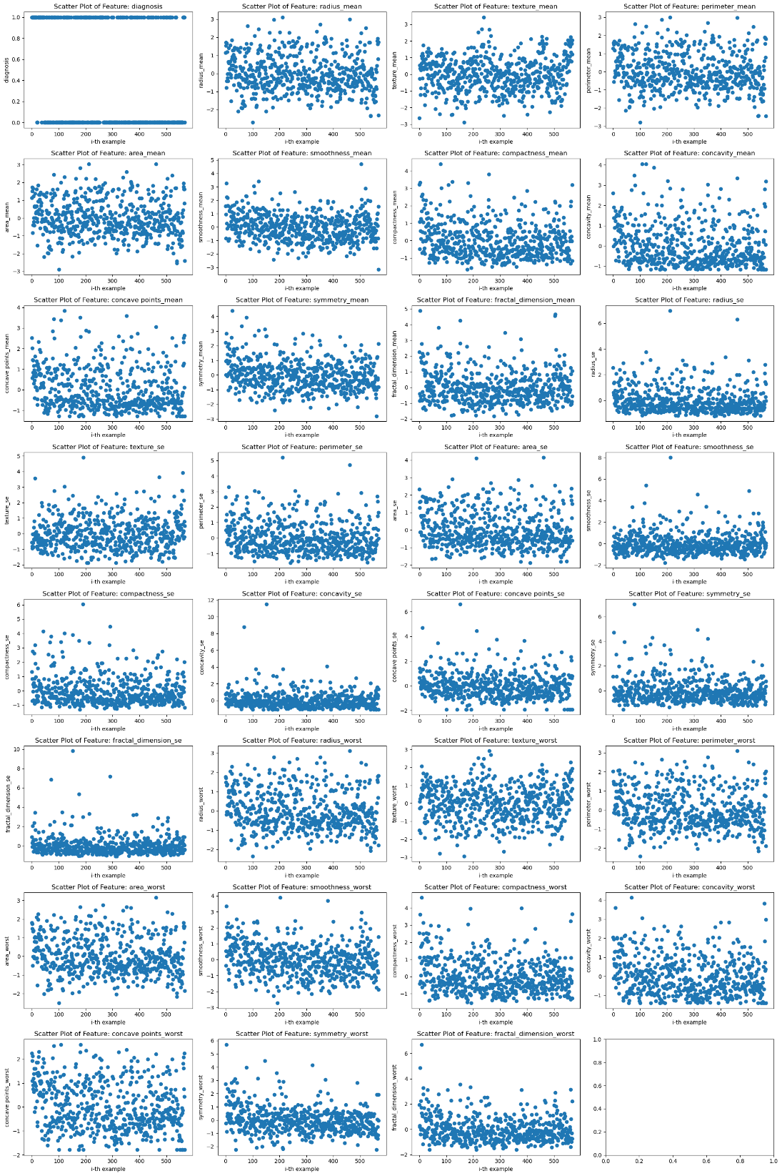
Exploratory Data Analysis (EDA) and Feature Engineering
Frontier Tech Leaders Programme Global Cohort 1
Scatter Plot

Slide 15
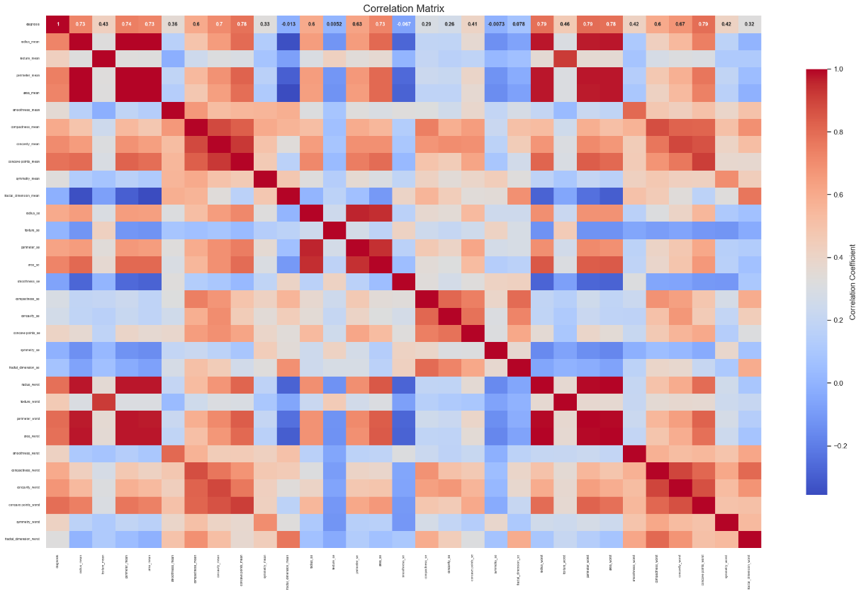
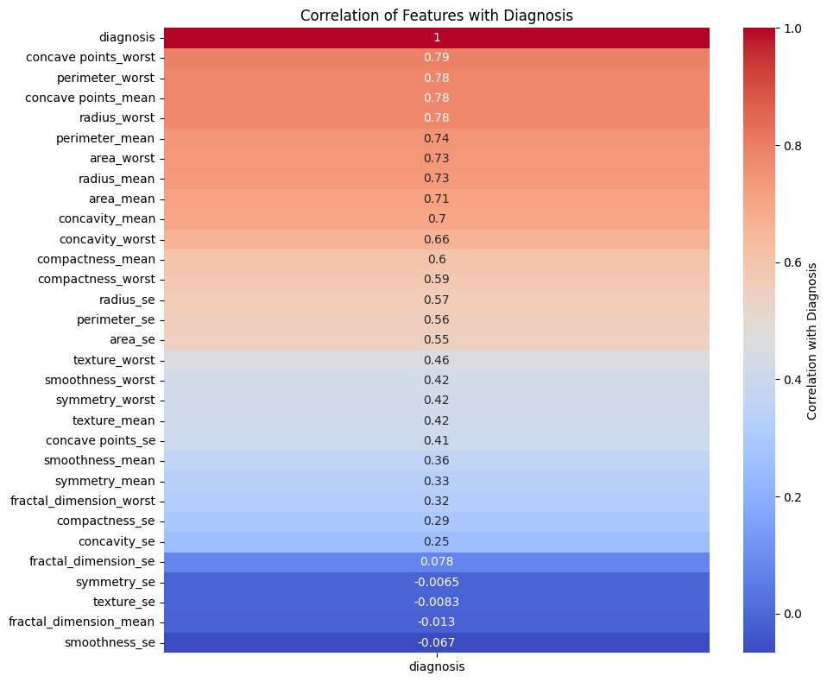
Exploratory Data Analysis (EDA) and Feature Engineering
Frontier Tech Leaders Programme Global Cohort 1
High correlation among some features

Slide 16
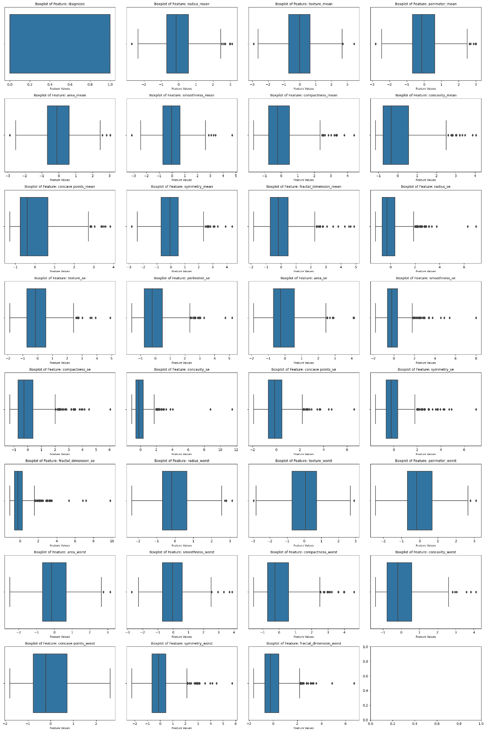
Exploratory Data Analysis (EDA) and Feature Engineering
Frontier Tech Leaders Programme Global Cohort 1
Outliers
Notes:
Before: 2.2677022506944833
After median imputation percentage of outliers: 0.8560575996371677

Slide 17
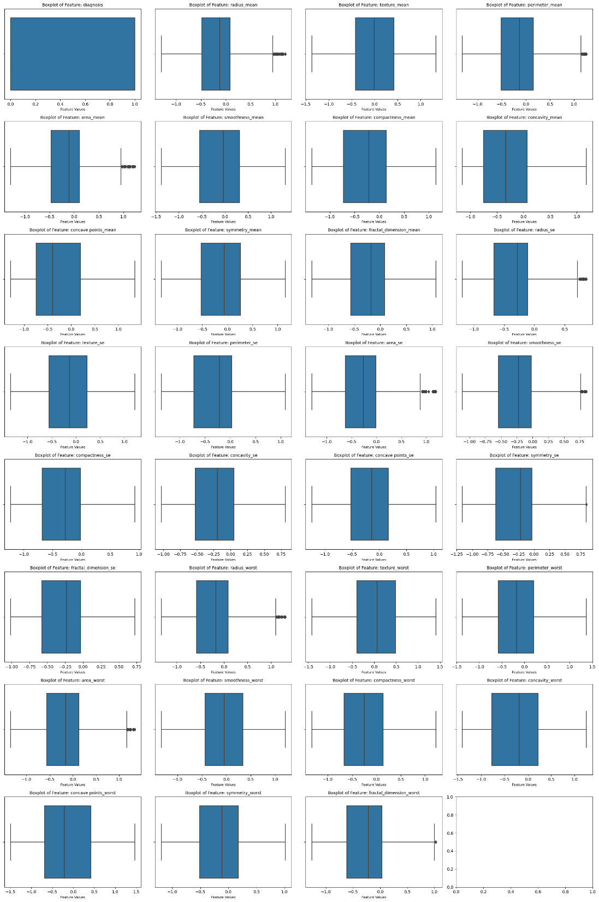
Exploratory Data Analysis (EDA) and Feature Engineering
Frontier Tech Leaders Programme Global Cohort 1
Outliers (Median Imputation)
Notes:
Accuracy Suffered: 1.40 Percent

Slide 18
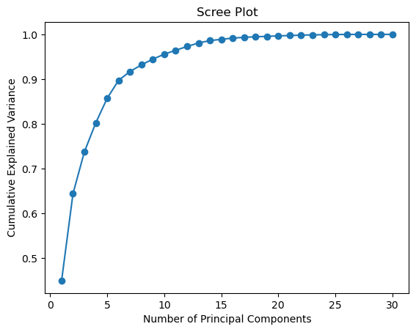
Exploratory Data Analysis (EDA) and Feature Engineering
Frontier Tech Leaders Programme Global Cohort 1
PCA
1 | 2 | 3 | 4 | 5 | 6 | 7 | 8 | 9 | 10
0.449 | 0.644 | 0.737 | 0.802 | 0.857 | 0.897 | 0.917 | 0.932 | 0.945 | 0.956
11 | 12 | 13 | 14 | 15 | 16 | 17 | 18 | 19 | 20
0.964 | 0.973 | 0.981 | 0.986 | 0.989 | 0.992 | 0.993 | 0.995 | 0.996 | 0.997
21 | 22 | 23 | 24 | 25 | 26 | 27 | 28 | 29 | 30
0.997 | 0.998 | 0.999 | 0.999 | 1 | 1 | 1 | 1 | 1 | 1
Notes:
Accuracy
Random Forest: 99.3 vs 97.2 (with PCA)
ANN: 98.6 vs 98.6 (With PCA)

Slide 19
Model
Frontier Tech Leaders Programme Global Cohort 1

Slide 20
Model Selection and Training
Frontier Tech Leaders Programme Global Cohort 1
Models to consider:
Logistic Regression
K-Nearest Neighbor
N = 5
Random Forest
Artificial Neural Network
128, ReLU
64, ReLU
1, sigmoid
Adam optimizer, binary crossentropy, accuracy
Models | Accuracy | Precision (WA) | Recall (WA) | F1-Score (WA)
LR | 98.6 | 99 | 99 | 99
KNN | 98.6 | 99 | 99 | 99
Random Forest | 99.3 | 99 | 99 | 99
ANN | 98.6 | 99 | 99 | 99

Slide 21
Model Selection and Training
Frontier Tech Leaders Programme Global Cohort 1
Rationale:
Ensemble Learning Method
Improved predictive performance, generalization and robustness to individual Decision Tress.
Reduction in overfitting by aggregating predictions
Strengths:
High Accuracy (relative to single decision trees)
More robust to noise and outliers (unbalanced Datasets)
Feature Importance
Versatility

Slide 22
Model Selection and Training
Frontier Tech Leaders Programme Global Cohort 1
Weaknesses:
Less Interpretable
Computationally expensive (than Decision Trees)
Not Suitable for Real-Time Applications
No Online Learning
Black-Box Nature

Slide 23
Model Selection and Training
Frontier Tech Leaders Programme Global Cohort 1
Hyperparameters (default):
Hyperparameter | Value
bootstrap | True
max_depth | None
max_features | sqrt
max_leaf_nodes | None
min_samples_leaf | 1
min_samples_split | 2
n_estimators | 100

Slide 24
Model Evaluation and Hyperparameter Tuning
Frontier Tech Leaders Programme Global Cohort 1
Evaluation Metrics:
Accuracy Score
Precision-Recall
ROC Curve
Model | Accuracy | Precision (WA) | Recall (WA) | F1-Score (WA)
Random Forest | 99.3 | 99 | 99 | 99

Slide 25
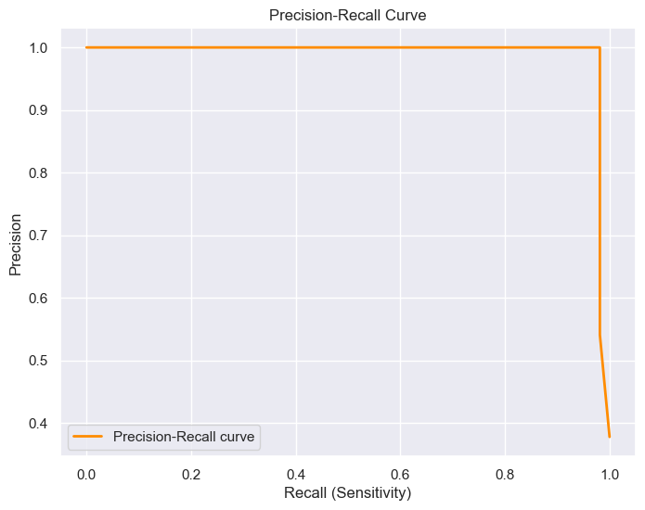
Model Evaluation and Hyperparameter Tuning
Frontier Tech Leaders Programme Global Cohort 1
Evaluation Metrics:
Precision-Recall

Slide 26
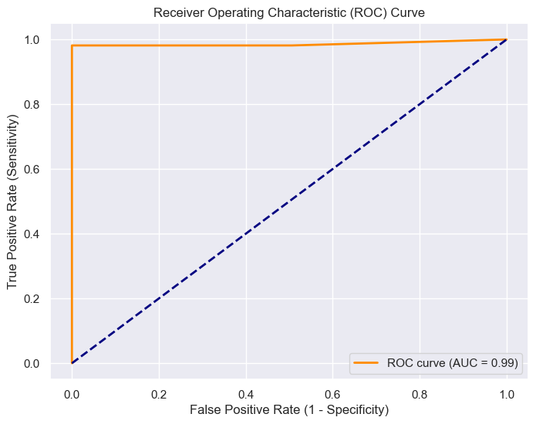
Model Evaluation and Hyperparameter Tuning
Frontier Tech Leaders Programme Global Cohort 1
Evaluation Metrics:
ROC Curve

Slide 27
Model Evaluation and Hyperparameter Tuning
Frontier Tech Leaders Programme Global Cohort 1
Hyperparameter Tuning:
RandomSearchCV
GridSearchCV
CV = 3
Hyperparameter | Value
bootstrap | True
max_depth | 10
max_features | Sqrt
max_leaf_nodes | None
min_samples_leaf | 2
min_samples_split | 5
n_estimators | 1000
Hyperparameter | Value
bootstrap | True
max_depth | 90
max_features | 2
max_leaf_nodes | None
min_samples_leaf | 3
min_samples_split | 10
n_estimators | 200

Slide 28
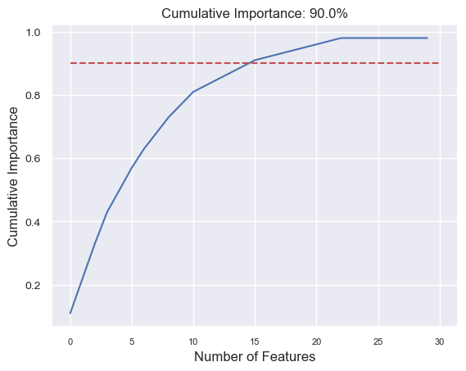
Model Refinement and Testing
Frontier Tech Leaders Programme Global Cohort 1
Feature Selection
Feature Importance
90% = 16 Features
Same Accuracy across all models
Training Performance Gain = 1.036%

Slide 29
Results
Frontier Tech Leaders Programme Global Cohort 1

Slide 30
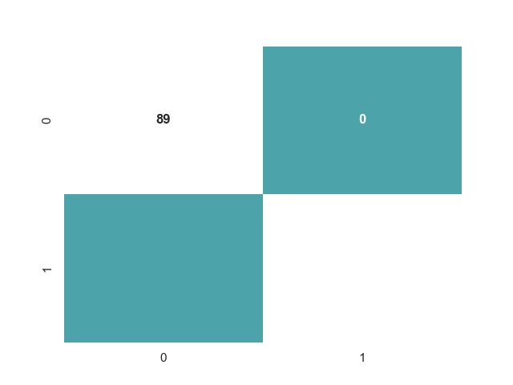
Evaluation Results
Frontier Tech Leaders Programme Global Cohort 1
Confusion Matrix
Model | Accuracy | Precision (WA) | Recall (WA) | F1-Score (WA)
Random Forest | 99.3 | 99 | 99 | 99
1
53

Slide 31
Deployment (Not yet implemented)
Frontier Tech Leaders Programme Global Cohort 1
Overview of the deployment phase
Model serialization, serving, and API integration
(You can fill this part after deployment submission)

Slide 32
Future Work
Frontier Tech Leaders Programme Global Cohort 1
Obtaining more FNA images and extracting features directly from them.
Expanding the work to detect and diagnose other types of cancer cells.

Slide 33
References
Frontier Tech Leaders Programme Global Cohort 1
Al-sammarraie, L. H. A. Predicting Breast Cancer in Fine Needle Aspiration Images Using Machine Learning (Doctoral dissertation, Altinbas University). Istanbul, Turkey
Shetty, Simitha (2020) Breast Cancer Analysis and Prognosis Using Machine Learning. Masters thesis, Dublin, National College of Ireland
Yue, W., Wang, Z., Chen, H., Payne, A., & Liu, X. (2018). Machine Learning with Applications in Breast Cancer Diagnosis and Prognosis
S. Łukasiewicz, M. Czeczelewski, A. Forma, J. Baj, R. Sitarz, and A. Stanisławek, “Breast Cancer—Epidemiology, Risk Factors, Classification, Prognostic Markers, and Current Treatment Strategies—An Updated Review,” Cancers 2021, Vol. 13, Page 4287, vol. 13, no. 17, p. 4287, Aug. 2021, doi: 10.3390/CANCERS13174287.
S. Paul, P. P. Solanki, U. P. Shahi, and S. Srikrishna, “Epidemiological Study on Breast Cancer Associated Risk Factors and Screening Practices among Women in the Holy City of Varanasi, Uttar Pradesh, India,” Asian Pac J Cancer Prev, vol. 16, no. 18, pp. 8163–8171, 2015, doi: 10.7314/APJCP.2015.16.18.8163.
Wolberg, W., Mangasarian, O., Street, N., & Street, W. (1995). Breast Cancer Wisconsin (Diagnostic). UCI Machine Learning Repository. https://doi.org/10.24432/C5DW2B

Slide 34


Thank you!
Frontier Tech Leaders Programme Global Cohort 1

