Slide 1
Malaria Parasite Detection
Frontier Tech Leaders Programme Global Cohort 1
Abbas Muhammad Zakariya
Edson
Date 12.12.2023

Slide 2
Outline
Frontier Tech Leaders Programme Global Cohort 1
Concept note and implementation plan:
Background
Objectives
SDG Relation
Data
Data Collection
Exploratory Data Analysis (EDA) and Feature Engineering
Model Selection and Training
Model Evaluation and Hyperparameter Tuning
Model Refinement and Testing
Results
Deployment
Future Work

Slide 3
Concept note and implementation plan
Frontier Tech Leaders Programme Global Cohort 1

Slide 4
Background
Frontier Tech Leaders Programme Global Cohort 1
Develop a ML model to detect malaria from microscopic images of blood samples.
The goal is to aid in early and accurate diagnosis, particularly in regions with limited access to healthcare facilities.
Malaria remains a significant global health issue, especially in developing countries according to WHO annual reports.
Timely detection and treatment are crucial to reducing mortality rates and controlling the spread of the disease.

Slide 5
Objectives
Frontier Tech Leaders Programme Global Cohort 1
The primary objective is to create a machine learning model capable of accurately identifying malaria parasites in blood smear images.
The model aims to achieve high accuracy, sensitivity, and specificity to assist healthcare professionals in efficient diagnosis.

Slide 6
SDG Relation
Frontier Tech Leaders Programme Global Cohort 1
This project aligns with two SDGs, notably:
SDG 3: Good Health and Well-being - By enhancing early disease detection and treatment, contributing to better health outcomes.
SDG 9: Industry, Innovation, and Infrastructure - Leveraging technology and innovation to improve healthcare solutions.

Slide 7
Data
Frontier Tech Leaders Programme Global Cohort 1

Slide 8
Data Collection
Frontier Tech Leaders Programme Global Cohort 1
This Dataset is taken from the official National Institutes of Health (NIH)
Website: https://ceb.nlm.nih.gov/repositories/malaria-datasets/
The dataset contains 2 folders
Infected
Uninfected
And a total of 27,558 images.

Slide 9
Exploratory Data Analysis (EDA) and Feature Engineering
Frontier Tech Leaders Programme Global Cohort 1
Data Transformation: Images were resized to a standard dimension (128x128) and normalized.
An ImageDataGenerator was used to perform preprocessing steps like rescaling, shearing, and zooming for augmentation.

Slide 10
Model
Frontier Tech Leaders Programme Global Cohort 1

Slide 11
Model Selection and Training
Frontier Tech Leaders Programme Global Cohort 1
A Convolutional Neural Network (CNN) was selected due to its proven efficacy in image classification tasks.
CNNs excel in learning spatial hierarchies, but they require substantial computational resources and large datasets.
The model comprised several convolutional and pooling layers, followed by dense layers for classification.

Slide 12
Model Evaluation and Hyperparameter Tuning
Frontier Tech Leaders Programme Global Cohort 1
Evaluation metrics used are Accuracy and confusion metrics.
The model obtained an accuracy 95.9%
Adjusted Learning rate, number of layers, kernel size and Pooling Size which had impact on performance improvement.

Slide 13
Model Refinement and Testing
Frontier Tech Leaders Programme Global Cohort 1
Adjusted Learning rate and number of layers which improved performance.
An increase in testing accuracy of 0.99 obtained.
94.86 -> 95.85

Slide 14
Results
Frontier Tech Leaders Programme Global Cohort 1

Slide 15
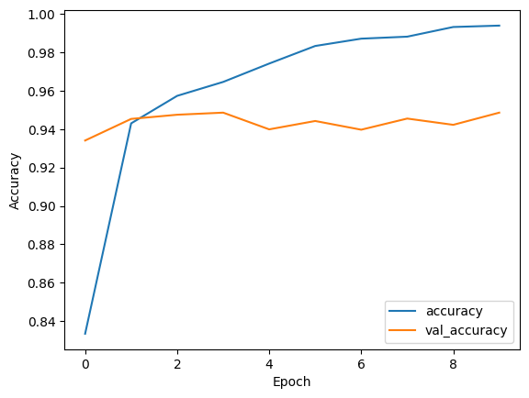
Evaluation Results(1)
Frontier Tech Leaders Programme Global Cohort 1
Number of Epoch: 10
Training Accuracy: 99.4
Training Loss: 0.019
Validation Accuracy: 94.87
Validation Loss: 0.4087
Test Accuracy: 94.86

Slide 16
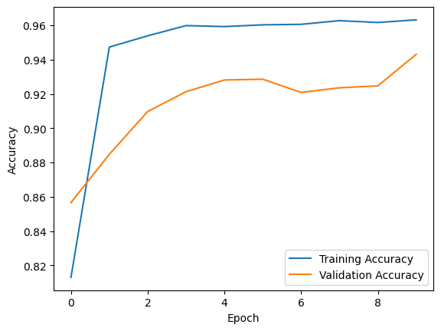
Evaluation Results(2)
Frontier Tech Leaders Programme Global Cohort 1
Number of Epoch: 10
Training Accuracy: 96.31
Training Loss: 0.1086
Validation Accuracy: 94.31
Validation Loss: 0.1952
Test Accuracy: 95.85

Slide 17
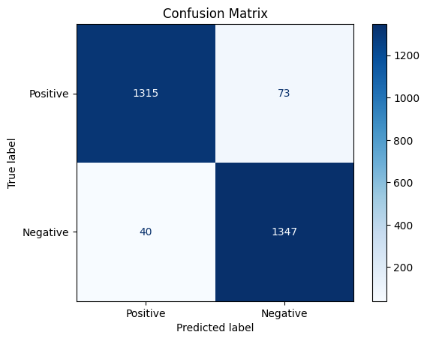
Evaluation Results(2)
Frontier Tech Leaders Programme Global Cohort 1

Slide 18
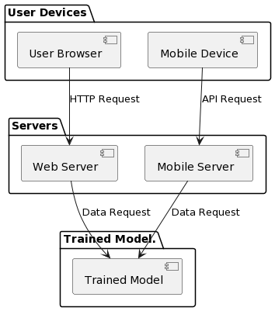
Deployment
Frontier Tech Leaders Programme Global Cohort 1
Due to resource and power limit
in the location of potential users
we suggest both web and mobile
based application to be deployed.
first deployment:
http://159.89.14.174:8080/#
Component Diagram =>

Slide 19
Future Work
Frontier Tech Leaders Programme Global Cohort 1
Refine the model to be more accurate.
Consider all possible adjustment for a system suitable for resource constrained environments.
Introduce a mechanism of collecting physician annotated dataset.
Develop and deploy both the android and iOS mobile applications.

Slide 20
References
Frontier Tech Leaders Programme Global Cohort 1
W. H. Organization, “World malaria report 2022.”
National Institutes of Health (NIH)
https://ceb.nlm.nih.gov/repositories/malaria-datasets/

Slide 21



Thank you!
Frontier Tech Leaders Programme Global Cohort 1

