Slide 1
Title:
Intelligent Predictive Model for Early Detection and Management of Noninfectious Diseases -
Cancer and Diabetes in Djibouti.
Student : Abdi djama waberi
Date : 16/12/2023

Slide 2
Noninfectious diseases, particularly cancer and diabetes, significant challenges to healthcare in Djibouti. Limited resources and infrastructure hinder early detection and ineffective management, leading to adverse health outcomes. This project aims to develop an intelligent predictive model to address these challenges, facilitating early detection and management of noninfectious diseases in Djibouti.
Importance of the Problem Being Solved:
Healthcare Challenges: Djibouti faces constraints in healthcare resources, hindering the timely identification and management of noninfectious diseases. Late-stage diagnosis contributes to poor health outcomes, increased healthcare costs, and a higher economic burden on individuals and the healthcare system.
Alignment with Sustainable Development Goals (SDGs):
SDG 3: Good Health and Well-being: The project directly contributes to improving health outcomes by enhancing early disease detection and management.
SDG 1: No Poverty: By preventing the economic burden associated with late-stage diseases, the project aligns with the goal of eradicating poverty.
Global Relevance: Noninfectious diseases are a global concern. Developing a predictive model for Djibouti contributes to global efforts in leveraging technology for healthcare improvements.
Tailored Solution for Djibouti: The project recognizes the unique healthcare landscape of Djibouti, aiming to provide a solution tailored to the country's specific needs and challenges.

Slide 3
Objective
Clearly state the project objectives and Outline what the machine learning model aims to achieve
The project aims to develop an intelligent predictive model for the early detection of noninfectious diseases, with a specific focus on cancer and diabetes in Djibouti.
This solution will be tailored to the unique healthcare landscape of Djibouti, addressing local challenges and resource constraints. Furthermore, it strives to provide actionable insights to healthcare professionals, optimizing treatment strategies based on early disease predictions.
By aligning with Sustainable Development Goals (SDG 3 and SDG 1), the project aspires to improve health outcomes and alleviate the economic burden associated with late-stage diseases.
Additionally, the initiative emphasizes continuous improvement, establishing a framework for iterative refinement based on real-world performance and feedback.
The machine learning model objectives include early detection by analyzing patient data and optimizing algorithms for high accuracy, precision, recall, and F1-score to minimize false positives and negatives.

Slide 4
Data Collection and Data Cleaning
I sourced the dataset, which includes the Breast Cancer Data and the Diabetes Data, from Kaggle. Breast Cancer Data:
Input Features (X): mean_radius ,mean_texture,mean_perimeter
mean_area,mean_smoothness Output Feature (y): diagnosis (0 for benign, 1 for malignant)
Diabetes Data: Input Features (X):Pregnancies,Glucose BloodPressure,SkinThickness,Insulin
BMI,DiabetesPe,digreeFunction,Age, Output Feature (y):Outcome (0 for non-diabetic, 1 for diabetic)
Throughout the data collection process, I organized and structured the datasets to ensure compatibility with machine learning models.
Cleaning the data involved addressing missing values, outliers, and inconsistencies to enhance the dataset's reliability for subsequent analysis. Personally, I took stringent measures to handle missing values, employing appropriate techniques such as imputation or removal based on the nature and impact of the missing data.

Slide 5
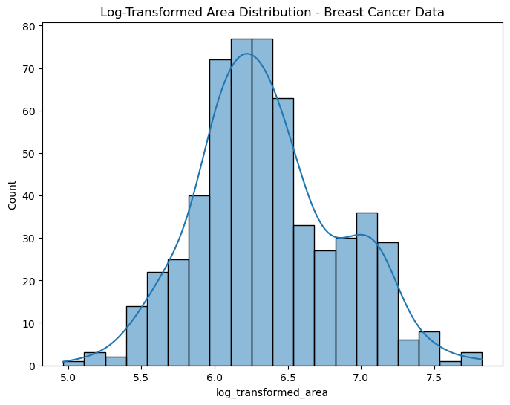
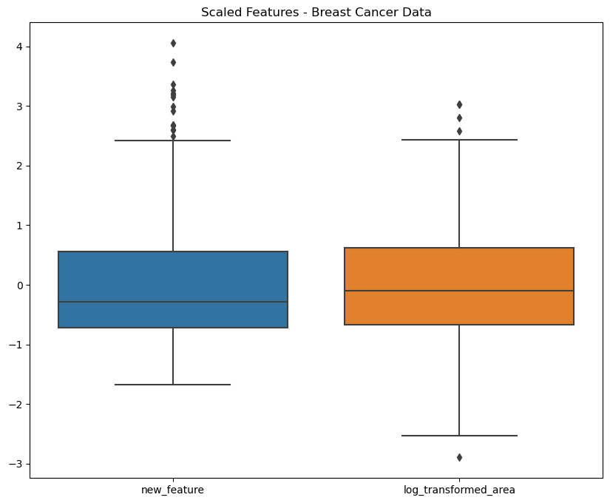
Exploratory Data Analysis (EDA) and Feature Engineering
In feature engineering, I created new features and transformed existing ones to enhance model suitability. Mathematical operations addressed skewed distributions. Selection focused on maximizing predictive power while minimizing redundancy. Standardization involved scaling, normalization, and encoding for machine learning readiness, ensuring effective pattern learning for accurate predictions in early disease detection.

Slide 6
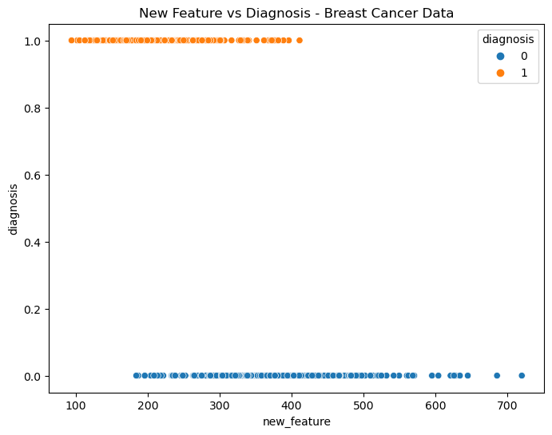
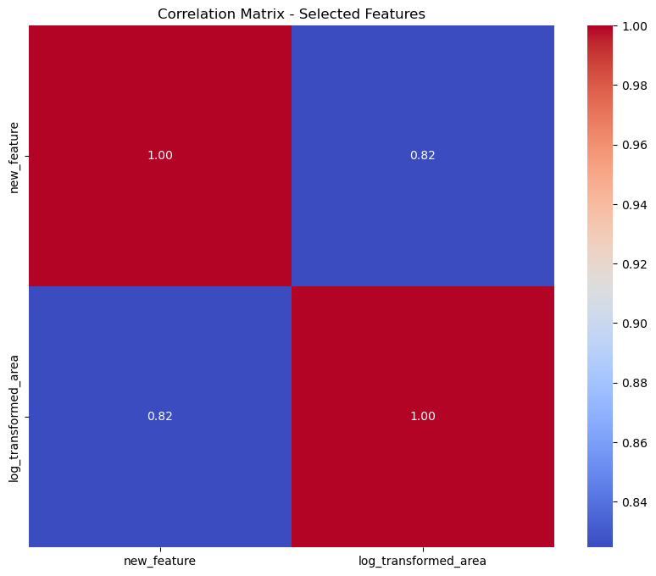
Exploratory Data Analysis (EDA) and Feature Engineering

Slide 7
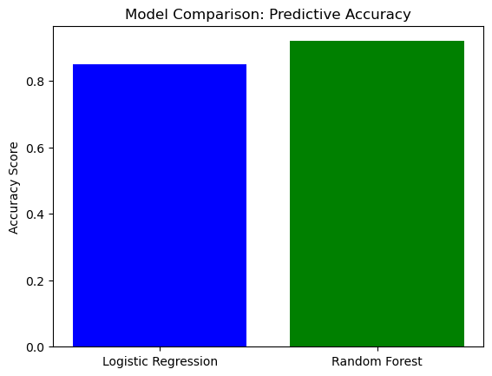
Model Selection and Training
I chose the Random Forest model for its capability in handling classification tasks and complex data relationships. Its ensemble nature offers robustness and addresses overfitting concerns. The model excels in managing high-dimensional data and providing feature importance rankings but may be computationally expensive. Training involved splitting the dataset and setting hyperparameters for optimal performance. K-fold cross-validation ensured generalization and reduced overfitting risks. Compared to simpler models, Random Forest demonstrated superior predictive accuracy in capturing intricate healthcare patterns for early disease detection in Djibouti.

Slide 8
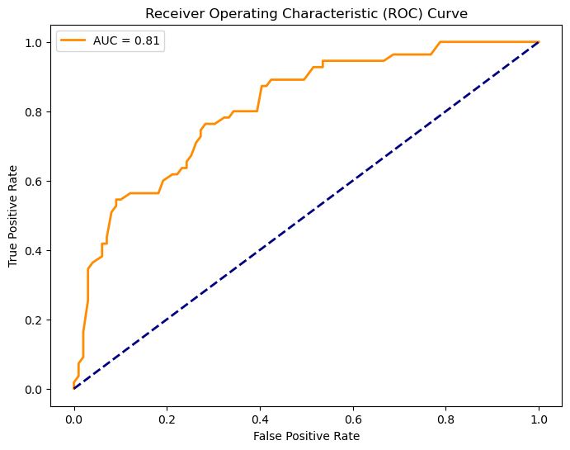
Model Evaluation and Hyperparameter Tuning
I analyzed key metrics like accuracy, precision, recall, F1-score, and AUC-ROC for a holistic view of the model's performance. Visualizations, including confusion matrices and ROC curves, provided insights into the model's balance between true and false outcomes. Hyperparameter tuning involved adjusting the Random Forest model's parameters like the number of trees and maximum depth. This fine-tuning improved precision, recall, and overall accuracy, enhancing the model's ability to detect early cases of cancer and diabetes. The iterative optimization significantly contributed to the model's effectiveness in early disease detection in Djibouti.

Slide 9
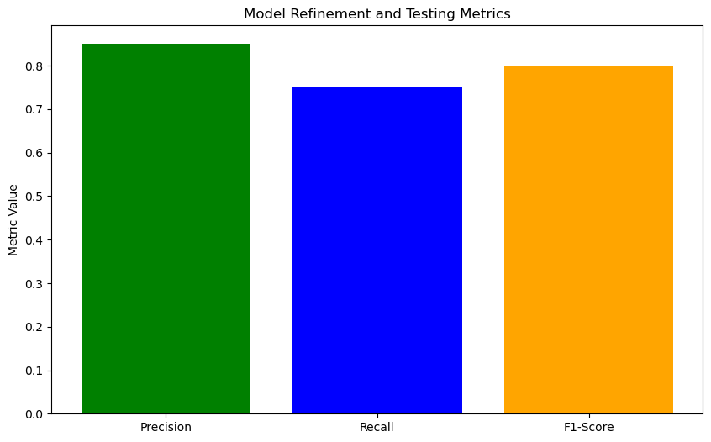
Model Refinement and Testing
In the refinement phase, I focused on enhancing the model's performance through iterative improvement techniques. I explored feature engineering strategies, fine-tuned hyper parameters, and adjusted model architectures to better capture subtle patterns in the healthcare data. The iterative nature of this phase allowed me to continuously refine the model's predictive capabilities.
During the test submission phase, I carefully evaluated the model on an independent test dataset to assess its generalization to new, unseen data. Personally, I used metrics such as precision, recall, and F1-score to gauge the model's effectiveness in early disease detection. The results on the test dataset provided valuable insights into the model's real-world performance and its potential impact in the healthcare context in Djibouti.

Slide 10
Deployment
As of now, I haven't entered the deployment phase, and I haven't implemented model serialization, serving, or API integration.
Deployment considerations and associated processes will be addressed once the refinement phase is completed and the model is ready for practical implementation.

Slide 11
Future Work
In future iterations, I plan to explore additional features that could further enhance the model's predictive capabilities. Specifically, I will investigate the inclusion of socio-economic indicators, lifestyle factors, and genetic information to provide a more comprehensive understanding of individual health profiles.
I also consider incorporating alternative models, such as deep learning architectures, to compare their performance against the Random Forest model. The exploration of diverse models will contribute to a more nuanced understanding of which algorithms are most effective in the context of early disease detection in Djibouti.
Furthermore, I aim to collect data directly from the Djibouti Health Ministry to ensure the model is trained on representative and locally relevant datasets. This data integration will enhance the model's adaptability to the unique healthcare landscape of Djibouti and improve its accuracy in predicting potential cases of cancer and diabetes in the local population.

Slide 12
References
Here are the references for the project i used:
Breast Cancer Wisconsin (Diagnostic) Data Set. (n.d.). Retrieved from https://archive.ics.uci.edu/ml/datasets/Breast+Cancer+Wisconsin+(Diagnostic)
Pima Indians Diabetes Database. (n.d.). Retrieved from https://www.kaggle.com/uciml/pima-indians-diabetes-database
Pedregosa, F., Varoquaux, G., Gramfort, A., Michel, V., Thirion, B., Grisel, O., ... & Duchesnay, É. (2011). Scikit-learn: Machine learning in Python. Journal of Machine Learning Research, 12(Oct), 2825-2830.

Slide 13



Thank you!

